Slide 1

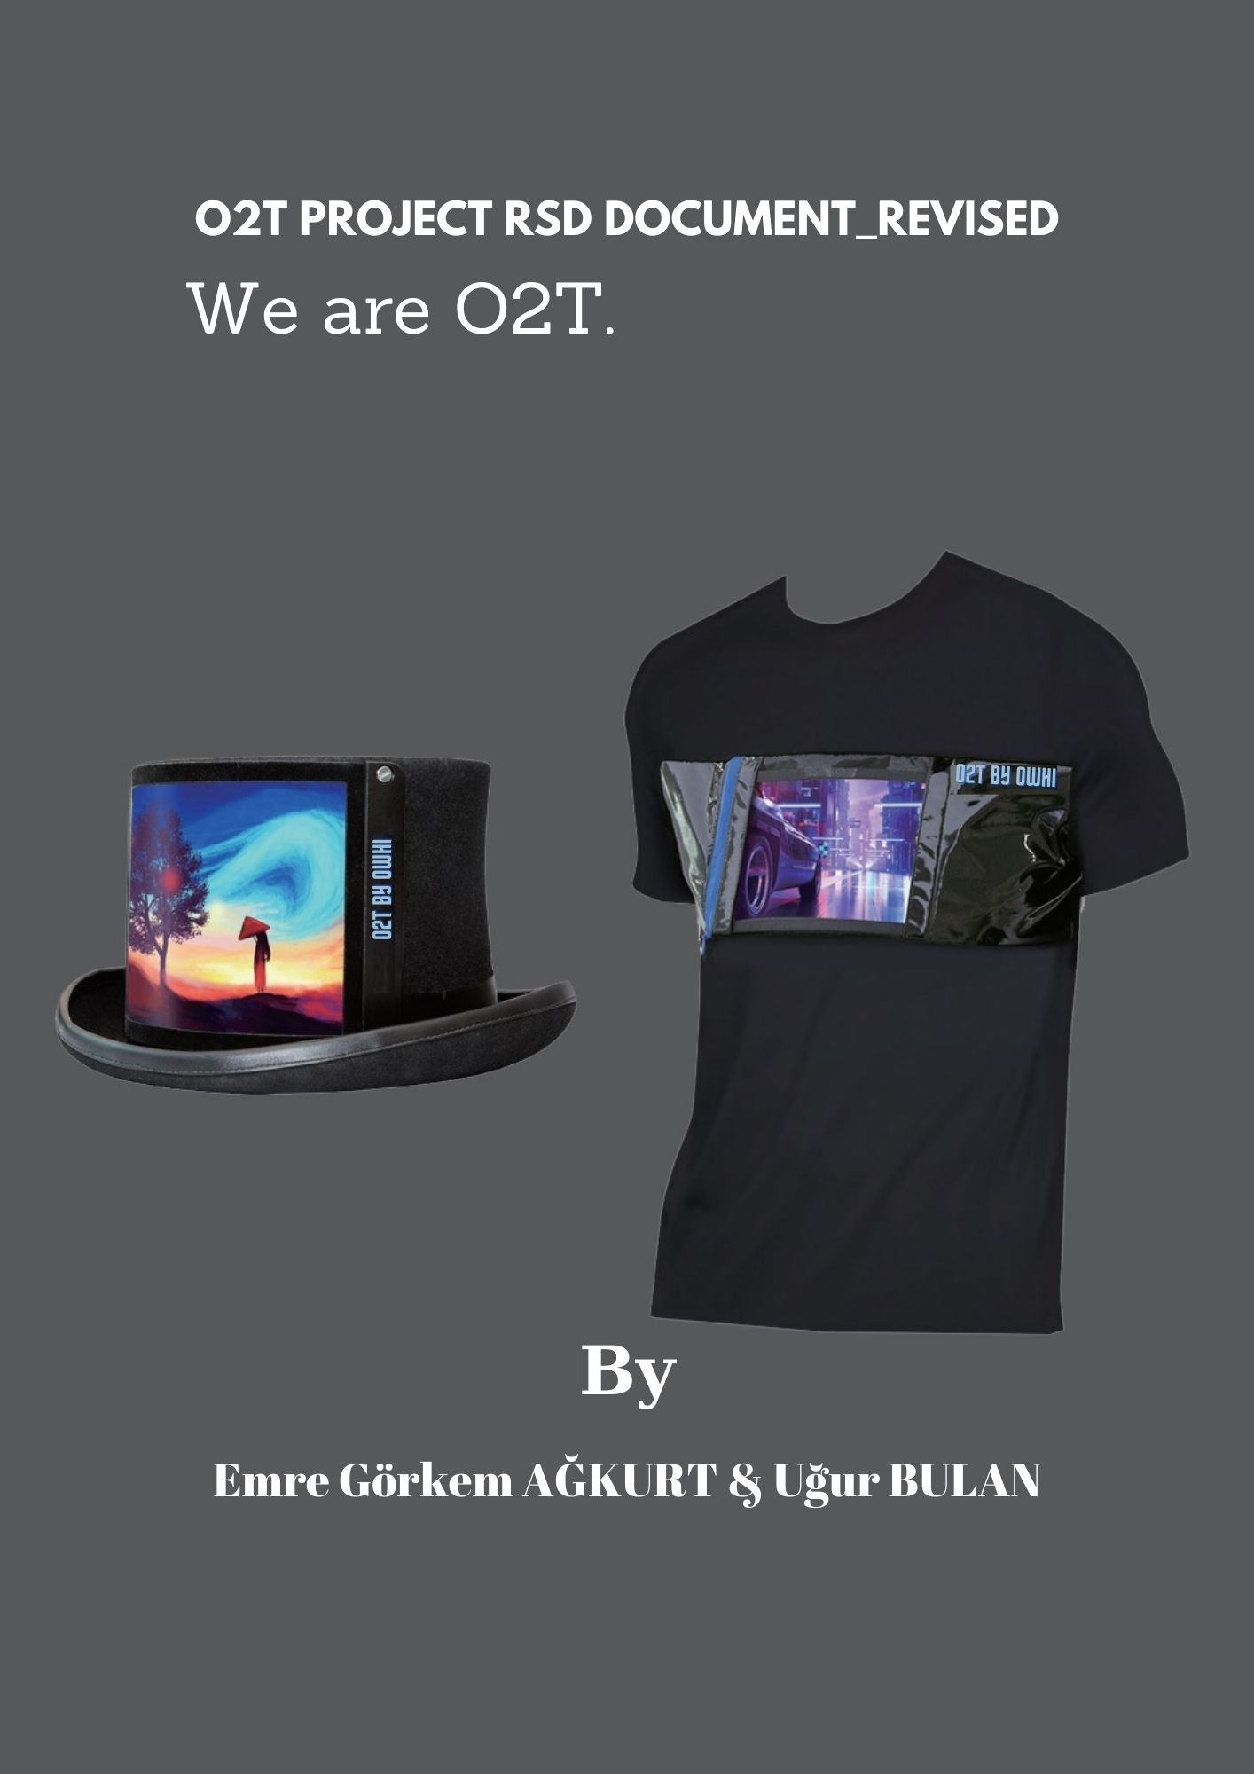
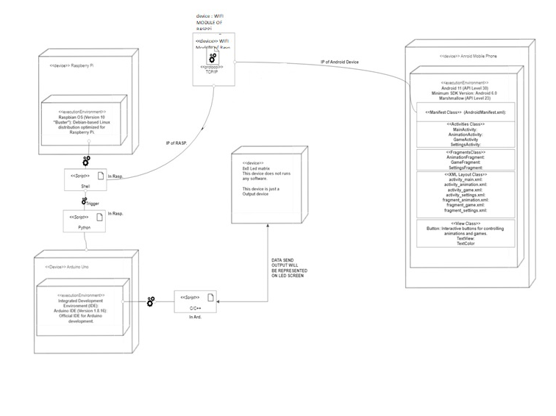
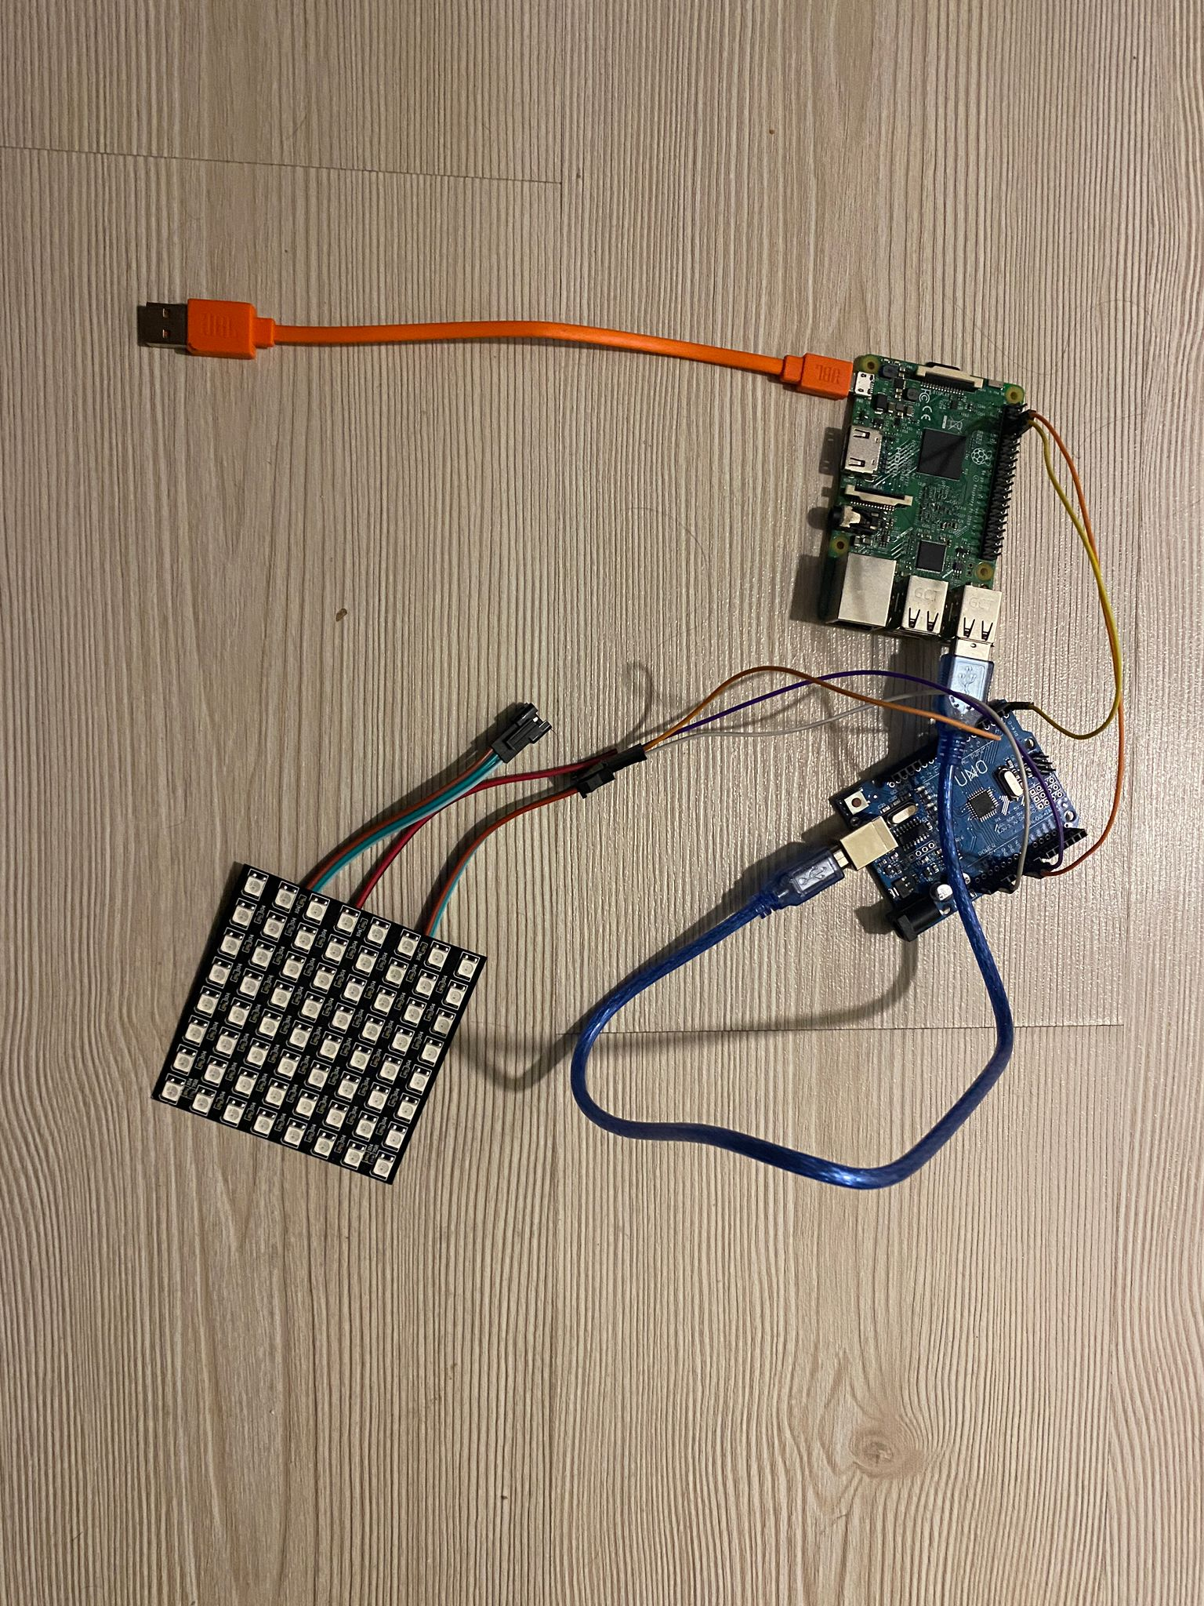
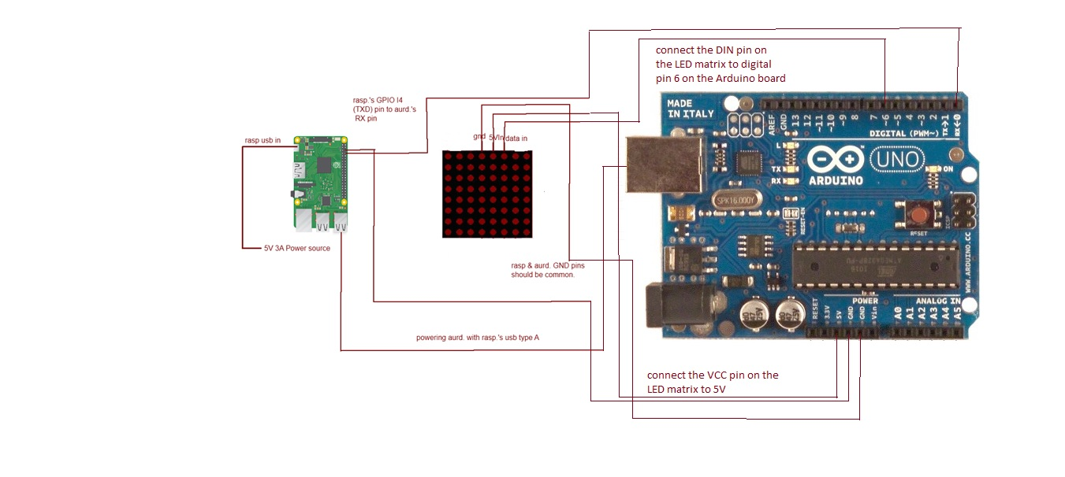
O2T – Wearable Technologies
Emre Görkem AĞKURT & Ugur BULAN -- Supervisor: Arman SAVRAN & Mehmet Ufuk ÇAĞLAYAN
Aim
The O2T project is a wearable technology that aims to introduce a new approach to sustainable fashion and advertising through the development of a wearable textile product with a built-in digital screen.
Implementation
Hardware Development: The O2T project involves the development of wearable textile products with built-in digital screens. This requires extensive research and engineering to create flexible and durable screens that can be integrated seamlessly into various garments. Software Development: A key aspect of the O2T implementation is the development of a mobile application that enables users to control the digital screens on their wearable products. The application allows for customization of designs, management of sponsor emblems, and real-time updates.
Evaluation
As part of our academic project, we embarked on the development of the O2T project, a wearable technology aimed at revolutionizing sustainable fashion and advertising. Being students passionate about technology and innovation, we took on the challenge of creating a unique wearable textile product with an embedded digital screen. Our journey began with extensive research on existing technologies, materials, and market trends in the fashion industry. We explored various concepts and brainstormed ideas to bring our vision of sustainable fashion and smart advertising to life. During the initial stages, we focused on hardware research and development. We carefully selected the components, including Raspberry Pi , Arduino and WS2812B 8X8 matrix led to ensure compatibility and functionality. We conducted rigorous testing to ensure the reliability and durability of the hardware components, considering factors like voltage distribution, electronic stability, and power management. Simultaneously, we delved into software development, leveraging our programming skills in Python, Java. We created a mobile application that serves as the control center for the wearable textile product. The app allows users to customize and manage the digital screen, adjust advertising emblems, and monitor battery life. To ensure a seamless user experience, we incorporated wireless communication protocols such as Bluetooth and Wi-Fi, enabling seamless connectivity between the wearable textile product and the mobile application. We performed extensive software testing and debugging to eliminate any bugs or glitches and ensure optimal performance. Throughout the project, we embraced the agile development approach, dividing our work into sprints and regularly conducting team meetings to discuss progress, challenges, and potential improvements. Collaboration and effective communication were essential for the successful implementation of the O2T project.
Conclusion
Overall, the O2T project has been an incredible learning experience for us as students. It has allowed us to apply our theoretical knowledge, sharpen our technical skills, and gain insights into real-world challenges in the fields of wearable technology, sustainable fashion, and advertising. We are proud of our accomplishments and excited to present our work to the academic community, showcasing the potential impact of the O2T project on the fashion industry.
Objectives
Introduce a new approach to sustainable fashion and advertising: The project aims to develop a wearable textile product with a built-in digital screen that allows for dynamic advertisement placement. This provides an alternative to traditional printing methods and allows for easy customization and replacement of emblems, enabling athletes and individuals to showcase multiple sponsors on their clothing. Enable smart advertising and global marketing strategies: By utilizing the O2T technology, the digital screen can be controlled through a mobile application, allowing for the display of numerous sponsor emblems. This opens up new opportunities for advertising and sponsorship collaborations, benefiting both athletes and brands. The flexible screen can be placed on various garments, such as gloves, providing more advertising space without the limitations of physical printing. Promote sustainability and reduce carbon emissions: The O2T project aims to extend the lifespan of wearable textile products by preventing discoloration and wear. With the ability to control and update designs through the mobile application, users can prolong the life of their garments. By reducing the disposal of aging designs, the project contributes to reducing waste and the carbon footprint associated with textile production and disposal.
A
All references given in: “ Rsd, Dsd and Final Document of this project WE ARE O2T.

