Slide 1
Global -Mart’s Ascension to the Cloud
A proposal by Cameron Walker

Slide 2
Agenda
Overview of Global Mart and our current situation
Desire to move to the cloud
Briefly Discuss My Role and what I was tasked to do.
Demonstrate my proposed ETL solution
ADLS > Storage Explorer > SSMS > ADF > Databricks > Synapse > Power BI
Discuss a particular issue I had to solve.
Brief pricing and security considerations

Slide 3
Global Mart
An E-Commerce company that deals in Technology, Office Supplies, and Furniture.
Recent regional expansion and increased customer base.
My tasks with:
Transitioning GM’s On-Prem infrastructure to the Cloud.
Building an end-to-end ETL solution that can be used to ultimately funnel BI reports to the company’s Customer Success Teams.

Slide 4
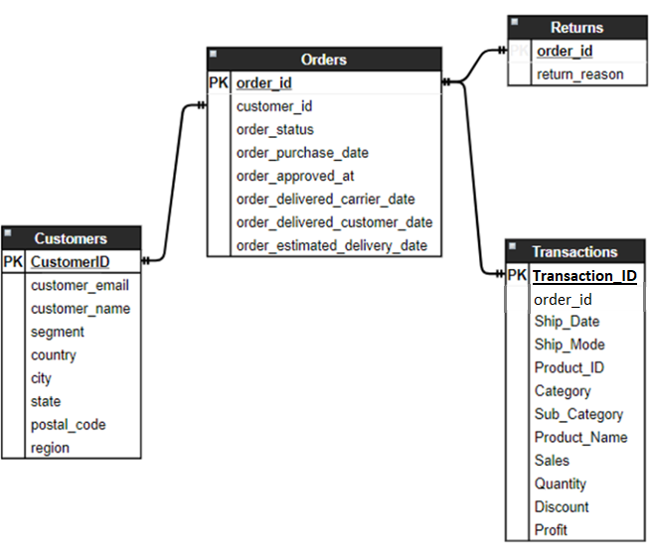
Global Mart’s On-Prem Data Model

Slide 5
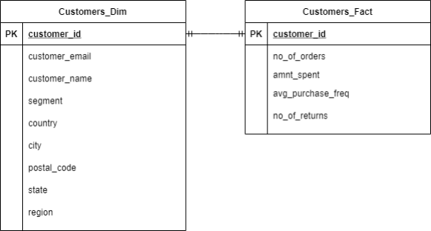
Global Mart’s Desired Data Model for BI Analytics

Slide 6
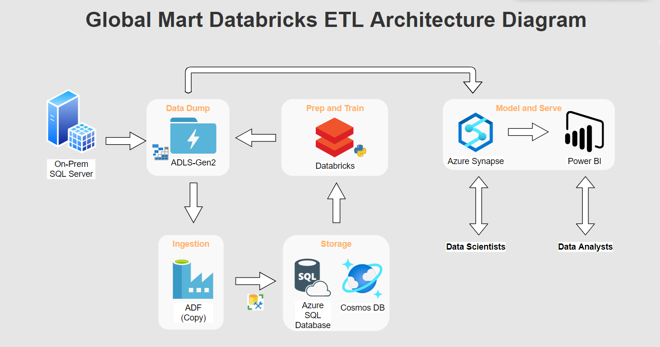

Slide 7
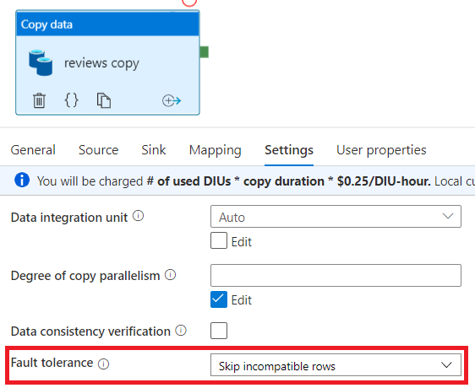
A Snag
reviews.csv pipeline
Unstructured data in second column.
Error when attempt to force though pipeline.
Enabled Fault Tolerance to ignore errors when reading data in.

Slide 9
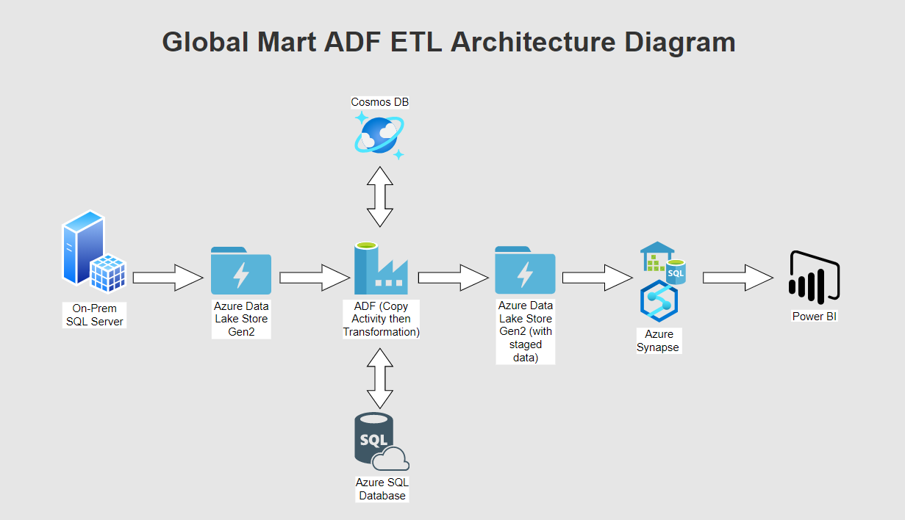

Slide 10
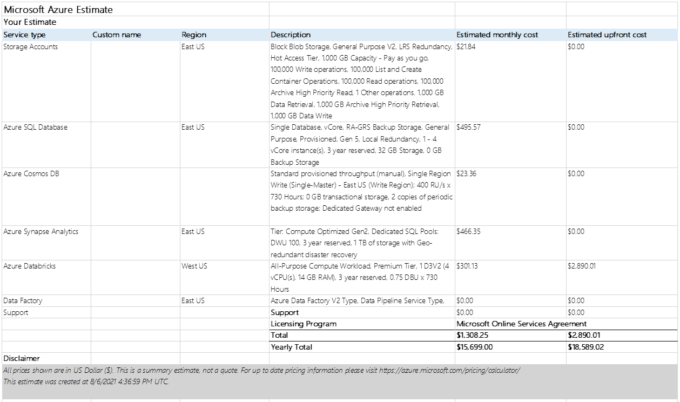

Slide 11
Security Options
Azure Data Lake:
SAS, Key Vault, RBAC, ACL, Firewall, TDS
SQL Database:
Key Vault, RBAC, TDE, TLS, DDM, Firewall
Databricks:
Strong integration with Azure AD, SSO, RBAC with premium tier
Synapse
TDE, TLS, DDM, Firewall
Power BI
Row Level Security, All persisted data encrypted by default.
DDOS Protection--Basic Tier.
All of Azure's infrastructure is protected from DDOS attack by default and for free.

