Slide 1
VAHAN ALERTS
Vehicle Document and Maintenance Reminder System
A Web Application for Tracking Vehicle Documents, Maintenance Records, and Expiry Reminders
Vaibhav Ghadi 2655
Vinay Sharma 2659

Slide 2
Problem Statement
Why Vahan Alerts is needed
Vehicle owners struggle to track multiple document expiration dates across one or more vehicles:
• Insurance, PUC, Registration Certificate (RC), Fitness Certificate
• Permit, Driving Licence
Missing a renewal deadline can result in:
• Legal penalties and fines
• Vehicle immobilization
• Lapsed insurance coverage
Service history is often maintained informally, making it difficult to track:
• Odometer progression
• Service intervals
• Cumulative maintenance costs
Current Approaches Are Inadequate
Generic calendar reminders are not vehicle-specific
Paid fleet-management systems target commercial operators
Paper-based logs are easily lost or damaged
No centralized view across multiple vehicles
No automated expiry status calculation
No scheduled reminders for upcoming expirations
Vahan Alerts — Project Presentation
2

Slide 3
Objectives & Scope
What the system aims to achieve
Key Objectives:
Out of Scope
Secure phone-number-based registration and authentication with BCrypt password hashing
Owner-scoped vehicle CRUD — no cross-user access
Vehicle document lifecycle management with automatic expiry status calculation
Scheduled in-app reminders at 30, 7, 1, and 0 days before expiry
Chronological maintenance history with odometer sequence validation
In-app notification centre with read/unread tracking
CSRF protection, session fixation protection, HTTP-only cookies
Health-check endpoint for application monitoring
No real WhatsApp/email/SMS delivery (consent stored only)
No file upload/download for document attachments
No government database integration (VAHAN, etc.)
No payment gateway or premium calculation
No PWA, mobile app, or OAuth/social login
Single role (ROLE_USER) — no admin role
Vahan Alerts — Project Presentation
3

Slide 4
Proposed Solution & Features
What the system delivers
User Management
Registration, login, WhatsApp consent opt-in/withdrawal, BCrypt password hashing
Vehicle Management
Create, list, view, update, delete — owner-scoped with registration number normalization
Document Management
Track insurance, PUC, RC, fitness, permit, DL with expiry status (Expired / Expiring Soon / Valid / No Expiry)
Reminder Engine
Scheduled daily reminders at 09:00 Asia/Kolkata with offsets of 30, 7, 1, and 0 days before expiry
Notifications
In-app notification centre, mark as read, mark all as read, unread count badge
Maintenance Records
Service history with odometer sequence validation, service cost tracking in BigDecimal
Vahan Alerts — Project Presentation
4

Slide 5
Technology Stack
Tools and frameworks used
Backend & Framework
Database, Build & Testing
Java 17
Programming language
Flyway
Schema migration (V1–V7)
Spring Boot 4.1.2
Application framework
Jakarta Validation
Bean validation for forms
Spring MVC + Thymeleaf
Web layer and server-side rendering
BCrypt
Password hashing
Spring Security
Authentication, CSRF, session management
Apache Maven 3.9.16
Build and dependency management
Spring Data JPA + Hibernate
ORM and data access
JUnit 5 + MockMvc
Testing framework
H2 Database
Embedded file-based database
Spring @Scheduled
Daily reminder job
Vahan Alerts — Project Presentation
5

Slide 6
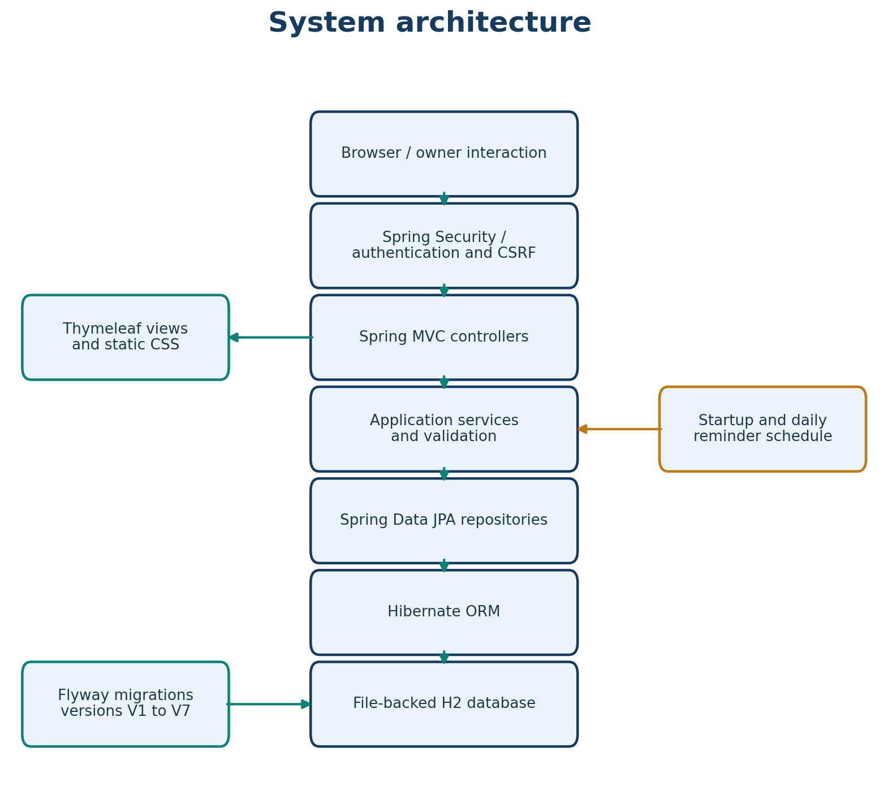
System Architecture
Layered Spring Boot architecture
Architecture Layers
Presentation: Spring MVC controllers + Thymeleaf templates
Business: @Service classes with @Transactional
Data: Spring Data JPA repositories + Hibernate ORM
Database: File-backed H2 with Flyway migrations
Security: Spring Security filter chain
Scheduling: Document expiry reminder job
Vahan Alerts — Project Presentation
6

Slide 7
Module Overview
Functional modules
User Account
Registration, authentication, WhatsApp consent
Vehicle
Vehicle CRUD, owner-scoped access
com.vahanalerts.user
com.vahanalerts.vehicle
Document
Document lifecycle, expiry status
Maintenance
Service history, odometer validation
com.vahanalerts.document
com.vahanalerts.maintenance
Notification
Reminder generation, notification centre
com.vahanalerts.notification
Controller
HTTP routing, Thymeleaf views
Configuration
Security, time zone (Asia/Kolkata)
com.vahanalerts.controller
com.vahanalerts.config
Vahan Alerts — Project Presentation
7

Slide 8
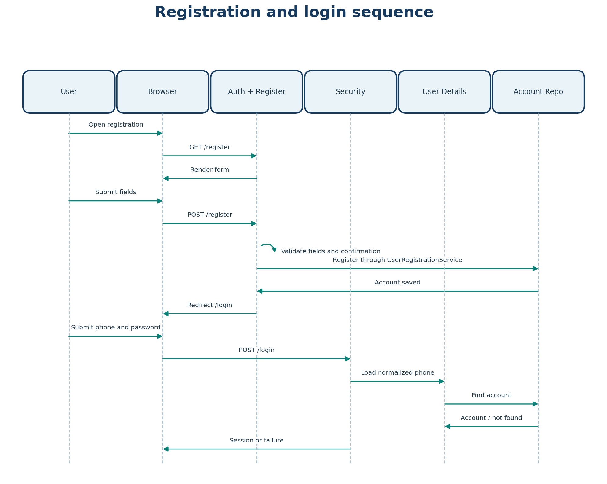
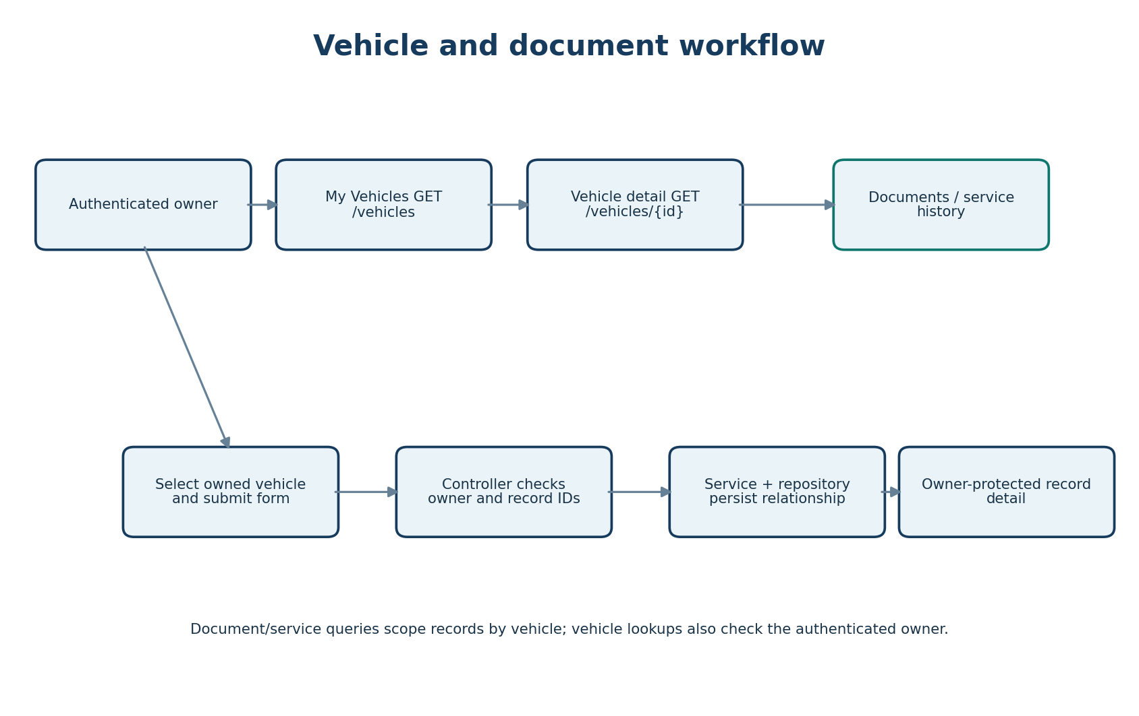
Application Workflows
Registration/Login and Document Management
Registration & Login Sequence
Document Management Workflow
Vahan Alerts — Project Presentation
8

Slide 9
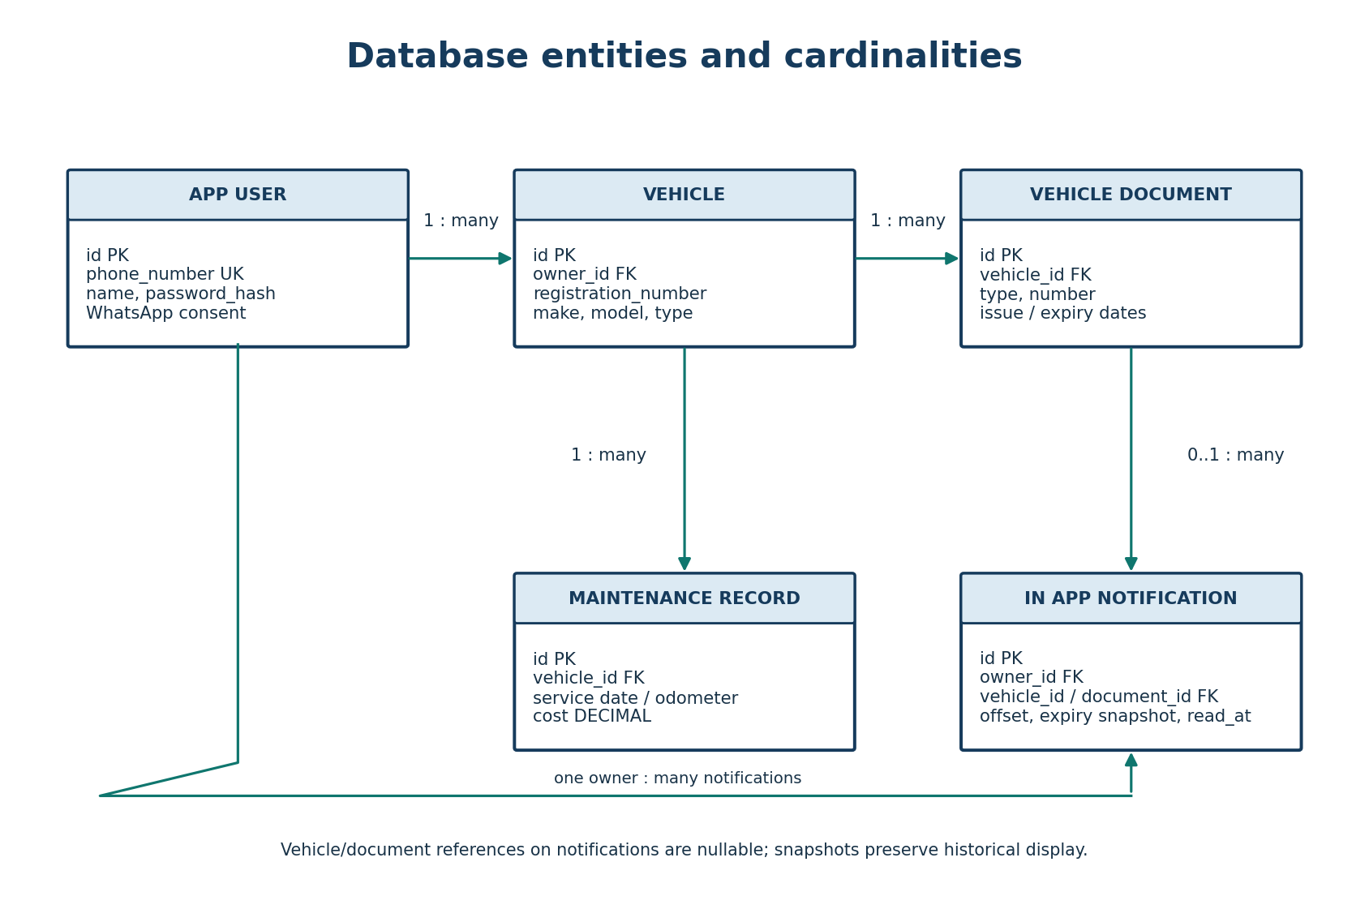
Database Design
Entity relationships (Flyway V1–V7)
Core Tables
app_user — Registered users (phone_number unique)
vehicle — Owner's vehicles (registration unique per owner)
vehicle_document — Documents linked to vehicles
vehicle_maintenance_record — Service history
in_app_notification — Expiry reminders
Vahan Alerts — Project Presentation
10

Slide 10
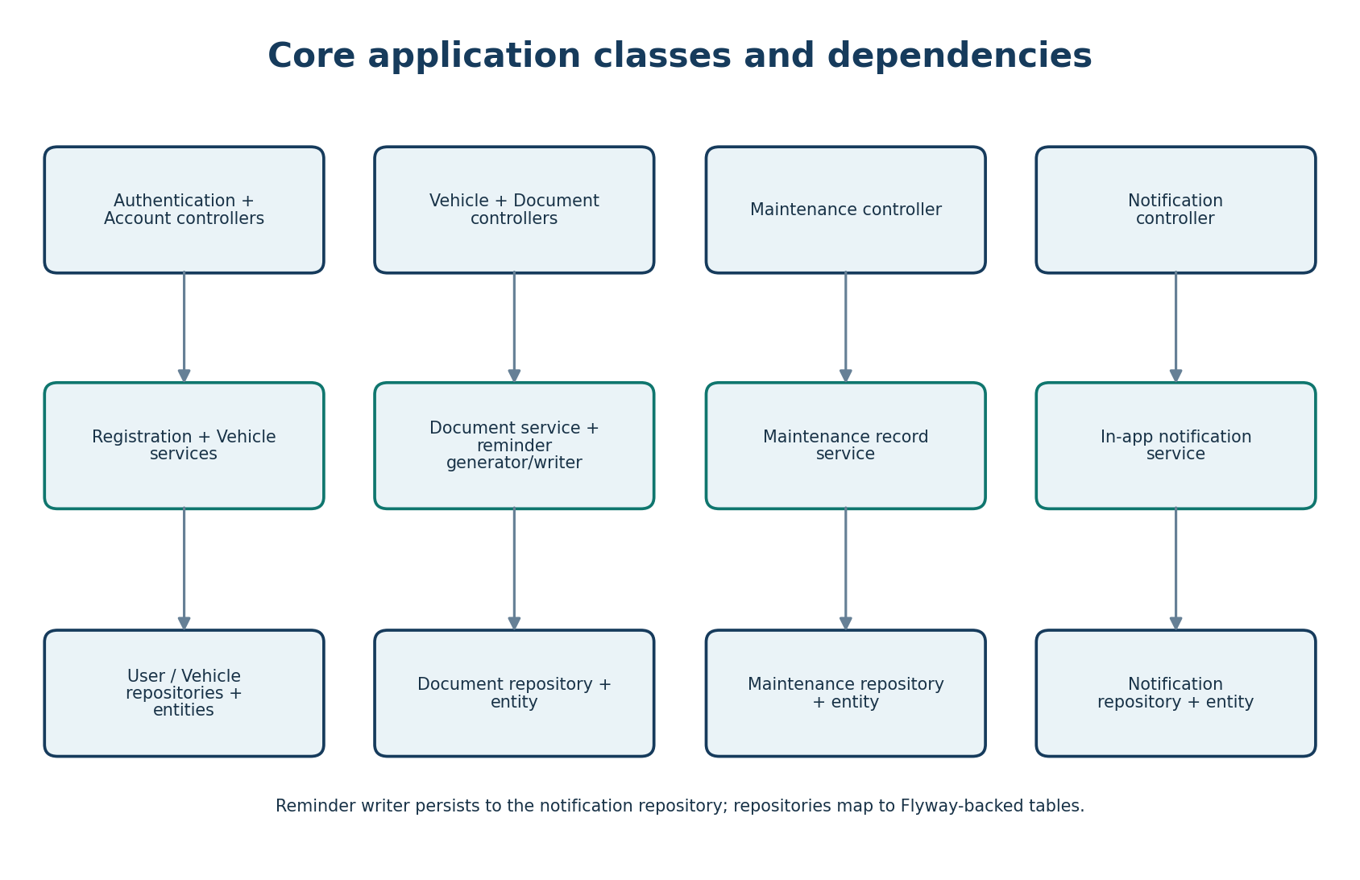
Security & Authentication
Protecting user data and sessions
Security Measures
Phone-number-based authentication with Spring Security form login
BCrypt password hashing (72-byte UTF-8 limit enforced)
CSRF protection on all state-changing POST requests
Session fixation protection (change session ID on login)
HTTP-only and SameSite=Lax session cookies
30-minute session timeout
Owner-scoped data access (no cross-user entity access)
Error responses exclude stack traces and binding errors
Vahan Alerts — Project Presentation
11

Slide 11
Limitations & Future Scope
Current gaps and roadmap
Limitations:
Why It Matters
No real WhatsApp/email/SMS delivery
No file upload/download for attachments
No government database integration
Single role (ROLE_USER)
No OAuth/social login
Prevents missed document renewals and legal penalties
Centralizes vehicle documentation for individual owners
Automated reminders reduce manual tracking burden
Secure, owner-scoped data access protects privacy
Well-tested (56 passing tests) ensures reliability
Future Enhancements:
WhatsApp Business API / SMS integration
Document file upload and download
Role-based access control (ADMIN/USER)
PWA or native mobile app
Government vehicle API integration
Vahan Alerts — Project Presentation
13

Slide 12
Conclusion
Vahan Alerts delivers a practical, secure, and well-tested solution for personal vehicle document and maintenance tracking. Automated expiry status calculation and scheduled in-app reminders address the core problem of missed renewals. Built on Spring Boot with industry-standard security practices and validated by 56 passing tests, it provides a solid foundation for vehicle owners to manage their documentation proactively.
Thank You
Questions & Discussion

