Slide 1
Credibility Assessment
of News on Social Media
Group 7
Chen Liuyang A0231850M
Jiankun Wang A0231869U
Liu Yishun A0231849X
Nanhai Zhong A0231953E
Yuankai Ma A0231868W

Slide 2
CONTENT
Introduction
EDA
Preprocessing
PART ONE
PART TWO
PART THREE
Baseline Model
Self-training
Insights
PART FOUR
PART FIVE
PART SIX

Slide 3
Introduction
PART ONE

Slide 4
PART ONE Introduction
Introduction
Purpose: establish an automated credibility assessment model for social media news
Techniques: text analytics techniques, machine learning tools and self-training method
Dataset: 2 labeled datasets + 1 unlabeled datasets with interactive information
Use self-training to label the third dataset and conduct interactive information exploratory
Lower the risk of platform-induced bias
Exploratory Data Analysis
Baseline Model Selection
Interactive Information Exploratory
2 labeled datasets
Only focus on the text features (title, content…）
2 labeled datasets
Compare the performance of different models
Main dataset
Explore the relationship between fake news and interactive information
Data Preprocessing
Self-training Model
All datasets
Convert the text into vector
Remove noise
Using RDD and pyspark.ml.feature
All datasets
Use baseline model to predict the label of the unlabeled dataset
Update the model with all the datasets
Notes:
Reuters.com Facebook(Politifact)

Slide 5
Exploratory Data Analysis
PART TWO

Slide 6
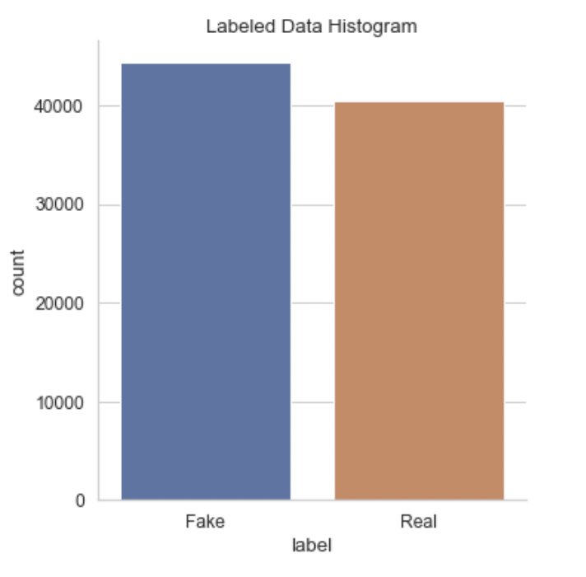
PART TWO EDA
Check Data Balance
Combine two labeled dataset. The overall balance looks solid.

Slide 7
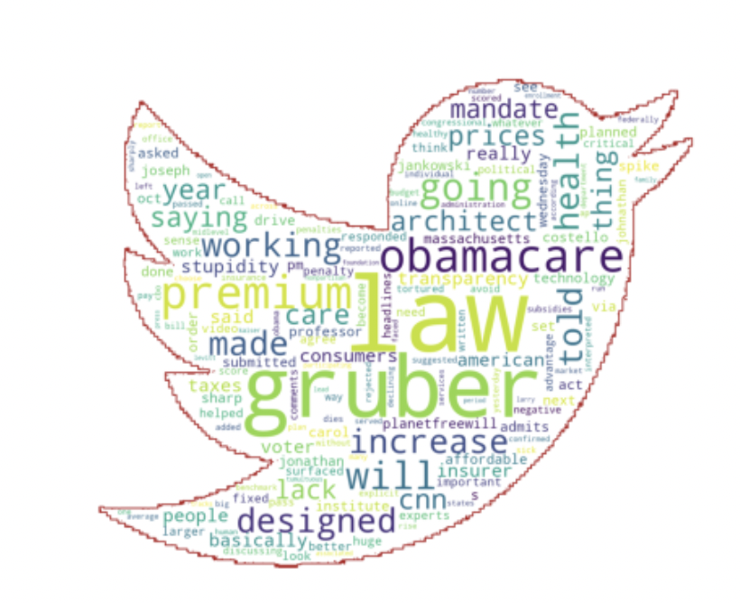
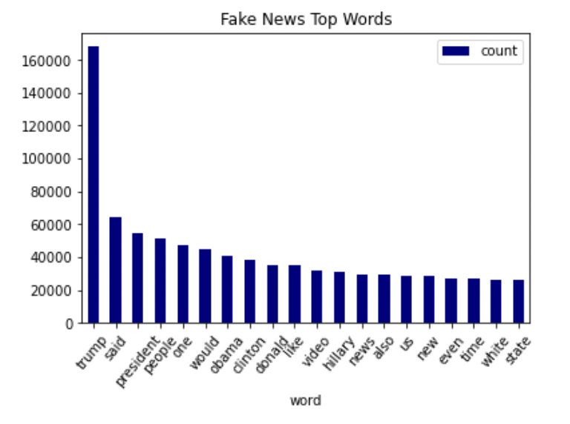
PART TWO EDA
Frequent Words
To dig into the how fake news are composed, we split each sentence to words, and count the top 20 frequent words in fake news.
Also, a word cloud graph is generated.

Slide 8
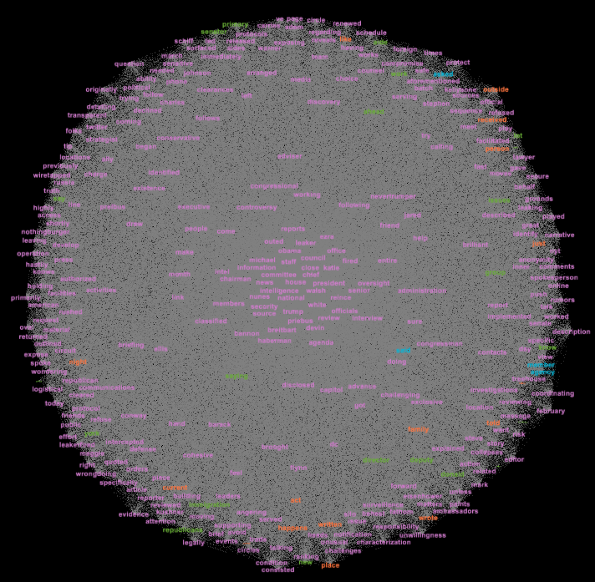
PART TWO EDA
Frequent Words
We also recorded the co-occurrence of words and created a network where each node is a word, and two words are linked if they are both in a fake-news twitter.

Slide 9
Data Preprocessing
PART THREE

Slide 10



PART THREE Data Preprocessing
Step 1
Construct the labeled datasets and the unlabeled datasets
Labeled datasets (id, label, text) and unlabeled dataset (id, text)
Step 2
Convert to lowercase and remove noise
Remove numbers, punctuation and stopwords
Step 3
Lemmatize the words
PySpark
Define part of speech tag
Use WordNetLemmatizer
Step 4
Tokenize and Vectorize
Count Vectorize: pyspark..ml.feature CountVector
TF-IDF Vectorize: pyspark..ml.feature Hashing TF, IDF
Result
Vector of the labeled dataset: 84897*100948
Vector of the unlabeled dataset: 11677*100948

Slide 11
Baseline Model
PART FOUR

Slide 12
PART FOUR Baseline Model
Prediction Model Pipeline
Decision Tree
Frequency Vectors
Random Forest
XGBoost
> >
2 labeled dataset
Same Dimensions
Concatenated
> >
<ID> <text> <label>
Decision Tree
TF-IDF Vectors
Random Forest
XGBoost

Slide 13
PART FOUR Baseline Model
For both the Count Vectorized dataset and TF-IDF dataset
Split the Data
Hyperparameter Tuning
Evaluate on test set
70% into training set
30% into test set
Cross Validation
5-Fold
Grid Search Parameters
Evaluate the predicting performance on test set
Focus on the accuracy
Build Tree-Based Models
Choose Best Combination
Decision Tree
Random Forest
XGBoost
Best Hyperparameter for 3 models
Based on the cross-validation accuracy

Slide 14
PART FOUR Baseline Model
So, we will use CountVectorize >> XGBoost pipeline to do self-training

Slide 15
Self-training
PART FIVE

Slide 16
PART FIVE Self-Training
Labeled Data
A trained supervised model using labeled data
Combine labeled and pseudo-labeled data and train next version of the model,
Repeat until no satisfying observation
Unlabeled Data
Predict on unlabeled data using previous model
Pseudo-labeled Data
Add predictions satisfying probability threshold to pseudo-labeled set
Final Model
Get insights on the original unlabeled data

Slide 17
Insights
PART SIX

Slide 18
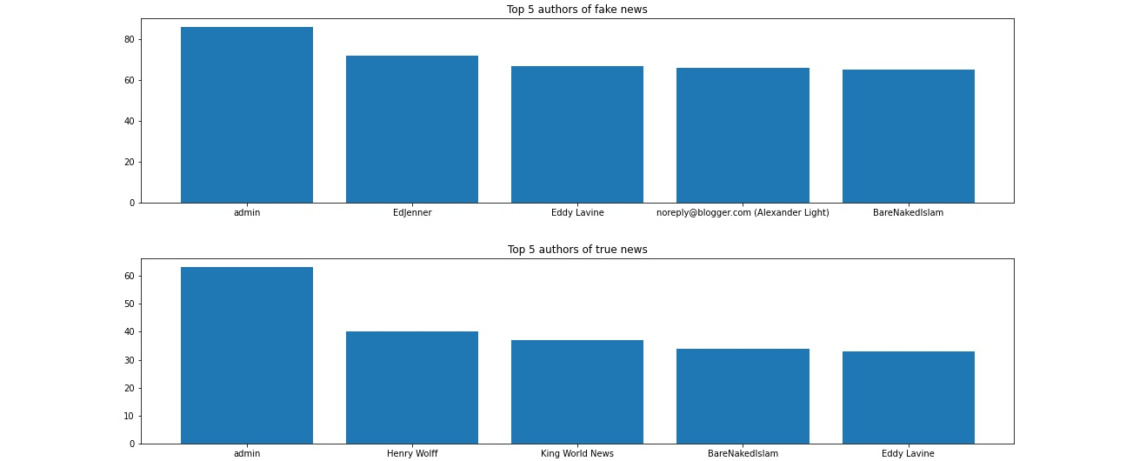
PART SIX Insights
Top 5 Authors of fake and true news
According to the charts above, we can identify two authors with a high probability of publishing fake news ('EdJenner’ and 'noreply@blogger.com (Alexander Light)’).

Slide 19
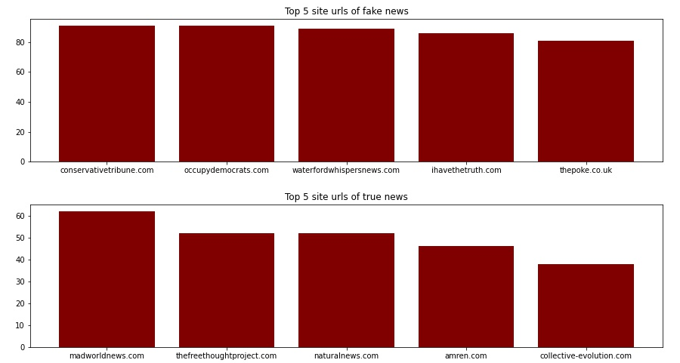
PART SIX Insights
Top 5 Site URLs of fake and true news
Since there is no overlap, it is reasonable to classify these five sites ('conservativetribune.com’, 'occupydemocrats.com’, 'waterfordwhispersnews.com', 'ihavethetruth.com', 'thepoke.co.uk'), which each posted more than 80 fake news items, as fake news sites.

Slide 20
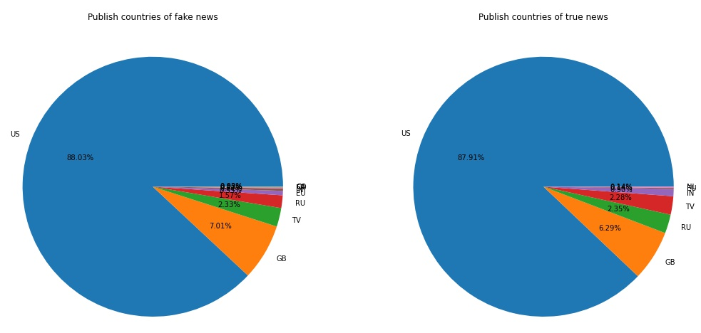
PART SIX Insights
Proportion of news release countries
The results shows that there was little difference in the proportion of fake news and true news release countries, with the United States and Great Britain dominating both categories. This is mainly due to the fact that most news data sources come from these two countries.

Slide 21
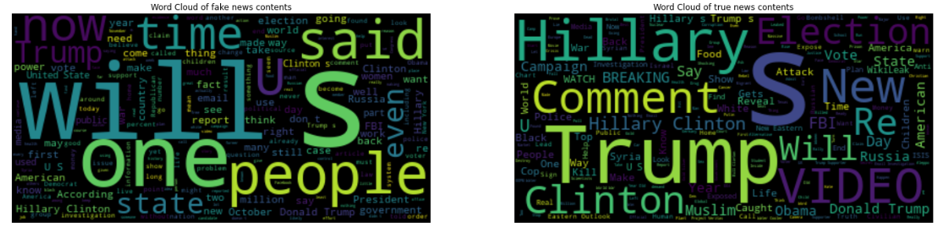
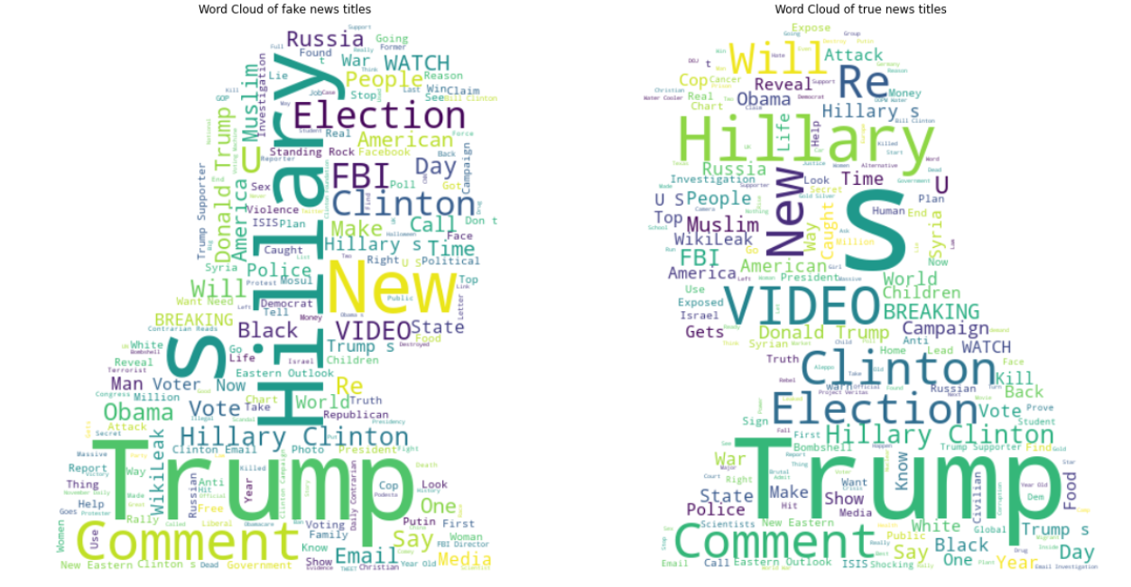
PART SIX Insights
Word cloud of fake and true news contents
Word cloud of fake and true news titles
Through the word clouds of fake news and real news contents and titles, we can see that the high-frequency words in the two categories are roughly similar. This also indicates that, it is actually pretty difficult to judge a news as fake or true only based on those single words that appear frequently in its title or content.

Slide 22
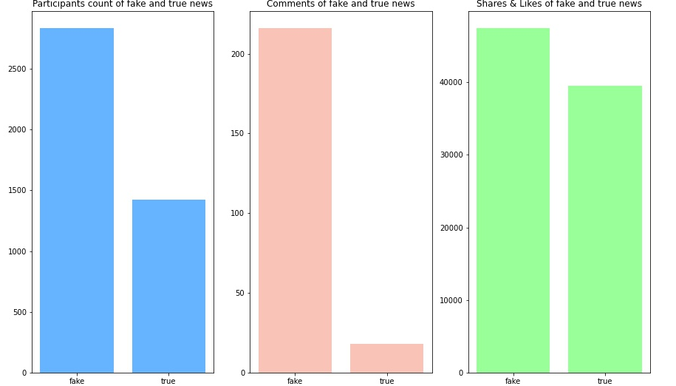
PART SIX Insights
Participants, Comments, Shares & Likes of fake and true news
There are significant differences between fake news and real news in these features. It is clear that fake news, compared to real news, would attract much more participants and more comments, likes and shares. These characteristics can also provide important reference and information for us to screen fake news.

Slide 23
Summary

Slide 24
Summary
Important steps
1. Use datasets from different sources to eliminate bias
2. Compare the model performance based on the count vector and TF-IDF vector
3. Use self-training to label the main dataset
4. Explore the relationship between interactive information and news credibility
Following steps
Find ways to evaluate the self-training model and improve the model

Slide 25
Thank you
Group 7
Chen Liuyang A0231850M
Jiankun Wang A0231869U
Liu Yishun A0231849X
Nanhai Zhong A0231953E
Yuankai Ma A0231868W

