Slide 1

Assessing Predictive Models for Cardiovascular Disease
Ty Johnson

Slide 2
Overview
Cardiovascular disease (CVD) – leading cause of death worldwide
Disorders affecting heart and blood vessels
EDA => Model Building

Slide 3
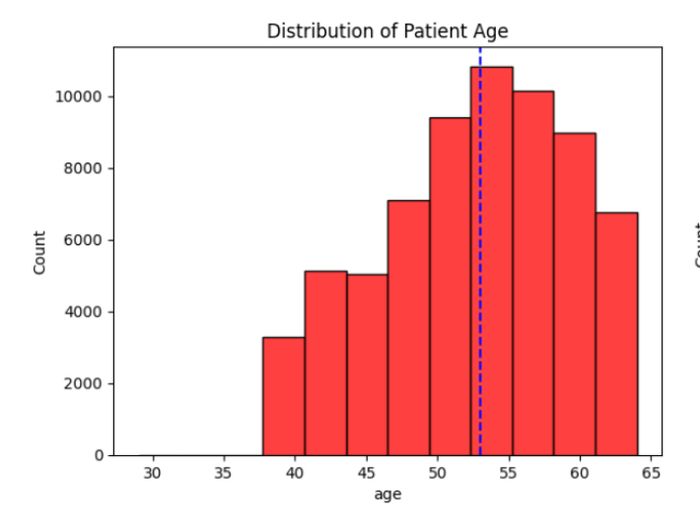
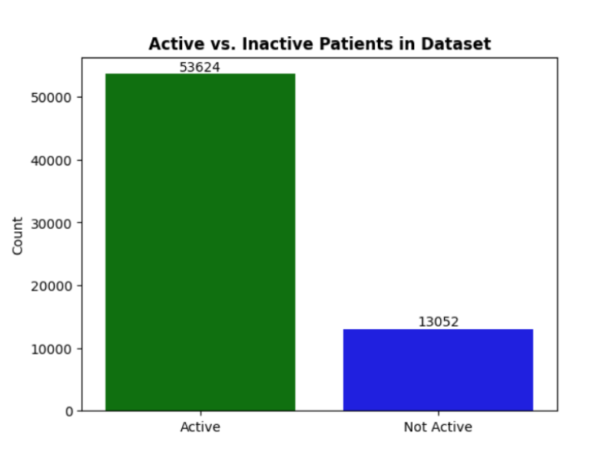
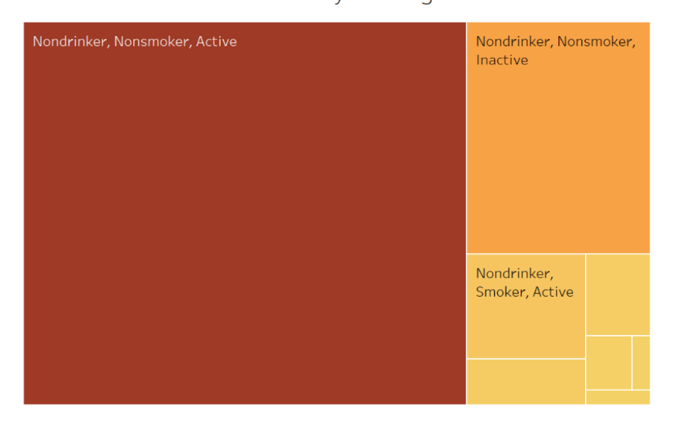
Exploratory Data Analysis
70,000 Patients
12 Features
Lifestyle, Demographic, Biometric Data

Slide 4
Patient Age Distribution

Slide 5
Patient Lifestyle Categories

Slide 7
Methods & Modeling
Logistic Regression
K-Nearest Neighbors (KNN)
Decision Tree
Random Forest

Slide 8
Preliminary Results

Slide 9

Final Results

Slide 10
Conclusion
Accurate predictive model not yet created
01
Project objectives not met
02
Dataset lacks much needed features
03

Slide 11
Reflections
Dataset selection
Complex Data
Model selection

Slide 12

Questions?

