Slide 1
User-Defined Functions
Ty Johnson

Slide 2
What is a User-Designed Function?
Block of code created by the user that are designed to perform a specific task(s)
Can take any number of parameters
Can perform actions such as returning a value

Slide 3
Why use them?
Reusability: Can call a function multiple times throughout program after defining it. Makes the code more efficient and easier to maintain.
Modularity: Allows you to break down complex tasks into smaller, more manageable pieces of code. Will make the program easier to read, write, and debug

Slide 4
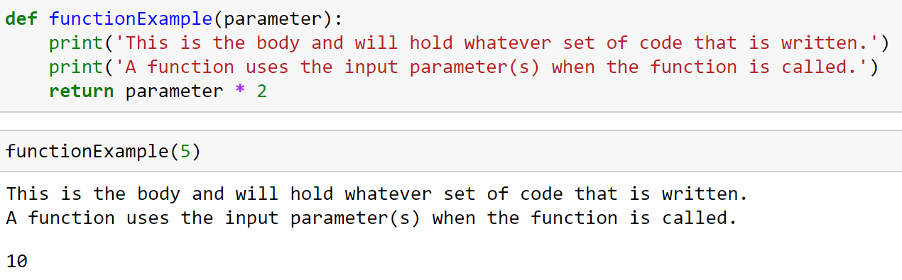
How do you use a Python function?
Use ‘def’ to define and name a function
Enter the input parameters inside parathesis that the function will accept. Follow with “:” and then indentation
Write the code for the task you wish the function to perform
Call the function with its name and the input parameter that the function will accept

Slide 5
Scope
Local - Variables defined inside a function and can only be accessed within that function
Global - Variables defined outside of a function and can be accessed anywhere in the program

Slide 6
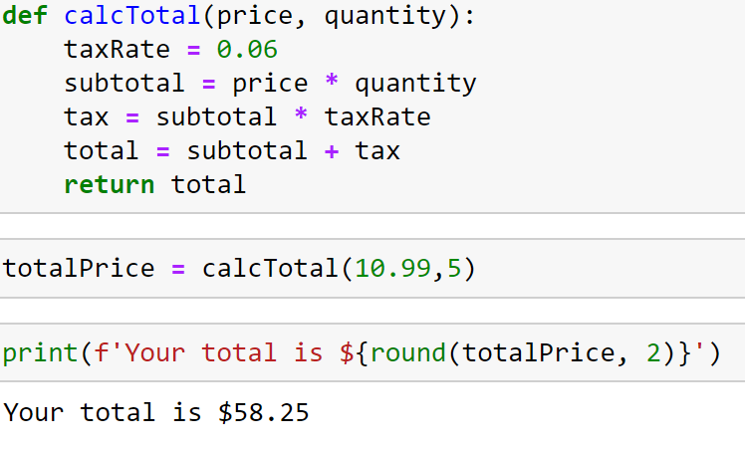
Example: Calculating Sale Total
Function Name: calcTotal
Parameters: price, quantity
Task: Calculating total price including sales tax

