Slide 1
Logistic Regression for Predicting Earthquake Outcomes
Ty Johnson

Slide 2
Project Introduction
Using Exploratory Data Analysis and Logistic Regression Model:
How do different characteristics of a building affect the outcome of a building?
Can the outcome of a building be accurately predicted?

Slide 3
Background
Dataset is based a 2015 Earthquake in Nepal
7.8 magnitude earthquake that destroyed over 600,000 buildings and caused $5-10 billion dollars in damage in the country.
2.8 million people were displaced by the earthquake
Dataset includes over 700,000 rows and 21 columns

Slide 4
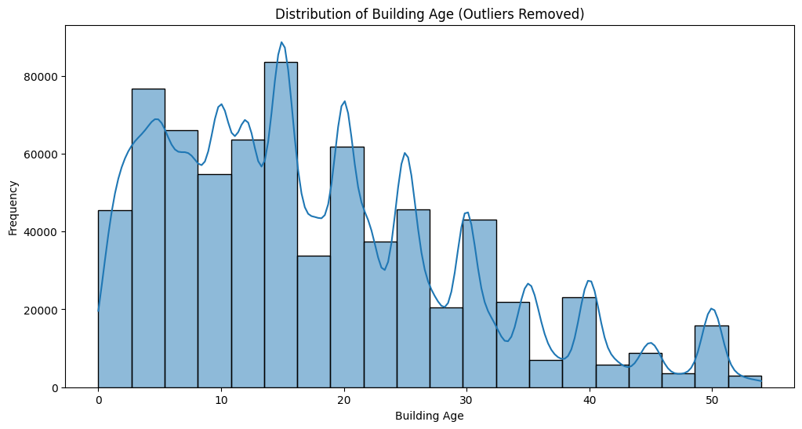
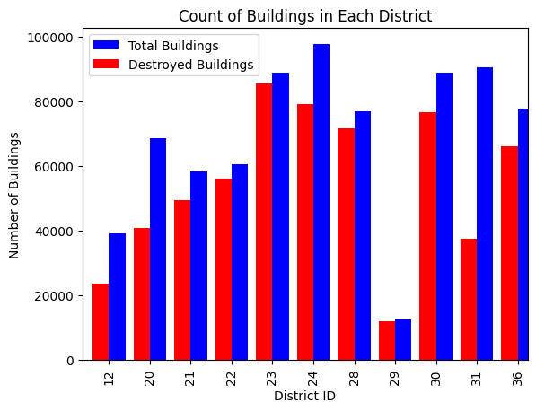
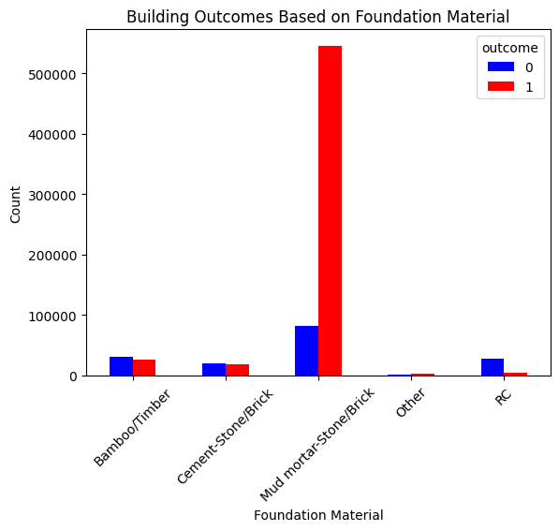
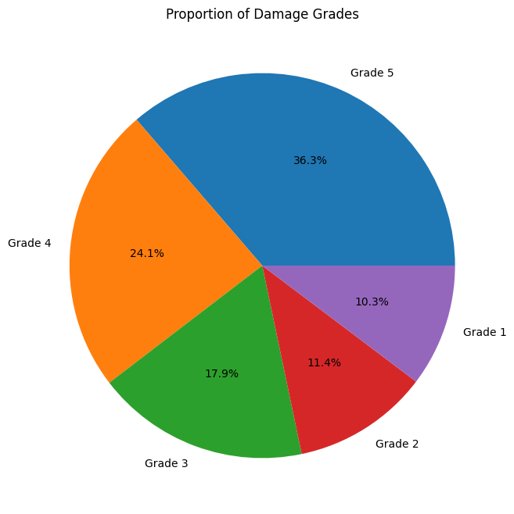
EDA

Slide 5
What is the distribution of building ages?

Slide 6
How many buildings are in each district and how many were destroyed?

Slide 7
What is the proportion of damage grades following the earthquake?

Slide 8
What foundation types performed better in withstanding the earthquake?

Slide 9
Experimental Design
Predicting binary outcome of 0 (Withstood) and 1 (Destroyed)
Three different test sizes (33%, 25%, 1%)
Using only variables related to building and land characteristics

Slide 10
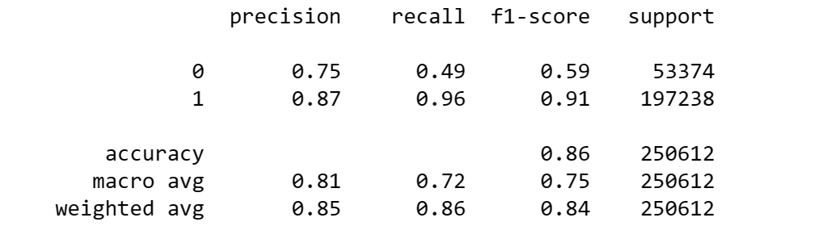
Experiment One – 33% Test Size

Slide 11
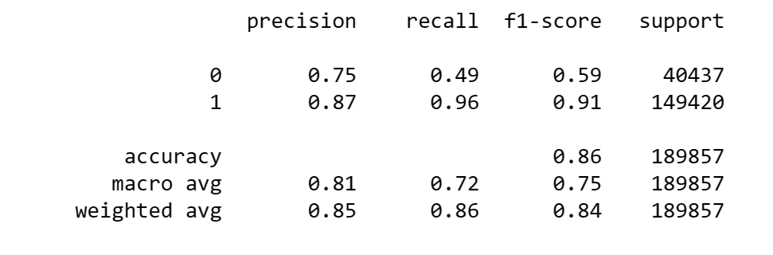
Experiment Two – 25% Test Size

Slide 12
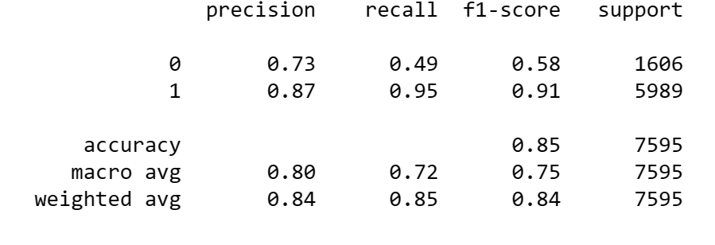
Experiment Three – 1% Test Size

Slide 13
Discussion of Results
Questionable consistency across different test sizes
All three models performed fairly close in all classification measures
85-86% accuracy

Slide 14
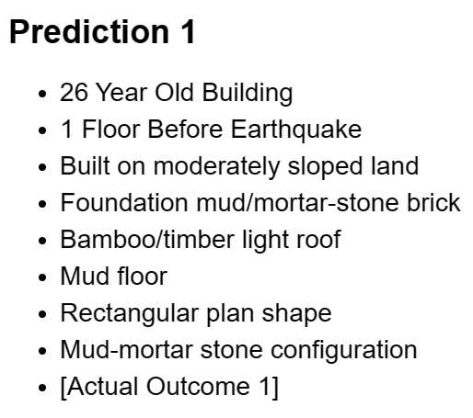
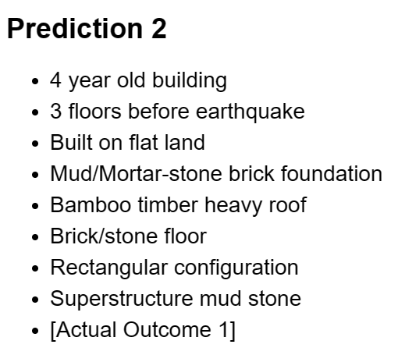
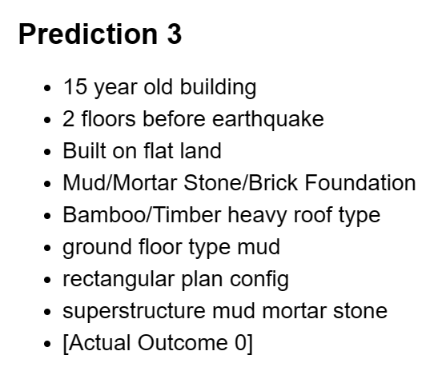
Using the Model for Predictions
Using the 33% Test Split, generated three random samples from dataset:
First two predictions successful, prediction 3 was unsuccessful

Slide 15
Conclusion
The model was successful in predicting the outcome of a building
In order to be more reliable and answer critical questions, the model needs improvement:
Tracking different earthquakes
Tracking different factors when it comes to building and land characteristics
More advanced model

