Slide 1
CPP Library System
By: Nathaniel Battad, Tyler Hipolito, Ryan Phan, Jeremy Po, Erica Tan

Slide 2
System as is
manually track and record the books and films that are loaned
staff is responsible for manually recording down student details and loan details
generate two receipts, one for the student with the information about the loan and a copy for staff in order to be used for financial reports
loan is then calculated based on the item rented and any interest that was accrued by student
Overall, a very slow process all around for the staff

Slide 3
System to be
allow staff to easily record student and loan details efficiently
allows easy navigation for staffs
Functions
ease of registering a student and/or item for easier bookkeeping
ability to create a loan for a student, which will automatically generate a receipt for both parties
allow for easier management and can allow for the possibility of an intelligent revenue report
allow for the parties using it to have a much easier and faster process in the renting of items

Slide 4
Requirements Specification
A new item system where it can be more efficient in storing data, generate loan information, and print receipts
A way to keep track of info for the loans made by students and for staff that need to access the data

Slide 5
Assumptions
Item reservation would not need to be considered in the system
Logins should be not considered when making the system
Functionality over personality
Functionality should be the primary focus of the GUI, only then the looks of the GUI can be considered
record the student ID number in order to have an ease of tracking

Slide 6
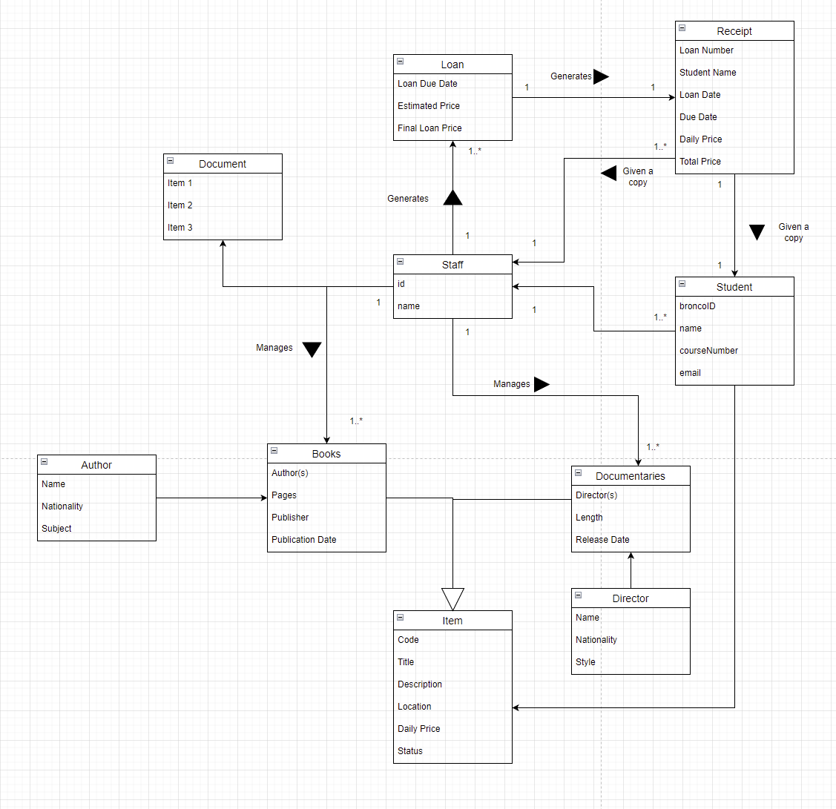
Domain Model

Slide 7
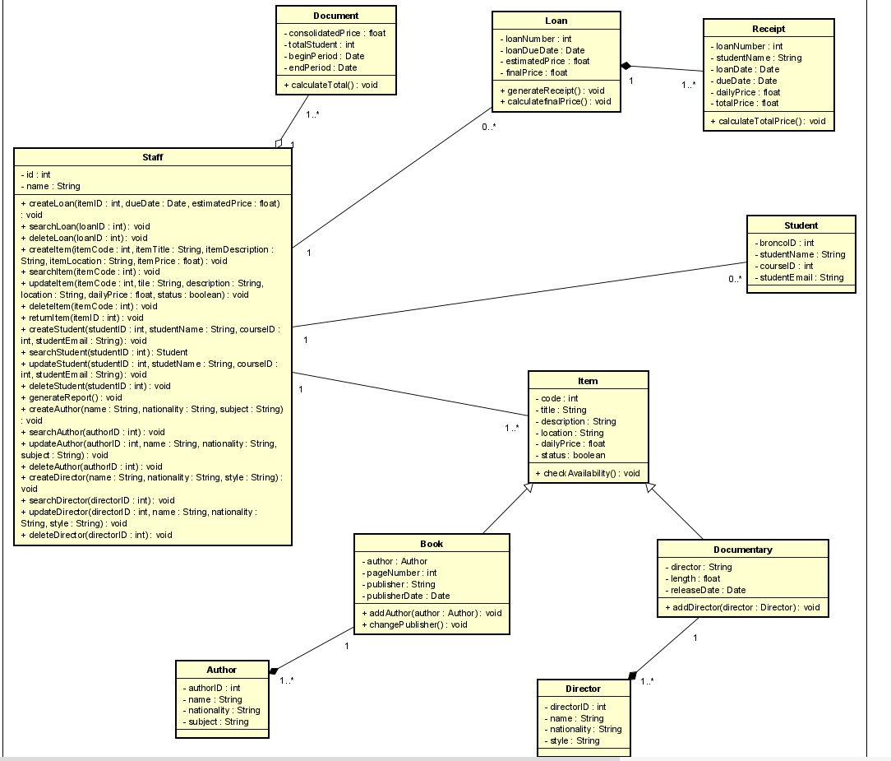
Object Oriented Model

Slide 8
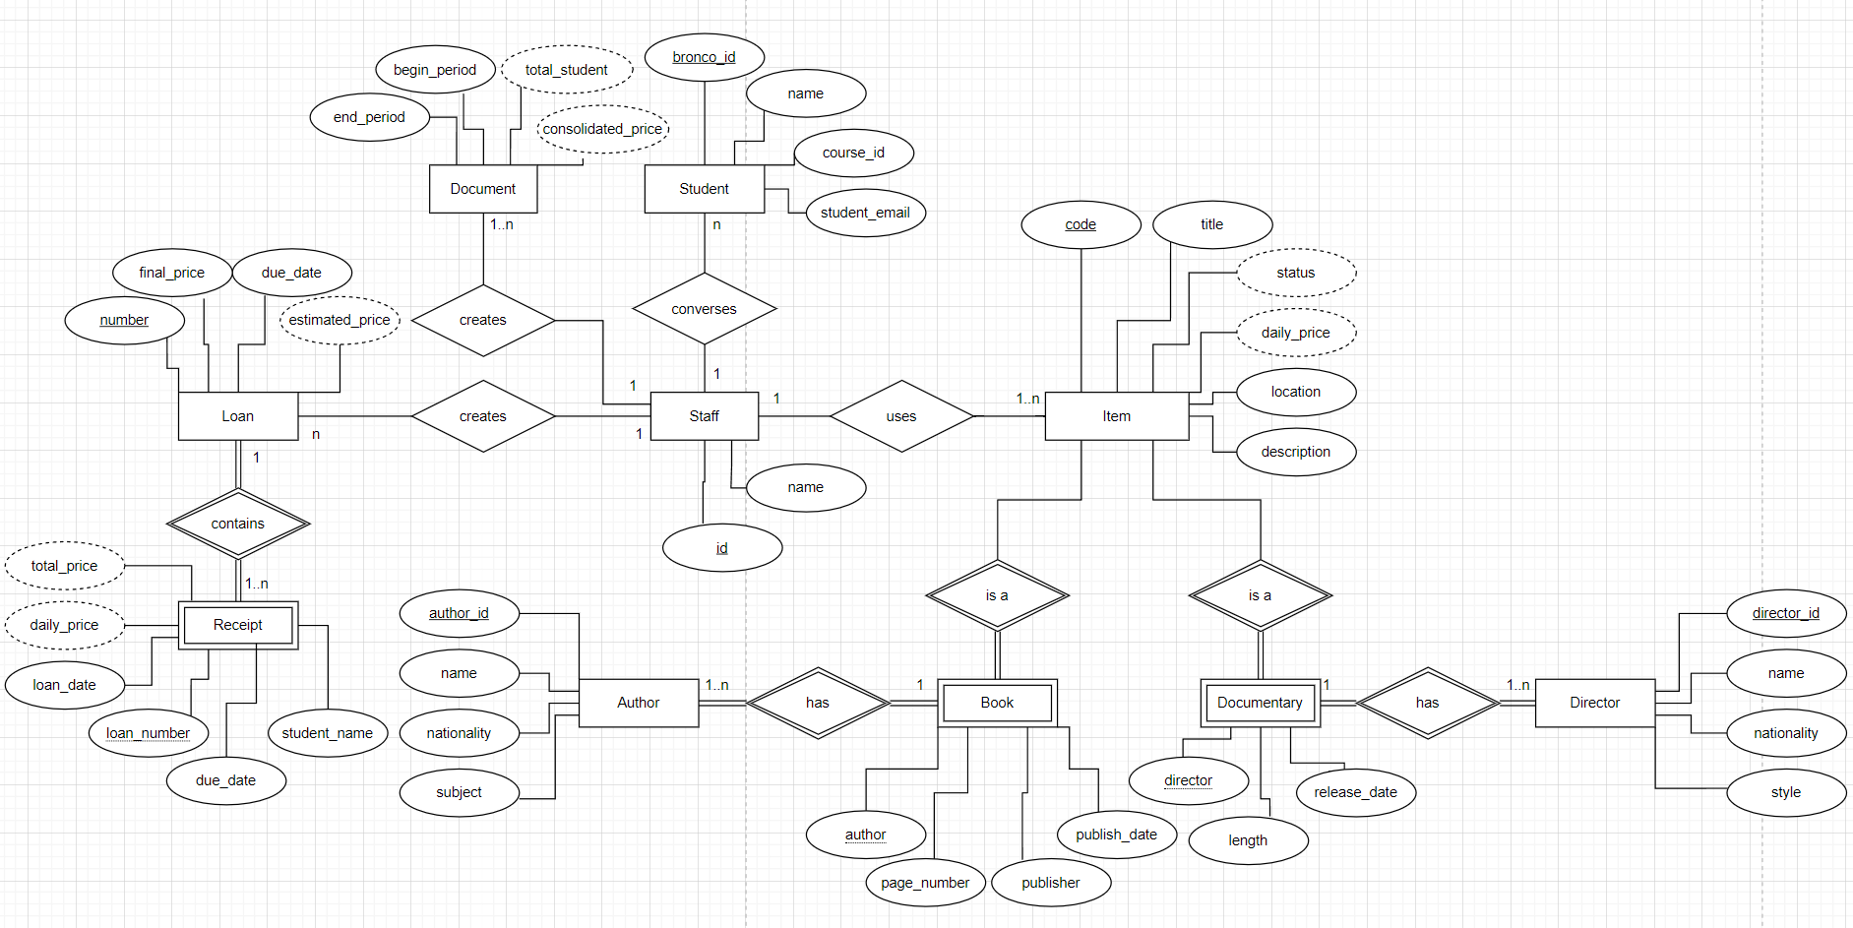
Entity Relationship Diagram

Slide 9
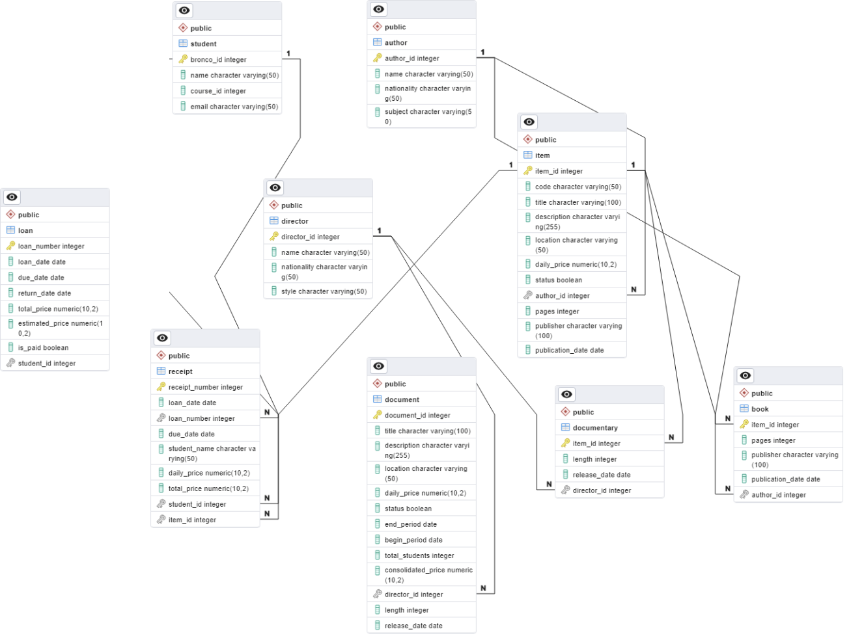
Data Logical Model

Slide 10
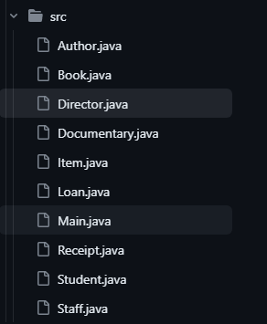
Implementation
Steps:
Creating classes based on proposed models/diagrams.
Creating a database.
Linking both together.

Slide 11
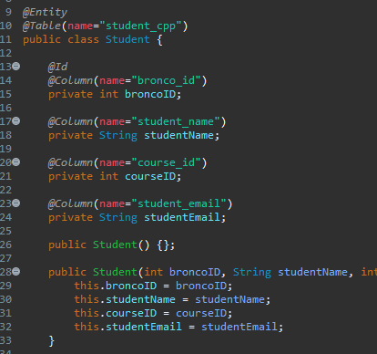
Student Class
Standard fields, constructors, setters/getters.
Added lines of code to support hibernate.

Slide 12
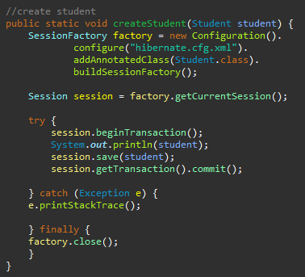
Saving Student Data
Method for creating/saving a student in the appropriate database table.
Modified and reused later for other cases.

Slide 13
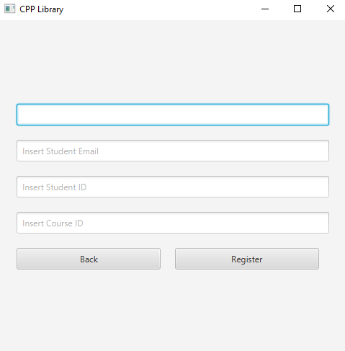
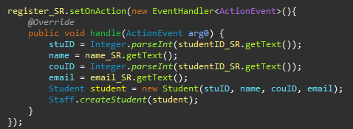

GUI to Database
Input -> Handler -> Database Table

Slide 14

Demo
https://docs.google.com/presentation/d/1FrteICylXsUnZcAVW15m2I5OOSgHdUvFuQSO3vDgECU/edit?usp=sharing

Slide 15
Thank you!

