Slide 1
BUDGETING
Group 6:
Leonardo Bunjamin - 00000014225 (Koor)
Octa Wahana Widiwijaya - 00000019399
Rickhen Hermawan - 00000012311
William Citralin - 00000014292

Slide 2
List of Content
List of Content
Work Plan
Work Division
Score Board
Brief Description
Layout
Colour & Font
Icon
Functionalities
Project Structure
Java Packages
Limitation consideration
Survei
T-Test
Anova&Tukey
Github

Slide 3
WORK PLAN
 | September | October |  |  |  | November
 | IV | I | II | III | IV | I | II | III | IV
Main Feature |  |  | 10-12 Williem | 17-19 Williem | 24-26 Williem
Database Update |  |  |  |  | 24-26 Williem | 31-4 Williem
Balance
Material Design |  |  | 10-12 Rickhen |  |  |  | 7-9 Williem
Anova, Ttest, Tukey Survey |  |  |  |  |  |  |  |  | 27-28 Rickhen
Documentation |  |  |  |  |  |  |  |  | 28-30 Octa&LEO
1

Slide 4
WORK DIVISION
NO | NAME | JOB DESCRIPTION
1. | Leonardo Bunjamin | Main Feature, Slide, Documentation, User Manual, Program Manual, Limitation & Prototype Consideration, Coordinator
2 | Rickhen Hermawan | Slide, Documentation, Design, Main Feature, Questionnaire & Evaluation,T-test, Anova
3 | Williem Citralin | Database Management, Documentation, Schedule and Resource, Main Feature, Design, Slide
4 | Octa Wahana Widiwijaya | Main Feature, Documentation, Slide, User Manual, Program Manual, Design Manual
2

Slide 5
Score Board
[]
Back Ground colour other than default
Button min. 7
Button Design
Icon min. 4
Icon design
Menu
Help file
Form captioned
Form shapes variation
Tool tip text
3

Slide 6
Splash
Search data
Animations
User manual
Program Manual
Questionnaire & Evaluation
T-test
Anova **
4

Slide 7
Other working program/excellence, complexity of coding
SQL Connection
Passworded data base and/or user name + pwd
Limitation Considerations
team work + Presentation
Redesign
Creativity/Innovation
Report quality (completeness)
Quality work/honesty/integrity
5

Slide 8
Literature Survey
Mengenal Human Computer Interaction
Pengembangan Aplikasi Mobile untuk Budgeting
Mengenal Database
Human Centered Computing
Mengenai Human-Centered Computing pada multimedia
Mengenal Mobile Apps Design
Mengenal Tabungan Digital
6

Slide 9

BRIEF DESCRIPTION
In a Brief, Budgeting Created to manage finance or budgeting that allows users to access and have a simple design that has new innovations such as having some features Today’s Transaction, Transaction Report, Transaction History.
Minimum System Requirement for Budget to run:
Android OS: LOLLIPOP(API 21)
7

Slide 10
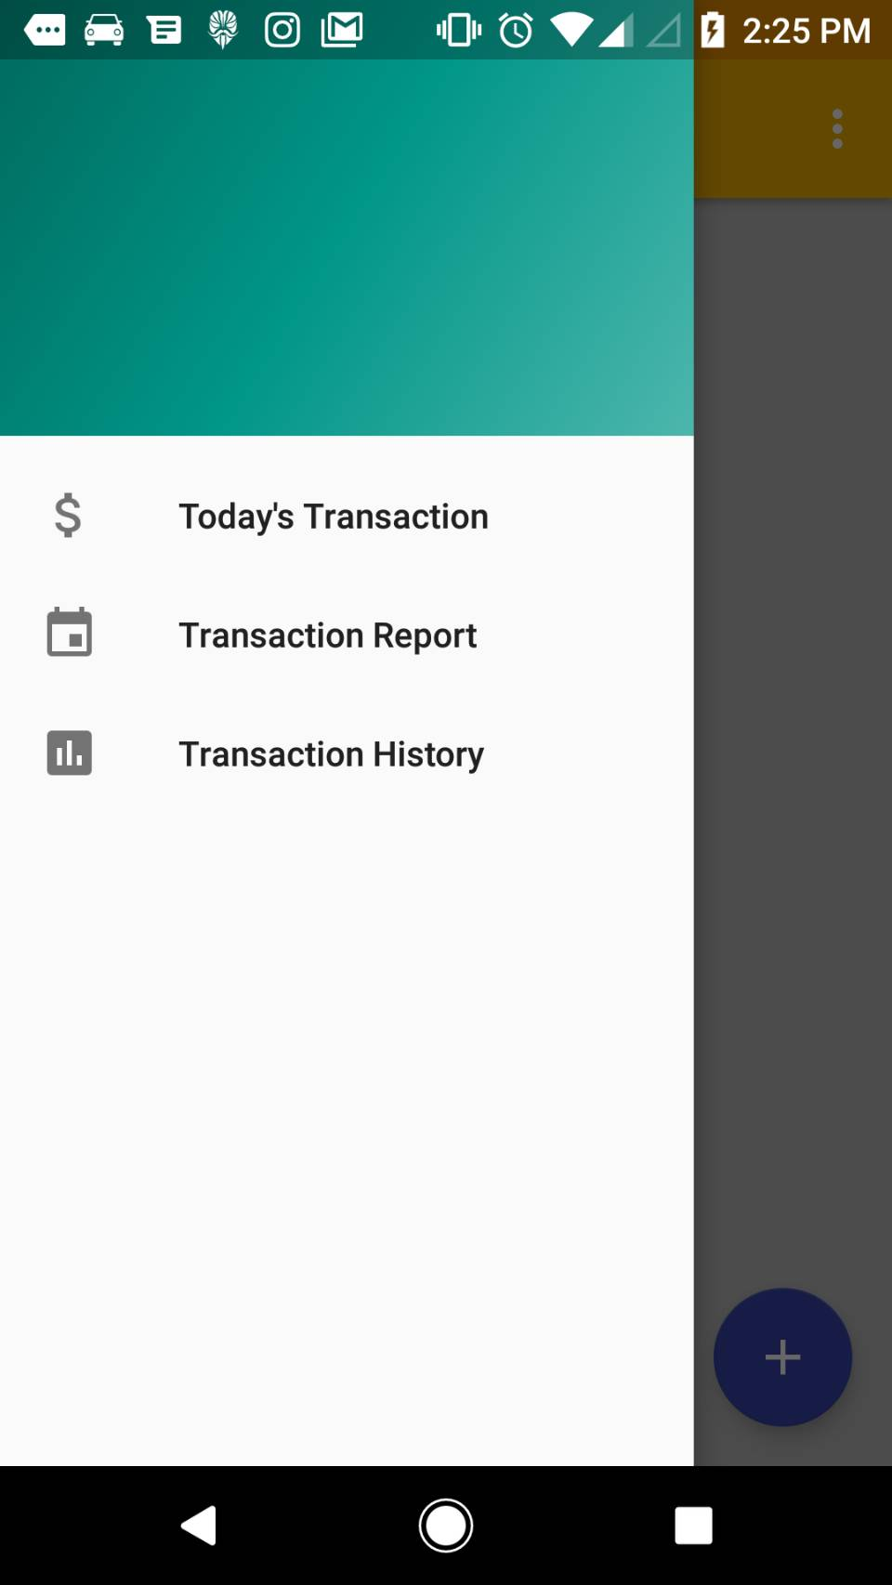
Layout
In general, the layout for main activity Budgeting is given below:
-Navigation drawer: when clicked, it will show Today’s Transaction, Transaction Report, Transaction History.
-Top Bar: shows the title of apps, contains navigation drawer and options menu.
-Options menu: when clicked, options will pop out help file,settings.
-Main Content: all the content for apps will be shown here.
References :
[5]
[6]
8

Slide 11
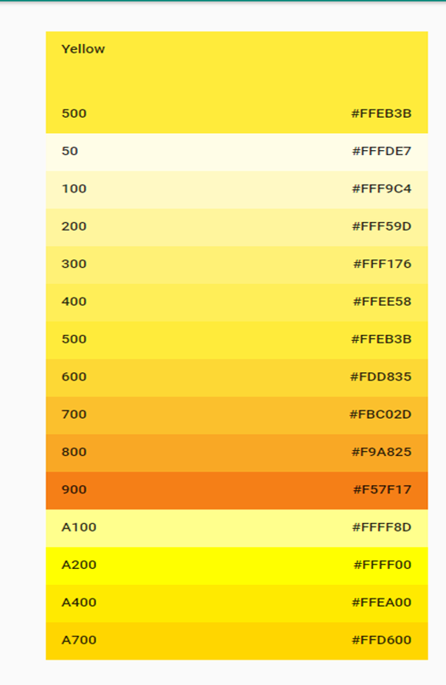
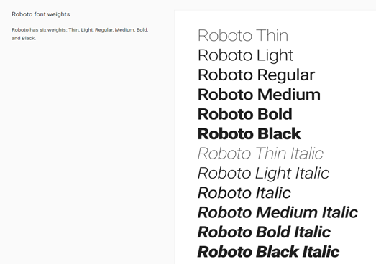
Colors and Fonts
References :
[2]
[3]
9

Slide 12
Icons
[4]
10

Slide 13
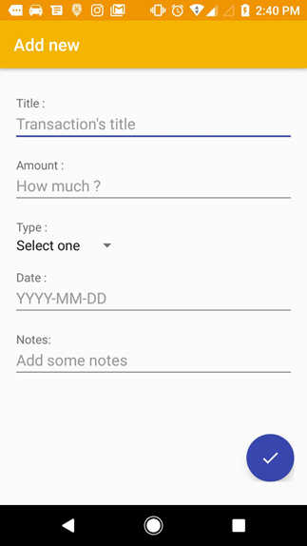
Functionalities 1: ADD NEW
will contain :
Tittle
Amount
Type
Date
Notes
11

Slide 14
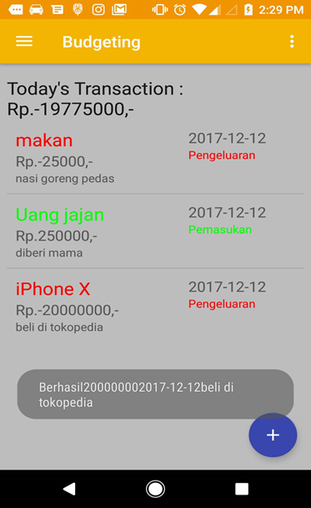
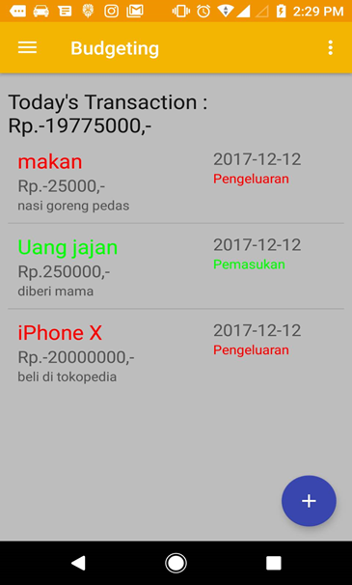
Functionalities 2: Today’s Transaction
This function enables user to view Today’s Transaction and add transaction. The information will contain :
1. Type
2. Amount
3. Note
4. Date
5. Income/expenditure
12

Slide 15
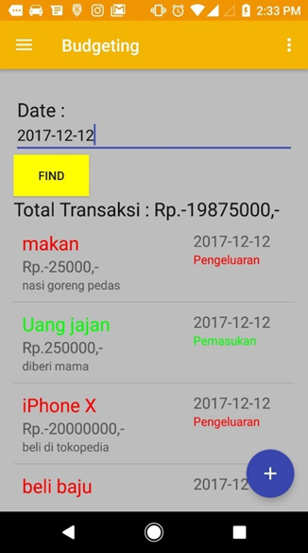
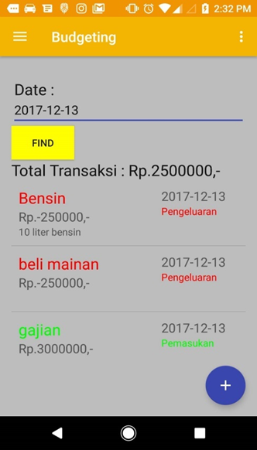
Functionalities 3: Transaction Report
The return results will show transaction by date on search query. All transaction that contain search query will be shown in the screen.
13

Slide 16
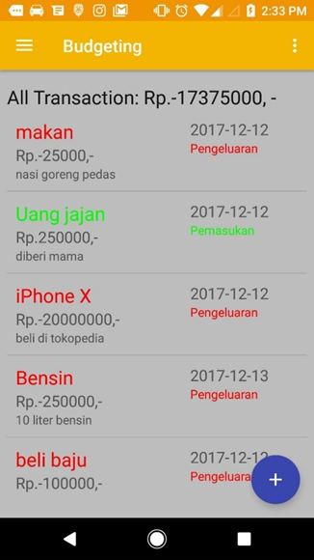
Functionalities 4: Transaction History
Transaction History are list of transaction after submit at add new. This feature allows the user to view the last transaction that has been made and can be known various information such as amount, type, note, date and title.
14

Slide 17
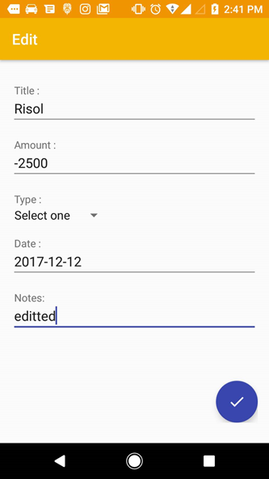
Functionalities 5: Edit
Screenshot shows all the functionalities of edit. Different from add new, edit only change if user want to change transaction information.
15

Slide 18
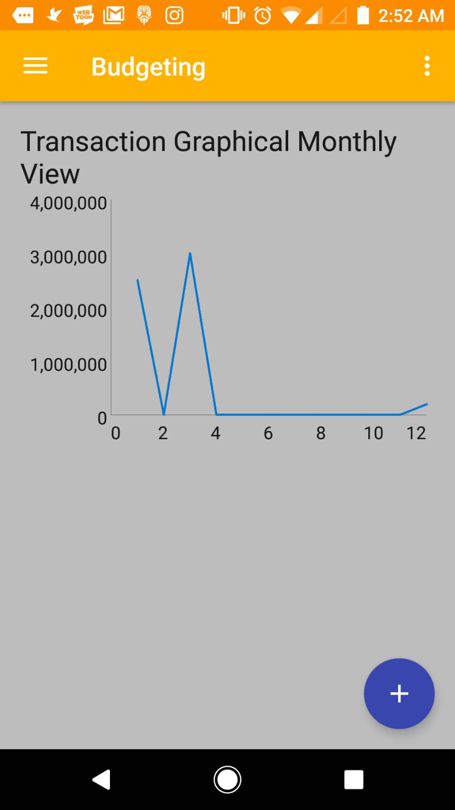
Functionalities 5: Graph
[13]
Screenshot shows all the functionalities of Graph.Show monthly Transaction of our apps .
16

Slide 19
Project Structure
[doc] -documentation
[gradle]
[gradle]/[wrapper]- Gradle Wrapper
[Apps]-main module
[Apps] - main module
[Apps]/[libs] - contains 3rd party libraries (not used)
[Apps]/[src] - contains source code
[Apps]/[src]/[main]
[Apps]/[src]/[main]/[assets] - asset files (prepopulated database, images)
[Apps]/[src]/[main]/[java] - java sources
17

Slide 20
Project Structure
[Apps]/[src]/[main]/[res] - xml resources, drawables
[Apps]/[src]/[main]/AndroidManifest.xml - manifest file
[Apps]/build.gradle - main build script
.gitignore - Gitignore file
build.gradle - parent build script
gradle.properties - build script properties
gradlew - Gradle Wrapper (Unix)
gradlew.bat - Gradle Wrapper (Windows)
README.md - readme file
settings.gradle - build settings containing list of modules
18

Slide 21
Java Packages
com.example.williem.hciss.AddActivity contains activity
com.example.williem.hciss.CalenderFragment – contains Calender class
com.example.williem.hciss.DatabaseHelper -contains database Sqlite class
com.example.williem.hciss.EditActivity- contain EditText Activity class
com.example.williem.hciss.ExpenseFragment -contains fragment class
com.example.williem.hciss.MainActivity -contains application class and main config class
com.example.williem.hciss.ToDoCursorAdapter - contains Cursor for To Do Adapter
19

Slide 22
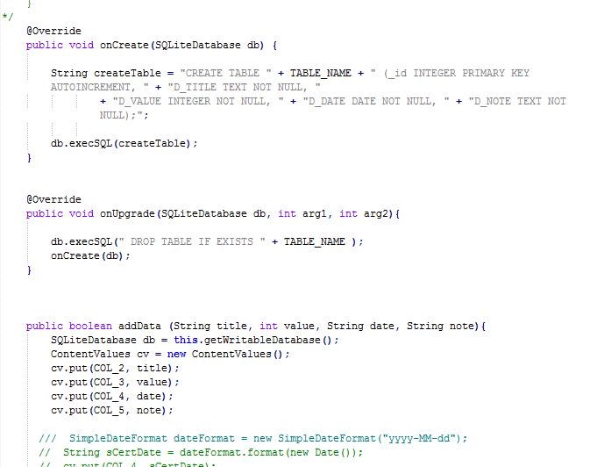
Limitation consideration
Only Using Sqlite for Database and SQL connection.
First we use Xampp as our Database Connection for our Android Studio but we found that, we Cannot Connect The Database server
Solve: [2]Using SqLite for Database for SQL connection by add the table
20
We Create the Table using Create Table() Function if the Sqlite object is called and We can add the data using AddData() function

Slide 23
Survey Before The Program has been Created
[14]
Question:
"Sebutkan nama anda:",
"Apakah anda pengguna Android atau Ios?",
"Apakah sebelumnya anda pernah menggunakan aplikasi budgeting? ",
"Apakah sebelumnya anda pernah menggunakan aplikasi budgeting dalam smartphone anda? ",
"Menurut anda, seberapa pentingkah menggunakan aplikasi budgeting dalam smartphone anda dalam kehidupan sehari-hari?",
"Apakah sebelumnya anda pernah mengetahui tentang fitur-fitur yang ada dalam aplikasi budgeting?",
"Dari 4 fitur dibawah ini, fitur manakah yang sebelumnya pernah anda ketahui?",
"Menurut anda dari skala 1 sampai 10, berapa nilai untuk fitur Income Money untuk ada dalam aplikasi kami:",
"Menurut anda dari skala 1 sampai 10, berapa nilai untuk fitur Expense Money untuk ada dalam aplikasi kami:",
"Menurut anda dari skala 1 sampai 10, berapa nilai untuk fitur Graph untuk ada dalam aplikasi kami:",
"Menurut anda dari skala 1 sampai 10, berapa nilai untuk fitur Schedule & Resource untuk ada dalam aplikasi kami:",
"Dari 4 fitur yang ingin kelompok kami buat untuk aplikasi budgeting, menurut anda fitur mana yang paling anda minati untuk aplikasi budgeting?",
"Kritik dan saran mengenai fitur dalam aplikasi budgeting:"
21

Slide 24
Survey Before The Program has been Created
Answer:
- "Yan Kristian","Android","Ya","Ya","4","Ya","Fitur Income Money","8","9","7","8","Fitur Schedule & Resource","Buatlah fitur yang lebih simple agar dapat lebih mudah digunakan"
- "Jordy Christopher","Android","Tidak","Tidak","3","Tidak","Tidak Ada","6","7","5","7","Fitur Expense Money","Bagus untuk ditingkatkan lebih lanjut lagi. Tambahkan banyak fitur yang belum ada sebelumnya."
- "Stevan","Android","Ya","Ya","5","Ya","Fitur Expense Money","9","9","10","8","Fitur Graph","Graph menurut saya dapat lebih mudah dipahami"
- "Michael Suryajaya","Android","Tidak","Tidak","2","Tidak","Tidak tau","6","6","9","8","Fitur Graph","Sudah bagus.Dapat dikembangkan lebih baik lagi"
- "Nico Timothy","Android","Ya","Ya","5","Ya","Fitur Expense Money","9","8","9","9","Fitur Expense Money","Dalam aplikasi budgeting, akan lebih baik apabila ditambahkan fitur printout“
Link: https://goo.gl/forms/WG8W0iyBPim7w7if2
22

Slide 25
Survey After The Program has been Created
Question:
"Siapakah nama anda?",
"Bagaimana tanggapan anda mengenai aplikasi budgeting yang telah kami buat?",
"Berikan nilai anda mengenai manfaat fitur Income Money yang ada dalam aplikasi kami:",
"Berikan nilai anda mengenai manfaat fitur Expense Money yang ada dalam aplikasi kami:",
"Berikan nilai anda mengenai manfaat fitur Graph yang ada dalam aplikasi kami:",
"Berikan nilai anda mengenai manfaat fitur Schedule & Resource yang ada dalam aplikasi kami:",
"Menurut anda dengan adanya fitur-fitur ini banyak membantu atau tidak?",
"Kritik dan saran mengenai program budgeting yang telah dibuat:"
23

Slide 26
Survey After The Program has been Created
Answer:
-"Yan Kristian","Baik","8","9","7","9","5","Sudah baik. tingkatkan lagi."
- "Jordy Christopher","Biasa Saja","6","7","8","9","4","Perbanyak fitur yang dapat lebih mudah digunakan"
- "Stevan","Sangat Baik","9","10","10","9","5","Good Enough"
- "Michael Suryajaya","Baik","8","9","8","8","4","Tambahkan fitur-fitur lagi"
- "Nico Timothy","Baik","8","8","9","10","5","Perbanyak fitur simple"
Link: https://goo.gl/forms/AAhTB7Y4I4Hlxh543
24

Slide 27
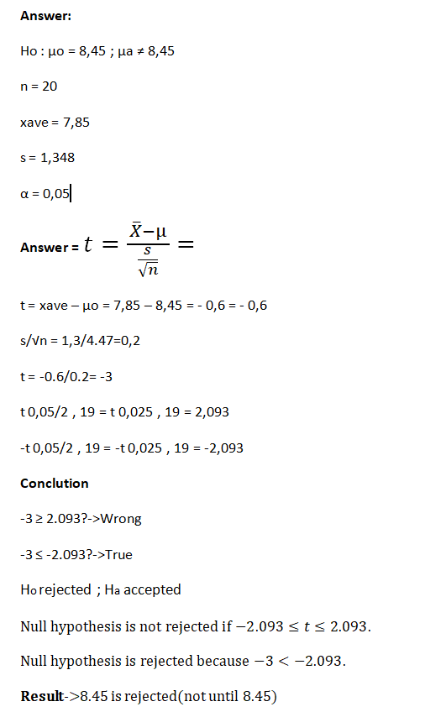
Ttest
[15]
25

Slide 28
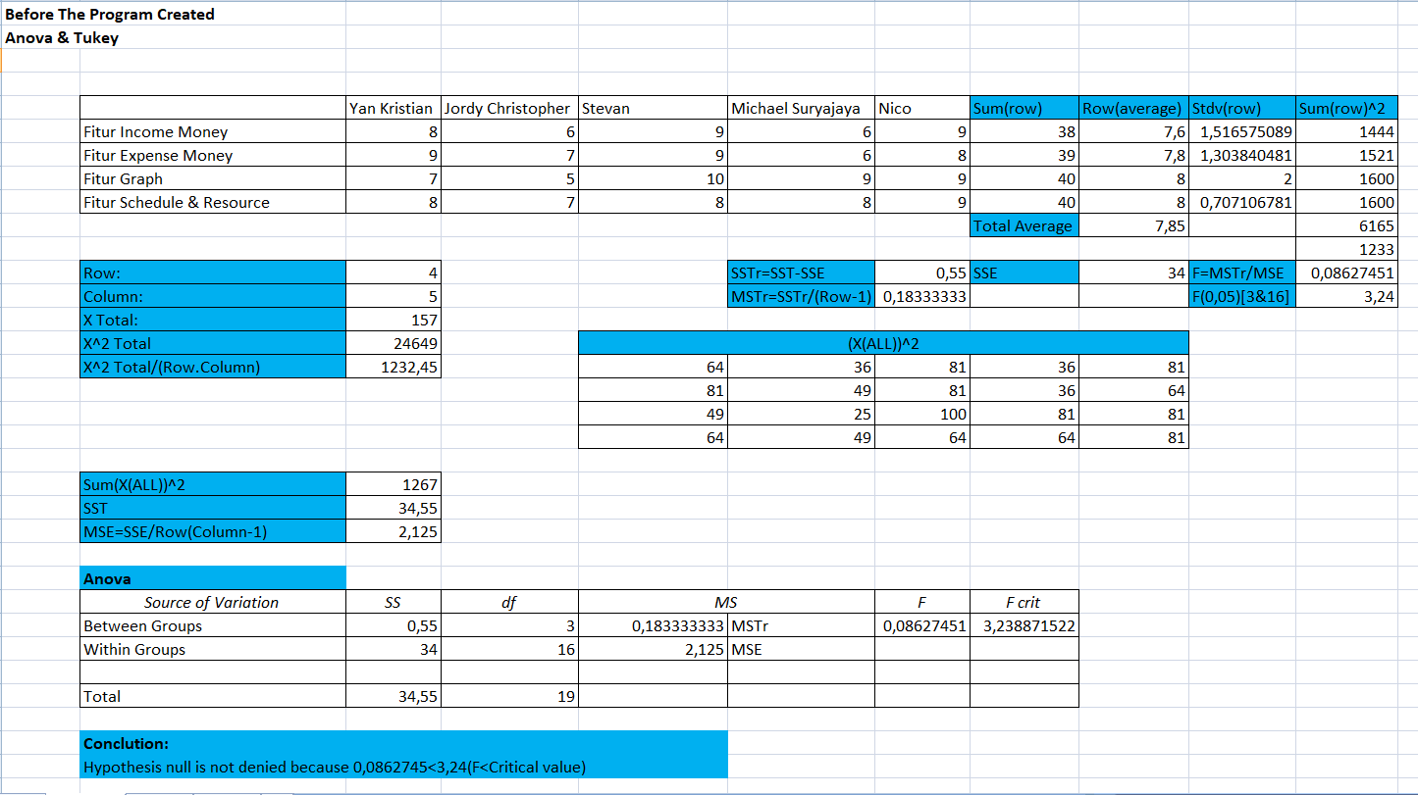
Anova &Tukey Before The Program has been Created
26

Slide 29
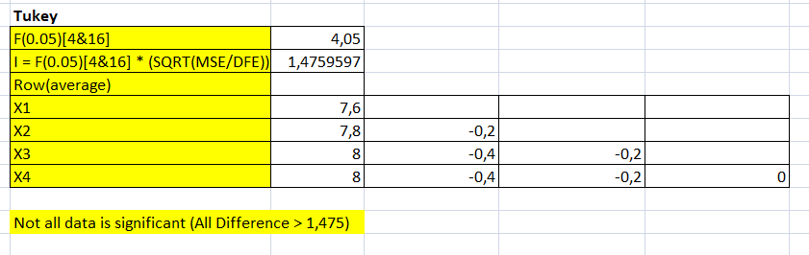
Anova &Tukey Before The Program has been Created
16
27

Slide 30
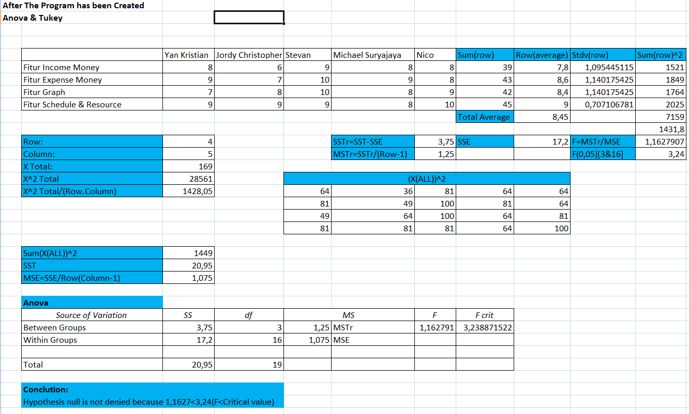
Anova &Tukey After The Program has been Created
28

Slide 31
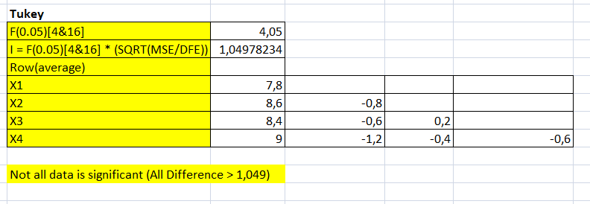
Anova &Tukey After The Program has been Created
29

Slide 32
Github
https://github.com/tyrand3/HCIs
30

Slide 33
Referensi
https://developer.android.com/guide/topics/ui/declaring-layout.html?hl=id
https://developer.android.com/guide/topics/ui/layout/linear.html?hl=id
https://material.io/guidelines/style/color.html
https://material.io/icons/
https://material.io/guidelines/material-design/introduction.html
https://material.io/guidelines/layout/structure.html#
https://material.io/guidelines/usability/accessibility.html#
“Android-er: Customize color for your app, for Material Theme, using Android Studio.” [Online]. Available: http://android-er.blogspot.co.id/2015/09/customize-color-for-your-app-for.html. [Accessed: 03-Dec-2017].
“Android SQLite Database Tutorial using Android Studio | MobileSiri.” [Online]. Available: http://mobilesiri.com/android-sqlite-database-tutorial-using-android-studio/. [Accessed: 03-Dec-2017].
31

Slide 34
Referensi
10. http://www.codebind.com/android-tutorials-and-examples/android-sqlite-tutorial-example/
11. https://www.youtube.com/watch?v=cp2rL3sAFmI&t=572
12. https://www.youtube.com/watch?v=q7ipa6zt4CU&t=1402
13 http://www.android-graphview.org/
14 https://docs.google.com/forms
15 http://www.statisticshowto.com/tables/t-distribution-table/
16 http://sphweb.bumc.bu.edu/otlt/MPH-Modules/BS/R/R4_One-TwoSampleTests-ANOVA/R4_One-TwoSampleTests-ANOVA_print.html
17 www.stat.ncsu.edu/courses/st311/Documents/Tables.pdf
32

Slide 35
Referensi-ScoreBoard
18. https://developer.android.com/guide/topics/ui/look-and-feel/themes.html
19. https://developer.android.com/training/search/search.html
20. https://developer.android.com/reference/android/widget/CalendarView.html
33

Slide 36
Thank You!

