Slide 1
DeFi Synthetic Assets: Systematization of Platforms and Data Insights
Tyler Danno
Imperial College London

Slide 2
Synthetic Assets in DeFi
Allows speculation on price of traditional assets, while remaining in the crypto system
Ease of access
Increased liquidity
Tokenization
Decentralization
Without these platforms users must:
Transfer crypto-assets from wallet to crypto exchange
Trade crypto-asset for spot currency (USD, GBP, etc.)
Request withdrawal to bank account
Wait 2-3 days for withdrawal to process
Deposit spot currency into traditional broker
Finally trade!

Slide 3
Project Contributions
Synthetic Asset Platform Systematization
On-chain Data Analysis
Platform Design Choice Trend Identification

Slide 4
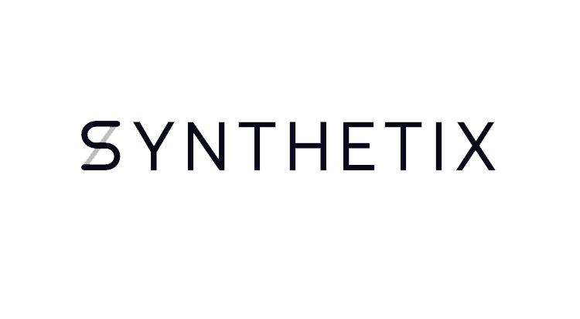

Types of Platforms
Asset Replication
Mostly delta-one assets - track another’s price
Set list of offered assets, amendable through protocol governance
Uses existing oracles for price feeds
Tracks all debt in a singular liquidity pool
Direct Creation
Geared to building assets with highly customizable pay-out functions
Users can design and build their own tokens
Uses their own Data Verification Mechanism to retrieve prices
Separate debt tracking for each different token

Slide 5
Main Mechanisms
Staking and Minting
Burning
Liquidation
Pricing
Rewards

Slide 6


Asset Replication Platforms
Synthetix (2018)
Ethereum
Mirror Protocol (2020)
Terra
Linear Finance (2021)
Ethereum
Binance Smart Chain
Capture >82% of all synthetic asset platform TVL

Slide 7
Staking and Minting
Synthetix C-ratio history:
2020: 800% -> 700% (1 change)
2021: 700% -> 500% (2 changes)
202: 500% -> 300% (2 changes)
Collateral Type
Asset price volatility
Stablecoins vs native tokens
Collateralization Ratio
Set too high - capital efficiency issues
Set too low - stability of platform at risk
 | Synthetix | Mirror | Linear Finance
Collateral Type | SNX, ETH | UST, aUST, LUNA | LINA
Target Ratio | 300% | 150% | 500%
Liq. Threshold | 150% | 150% | 200%

Slide 8
Liquidation
Two types: Auction and Fixed Spread
Flagged protection period/buffer
Time after account is flagged due C-Ratio to dropping under liq. Threshold before liquidation is executed – trend is seeing a decrease in this time
Liquidation profit distribution
Transferring discounted collateral reward directly to liquidators leads to higher risk of cascading liquidations
Distributing rewards amongst other stakers, and giving liquidators a flat reward reduces this risk – more platforms are implementing this rather than the old method
 | Synthetix | Mirror | Linear Finance
Liquidation Type | Fixed Spread | Auction | Fixed Spread

Slide 9
Inverse/Short Implementation
Platform net long/short position matters
All platforms investigated have been net long since inception
Traditional Short
Minted asset sold immediately into stablecoin, locked into contract, then bought back and burned to close position
Ranged Inverse Token
Separate token with entry point, upper limit, lower limit – price frozen at upper and lower limit
Requires “reloading” with new limits every time it is frozen due to effective leverage in pricing model
 | Synthetix | Mirror | Linear Finance
Inverse/Short Impl. | Ranged Inverse | Traditional | Traditional

Slide 10
Example of Ranged Inverse Token Effective Leverage
Entry point: BTC at $5000
Upper limit: $7500
Lower limit: $2500
Price of BTC -> $6500, then price of iBTC -> $3500
From here, if someone buys iBTC, they make a bet that price of BTC will decrease
BTC -> back to $5000, this leads to iBTC also -> $5000
BTC price decrease = 23%
iBTC price increase = 43%
Each $1 in BTC does not lead to a $1 movement in price of iBTC (apart from at entry point), more-so the closer price gets to the upper and lower limits, hence the requirement to “reload” with new limits periodically

Slide 11
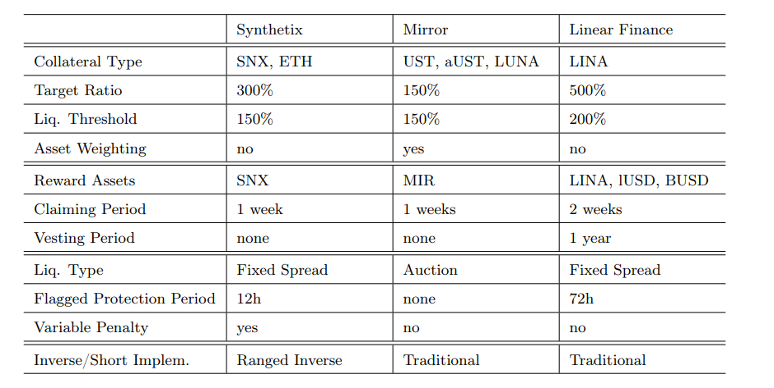
Asset Replication Platform Choices

Slide 12
Asset Replication Trends Identified
Collateralization ratios
C-ratios (both target ratios and liq. thresholds) have been on average decreasing over time
Synthetix went from 800% gradually down to 300% over 4 years
Improved capital efficiency -> greater demand for use of the platform
Liquidation profit distribution
Platforms moving away from crediting discounted collateral directly to liquidators – they tended to sell it immediately, putting further selling pressure on tokens like SNX
Now profits are distributed between other stakers and liquidators receive a flat fee
Liquidation reward escrow period
Many platforms now require up to 1y after liquidation before discounted collateral is released to those receiving the liquidation reward
Again to reduce risk of cascading liquidations

Slide 13
Direct Creation Platforms (UMA)
Customizable pay-out functions for tokens
Uses Data Verification Mechanism (DVM) instead of price feed oracles
Oracles are corruptible
DVM system ensures that Cost of Corruption > Profit from Corruption
Example: uGAS Token
Token allows users exposure to the change in average transaction gas costs
Allows :
Hedging of transaction costs
Pure speculation

Slide 14
Data Verification Mechanism
No running price feed
Prices are determined on request through “disputes”
If one party believes another’s position has become undercollateralized ( as there is no tracked C-ratio), they submit a dispute request
They lock in UMA to do this, and other UMA holders vote on what is the correct price, determining if the position is correctly collateralized
Greatly simplified:
If disputer was correct, they can liquidate some of the position until it is correctly collateralized, claiming the liquidator reward
If incorrect, some of their UMA locked in is taken as a penalty and distributed to the other party
The penalty for people incorrectly marking a position for liquidation reduces risk of malicious actors profiting
Most of UMA’s TVL comes from other platforms using DVM, rather than synthetic tokens created on UMA itself

Slide 15
Demo/Data Insights
Tyler Danno

Slide 16
Data Collection
Using The Graph protocol as a means for data collection
Decentralized blockchain indexing platform
Enables GraphQL querying of transaction data history on different platforms
Issues
Mirror built upon Terra, based a lot of operations around Terra’s stablecoin UST
De-pegged from USD in May 2022, crashed platform, TVL now <99% of peak
Linear GraphQL API is only used for internal project development
Doesn’t provide any historical data

Slide 17
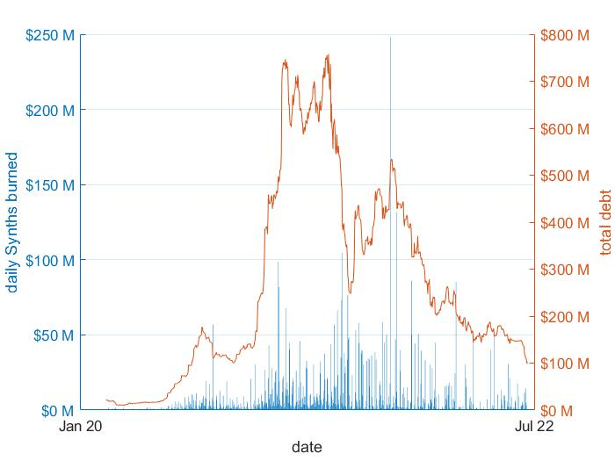
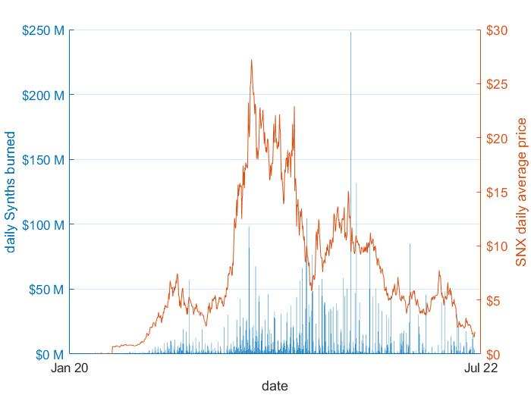
Synthetix Daily Burns
Daily Burned vs Total Debt
Daily Burned vs SNX Price

Slide 18
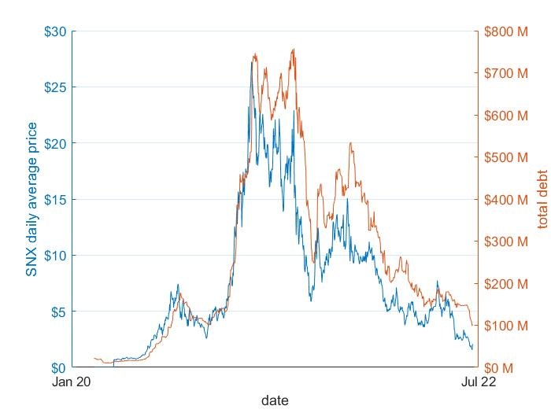
Synthetix Debt
From prev. slide, SNX price and debt are clearly correlated
This graph shows that relationship even better
Why?
Liquidators tend to sell off discounted collateral immediately for profit
Can lead to cascading liquidations
SNX Price vs Total Debt

Slide 19
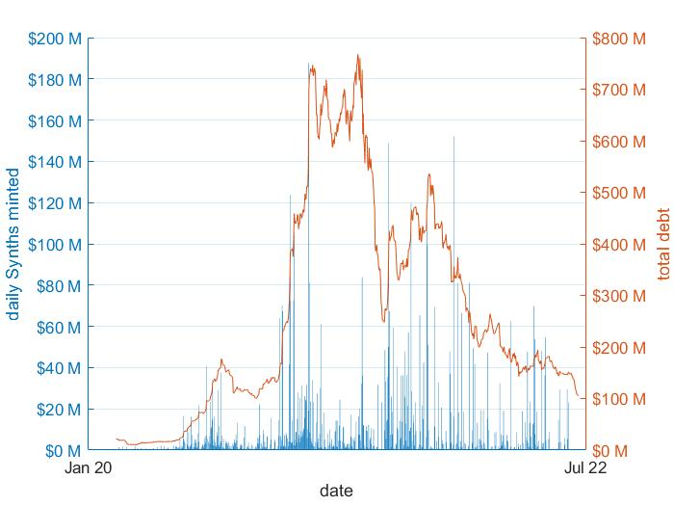
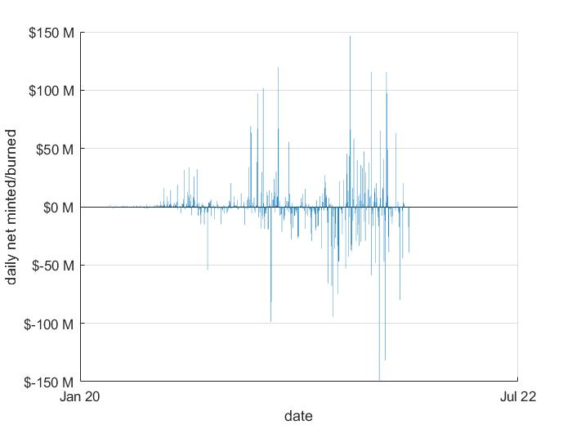
Synthetix Daily Mints
Daily Minted vs Total Debt
Daily Net Mints/Burns

Slide 20
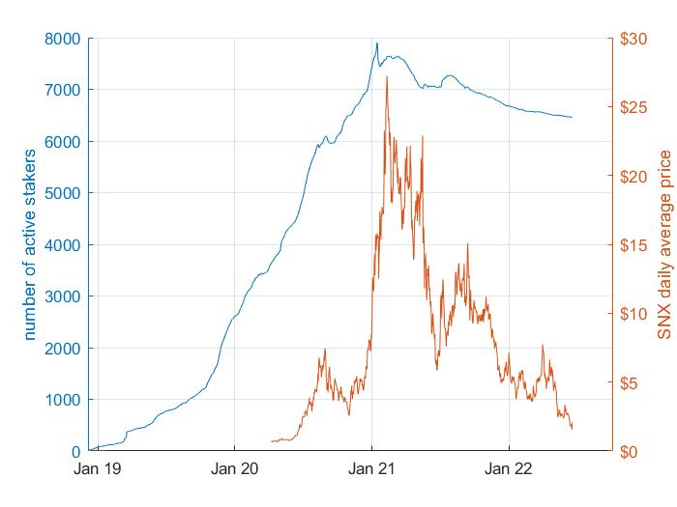
Synthetix ‘Active’ Stakers
Looks to be steadily increasing
Metric resilient to large drops in SNX price
90.1% SNX price decrease
18.2% active stakers decrease
Repeated liquidations may mean that amount staked in many wallets in negligible
Users may not even still realize they have SNX staked

Slide 21
UMA Data
Very different types of tokens (all customized for their specific purpose)
No comparable metrics like C-ratio, collateral type allowed – different for every token
Possible to look at the distribution of TVL across different types of products offered by UMA:
Key Performance Indicator (KPI) Options
Success Tokens
Range Tokens
Call/Put Options
Long Short Pair (LSP) Tokens
Integrations (external platforms using the DVM)

Slide 22
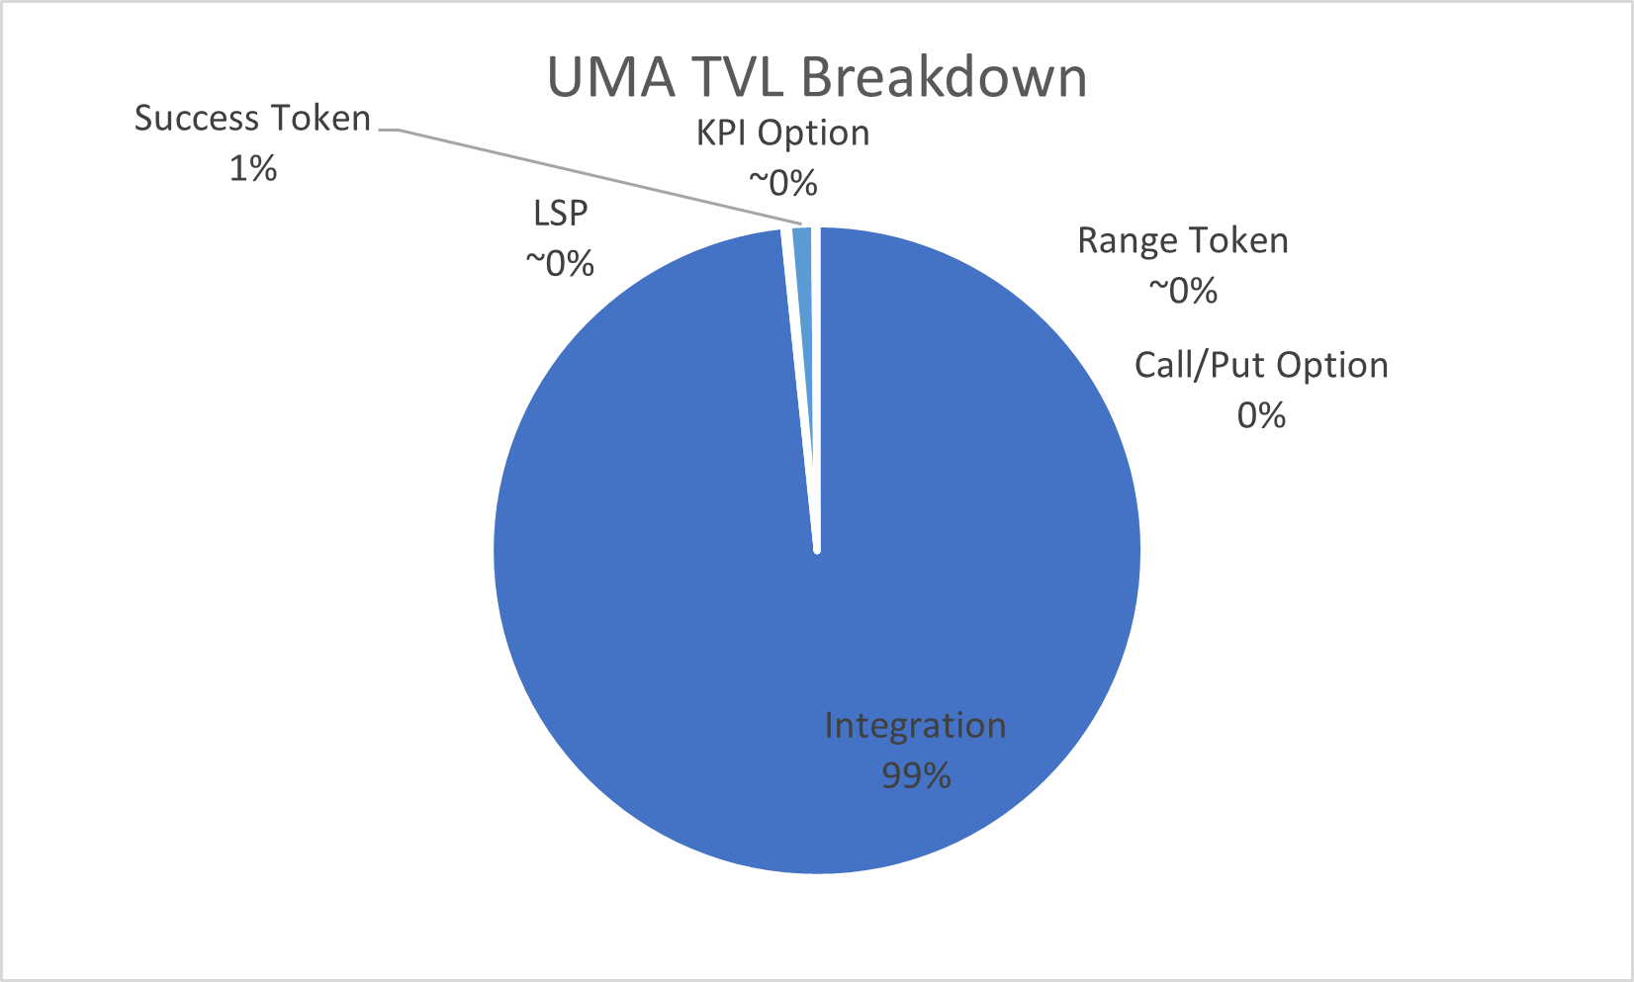
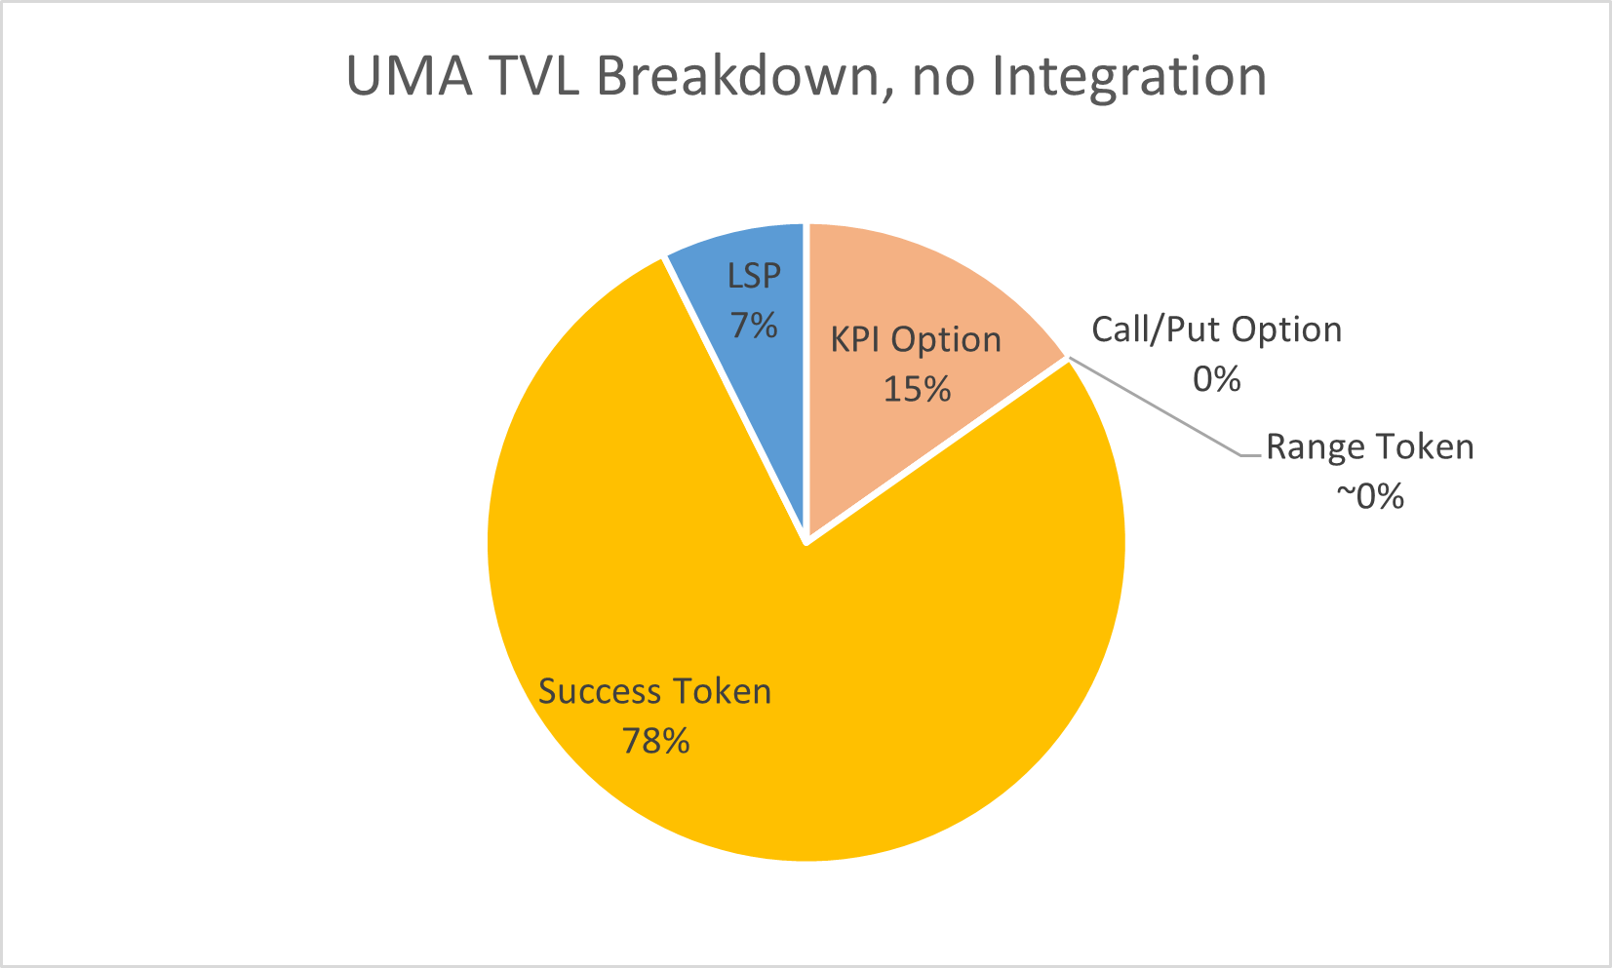
UMA Total Value Locked (TVL)
UMA TVL incl. Integrations
UMA TVL excl. Integrations
Integrations make up for over 99% of the total $76.4M for UMA
Many tokens have expiry dates, so past distributions between products have been very different

Slide 23
Thank you!

