Slide 1
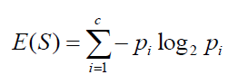
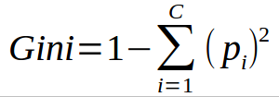

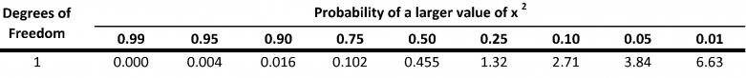
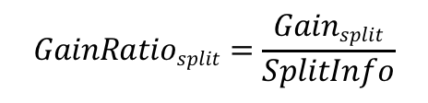
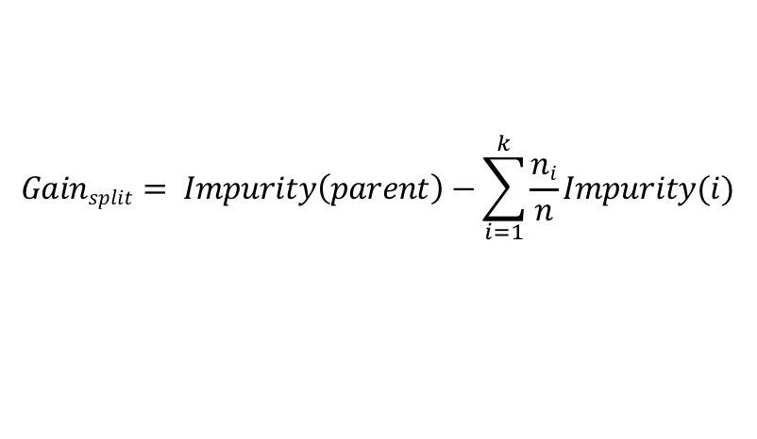
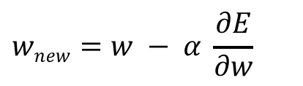
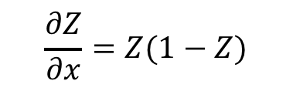
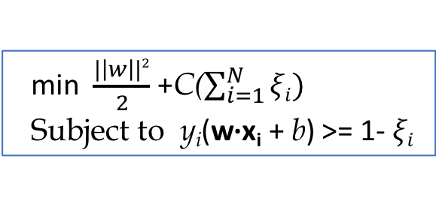
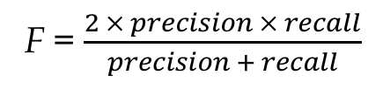
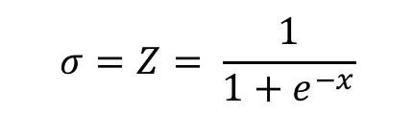
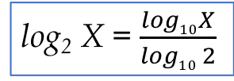
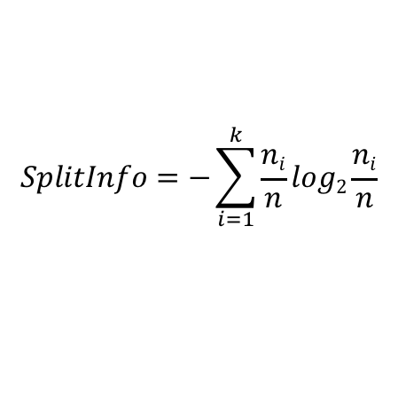
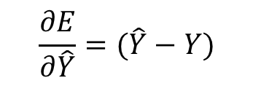
log₂ X = $\frac{log10X}{log10 2}$
$$wnew=w − α \frac{∂E}{∂w}$$
Entropy
Where c is the number of classes;
p_{i} is the fraction of records belonging
to class i;
and 0 log2 0 = 0 in entropy calculations
E =
$$\frac{∂E}{∂\hat{Y}}=(\hat{Y}−Y)$$
$$Gainsplit= Impurity\left(parent\right)−\sum_{i=1}^{k}{\frac{ni}{n}Impurity(i)}$$
$$GainRatiosplit=\frac{Gainsplit}{SplitInfo}$$
$$σ=Z= \frac{1}{1+e^{−x}}$$
$$SplitInfo=−\sum_{i=1}^{k}{\frac{ni}{n}log2\frac{ni}{n}}$$
Where k is the number of splits
and n_{i} is the number of records in partition i
$$\frac{∂Z}{∂x}=Z(1−Z)$$
F = $\frac{2 × precision × recall}{precision + recall}$
all classes i,
children j
min $\frac{|\left|w\right||2}{2}$ +C($\sum_{i=1}^{N}{ξi)}$
Subject to y_{i}(w∙x_{i} + b) >= 1- $ξi$
Where O is observed count, and E is expected count

