Slide 1
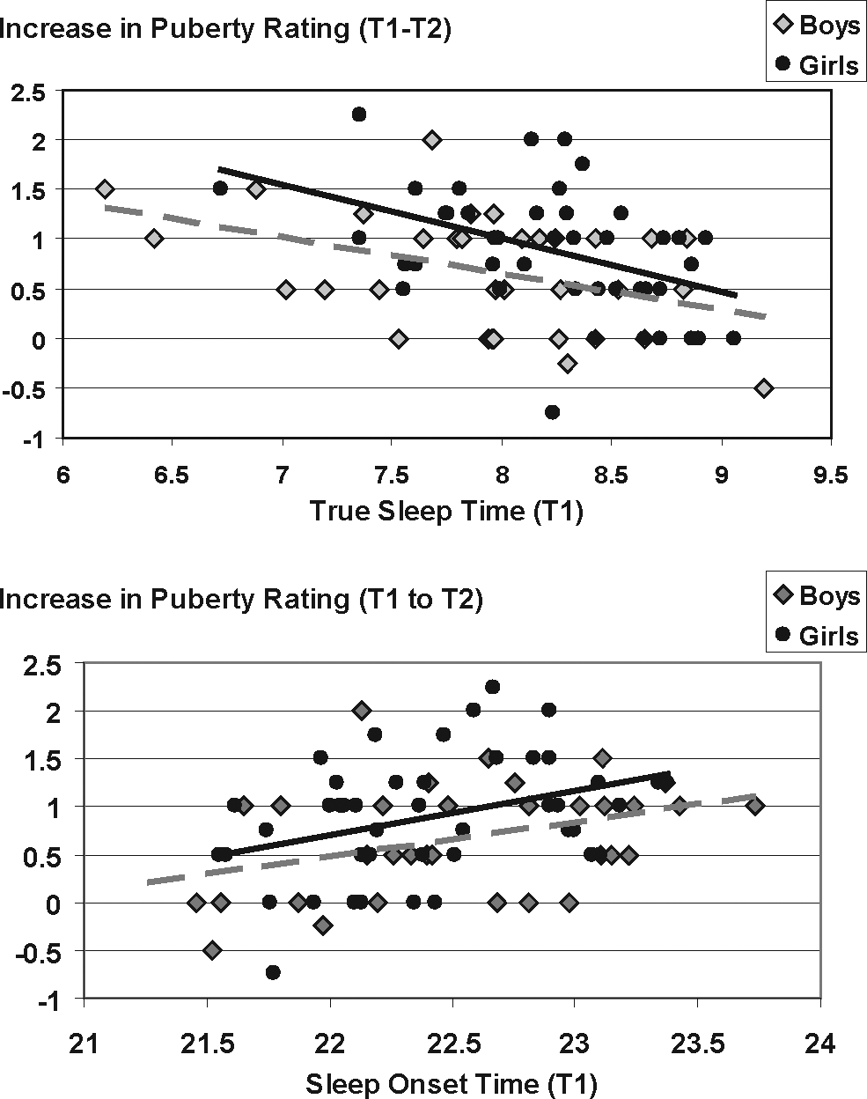

Figure 3 Correlations between sleep measures (sleep onset time and true sleep time) at Time 1 and the increase from ...
Notes:
Figure 3 Correlations between sleep measures (sleep onset time and true sleep time) at Time 1 and the increase from Time1 to Time 2 in puberty rating on the SMS. Regression lines are plotted in black for girls and in broken gray line for boys. No significant sex differences were found.
Unless provided in the caption above, the following copyright applies to the content of this slide:

