Slide 1
Binary Trees
TRUONG THI NGOC PHUONG

Slide 2
Content
Introduction
General trees & binary trees
Binary search trees (BST)
Operations on BST (Conceptual)
Find
Traverse
Insert
Delete

Slide 3
Introduction
Trees are one of the fundamental data structures
Many real-world phenomena cannot be represented in the data structures we’ve had so far

Slide 4
Array & Linked List
Array
Easy to search
O(log2n) – Binary search
Slow Insertion & Deletion
Linked List
Easy to insert, delete
But slow in searching, deleting the given item, …

Slide 5
Trees
Is a data structure with
Quick Insertion
Quick Deletion
Quick Searching
→ Interesting data structures

Slide 6
What is a Tree?
A tree consists of
Nodes & Edges
Nodes
Edges

Slide 7
Trees as tool
Describe relationships between students in class
Student
Relationship

Slide 8
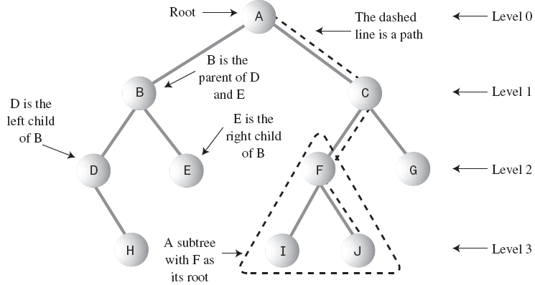
Trees terminology
Path, Root, Parent, Child, Leaf, Subtree, Visiting, Traversing, Levels, Keys

Slide 9
Properties of Trees
Have one and only one Root
One and only one Path from root to any other node
→ Only one parent
→ No circles
Example
File hierarchy

Slide 10
Binary tree
Is a tree and
every node have at most two children
Binary tree Not a binary tree

Slide 11
Binary search tree (BST)
Properties
Node’s left child:
Key < Key of Parent
Node’s right child:
Key >= Key of Parent
5
3
7
2
4
9

Slide 12
How Do BST Work?
Need to carry out basic tree operations such as
finding a node,
traversing a tree,
adding a node,
deleting a node, etc.
This is what this chapter is all about

Slide 13
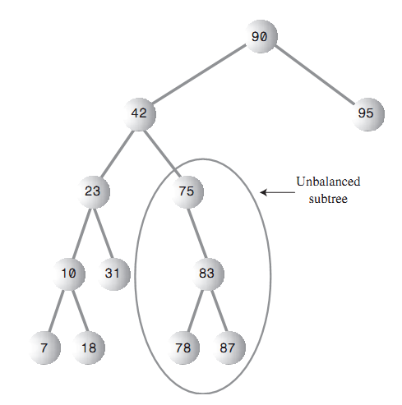
Unbalanced tree

Slide 14
Unbalanced tree
Is when nodes are mostly in one side
Is the result of the way they are created
Prefer balanced tree

Slide 15
Operations on BST
Conceptual algorithms

Slide 16
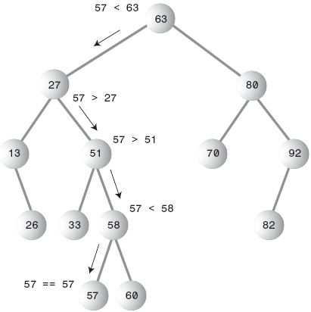
Finding

Slide 17
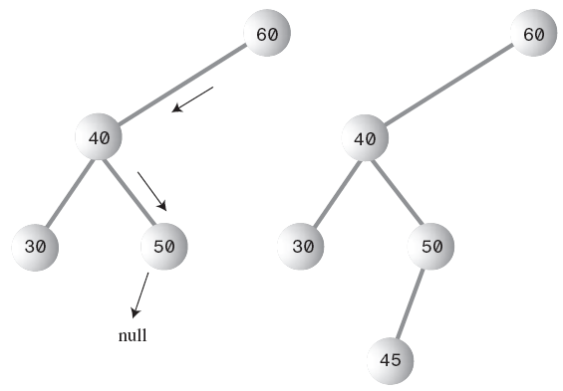
Insert 45 into the tree

Slide 18
Insertion
Unless we run out of memory, we always found the place to insert
Can handle duplication by modifying the search condition.

Slide 19
Traversing
Visit all nodes of the tree
3 ways to traverse a tree
Preorder
Inorder
Postorder
Inorder traversing
Traverse the node’s left subtree
Visit the node
Traverse the node’s right subtree

Slide 20
Traverse the tree
10
5
20

Slide 21
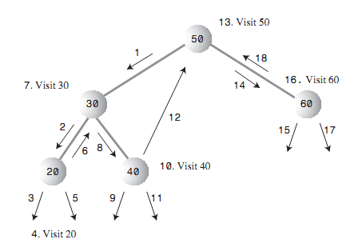
Traverse the tree

Slide 22
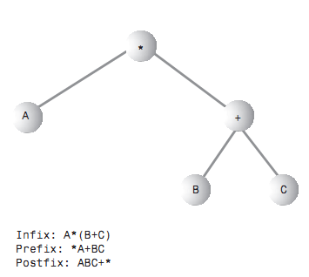
Algebraic expression

Slide 23
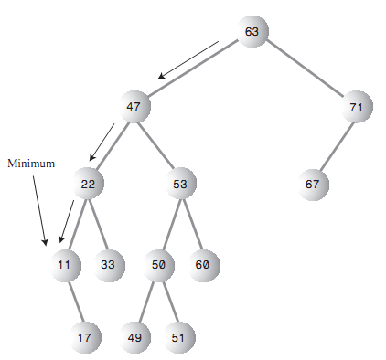
Find max & min

Slide 24
Deleting a Node
Most complicated operation
3 main cases
Node to be deleted is a leaf
Node to be deleted has one child
Node to be deleted has two children

Slide 25
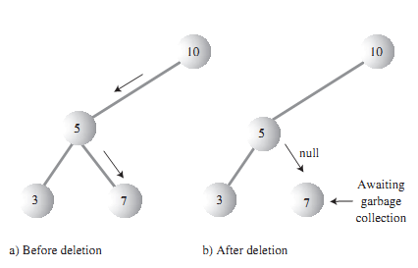
Case 1: Node has no children

Slide 26
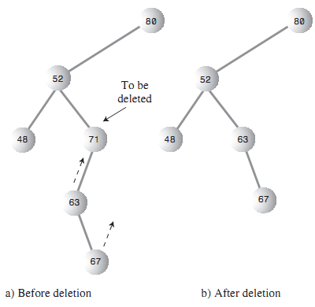
Case2: Node has one child
Notes:
Have 4 variations:
Node to be deleted (X)
is leftchild/rightchild
has leftchild/rightchild

Slide 27
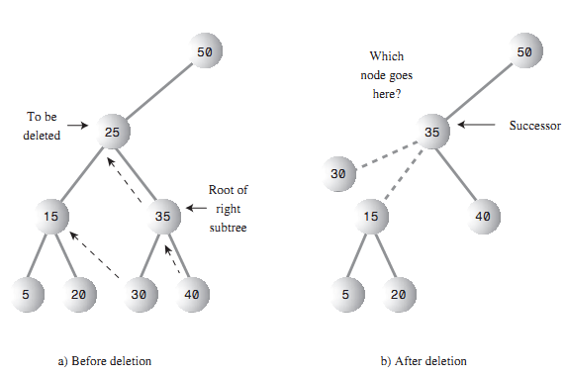
Case 3: Node has two children

Slide 28
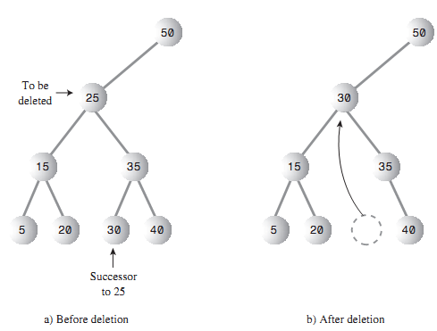
Case 3: Node has two children

Slide 29
Find the successor
Successor:
The smallest of the set of nodes that are larger than the given node

Slide 30
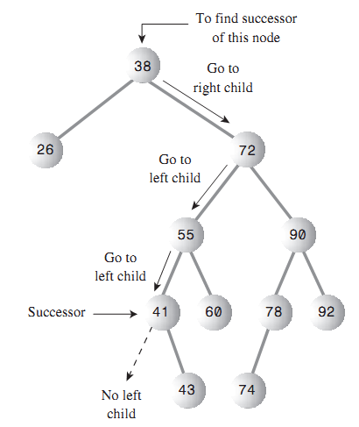
Find successor

Slide 31
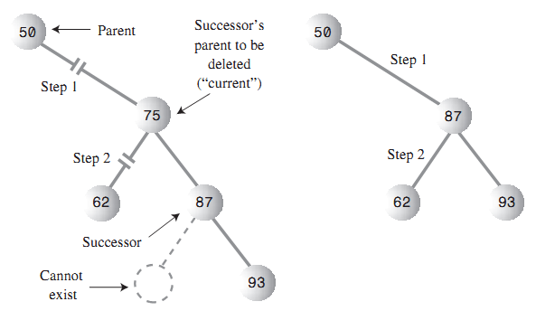
Case 3.1: Successor is the right child of delNode

Slide 32
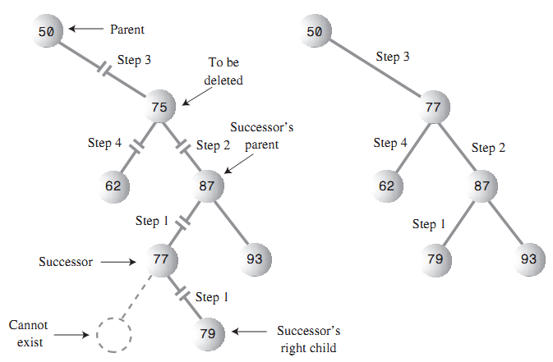
Case 3.2: Successor is left descendant of right child

Slide 33
Implementation of BST

Slide 34
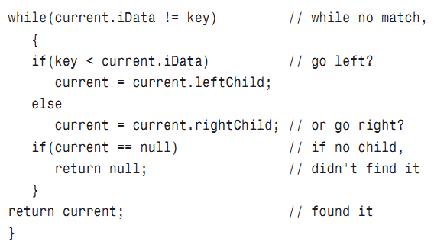
Find a node

Slide 35
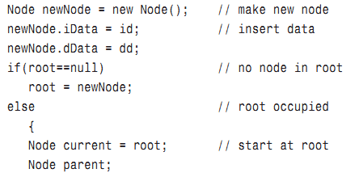
Insert a node

Slide 36
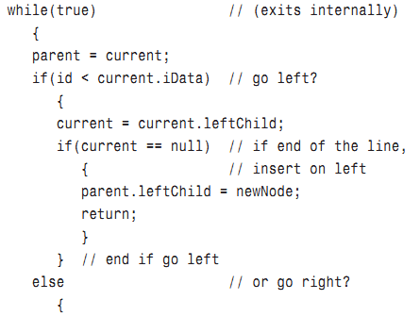
Insert a node (cont.)

Slide 37
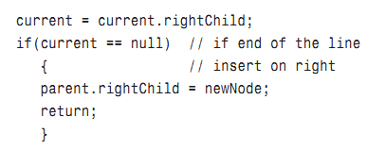
Insert a node (cont.)
Homework:
Handle the duplication when insert a new node
See page 380-381 for full code of insertion.

Slide 38
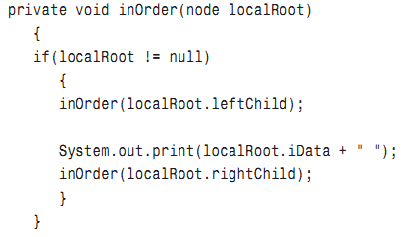
Traverse

Slide 39
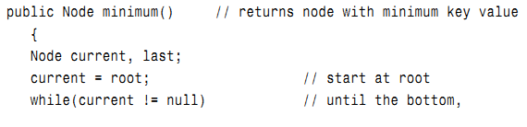
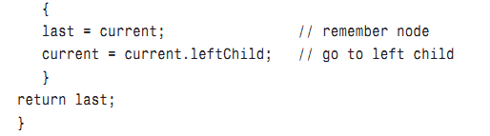
Find min
Homework: Write the find max function

Slide 40
Deletion
Homework:
Read code from 406-415

Slide 41
Huffman Code
Read &
Implement Huffman Code (if possible)

Slide 42
Red-Black tree, 2-3-4 tree
Read yourself

