Slide 1
WEEK EIGHT: Profit! Class 15 & 16
Income Statement and the Statement of Changes in Equity
Income by Nature and by Function
Standard lines from Revenue to Earnings
Just as the Statement of Cash Flow rearranged the Cash Ledger
… the Statement of Changes in Equity rearranges the Equity Ledger
… and the main change in Equity is analyzed in the Income Statement

Slide 2
Statements fit together
Opening Balance Sheet
Closing Balance Sheet
Cash
Cash Flow Statement
Cash
Income Statement
Revenue & gains
_
Expenses & losses
=
Income
Equity
New equity + - dividends
Equity
Statement of Changes in Equity
Notes:
Other changes in equity include raising new equity or paying out dividends or buying back shares.

Slide 3
Income, Transactions with owners, Other
Income increases Equity
Issuing shares increases Equity. Buying back shares or paying dividends reduces Equity
IAS1 allows Income and ‘Other Comprehensive Income’ as one or two Statements
Income is Revenue (& Gains) minus Expenses (& Losses). The Income Statement is often called the Profit and Loss Account (P&L). Income increases Equity if positive (a profit) and reduces Equity if negative.
Transactions with owners also affect Equity. Firms issue shares when formed, increasing Equity. Issuing more shares later also increasing Equity. They can buy back their own shares, reducing Equity. Dividends also reduce Equity.
Other Comprehensive Income includes: revaluation gain and losses, changes in the fair value of available-for-sale financial assets, exchange differences on translation of foreign operations, share of other comprehensive income of associates … less income tax relating to these items.

Slide 4
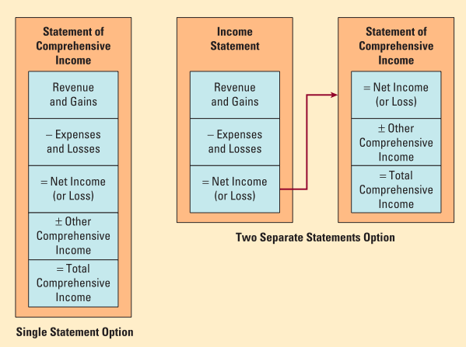
Other Comprehensive Income
One Statement
… or Two
Notes:
IAS 1 requires an entity to present all items of income and expense recognized in a period:
A) in either a single statement of comprehensive income; or B) in two statements: (1) an income statement and (2) a statement of comprehensive
income that starts with the profit or loss from the income statement and continues with other comprehensive income to arrive at total comprehensive income

Slide 5
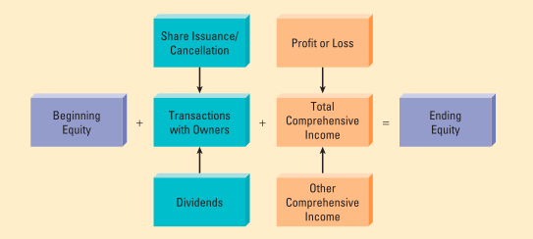
Statement of Changes in Equity
Transactions … and Income
with Owners
Notes:
The statement of changes in equity reconciles the movement in total equity, from the beginning to the end of its financial period. The changes may come from transactions with owners (in their capacity as shareholders) such as additional capital contribution, capital withdrawals (or share buyback and cancellation), and dividend payments. Another reason why equity would change from one period to another is, of course, the resulting total comprehensive income (or loss) for the period.

Slide 6
Income statement
Categorised by nature to understand specific business
Categorised by function to understand general business
Standard lines have acronyms: GP, EBITDA, OP, PBT, PAT, EPS
Operating costs can simply be categorised by nature – airlines could report staff, fuel, aircraft maintenance, etc.– to understand specific business, help forecast
Operating costs can be by functions – cost of goods sold (CoGS); selling, general & administrative (SG&A) expense; research and development (R&D) expense; other expenses – to understand general business, compare firms in different industries
Can have lines for: gross profit (GP); Earning before interest tax, depreciation & amortisation (EBITDA) though not defined in IFRS; operating profit (OP); profit before tax (PBT); profit after tax (PAT); net income (Earnings); earnings per share (EPS)
Notes:
Main decision is

Slide 7
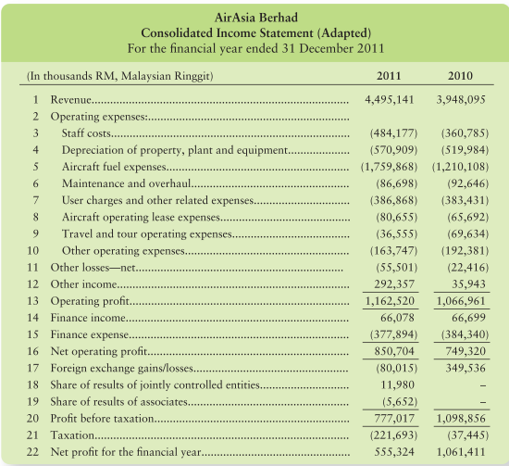
Income ... by nature
Revenue
Add back D&A
specific to
| airlines |
EBITDA
OP
PBT
Earnings
Notes:
Main decision is

Slide 8
Earnings Before Interest, Tax, Depreciation & Amortisation (EBITDA)
Operating Profit is before Interest & Tax but after Depreciation & Amoritization
Non-IFRS: EBITDA is not standardised for external use by investors and creditors
Achieved early: Revenue comes first, then EBITDA, then Operating Profit, etc.
EBITDA is not standardised under IFRS. Although there are common practices in calculating EBITDA, such as taking Operating Profit and adding back Depreciation and Amortisation, but there is some room for interpretation. Less reliable but often used.
New firms raise Equity, launch and grow Revenues, achieve EBITDA, then operating profit (and Operating Cash Flow), then Income, then pay Dividends
EBITDA positive is seen as an important achievement and EV/EBITDA is used to value many start-ups that achieved EBITDA positive but not yet Income or Dividends

Slide 9
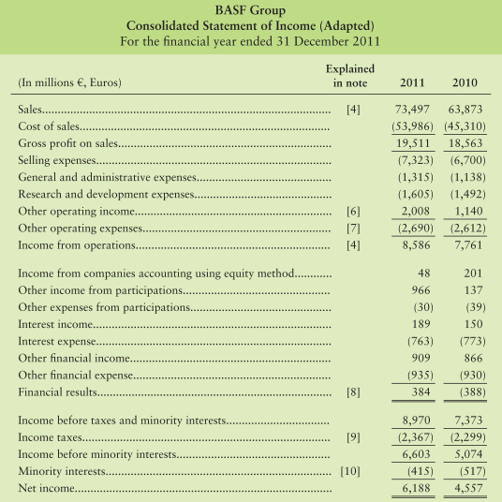
Income ... by function
Revenue
GP
OP
PBT
PAT
Earnings

Slide 10
Below EBITDA
Depreciation and amortisation are non-cash but affect operating profit
Interest and associates affect profit before tax
Taxes affect PAT and non-controlling interests affect net income (earnings)
We saw that capital expenditure affects investing cash flow but not income. It then affects operating profit, but not operating cash flow via depreciation and amortisation.
Interest reduces profit before tax (PBT). Our share of Associate profits (or losses) also affect PBT.
Taxes are only on profits. Sales taxes are already deducted from sales and employment taxes, property taxes, etc. are included in expenses. Deduct to get profit after tax (PAT).
Non-controlling interests are where we do not own 100% of our subsidiaries, whose profits are shared with minority owners of the subsidiary. Leaves net income (Earnings), divide by number of shares to give Earnings per share (EPS).
Notes:
Non-Controlling Interests used to be called minorities to distinguish them from majority shareholders. However, control an majority are not the same.

Slide 11
Standard lines
Revenue
EV/Sales
Cost of Goods Sold
Gross profit
Gross profit margin
SG&A, R&D, etc.
EBITDA
EBITDA margin
EV/EBITDA
D&A
Operating profit
Operating margin
EV/OP
Interest, associates
Profit before tax
Taxes
Profit after tax
Minorities
Income (earnings)
Earnings per share
Price/Earnings
Notes:
Note that expenses above D&A (CoS, SG&A, R&D etc.) should exclude D&A allocations to avoid double counting.

Slide 12
Exceptional Items
IAS1 defines Gains and Losses but not Exceptional / significant / unusual items but …
Exceptional items though should be material and unusual or infrequent events
Investors and creditors choose whether to include or exclude them from analysis
Gains are not from ordinary business (e.g. gain on disposal). Exceptional items should be significant enough to need to be identified in the Notes. Firms may additionally report income adjusted to exclude gains and losses, exceptional items, etc.
It is useful to disclose unusual or infrequent events so performance trends are visible. Where exceptional, significant, or unusual items are disclosed, a policy note should define the term. Presentation and definition must be consistent from year to year.
Investors and creditors may choose to exclude non-recurring events from analysis. For example, a gain on sale of a particular subsidiary can only be achieved once. They may choose to exclude random seeming effects, e.g. exchange rate gains and losses.

Slide 13
Simulation
Notes:
Note that expenses above D&A (CoS, SG&A, R&D etc.) should exclude D&A allocations to avoid double counting.

Slide 14
Common size
Notes:
Note that expenses above D&A (CoS, SG&A, R&D etc.) should exclude D&A allocations to avoid double counting.

Slide 15
Industry examples
Retail: high CoGS, SG&A => low margins
Industry: high CoGS, SG&A + R&D + other => low margins
Tech giant: why are margins high?
Notes:
Note that expenses above D&A (CoS, SG&A, R&D etc.) should exclude D&A allocations to avoid double counting.

Slide 16
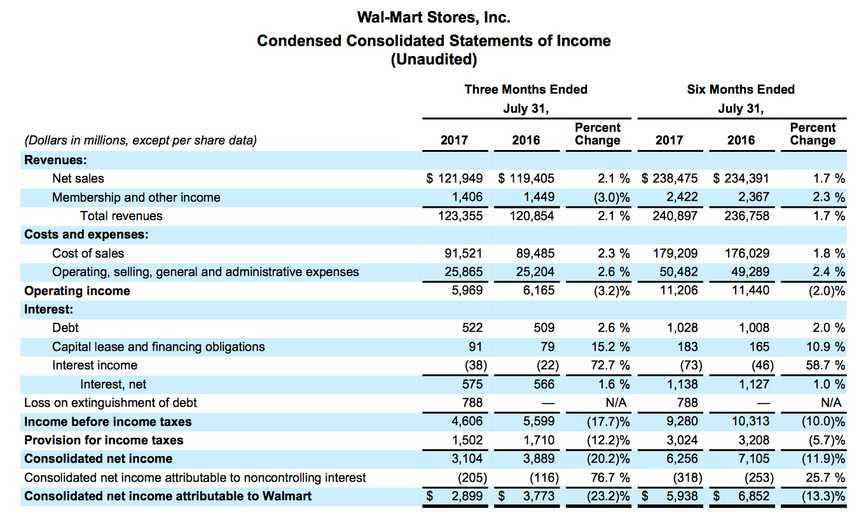
Industry examples
Notes:
Note that expenses above D&A (CoS, SG&A, R&D etc.) should exclude D&A allocations to avoid double counting.

Slide 17
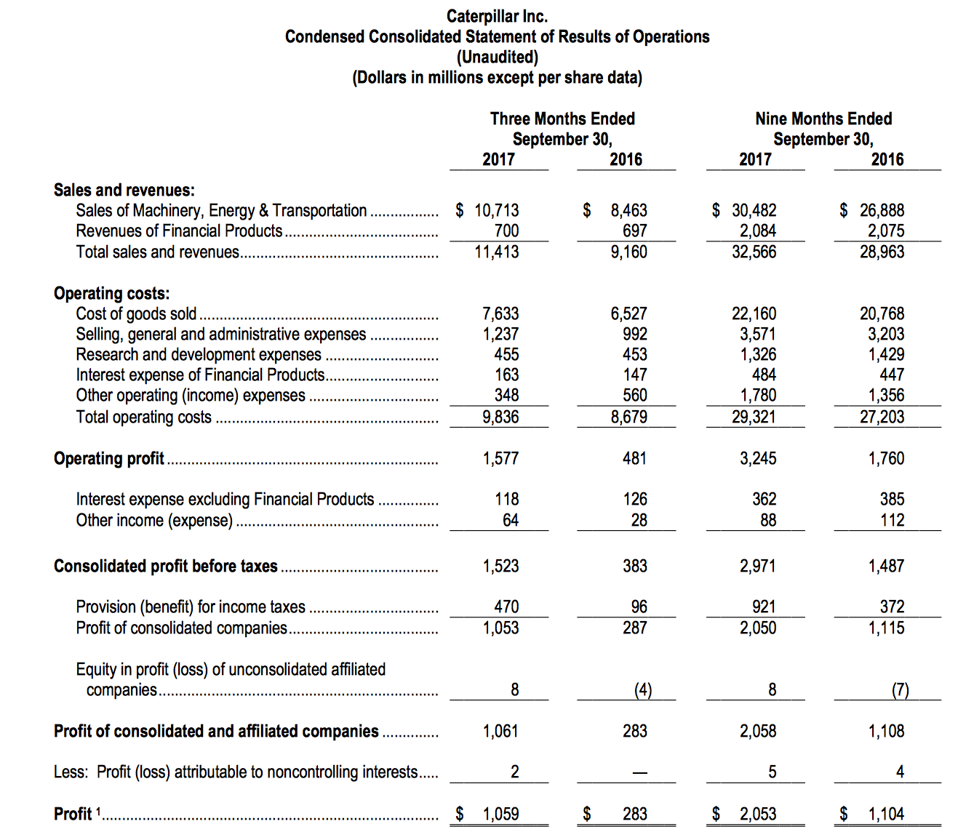
Industry examples
Notes:
Note that expenses above D&A (CoS, SG&A, R&D etc.) should exclude D&A allocations to avoid double counting.

Slide 18
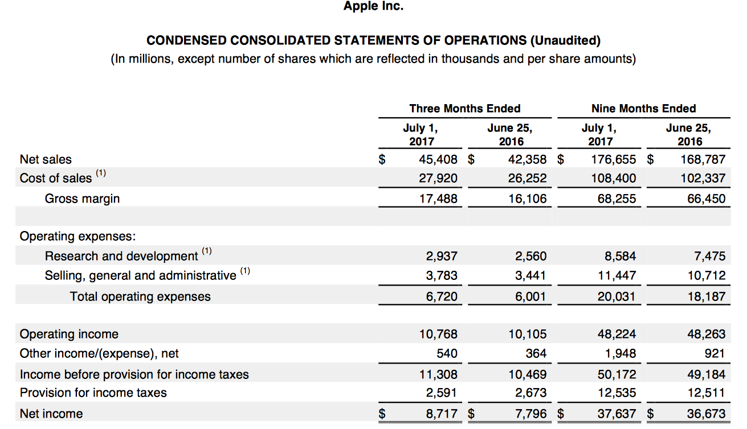
Industry examples
Notes:
Note that expenses above D&A (CoS, SG&A, R&D etc.) should exclude D&A allocations to avoid double counting.

Slide 19
Complete set of Financial Statements
Statement of Financial Position (Balance Sheet)
Statement of Income (P&L) / Comprehensive Income
Statement of Changes in Equity
Statement of Cash Flows
Notes to the Accounts
Notes:
According to the general presentation requirements, a complete set of financial statements a statement of financial position as at the end of the period; a statement of comprehensive income for the period; a statement of changes in equity for the period; a statement of cash flows for the period; and notes.
Entities are allowed to use alternative names for the financial statements.
These financial statements must be displayed with equal prominence.

Slide 20
Case study: Profit!
Rearrange Expenses and other Equity Ledger items into the Income Statement and Statement of Changes of Equity (Week 8: O45:O69)
Draw 2 profit opportunity cards and 1 hazard card
Study the resulting charts and start to prepare for your group presentation

