Slide 1
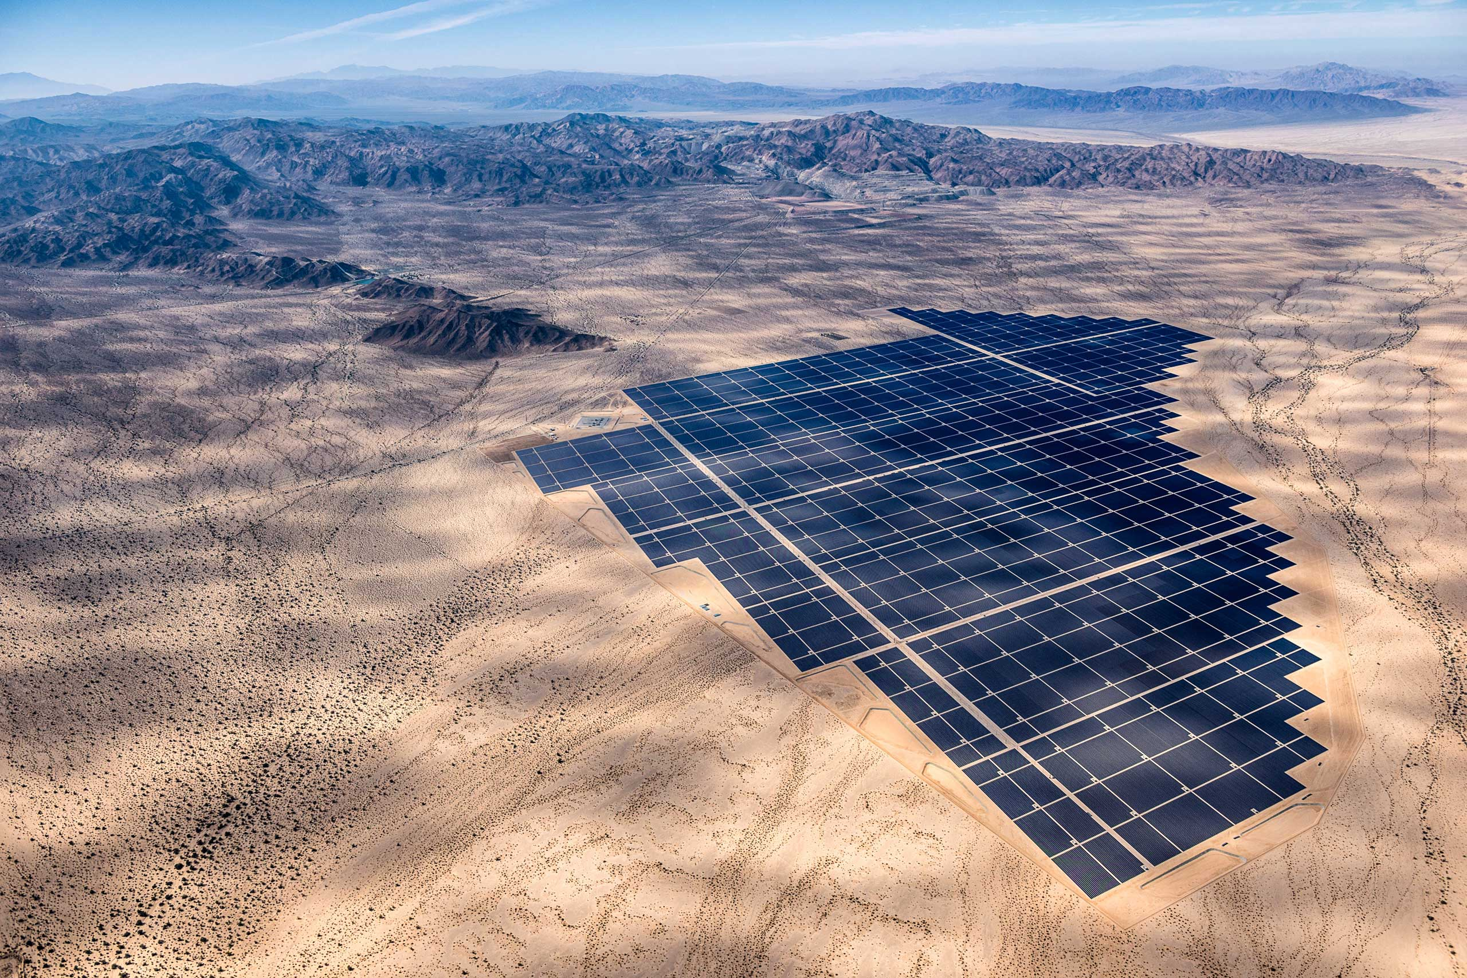
Transenergy
The Future of Electric Infrastructure
Notes:
Accelerate local economy

Slide 2
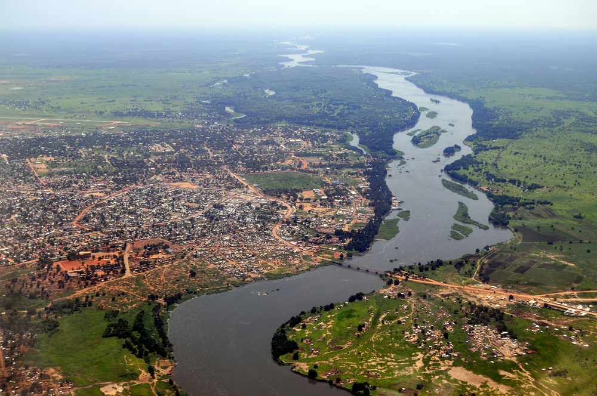
Sustainable Solar Powered transporting Systems (SPTS)
Transenergy

Slide 3
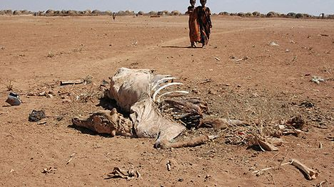
Why hasn’t it happened?
Upfront investment costs - feasibility
Difficulty accessing information
Difficulty maintaining inputs

Slide 4
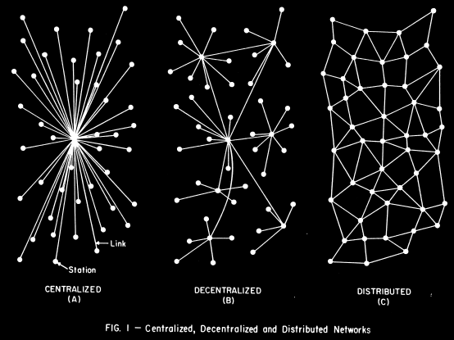

Slide 5

The Transenergy Process
1. Locate communities who are in relative proximity
2. Lease and manage SPT systems
3. Educate local communities

Slide 6
The Transenergy Process
4. Buy produce directly from communities
5. Sell produce to the international market
6. Use profit to scale

