Slide 1

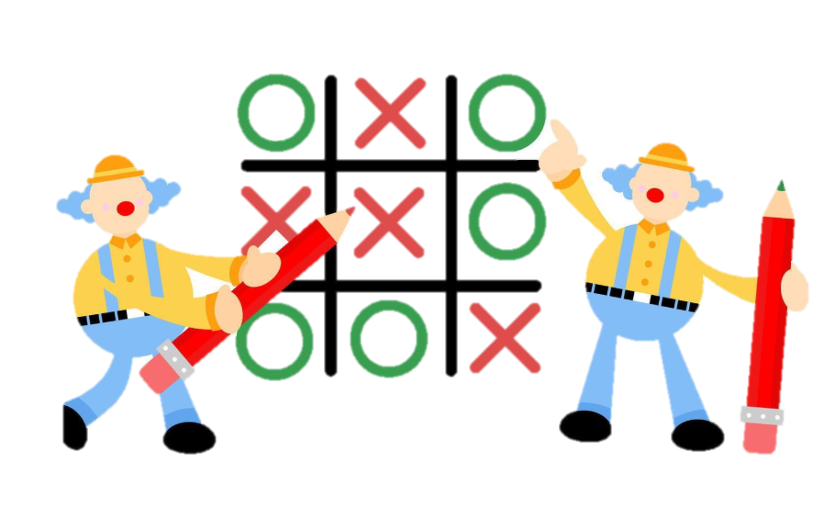
TicTacx
Course Code: CSE115.4
Group: 2
Project Description: Developing a console-based version of the classic Tic-Tac-Toe game where two players can compete against each other.

Slide 2


What we built:
Classic 3x3 Tic-Tac-Toe game in C
CLI-based interface, fully playable

Slide 3

Code Structure:
main.c : Controls flow
game.c :
Logic+Turn management
board.c :
Display+ update

Slide 4


Game Flow:
Menu
Draw or Win →Replay Option
Input
Validation
Uses clear+ ANSI for clean updates
Update
Result

Slide 5

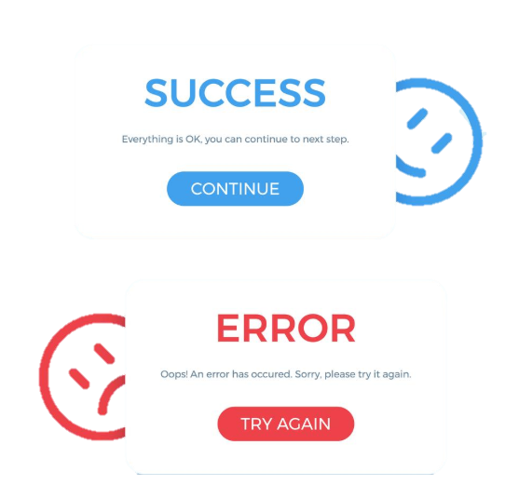
Error Handling & UX
Invalid Input Handling
If a user enters a non-integer or an invalid move (such as an already filled cell), the program displays a clear error message and prompts the user to try again.
scanf() handled both int and string input to avoid buffer issues.
Responsive CLI Design
Clean, minimal interface with neat formatting.
Makes it easy to view the board even in a basic
terminal.

Slide 6
Key Challenges:

Slide 7
Future Plan

Slide 8
GitHub Report Link

