Slide 1

CSE 115.4 | Group 4
TicTacX
TicTacX
CSE115.4 | Group 4
Classic TicTacToe Game
Presented by
Avishek Dutta • Md. Ishrak Mashroor • Ashab Mahmud Raseen • Sneha Nandy

Slide 2
CSE 115.4 | Group 4
TicTacX
DESCRIPTION
Project Description: Developing a console-based version of the classic Tic-Tac-Toe game where two players can compete against each other.
Presented by
Avishek Dutta • Md. Ishrak Mashroor • Ashab Mahmud Raseen • Sneha Nandy

Slide 3
CSE 115.4 | Group 4
TicTacX
INTRODUCTION
Course Instructor: Mohammad Shifat-E-Rabbi
Avishek Dutta (Lead) – 2524093042
Md Ishrak Mashroor – 2524709042
Ashab Mahmud Raseen – 2524767042
Sneha Nandy – 2524508042
Presented by
Avishek Dutta • Md. Ishrak Mashroor • Ashab Mahmud Raseen • Sneha Nandy

Slide 4
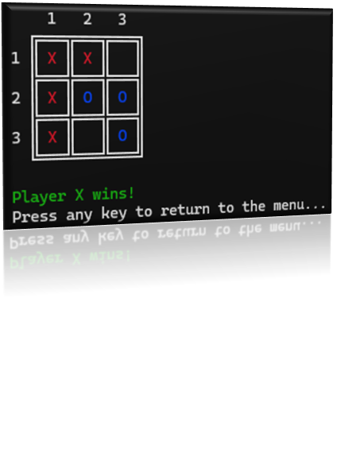
CSE 115.4 | Group 4
TicTacX
WHAT WE BUILT
Classic Tic-Tac-Toe game in the C programming language.
CLI-based interface, modern UI/UX. Fully playable and interactive.
Presented by
Avishek Dutta • Md. Ishrak Mashroor • Ashab Mahmud Raseen • Sneha Nandy

Slide 5
CSE 115.4 | Group 4
TicTacX
GAME MODES
Multiplayer Mode: Two players can play against each other.
2. AI Mode: One player can play against a computer opponent.
Presented by
Avishek Dutta • Md. Ishrak Mashroor • Ashab Mahmud Raseen • Sneha Nandy

Slide 6
CSE 115.4 | Group 4
TicTacX
FEATURES
Player vs Player and Player vs AI Modes
AI (Easy Level) for solo play
CLI Interface with color (ANSI escape codes)
Replay without restarting the app
Valid input checking & clear error messages
Instructions & About sections
Cross-platform compatibility (Windows, Linux, macOS)
t
Presented by
Avishek Dutta • Md. Ishrak Mashroor • Ashab Mahmud Raseen • Sneha Nandy

Slide 7
CSE 115.4 | Group 4
TicTacX
CODE STRUCTURE
Makefile
- Automated compilation
.h files
- Header files
README.md
- Docs
main.c
- Controls flow
support/game.c
- Logic + turn management
support/board.c
- Display + update
Presented by
Avishek Dutta • Md. Ishrak Mashroor • Ashab Mahmud Raseen • Sneha Nandy

Slide 8
CSE 115.4 | Group 4
TicTacX
GAME FLOW
Menu
Input
Validation
Update
Result
Draw or Win
-> Replay Option
Uses Clear + ANSI + Unicode for clean updates and display
Presented by
Avishek Dutta • Md. Ishrak Mashroor • Ashab Mahmud Raseen • Sneha Nandy

Slide 9
CSE 115.4 | Group 4
TicTacX
UI/UX
Clean 3x3 Grid
Display using text
Colors using
ANSI Escape Codes
Turn-based prompts (“Enter row and column: ”)
Clear screen on transitions using clear() function
Invalid move?
Shows message & asks again
Menu navigation with simple number input
Presented by
Avishek Dutta • Md. Ishrak Mashroor • Ashab Mahmud Raseen • Sneha Nandy

Slide 10
CSE 115.4 | Group 4
TicTacX
GAME LOGIC
Presented by
Avishek Dutta • Md. Ishrak Mashroor • Ashab Mahmud Raseen • Sneha Nandy

Slide 11
CSE 115.4 | Group 4
TicTacX
AI IMPLEMENTATION
Presented by
Avishek Dutta • Md. Ishrak Mashroor • Ashab Mahmud Raseen • Sneha Nandy

Slide 12
CSE 115.4 | Group 4
TicTacX
KEY CHALLENGES
Cross-platform compatibility (used preprocessor directives to support Windows, Linux, macOS)
Input Validation
Had to flush input buffer to prevent infinite loops
Terminal formatting
Used ANSI codes; managed screen clears
Presented by
Avishek Dutta • Md. Ishrak Mashroor • Ashab Mahmud Raseen • Sneha Nandy

Slide 13
CSE 115.4 | Group 4
TicTacX
KEY CHALLENGES
AI logic — Balanced simplicity with challenge
Replay support without memory leak or crashing
Modular design — Separated logic into game.c, board.c, GameAI.c
Presented by
Avishek Dutta • Md. Ishrak Mashroor • Ashab Mahmud Raseen • Sneha Nandy

Slide 14

CSE 115.4 | Group 4
TicTacX
CONCLUSION
Presented by
Avishek Dutta • Md. Ishrak Mashroor • Ashab Mahmud Raseen • Sneha Nandy

Slide 15
CSE 115.4 | Group 4
TicTacX
Thank You So Much!
CSE115.4 | Group 4
Presented by
Avishek Dutta • Md. Ishrak Mashroor • Ashab Mahmud Raseen • Sneha Nandy

