Slide 1
TicTacX
CSE115.4 | Group 2
Classic TicTacToe Game

Slide 2
INTRODUCTION
Course Instructor: Mohammad Shifat-E-Rabbi
Avishek Dutta (Lead) – 2524093042
Md Ishrak Mashroor – 2524709042
Ashab Mahmud Raseen – 2524767042
Sneha Nandy – 2524508042
Notes:
rafsan

Slide 3

CSE 115.4 | Group 2
TicTacX
DESCRIPTION
Project Description: Developing a console-based interface version of the classic Tic-Tac-Toe game where two players can compete against each other.
Presented by
Avishek Dutta • Md. Ishrak Mashroor • Ashab Mahmud Raseen • Sneha Nandy
Notes:
rafsan

Slide 4
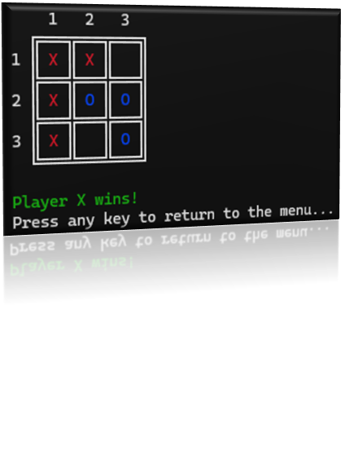
WHAT WE BUILT
Classic Tic-Tac-Toe game in the C programming language.
CLI-based interface, modern UI/UX. Fully playable and interactive.
Notes:
rafsan

Slide 5
CSE 115.4 | Group 2
TicTacX
GAME MODES
Multiplayer Mode: Two players can play against each other.
2. AI Mode: One player can play against a computer opponent.
Presented by
Avishek Dutta • Md. Ishrak Mashroor • Ashab Mahmud Raseen • Sneha Nandy
Notes:
nandy

Slide 6
TicTacX
FEATURES
Player vs Player and Player vs AI Modes
AI (Easy Level) for solo play
CLI Interface with color (ANSI escape codes)
Replay without restarting the app
Valid input checking & clear error messages
Instructions & About sections
Cross-platform compatibility (Windows, Linux, macOS)
Presented by
Avishek Dutta • Md. Ishrak Mashroor • Ashab Mahmud Raseen • Sneha Nandy
Notes:
nandy

Slide 7
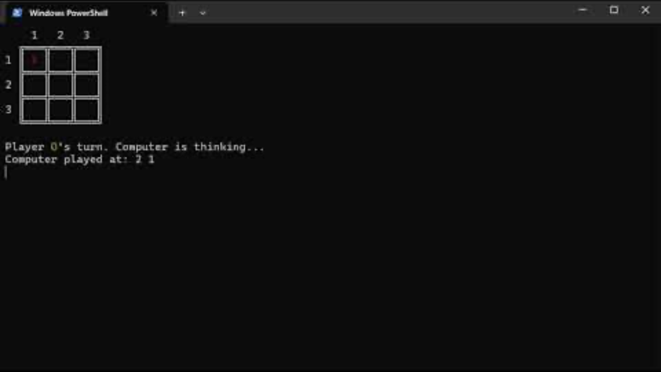
TicTacX
VIDEO
DEMO
Presented by
Avishek Dutta • Md. Ishrak Mashroor • Ashab Mahmud Raseen • Sneha Nandy
Notes:
nandy

Slide 8
CODE STRUCTURE
README.md
- Docs
main.c
- Controls flow
.h files
- Header files
support/game.c
- Logic + turn management
support / GameAI.c
- Game Bot
for mode == 2
support/board.c
- Display + update
Notes:
avishek

Slide 9
TicTacX
GAME FLOW
Menu
Input
Validation
Update
Result
Draw or Win
-> Replay Option
Uses Clear + ANSI + Unicode for clean updates and display
Notes:
avishek

Slide 10
UI/UX
Clean 3x3 Grid
Display using text
Colors using
ANSI Escape Codes
Turn-based prompts (“Enter row and column: ”)
Clear screen on transitions using clear() function
Invalid move?
Shows message & asks again
Menu navigation with simple number input

Slide 11
GAME LOGIC
main() calls run_game(mode) based on mode selected
3×3 char array for board state
Turn toggling between X and O
Input checks: format, range, occupancy
Win/ Draw detection through loops and counter
Calls print_board() and ai_move() for output and bot turn
Notes:
avishek

Slide 12
Uses same win/draw checks
AI IMPLEMENTATION
Function Driven AI: ai_move() makes computer moves
Random row,col until EMPTY cell found
Player vs AI: human plays X, AI plays O
sleep(1) for 1s human-like thinking delay
Notes:
mashroor

Slide 13
KEY CHALLENGES
Challenge
Challenge
Challenge
Cross-platform compatibility
used preprocessor directives to support Windows, Linux, macOS
Input Validation
Had to flush input buffer to prevent infinite loops
Terminal formatting
Used ANSI codes; managed screen clears
Solution
Solution
Solution
Notes:
avishek

Slide 14
KEY CHALLENGES
challenge
challenge
challenge
Near-Full Board Looping
Break; on valid cell found
Inefficient RNG Seeding
Moved srand(time(NULL)) to main() for single initialization
Redundancy AI Win check
Reused existing
Player/vs/Player
Win logic
Solution
Solution
Solution
Notes:
ishrak

Slide 15

CONCLUSION
TicTacX showcases how structured code, modular design, and simple AI can create an engaging, seamless console gaming experience.
Notes:
nandy

Slide 16
Thank You So Much!
CSE115.4 | Group 2

