Slide 1
TicTacx – A Modern CLI-based Tic-Tac-Toe Game
CSE115.4 | Group - 2 | Summer 2025
Project Description: Developing a console-based version of the classic Tic-Tac-Toe game where two players can compete against each other.

Slide 2
Introduction
Course Instructor: Mohammad Shifat-E-Rabbi
Avishek Dutta (Lead) – 2524093042
Md Ishrak Mashroor – 2524709042
Ashab Mahmud Raseen – 2524767042
Sneha Nandy – 2524508042

Slide 3
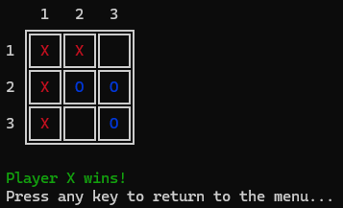
What We Built
Classic Tic-Tac-Toe game in C programming language.
CLI-based interface, modern UI/UX. Fully playable and interactive.
Notes:
sneha

Slide 4
Code Structure
README.md
- Docs
Makefile
- Automated compilation
.h files
- Header files
main.c
- Controls flow
support/game.c
- Logic + turn management
support/board.c
- Display + update
Notes:
rafsan

Slide 5
Game Flow
Menu
Draw or Win
-> Replay Option
Input
Validation
Uses Clear + ANSI + Unicode for clean updates and display
Update
Result
Notes:
ishrak

Slide 6
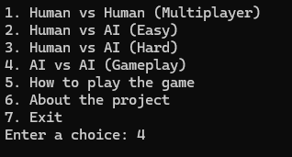
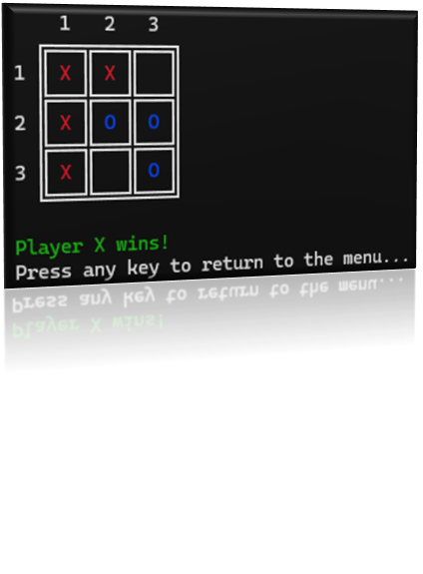
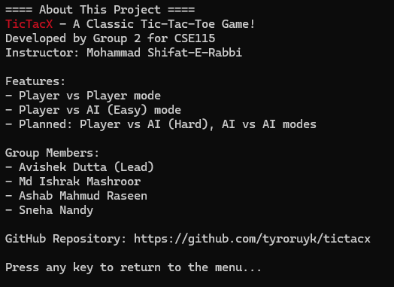
User Interface/User Experience
Main Menu
Player chooses desired
game-mode
Enter choice and press return
Gameplay
Game-board display
Win/Lose/Tie Message
About menu
Developer details
Game features
Collaborators
Notes:
avi

Slide 7
How To Play
Menu Modes:
Human vs Human
Human vs AI (Planned)
How To Play
About
Exit
Input Mode:
To play input Row and Column separated by a space; i.e. 2 3
Exit Mode:
To exit from a mode press any key when prompted to exit…
Each is written in modular and scalable approach
Notes:
sneha

Slide 8
Error Handling & UX
Responsive CLI Design
Clean, minimal interface with neat formatting.
Makes it easy to view the board even in a basic
terminal.
The scanf() function handled both int and string input to avoid buffer issues
Invalid Input Handling
If a user enters an invalid move, the program displays a clear error message and prompts the user to try again
An else statement for invalid menu input
Notes:
rafsan

Slide 9
Key Challenges
Input Buffer Issues:
After using scanf(), left over newline characters caused unintended skips.
Used getchar() to flush the buffer before reading next input.
Cross-Platform Color Issues:
Unicode characters didn’t render properly on some terminals
Pre-checks Unicode-support before starting the main menu.
Segmentation Fault During Replay:
The game crashed when restarting after a match.
Properly reinitialized the board and all game variables at reply.
Notes:
ishrak

Slide 10
Future Plan
Human vs AI Mode
Generate move using rand() function
Seed by srand() and time() from <time.h> file
Using pointer variables to return two values (row and column)
Scalable code – Hard AI, and AI vs AI mode
Notes:
avi

Slide 11

The End
Thank You!
Notes:
avi

