Slide 1

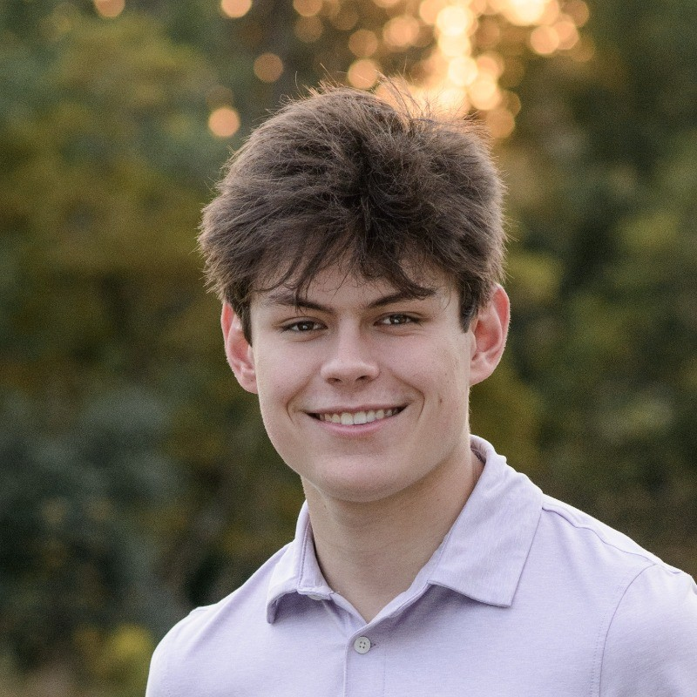


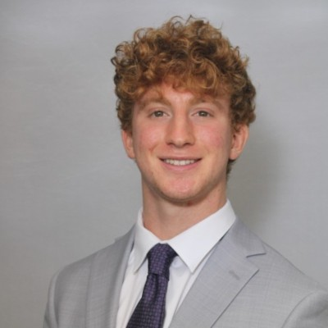
Crisper Chabris
Aryan Patel
Ethan Sargeant
Nate Bunkowske

Slide 2

COLUMBUS LEAP
LEAP
Lead Exposure Assistance Program
"How much does Columbus need on hand today to fix 16,280 homes by 2037?"
OSU Quantathon – March 2026

Slide 3

THE PROBLEM
A Federal Mandate Demands Immediate Action
16,280
The EPA Mandate
EPA requires replacement of all lead service lines and galvanized pipes by 2037, with no extensions.
Targeted HOMES
$10k
Columbus's Solution
A 0% interest, 99-year deferred loan up to $10,000 per household, repaid on sale, refinance, or qualifying aid.
LOAN CAP PER HOME
2037
The Central Question
How much upfront capital must the City reserve today to fund all loans until repayments begin?
FEDERAL DEADLINE
Why It Matters
This is both a public health imperative and a fiscal responsibility for city planners.

Slide 4
THE MODEL — REPAYMENT LOGIC
Three Ways a Loan Closes — and One Way It Doesn't
8.78%
What Happens to Each Loan
Home Sale
Each year, an 8.78% chance the homeowner sells. On sale, the full loan balance is repaid — capital returned to the City's revolving fund.
Source: ColumbusRealators.com
Loan Issued
3.25%
Each Future Year
Refinance
A 3.25% annual refinance probability. When homeowners refinance, the deferred lien is typically cleared at closing — another repayment event. Source: FreddieMac.com
Sale
Refi
Forgiven
8.78%/yr
3.25%/yr
3.82% ever
3.82%
Aid / Forgiven
Repaid
Repaid
Lost
3.82% of recipients qualify for assistance — their loan is forgiven and never repaid. Modeled as permanent outflows with zero recovery.
Source: Homeowners Poverty Rate
Loans not repaid within 2026–2037 excluded (conservative assumption)
Key: forgiven loans are permanent costs, not deferred ones. Yet 96.18% of loans do eventually repay — that is why the loan structure saves $54.6M versus a pure grant program.
Notes:
SPEAKER NOTES — Loan Repayment Logic (~75 seconds) Left column — walk through each rate: "The model simulates three ways a loan gets repaid, and one way it doesn't. The most common trigger is a home sale — the model checks an 8.78% annual probability for every outstanding loan, derived from Columbus housing turnover data. Refinancing is less frequent at 3.25%, but meaningful — when someone rolls into a new mortgage, the deferred lien gets cleared at closing. And 3.82% of homeowners receive assistance that forgives their loan entirely. We model these as permanent outflows — that money is gone. It's not deferred, it's forgiven." Right column: "The flow on the right shows how each loan marches through time. Every year, the model rolls the dice on sale and refi events. If neither triggers before 2037, we conservatively exclude late repayments — this keeps our funding estimate honest. The punchline: 96% of loans do come back. That's exactly why the deferred loan structure is so powerful — it halves the capital requirement compared to a grant program where none of it returns."

Slide 5
Key Assumptions
GALVANIZED PIPE ESTIMATE
LOW-INCOME HOUSEHOLDS AFFECTED
16,280
3.82%
homes estimated to have galvanized pipes
16,051 of 420,068 total homes
owned by households under $20k income
228,416
59,973
known material
unknown material
PROGRAM REACH & CONVERSION
Method: 6.28% galvanized rate found in known material → extrapolated 3,769 additional homes from unknowns → added to 12,511 confirmed = 16,280 total
5–7%
70%
70%
homes reached
(goal: 10%)
pass stochastic
filter
loan approval
rate (LEAP)
Total universe: 288,389 service lines

Slide 6

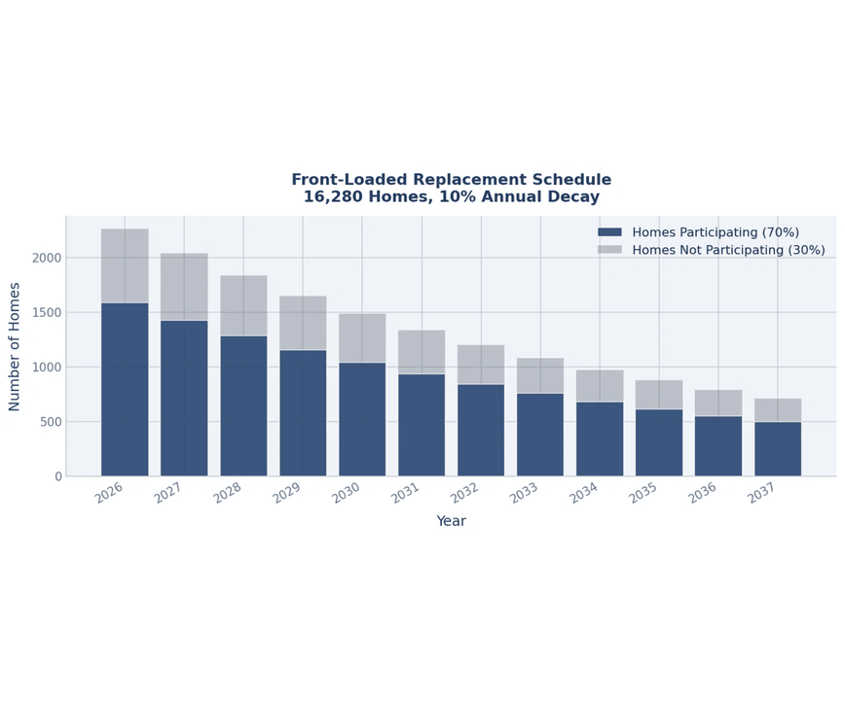
KEY ASSUMPTIONS
Transparent Assumptions Drive a Credible Model
PARAMETER
BASE VALUE
UNCERTAINTY
Homes in Pool
16,280
Fixed
Participation Rate
70%
±5% (stochastic)
Avg Replacement Cost
$7,386 (cap $10,000)
Inflation 3.2%/yr ±1.93%
Weather Cost Spike
+15%
0.2% probability/yr
Annual Sale Rate
8.78%
—
Refinance Rate
3.25%
—
Forgiven Loans
3.82%
—
Front-loaded schedule: earlier years see the highest volume, tapering through 2037.

Slide 7








THE MODEL
A Monte Carlo Engine Simulates 1,000 Possible Futures
HOMES SCHEDULED
PARTICIPATION
LOANS ISSUED
PEAK GAP
Front-loaded
Stochastic Filter
Cash Outflows
Funding Needed
REPAYMENTS
Cash Inflows
1,000 Independent Futures
Tracking Cash Flows
Finding the Peak Gap
We run 1,000 simulations, each drawing random values for participation, inflation, weather shocks, and repayment timing from their respective distributions.
In each simulation, cash flows out as loans are issued following the schedule, and cash flows in as loans are repaid upon sale or refinancing.
The peak cumulative gap—where outflows most exceed repayments—represents the capital needed. Aggregating these peaks gives our mean and 95th percentile.

Slide 8
THE MODEL — DEEP DIVE
How the Monte Carlo Engine Works
1
2
3
Draw Random Parameters
Compute Annual Cash Flows
Find the Peak Funding Gap
Each of 1,000 simulations independently samples participation rate (±5%), inflation (3.2% ±1.93%), weather shocks (0.2%/yr), and repayment timing from their fitted distributions.
Loans are issued on the front-loaded schedule. Each loan triggers a repayment search: every future year, the model tests whether a sale (8.78%) or refinance (3.25%) event occurs. Aid recipients (3.82%) never repay.
Cumulative net cash (outflows minus inflows) is tracked year by year. The maximum of this curve — the deepest the City's account goes — is the funding requirement for that simulation.
Aggregating 1,000 peak gaps yields the mean ($33.01M) and the 95th-percentile safety reserve ($37.02M) — the recommended allocation.
Notes:
SPEAKER NOTES — Monte Carlo Methodology (~90 seconds) Walk through left to right: Step 1 — "Before each of the 1,000 simulations begins, the model draws a fresh random value for every uncertain input. Participation could be 65% this run and 74% the next — each simulation is its own independent future." Step 2 — "Inside each simulation, we track dollars flowing out as loans are issued and dollars flowing back in as homeowners sell or refinance. The three repayment triggers come straight from Columbus market data. Aid recipients are treated as permanent costs — those loans will never come back." Step 3 — "We're not interested in the total cost — we're interested in the peak strain on the City's account. The maximum point of the cumulative gap curve is what the City must have in reserve before repayments start catching up." Bottom bar — "Running this 1,000 times gives us a full distribution. We're recommending the 95th percentile, not the mean, because the downside of under-funding is much worse than the downside of over-funding."

Slide 9

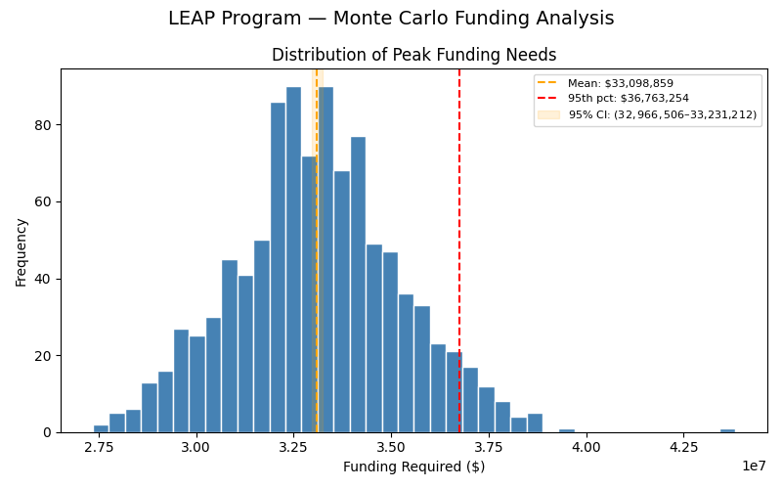
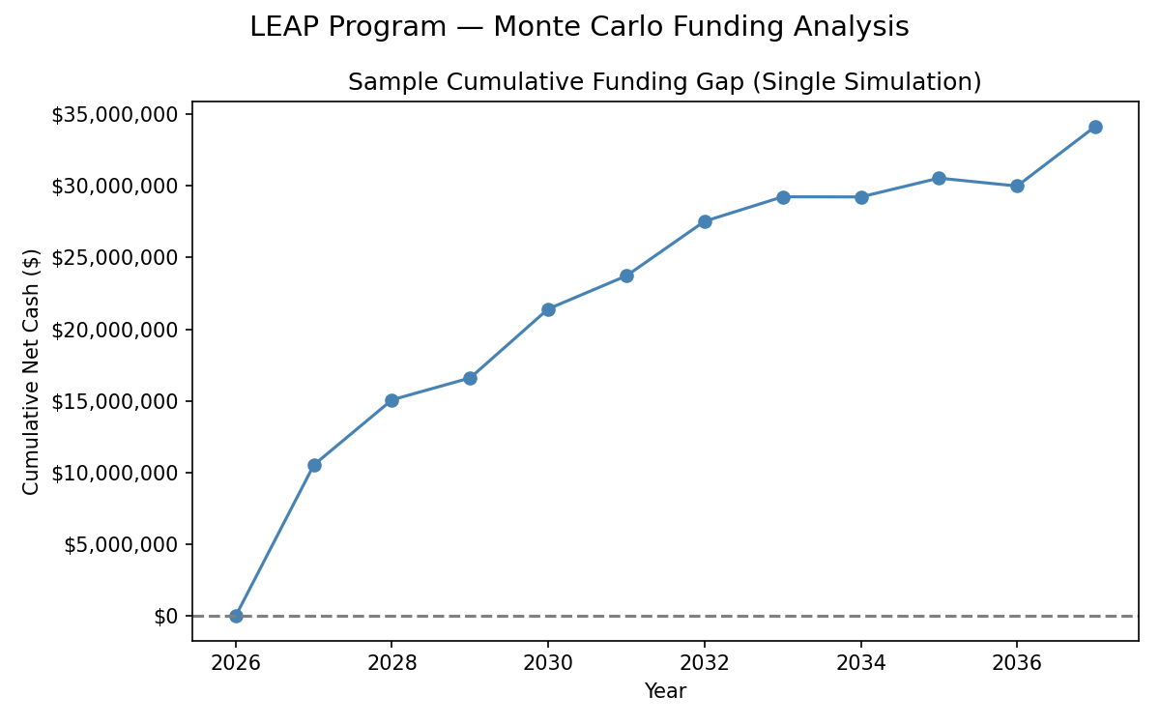
LOAN MODEL RESULTS
The Loan Model Points to a $44.7M Mean Need
$33.02M
$32.88M – $33.16M
$37.02M
MEAN PEAK FUNDING
95TH PERCENTILE
95% CONFIDENCE INTERVAL
The distribution is approximately normal and well-behaved, indicating model stability across 1,000 simulations.
The cumulative gap peaks around 2033–2035, as loan issuance slows and repayments begin to offset new disbursements.

Slide 10

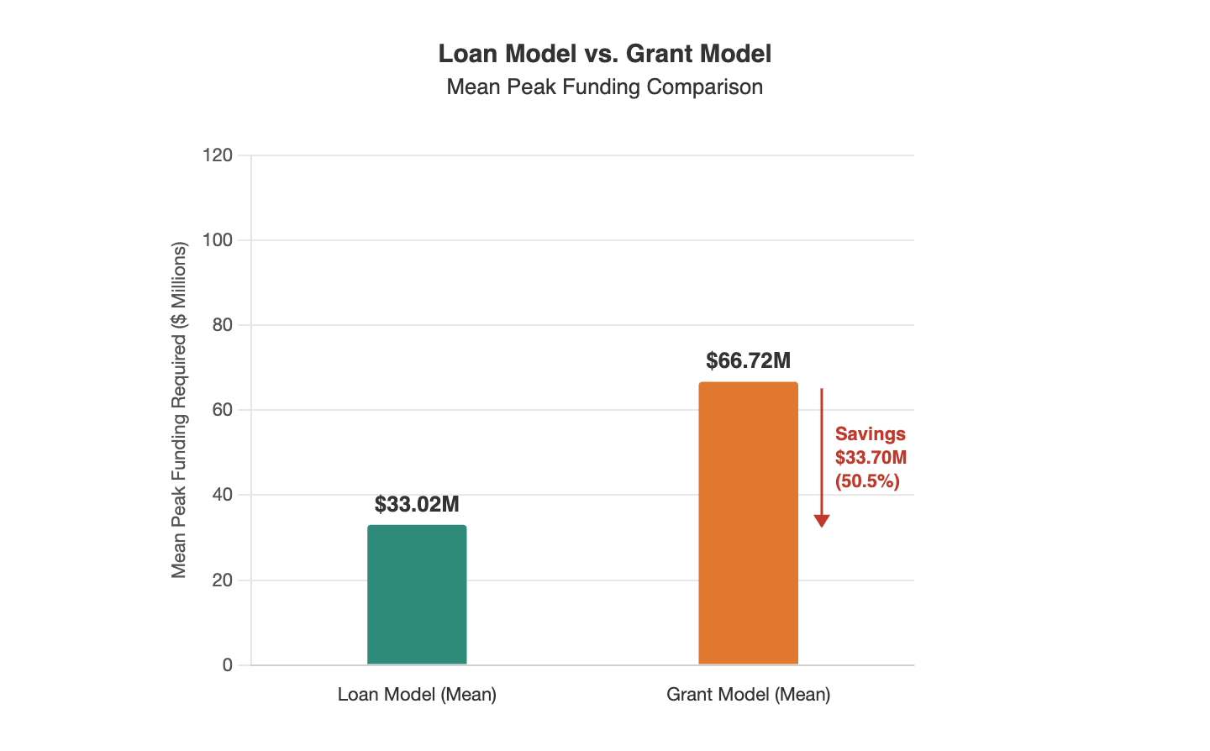
GRANT MODEL COMPARISON
The Loan Structure Saves Columbus $33.7M vs. a Pure Grant Program
A grant model (no repayments) represents the worst-case / upper-bound scenario — the City never recovers any capital.
Grant model mean peak funding: $66.72M— more than double the loan model.
The loan structure reduces the required capital by $33.7M (50.5%) on a mean basis.
Even at the 95th percentile, the loan model ($37.02M) is far below the grant model mean ($66.72M).
This quantifies the fiscal value of the 0% deferred loan structure: repayments meaningfully recycle capital back to the City over time.

Slide 11

RECOMMENDATION
Columbus Should Allocate $37.02M in 2026
WE RECOMMEND THE CITY OF COLUMBUS ALLOCATE $37.02M IN 2026
95th Percentile · 95% CI: $32.88M – $33.16M
THE MATH
IF UNDERFUNDED
IF OVERFUNDED
This is the 95th percentile of our simulation — meaning only 5% of all modeled futures would require more capital than this amount. The 95% confidence interval confirms this figure sits at the responsible upper edge of the expected range.
The City risks a mid-program liquidity gap, potentially forcing a pause in loan issuance and delaying compliance with the 2037 federal deadline. The cost of under-preparation is severe.
Excess reserves can be redeployed or returned to the general fund. The cost of over-preparation is low relative to the public health and regulatory risks of falling short.

Slide 12

FUTURE RESEARCH & LIMITATIONS
Refining the Model for Long-Term Precision
MODEL LIMITATIONS
FUTURE RESEARCH PRIORITIES
Data Granularity
Program Scaling
Repayment timing is currently based on national averages; future iterations should use Columbus-specific housing turnover and refinancing datasets to refine the cash flow curve.
Evaluate the fiscal impact of expanding the $10,000 cap to accommodate higher-cost specialized replacements while also accounting for additional costs due to inflation.
Copper Pricing
Stochastic Refinement
Repair costs are tightly linked to copper prices, with a correlation of 0.87.​
Since copper is the primary material in water line replacements, contractor prices rise with the commodity. Copper has grown at 9% annually with a standard deviation of 1.5% — this growth rate directly drives repair cost escalation in our model through 203
Transitioning from static probability distributions to time-varying Markov chains could better simulate economic cycles and their impact on program liquidity.
Economic Sensitivity
Legislature, Regulations, and Political Factors
The interaction between high interest rates and home equity (the "lock-in effect") could significantly affect the 8.78% projected sale rate.
Given the nature of this problem, unexpected legislature or regulatory changes could heavily impact timelines, costs, and materials impacting budget.

Slide 13

EXECUTIVE SUMMARY
Three Numbers Every City Official Should Know
$37.02M
$33.7M
2
RECOMMENDED RESERVE
CAPITAL SAVED
DOMINANT VARIABLES
Sufficient with 95% probability across 1,000 simulated futures to fund the LEAP program through 2037.
The deferred loan structure reduces the City's capital burden by 55% compared to a pure grant program.
Participation rate and home sale activity drive the risk. Monitor annually and adjust reserves accordingly.
LIMITATIONS & NEXT STEPS
■
■
Repayment timing uses national averages; local Columbus turnover data would sharpen estimates.
Inheritance and estate transfers are not modeled and could delay repayment timelines.
■
■
A phased funding approach (initial tranche + contingency) could optimize cash deployment.
The model is transparent and should be updated annually as real program data accumulates.

