Slide 1
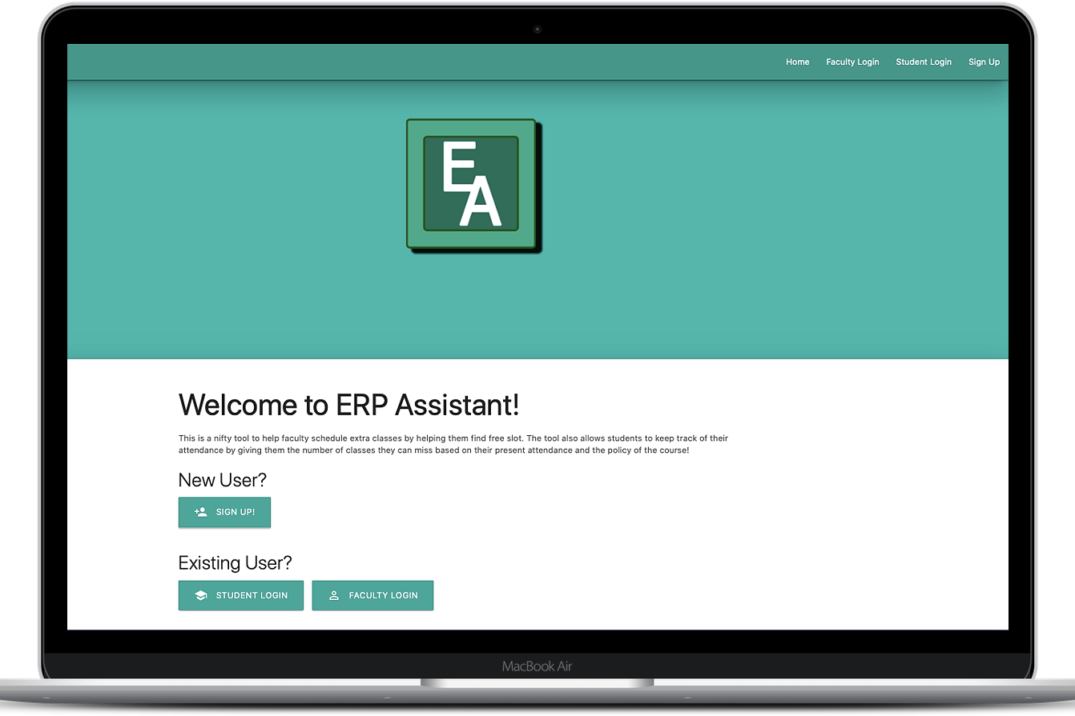

ERP ASSISTANT
A new Dimension to the ERP

Slide 2


ERP Assistant?
Extension of the existing ERP by adding a set of new features
Ability to find free slots for extra class, for professors
Ability to see number of classes that can be missed while respecting the attendance criteria, for students

Slide 3





Tech Stack
This project has been implemented using FireBase in the backend and the frontend has been done with HTML5, CSS3 and JavaScript using the Materialize framework.
We have used Firebase realtime database, which is a noSQL type database and uses JSON as the main storage structure.

Slide 4
The Frontend
The frontend has been developed using the Materialize Framework keeping in mind Google’s Material Design UI guidelines
The aim was to ensure a modern look along with a smooth user experience
The design has also been implemented in a manner to ensure that it can be easily extrapolated for use in mobile devices

Slide 5
Backend
The backend is implemented using Firebase realtime database. It is a noSQL type database and uses JSON as the main storage structure.
Implements 3 tools:
Free time calculation of students enrolled in a course for the professor to conduct extra classes
An attendance management system for the students
An enrollment tool to help with enrolling into courses

Slide 6
Main Objective
Easy, quick and simple to use web app
Relevant to the student and teacher community
Easy to modify, scale and enhance throughout the future

Slide 7
Problems Faced
One of the problem that posed at end of the development of the website. The Backend uses IDs to fetch data from the web pages and the corresponding IDs did not match with the Frontend. It took precise revision of the code in order to fix the issue.
It became quite a task to creating an organisational standard that all the developers on team could follow because of large number of files to work. This increased the work towards the end when it all was supposed to come together

Slide 8
Future?
Seamless connection with the current ERP to eliminate the need for manual data input
Extend features to include new ones, like a tool to show courses a student can take for a semester in order to fulfil requirements for a minor
Connection to the current attendance system
Mobile App

