Slide 1
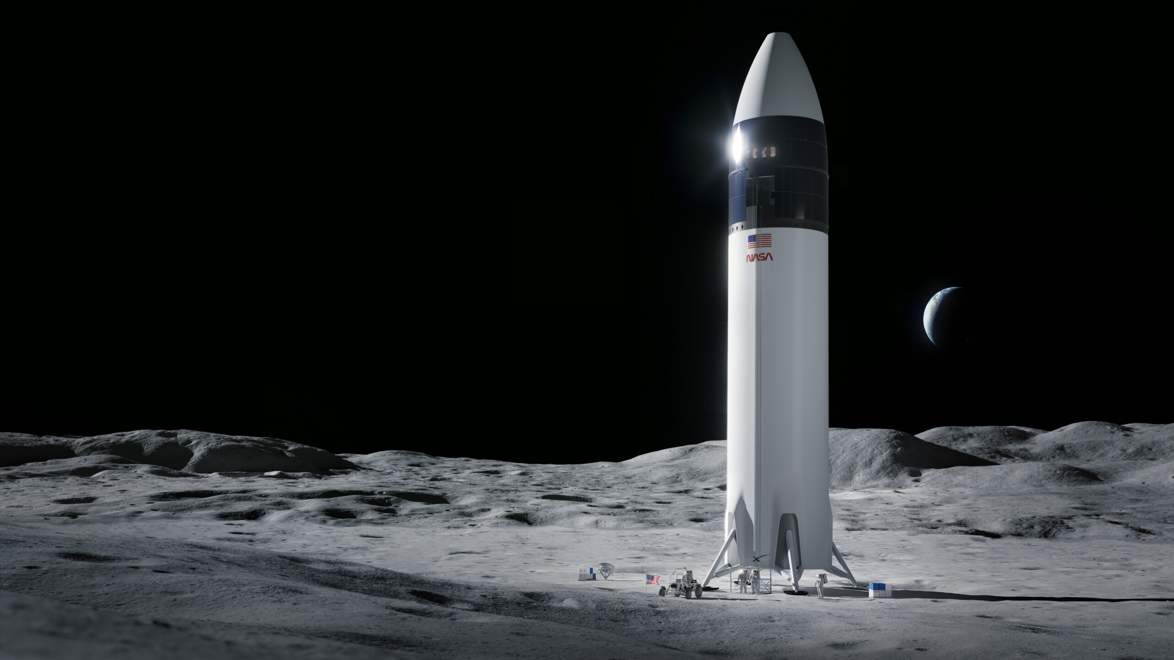
Applied Data Science Capstone
Tysha Batts
November 2022
This Photo by Unknown Author is licensed under CC BY-NC

Slide 2


OUTLINE
Executive Summary
Introduction
Methodology
Results
  Visualization – Charts
  Dashboard
Discussion
  Findings & Implications
This Photo by Unknown Author is licensed under CC BY-SA

Slide 3

EXECUTIVE SUMMARY
Summary of methodologies
  Data Collection via API, SQL, and Web scraping
  Data Wrangling and Analysis
  Interactive Maps with Folium
  Predictive Analysis for each classification model
Summary of Results
  Low weighted payloads perform better than heavy payloads
  KSC LC 39 A has the most successful launches from all sites
  Orbit GEO, HEO, SSO, ES L1 has the best success rate
  Success rate for SpaceX is directly proportional in years

Slide 4

INTRODUCTION
Predict if the Flacon 9 first stage will land successfully.
If we can predict if the first stage will land, we can determine the cost of the launch.
Key Problems?
  What is the price for each launch?
  Will SpaceX reuse the first stage of Falcon 9?
  What information (factors) can help to predict is Space X will reuse the first stage?

Slide 5

METHODOLOGY
Data Collection
  SpaceX Rest API
  Web Scraping
Data Wrangling
  Transforming data for machine Learning
  Using one hot encoding fields
Exploratory Data Analysis using SQL
Interactive Visual Analytics with Folium and Ploty Dash
Predictive Analysis
  Build and evaluate classification models
This Photo by Unknown Author is licensed under CC BY-NC

Slide 6
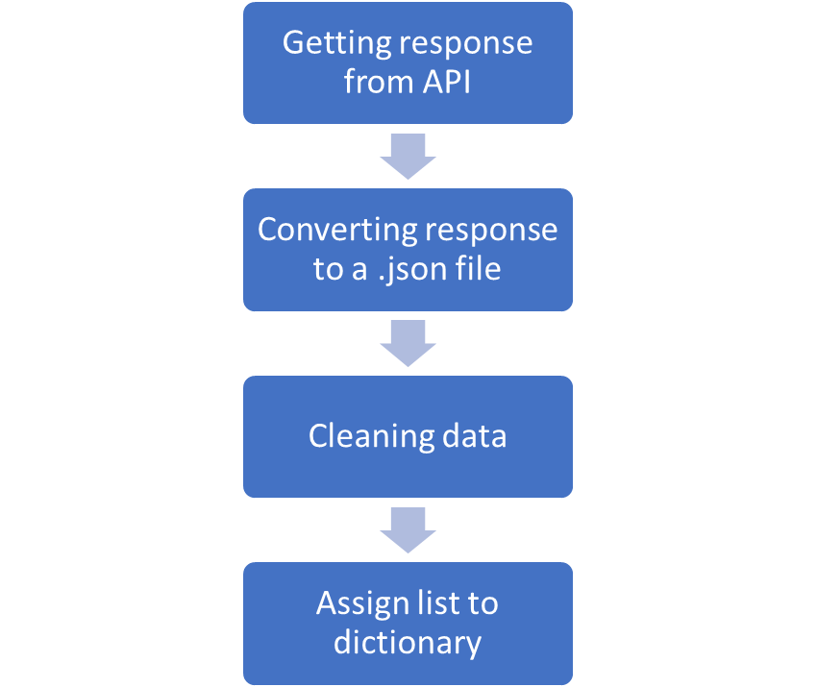
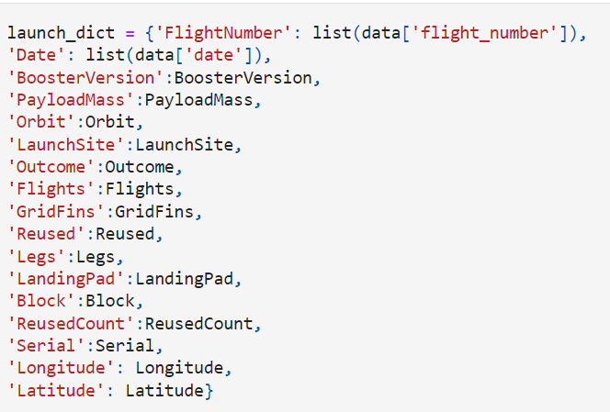
Data Collection
https://github.com/tyshsan13/testrepo/blob/main/Data%20Collection%20API%20Lab_TB.ipynb

Slide 7
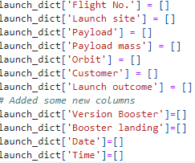

Data Collection -Scrapping https://github.com/tyshsan13/testrepo/blob/main/Web%20Scrapping%20Lab_TB.ipynb
Getting response from HTML
Creating Beautiful Soup Object
Finding tables
Getting column names
Creating dictionary
Converting dictionary to dataframe
Dataframe to .CSV

Slide 8

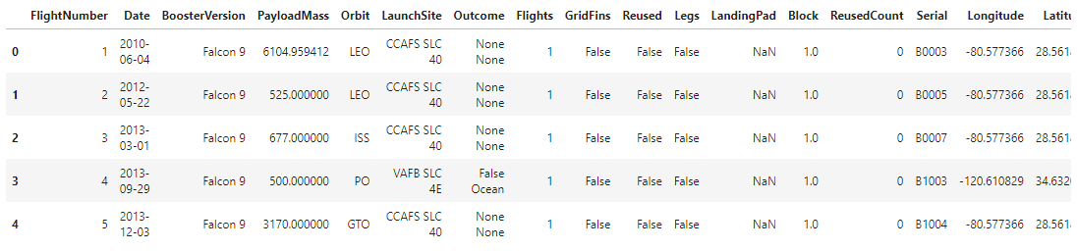

Data Wrangling https://github.com/tyshsan13/testrepo/blob/main/Data%20Wrangling%20Capstone_TB.ipynb
Calculate number of launches at each site
Calculate number and occurrence at each orbit
Calculate number and occurrence of mission outcome per orbit
Create landing outcome label from Outcome column
Export data as .csv

Slide 9
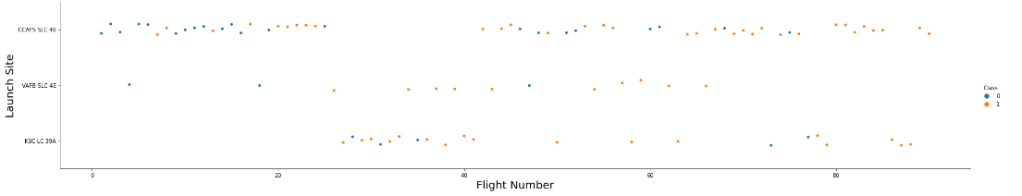
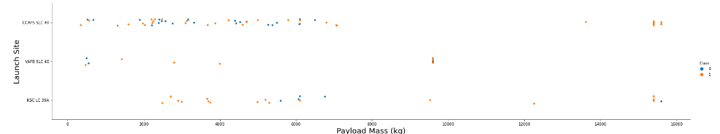
EDA with Data Visualization
https://github.com/tyshsan13/testrepo/blob/main/EDA%20with%20Visualization_TB.ipynb

Slide 10
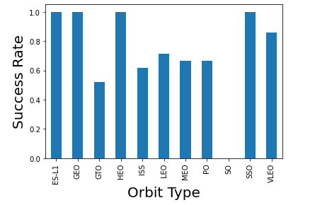
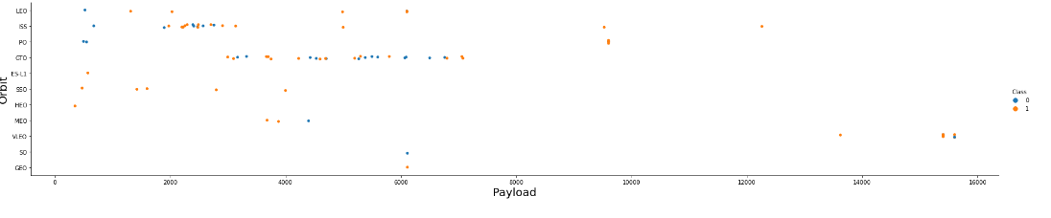
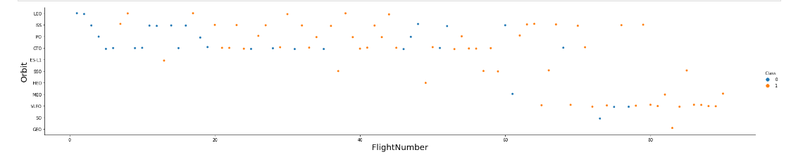
EDA with Data Visualization

Slide 11



EDA with SQL
https://github.com/tyshsan13/testrepo/blob/main/EDA%20with%20SQL.ipynb
Display the names of the unique launch sites in the space mission
Display 5 records where launch sites being with ‘CCA”
Display the total payload mass carried by boosters
Display the average payload

Slide 12

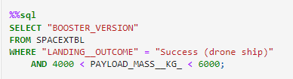

EDA with SQL
List the date when the first successful outcome was achieved
List the name of the boosters greater than 4000 but less than 6000
List the total number of successful and failure mission

Slide 13
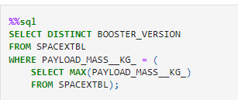
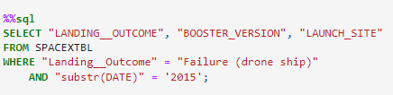
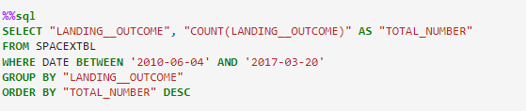
EDA with SQL
List the name of the booster_versions which have carried maximum payload
List the records for months in year 2015
Rank the count of successful landing_outcomes

Slide 14
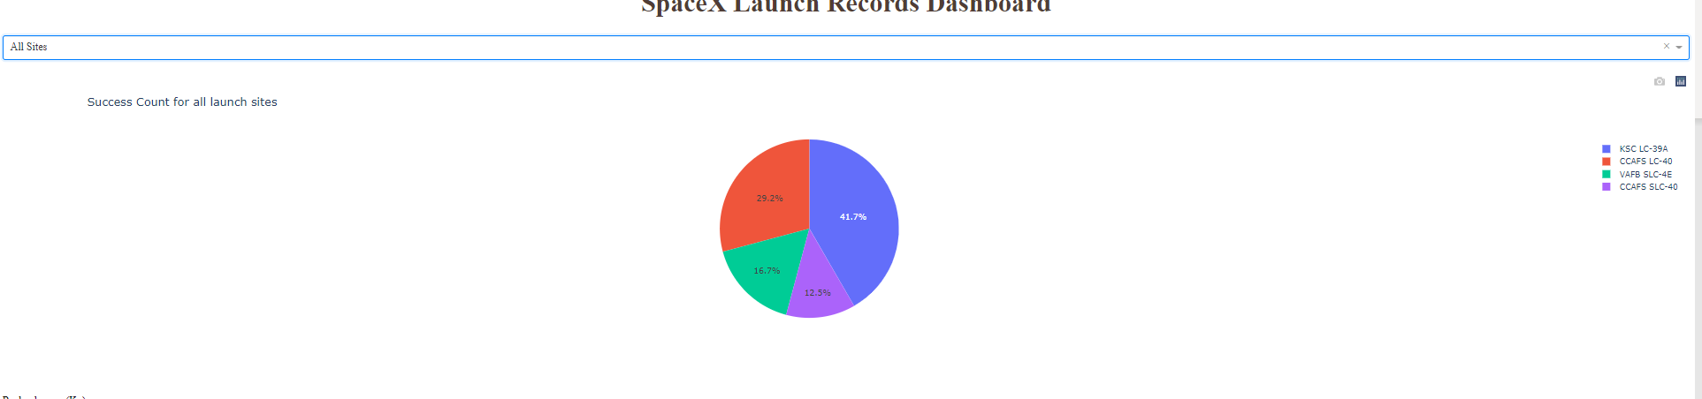
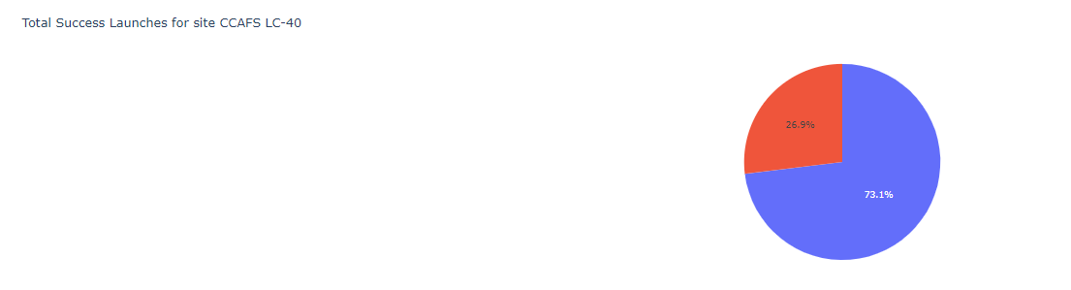
Build a Dashboard with Plotly

Slide 15
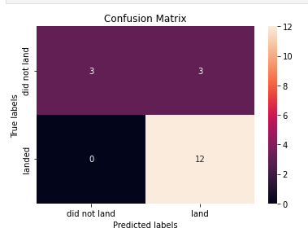
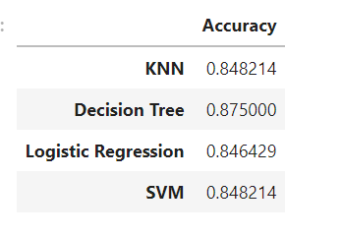
Predictive Analysis
https://github.com/tyshsan13/testrepo/blob/main/Machine%20Learning%20Prediction%20Lab_TB.ipynb

Slide 16
RESULTS- Flight Number vs. Launch Sites
We see that flight numbers greater than 30 have a better success rate.

Slide 17
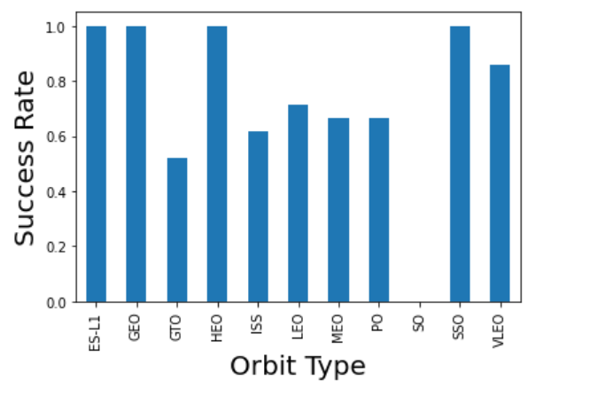
Results – Success Rate Vs. Orbit
You see that ES-L1, GEO, HEO, and SSO have the highest success rates.

Slide 18
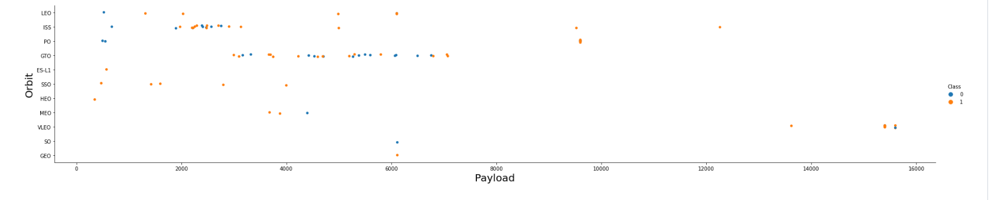
Results – Payload vs. Orbit Type
We see that Polar, LEO, and ISS have more of a success rate with heavy payloads.

Slide 19
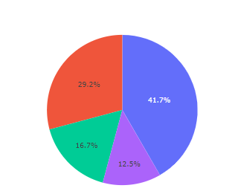
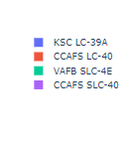
Discussion- Findings and Implications
The Decision Tree is best in terms of the SVM, KNN, and Logistic models.
The KSC LC 39 A had the most successful launches from all sites.

Slide 20
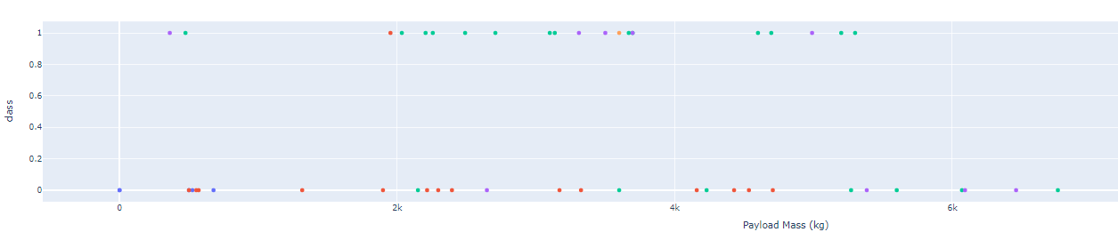
Discussion- Findings and Implications
Low weighted payloads have a better success rate than have payloads.

