Slide 1


Object Relational Mapping
Lars Mortensen
Literature: https://en.wikibooks.org/wiki/Java_Persistence
This second reference is for a specific database (ObjectDB) but since this database implements JPA, you can use the tutorial as a quick (or alternative) way to get started.
http://www.objectdb.com/java/jpa

Slide 2


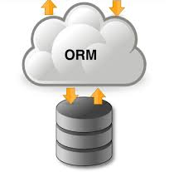







Welcome to Flow-2
Fullstack for year 2019
Object Relational Mapping
Java persistence API (JPA)
Restful Web Services
-------------------------------------------------------------------------------
JSON
-------------------------------------------------------------------------------
JavaScript required for REACT-
Developers
AJAX
W-1
W-2
W-3
W-4 CA-2

Slide 3
Object Relational Mapping
Technique for converting data between tables in relational databases to objects in an object oriented language and vice versa
Creates in effect a "virtual" object database
Why?
Data management tasks in OO-programming are typically implemented by manipulating objects that are almost always non-scalar values
Relational database management systems can only store and manipulate scalar values such as integers and strings organized within tables.

Slide 4
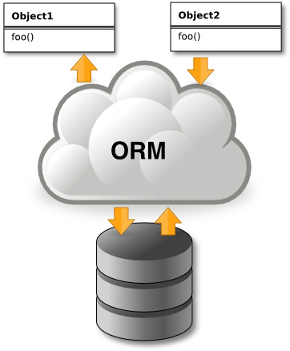
Without Object Relational Mapping
Programmers must:
Either convert the object values into groups of simpler values for storage in the database (and convert them back upon retrieval),
Use only simple scalar values within the program.
Object-relational mapping is used to implement the first approach

Slide 5
To ORM or not to ORM ☺
Comparison with traditional data access techniques
+ ORM typically reduces the amount of code that needs to be written
+ Avoids low level JDBC and SQL code
+ Provides database and schema independence
+ It allows us to use the OO-paradigm
+ Often protects against SQL Injection, but still: always validate inputs
- The high level of abstraction can obscure what is actually
happening in the implementation code.
- Be aware of JPA’s Convention-Over-Configuration Strategy
- Heavy reliance on ORM software has been cited as a major factor in
producing poorly designed databases.

Slide 6

Our Goals when selecting a ORM Framework
Take advantage of all the things Relational Databases do well
But doing it, without leaving all the all the things OO-languages do well
Have the illusion of only ”talking” OO, even when we manipulate data.
Do less work

Slide 7
Object-Relational Impedance Mismatch Issues
How are columns, rows, tables mapped to objects?
How are relationships handled?
How is OO inheritance mapped to relational tables?
How is composition and aggregation handled?
How are conflicting type systems between databases handled?
How are objects persisted?
How are different design goals handled?
Relational model designed for data storage/retrieval
Object Oriented model is about modelling behaviour

Slide 8
Object-Relational Impedance Mismatch Issues
Example – mismatch in data types
OO Languages such as Java C# have String and int data types
RDMBS such as MySQL has a varchar and smallint
Although values are stored and manipulated differently the database driver (JDBC in Java) handles conversions automatically

Slide 9
Object-Relational Impedance Mismatch Issues
Example – collections versus tables
Java/C# use collections to manage lists of objects
Databases uses tables to manage lists of entities
Example – blobs versus objects
Databases uses blobs to manage large objects as simple binary data
Java/C# use objects with behaviors

Slide 10









Object Relational Mapping Tools
JPA
Sequelize
http://en.wikipedia.org/wiki/List_of_object-relational_mapping_software#.NET

Slide 11
Introduction to Java Persistence API
JPA
Java Persistence consists of four areas:
The Java Persistence API
API which provides Java developers with an object/relational mapping facility for managing relational data in Java applications
The query language (JPQL)
Query language allows us to write portable queries that work regardless of the underlying data store
The Java Persistence Criteria API (OO-Queries)
Queries written using Java APIs, which are type safe, and portable.
Object/relational mapping metadata
http://docs.oracle.com/javaee/7/tutorial/doc/persistence-intro.htm#BNBPZ

Slide 12
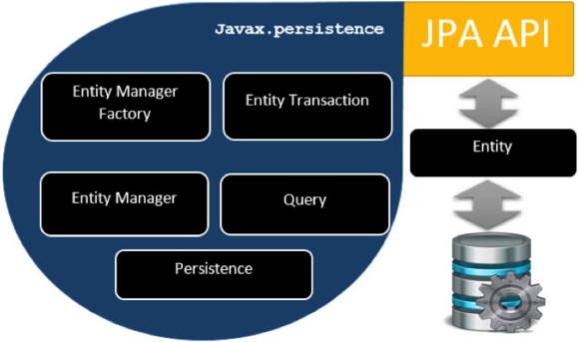
JPA Architecture
More Info: https://www.tutorialspoint.com/jpa/jpa_architecture.htm
http://docs.oracle.com/javaee/7/tutorial/doc/persistence-intro.htm#BNBPZ

Slide 13
Which JPA to use?
https://en.wikibooks.org/wiki/Java_Persistence/Persistence_Products
The one we will be using
https://en.wikibooks.org/wiki/Java_Persistence/EclipseLink

Slide 14
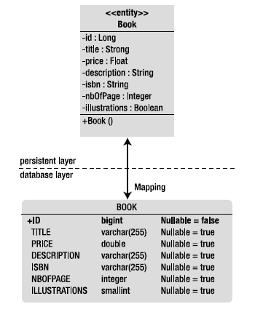
JPA - Entities
An entity is a lightweight persistence domain object. Typically, an Entity represents a table in a relational database, and each entity-instance corresponds to a row in that table.

Slide 15
Requirements for Entity Classes
The class must be annotated with the @Entity annotation.
The class must have (at least) a public or protected, no-argument constructor.
The class must not be declared final. No methods or persistent instance variables must be declared final.
If an entity instance is passed by value as a detached object, the class must implement the Serializable interface.
Entities may extend both entity and non-entity classes, and non-entity classes may extend entity classes.
Persistent instance variables must be declared private, protected, or package-private and can be accessed directly only by the entity class's methods. Clients must access the entity's state through accessor or business methods.

Slide 16
Mapping Entities
Because of the Convention-Over-Configuration
strategy used by the EE-framework, this is all that is required to turn the class in to a fully fledged Entity Class
@Entity
public class Book ...
{
@Id private Long id;
private String title;
private Float price;
private String description;
private String isbn;
private Integer nbOfPage;
private Boolean illustrations;
public Book() { }
// Getters, setters
}
BUT ALSO, because of the Convention-Over-Configuration strategy, you often get POORLY designed databases. Use the documentation to see how you can control size, nullable, Table Names, Column Names and much more for the matching Tables

Slide 17
Mapping Entities and what to skip when you read the wiki-book
https://en.wikibooks.org/wiki/Java_Persistence/Mapping

Slide 18

Getting Started ☺

Slide 19
The Entity Manager
JPA provides a runtime API defined by the javax.persistence. package.
The main runtime class is the EntityManager class.
The EntityManager:
manages the state and life cycle of entities as well as querying entities within a persistence context.
provides an API for creating queries, accessing transactions, and finding, persisting, merging and deleting objects
can lock entities for protecting against concurrent access by using optimistic or pessimistic locking.

Slide 20
The Entity Manager
Just a POJO (Plain Old Java Object)
Entities can be used as regular objects by different layers of an application
Book2 book = new Book2();
book.setDescription(“..");
//...
EntityManagerFactory emf;
emf = Persistence.createEntityManagerFactory(“pu-x");
EntityManager em = emf.createEntityManager();
Try{
em.getTransaction().begin();
em.persist(book);
em.getTransaction().commit();
}
finally{
em.close();
}
em.remove(book);
and become managed by the entity manager when
we need to load or insert data into the database
Now the book is Managed
Again, just a POJO (detached)

Slide 21
Obtaining an Entity Manager
Obtaining an Entity Manager depends on which of the following strategies are used
Application-Managed Entity Managers (what we will be using)
Uses the Persistence class to create an EntityManagerFactory.
emf = Persistence.createEntityManagerFactory(“pu-x");
EntityManager em = emf.createEntityManager();
With an application Managed EntityManager, we as programmers are in charge of creating, closing and handle transactions.
Container-Managed Entity Managers
In a container-managed evironment (i.e. Glassfish for us) the usual way to obtain a EntityManager is by injection:
@PersistenceContext
EntityManager em;
The component running in a container (servlet, EJB, web service, etc.) doesn’t need to create or close the entity manager, as its life cycle is managed by the container.

Slide 22

Using EntityManager and EntityManagerFactory in JSE
In JSE the EntityManager must be closed when your application is done with it. The life-cycle of the EntityManager is typically per client, or per request.
EntityManagerFactory can be shared among multiple threads or users, but the EntityManager should not be shared
Use the template given below for future facade classes
public class CustomerFacade { EntityManagerFactory emf; public CustomerFacade(EntityManagerFactory emf) { this.emf = emf; }
EntityManager getEntityManager(){ return emf.createEntityManager(); }
// Use this template for a method that uses the
// EntityManager
public Customer getCustomer(int id){
EntityManager em = getEntityManager(); try{ // Use the entity manager }
finally{ em.close(); } }
}

Slide 23
Persistence Units and Persistence.xml
A persistence unit defines the details that are required when you acquire an entity manager.
To package your EclipseLink JPA application, you must configure the persistence unit during the creation of the persistence.xml file.
Define each persistence unit in a persistence-unit element in the persistence.xml file.
Limit problems related to Persistence Units by following these simple rules/hints
A Persistence.xml file is created automatically by NetBeans first time you create an Entity Class.
NEVER commit your persistence.xml file. Add persistence.xml to your .gitignore file
You can always create a new Persistence.xml file, pointing to your own database, using the NetBeans Wizard
Remember to change the persistence.xml file, before you deploy your project to DigitalOcean
Important info, about the Persistence Unit

Slide 24
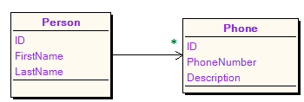





The Chicken or the Egg
With NetBeans and JPA we can either generate tables from existing Entity-classes or generate the Entity-classes from existing tables.
So which way should we go?
Person
Phone

Slide 25
Entity Classes from existing tables

Slide 26
Tables from Entity Classes

Slide 27
JPA – Object Relational Mappings
The following will far from introduce all OR-mapping annotations but should give you a general overview of what is possible.
Use the following for details:
https://en.wikibooks.org/wiki/Java_Persistence.
The link below is for another specific database (ObjectDB) but is relevant for 99% of its content, and very easy to read
http://www.objectdb.com/java/jpa

Slide 28
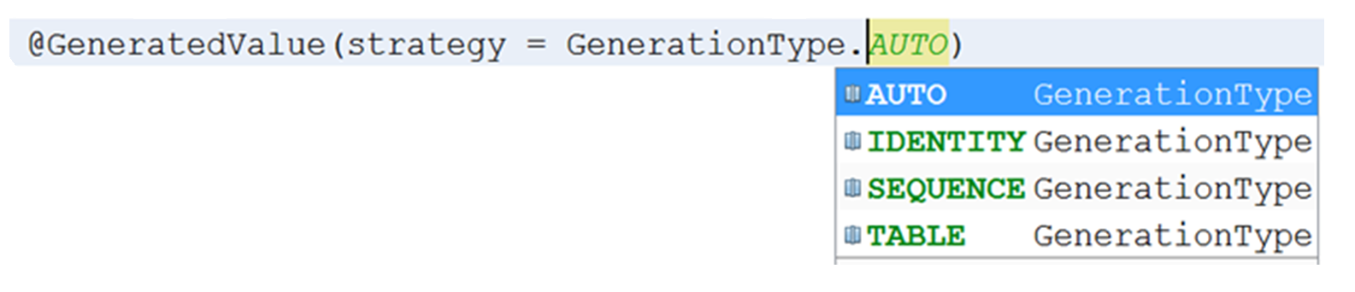
Primary Keys
@Id
Long id;
Good choice for an MySQL database
AUTO_INCREMENT
Good choice for a Database which support Sequences (Oracle or JavaDb)
Can be used by "all" DataBase Vendors.
Often the selected Strategy for AUTO

Slide 29
Auto Generation of ID's - Sequences (for databases that supports this, like Oracle and Derby)
We can control how a Sequence is generated or map it to an existing sequence.
Class Book{
...
@ID
@GeneratedValue(strategy = GenerationType.SEQUENCE,generator="s1")
@SequenceGenerator(name="s1",sequenceName = "My_SEQ",
initialValue = 200000,allocationSize = 1)
These annotations will:
Create a sequence as sketched below, if we are creating tables from Entities
Map to the existing sequence if we are creating Entities from tables
Table Create Script
DROP SEQUENCE My_SEQ RESTRICT;
CREATE SEQUENCE My_SEQ START WITH 200000 INCREMENT BY 1;

Slide 30
Auto Generation of ID's - Tables
All databases can use a separate Table as their strategy to provide a "next id" value
This is usually the default when you select: GenerationType.AUTO
Class Book{
...
@Id
@GeneratedValue(strategy = GenerationType.TABLE,generator="s1")
@TableGenerator(name="s1",table = "My_SEQ",
initialValue = 200000,allocationSize = 50)
These annotations will:
Create a table for auto id's if we are creating tables from Entities
Map to the existing table if we are creating Entities from tables

Slide 31
Auto Generation of ID's - IDENTITY
MySQL does not provide Sequences to generate a unique value for new Rows.
MySQL provides a construct AUTO_INCREMENT as sketched below:
CREATE TABLE Persons ( ID int NOT NULL AUTO_INCREMENT, Name varchar(80), PRIMARY KEY (ID) )
This is how you Signal JPA to use this strategy for automatic key generation:
@GeneratedValue(strategy = GenerationType.IDENTITY)
private Integer id;
There is no way, as for the other two strategies, to provide a start value and allocation size via JPA.
Se exercises for an example script you can use to insert data without conflicting with JPA.

Slide 32
Composite Primary Keys
Composite primary keys can be defined in two ways:
Using an Id Class
Using an Embeddable Class
@Entity @IdClass(ProjectId.class)
public class Project {
@Id int departmentId;
@Id long projectId;
:
}
@Entity
public class Project {
@EmbeddedId ProjectId id;
:
}
@Embeddable
Class ProjectId {
int departmentId;
long projectId;
}
Class ProjectId {
int departmentId;
long projectId;
}
The main purpose of both the IdClass and the Embeddable Class is to be used as the structure passed to the EntityManager find() and getReference() AP

Slide 33
Date Time and Transient Properties
@Temporal(TemporalType.DATE)
private Date dateOfBirth;
@Temporal(TemporalType.TIMESTAMP)
private Date creationDate;
@Transient
private int age;

Slide 34
Enums
public enum CustomerType {
GOLD,
SILVER,
IRON,
RUSTY
}
public class Customer {
...
@Enumerated(EnumType.STRING)
private CustomerType customerType;
}

Slide 35

Collections and Maps of Basic Types
@ElementCollection(fetch = FetchType.LAZY)
private List<String> hobbies= new ArrayList();
@ElementCollection(fetch = FetchType.LAZY)
@MapKeyColumn(name = "PHONE")
@Column(name = "Description") //Name of the Value column
private Map<String, String> phones = new HashMap();

