Slide 1
DB2 Database Migrations

Slide 2
The Challenge: How do we manage DB2 schema migrations
The Pain Points
No visibility on data schema updates
No code review
Sync between environments

Slide 3
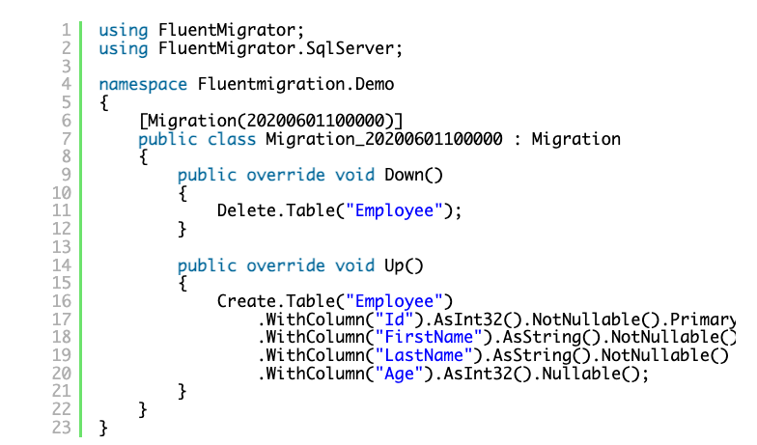
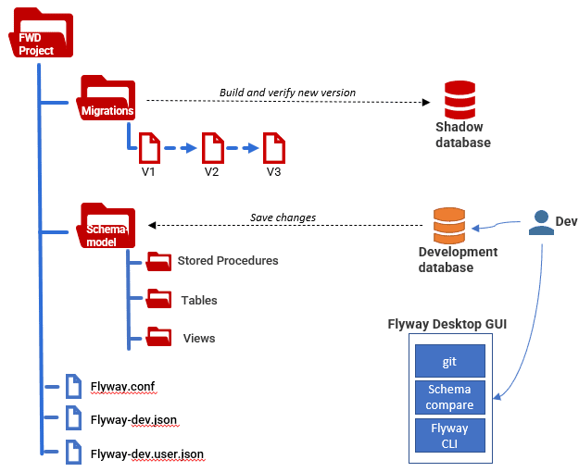
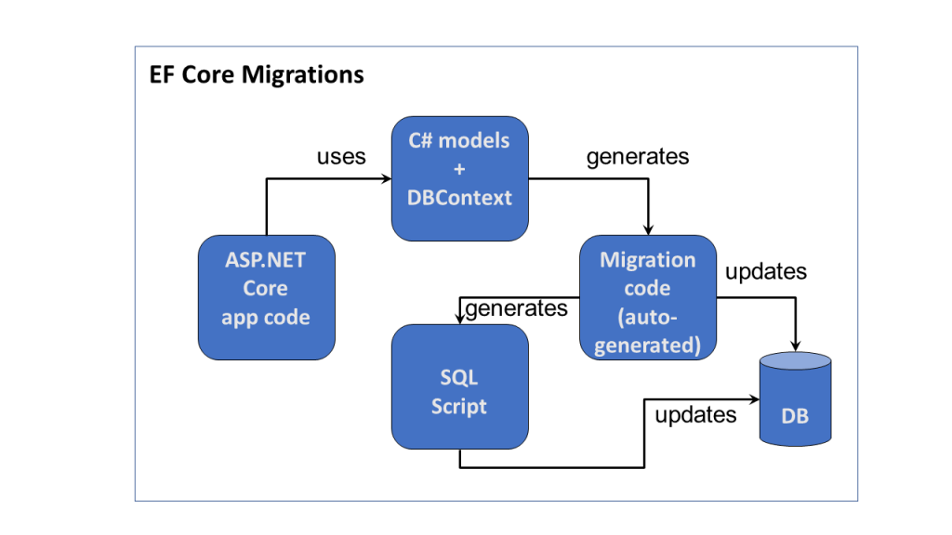
There are some options
EFCore
FluentMigrator
Flyway

Slide 4
Comparison
Feature | FluentMigrator | EF Core | Flyway
Language Agnostic | ❌ .NET only | ❌ .NET only | ✅ Any
Plain SQL | ❌ C# DSL | ❌ Generated | ✅ Yes
Version Control | ⚠️ Code files | ⚠️ Complex | ✅ Simple
CI/CD Integration | ⚠️ Needs SDK | ⚠️ Needs SDK | ✅ Native
DB2 Support | ✅ Good | ⚠️ Via IBM pkg | ✅ First-class
.NET Version Lock | ❌ Strict | ❌ Strict | ✅ None
Team Adoption | ❌ Dev only | ❌ Dev only | ✅ DBA-friendly

Slide 5
Why Flyway is Superior
1. Technology Independence
Switch languages without changing migrations
Upgrade .NET versions freely
2. Simple SQL Files
Any developer can read/write
Version control friendly
3. Production Ready
Used by Netflix, Amazon, Google
10+ years mature
Extensive DB2 support

Slide 6
Live Demo

Slide 7
CI/CD Integration
No .NET SDK needed
10x faster than EF Core
Works with any CI/CD platform

Slide 8
DB2 Database Migrations with Flyway
🚀 Native Performance
📦 Zero Dependencies
🔄 CI/CD Ready

Slide 9
Resource
GitHub: https://github.com/icwa-wa/core-insurance-platform-modernisation/tree/main/src/demos/db2-flyway-demo
Docs: https://www.red-gate.com/products/flyway/community/
Support: https://www.red-gate.com/hub/

