Slide 1
Defining Good Revenue
Data & Analytics
April 2025

Slide 2
Background – Why is this important?
Where are we making good pricing decisions?
Use this information to develop future recommendation models
(Training only on periods with “good revenue”)
Allow continuous monitoring of which assets are consistently performing well or poorly

Slide 3
Process Overview
1. Establish a comprehensive metric to benchmark asset performance against competitors
2. Build a tailored comp set for each asset
3. Monitor each asset’s position within its comp set using the defined metric

Slide 4
1. Establishing a Metric
Net Leased:
1 – (Total # of listings / Total # of units)
Rent Roll¹:
Effective rent / sqft. adjusting for unit group
RevPASF
(Rent Roll / sqft.) x (Net Leased)

Slide 5
2. Building Comp Sets
HelloData has an algorithm to calculate similarity between properties using various parameters.
Convene on next steps
Use https://create-compsets.streamlit.app/ as a guide when creating sets

Slide 6
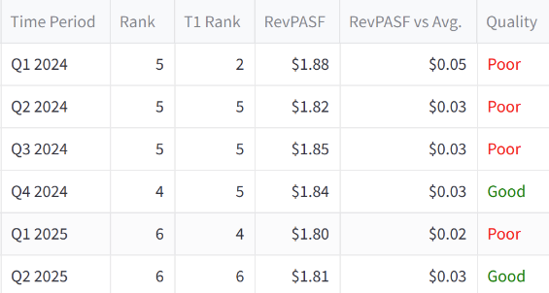
3. Monitoring Position in RevPASF among Comps
If RevPASF Rank…
RevPASF Rank among Comp Set
Last Quarter’s RevPASF Rank among Comp Set
Improves
Declines
Stays the same
If RevPASF vs. Avg…
Period Quality: Good
Increases
Decreases
Period Quality: Poor

Slide 7
Appendix

Slide 8
Rent Roll Calculation
1
The only information we have for external assets is their online listings every day.
For rent roll calculations, we’re assuming that the new resident chose the most financially optimal lease term, based on what was listed.
The way we’re calculating rent roll for each day is:
Take the most recent lease for each unit up to that day
Estimate that asset’s unit mix and apply the reference property’s mix as a weighting factor to normalize them to the same scale
Calculate rent roll / sqft.

