Slide 1
RMP Adherence Report
March 5th, 2025
Notes:
- I just want to run through some trends that we’ve seen when it comes to RMP acceptance rates and then we can talk about y’all’s feedback.
Feel free to stop me at any point if you have any comments or questions about the figures
The main goal of this is to get feedback of what you guys think about these ideas

Slide 2
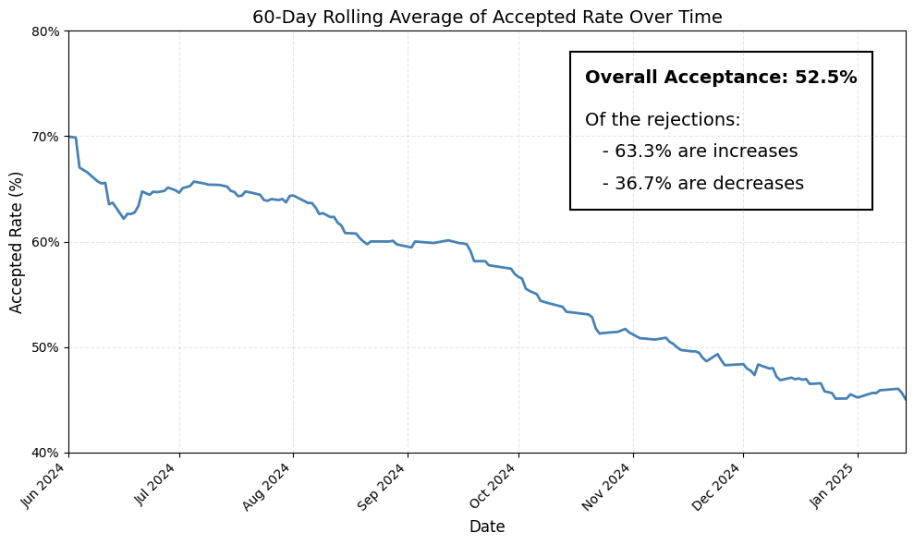
RMP Acceptance Trend
Notes:
This is the biggest trend I noticed. Over the past 6 months, acceptance rate has gradually but steadily dropped from 70% to below 50%. Most of the rejections are increases.
Definition of ‘acceptance’:
Baseline input is within the range given by RMP

Slide 3
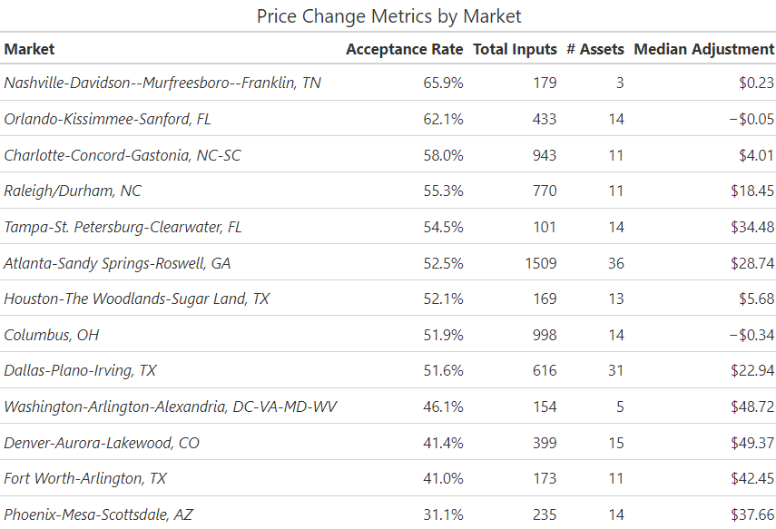
Breakdown by Market
Notes:
Here’s a breakdown of the biggest markets. The lower they are in this table, the lower the recommendation acceptance rate. You can see that almost every market has a positive median adjustment, showing that there are a lot of increases

Slide 4
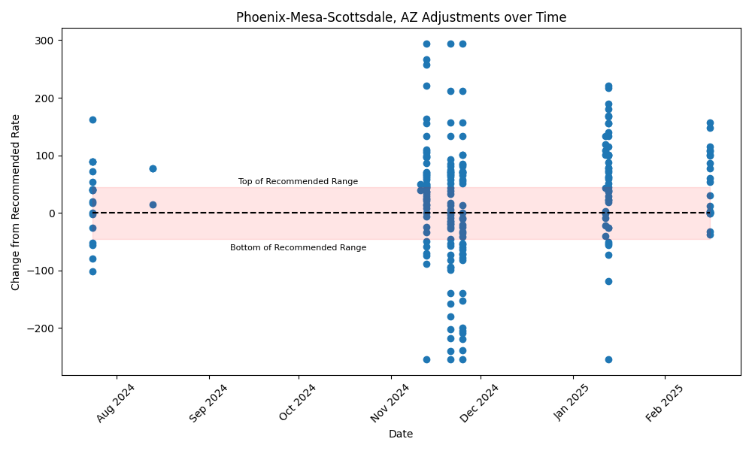
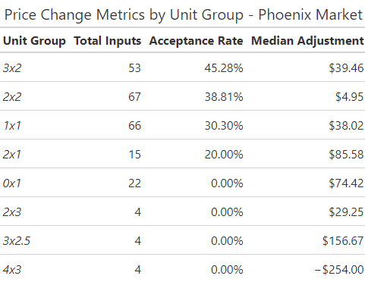
Phoenix Trend
Notes:
Heres a deep dive of the trend in Phoenix.
Each dot on this chart is an individual baseline input, shown as its relation to the RMP recommendation.
Some unit groups in this market are just completely off, it would be interesting to look at what’s going wrong with the studios. (mostly increases but some decreases)

Slide 5
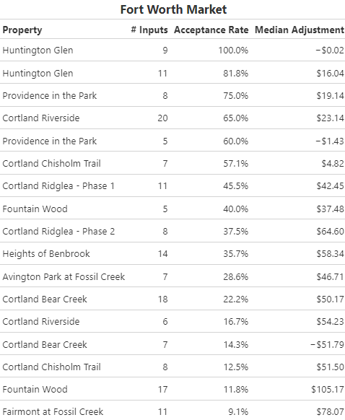
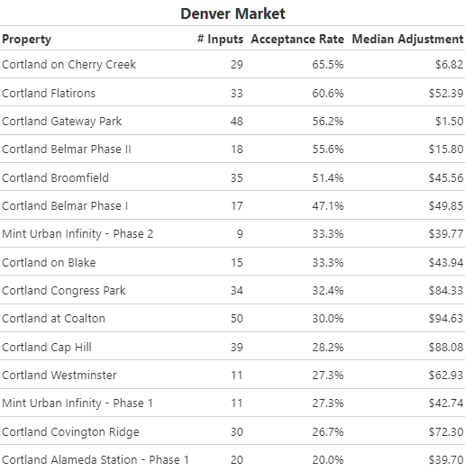
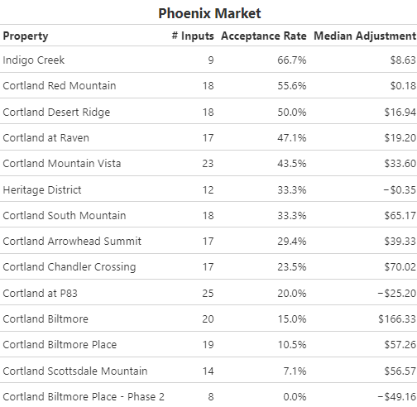
Asset-Level Metrics by Market
Notes:
Phoenix: Joshua
Fort Worth: Jason
Dener: Joshua

Slide 6
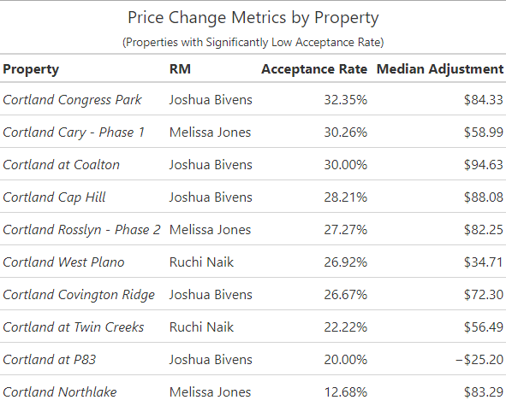
Breakdown by Property

Slide 7
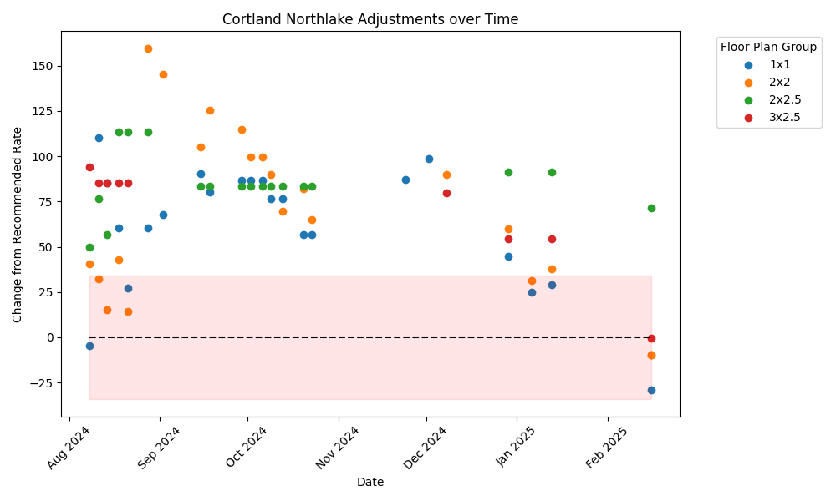
Northlake Trend

