Slide 1
RMP Adherence Report
March 5th, 2025
Notes:
- I just want to run through some trends that we’ve seen when it comes to RMP acceptance rates and then we can talk about y’all’s feedback.
Feel free to stop me at any point if you have any comments or questions about the figures
The main goal of this is to get feedback of what you guys think about these ideas

Slide 2
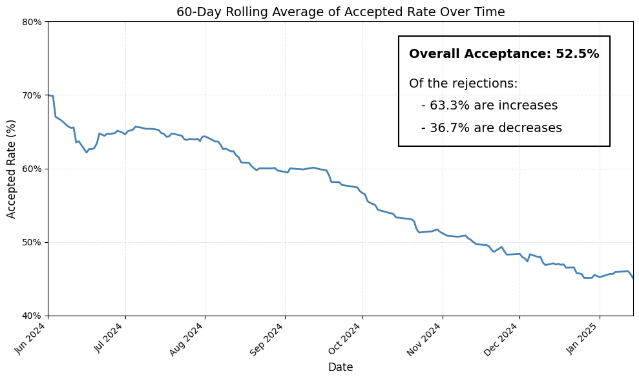
RMP Acceptance Trend
Notes:
Definition of ‘acceptance’:
Baseline input is within the range given by RMP

Slide 3
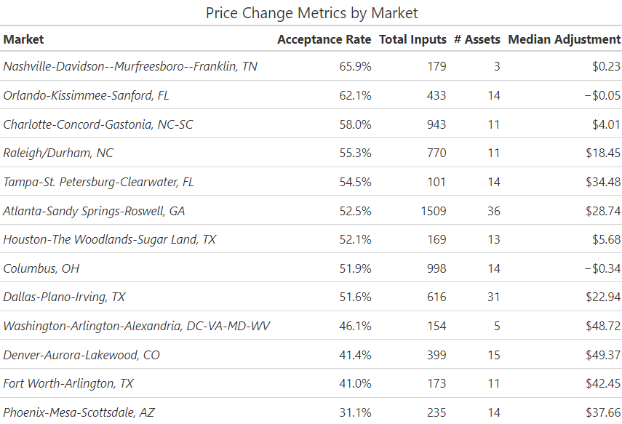
Breakdown by Market

Slide 4
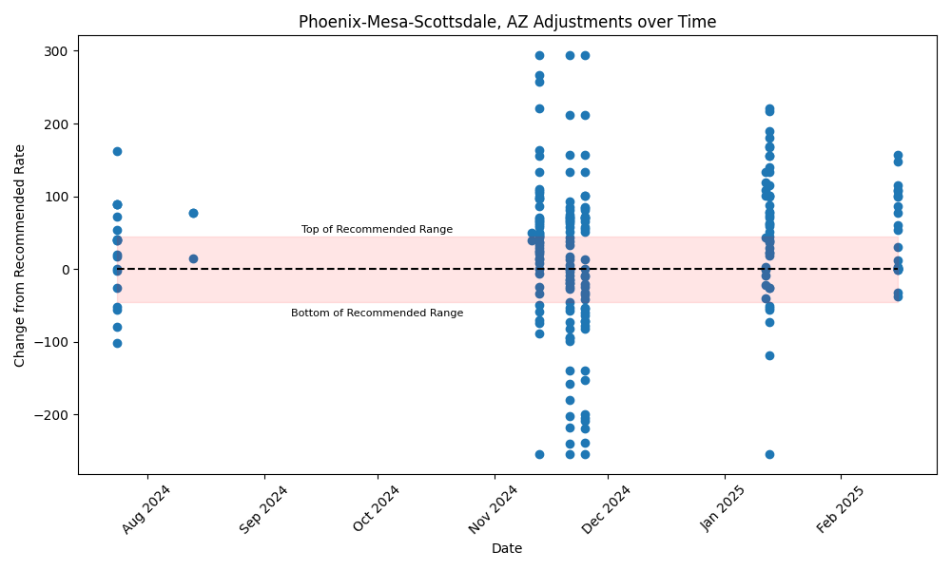
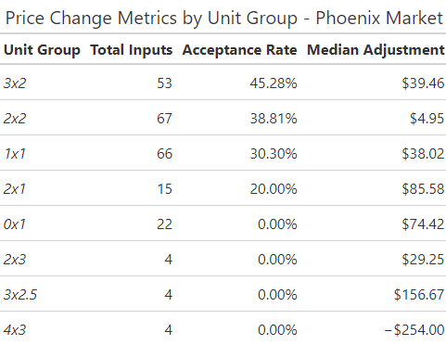
Phoenix Trend

Slide 5
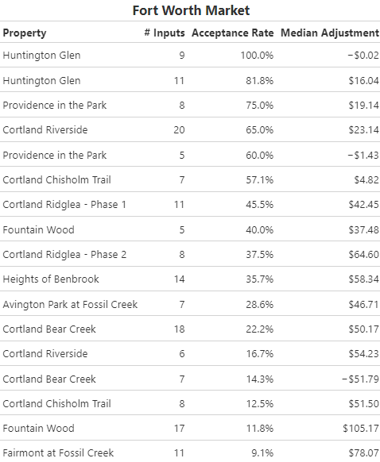
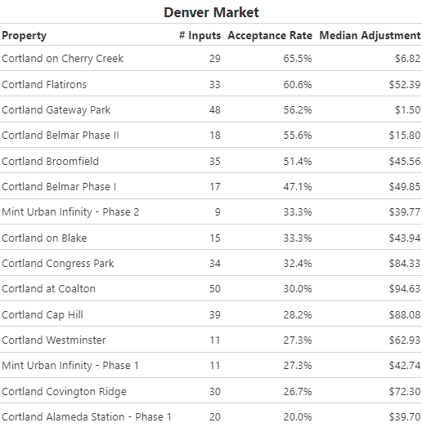
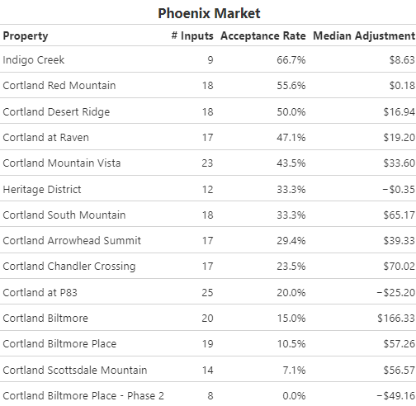
Asset-Level Metrics by Market

Slide 6
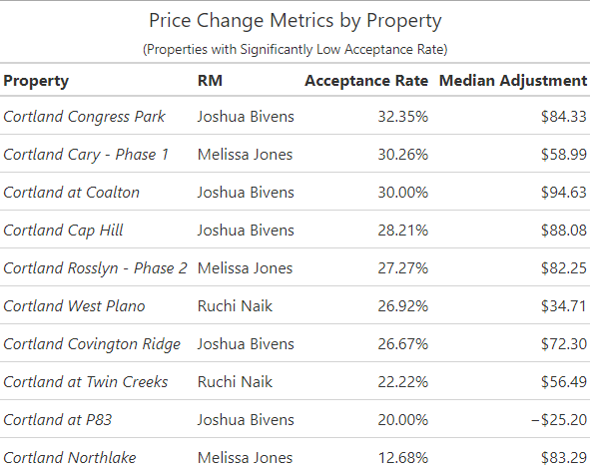
Breakdown by Property

Slide 7
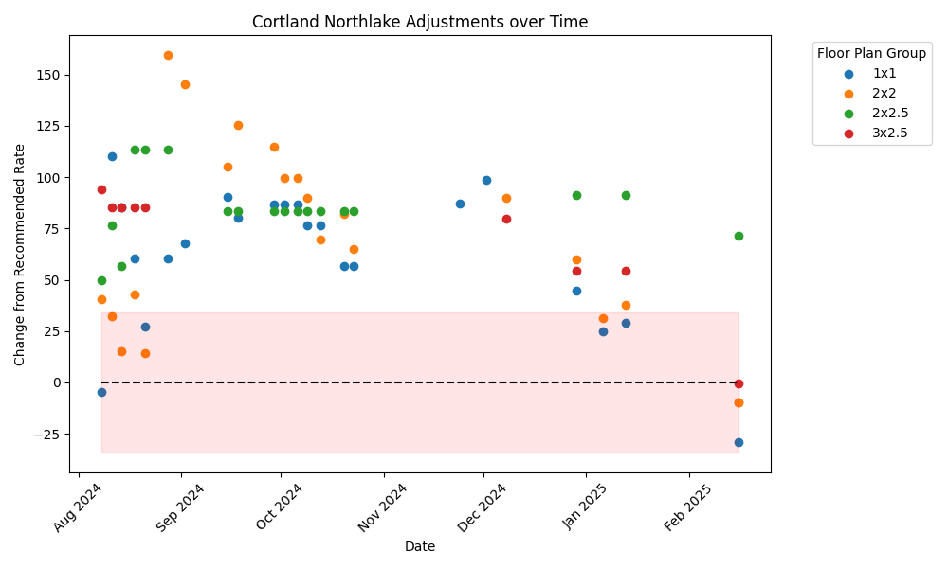
Northlake Trend

