Slide 1
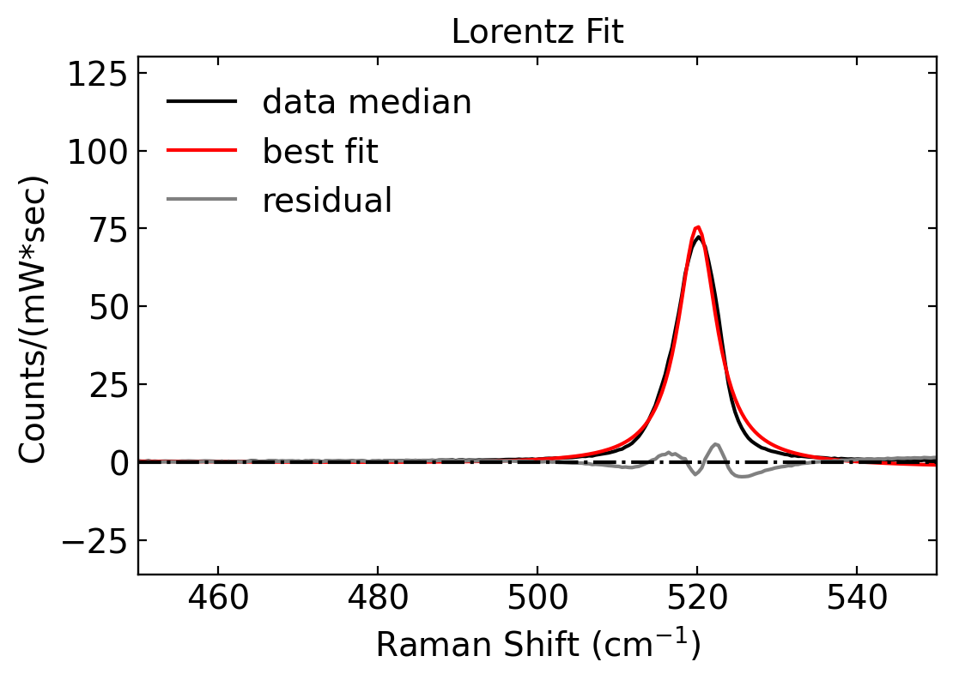
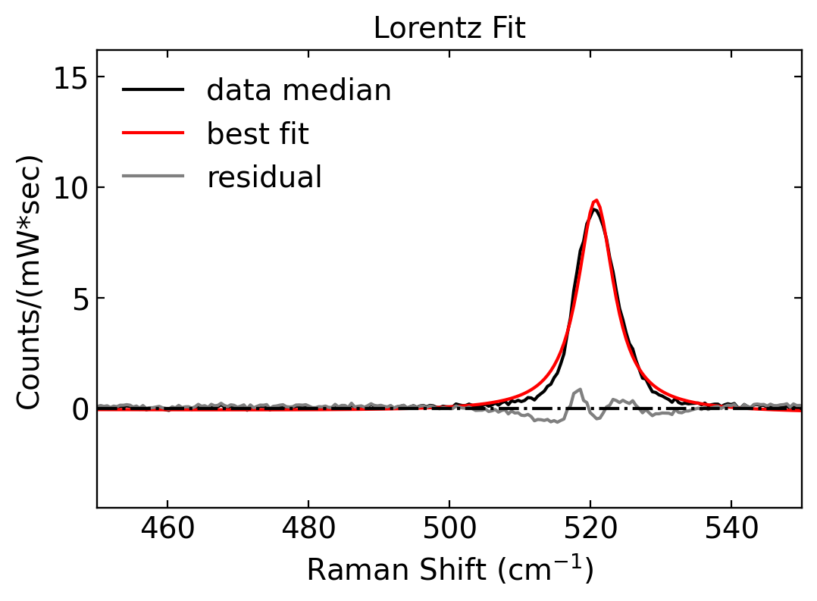
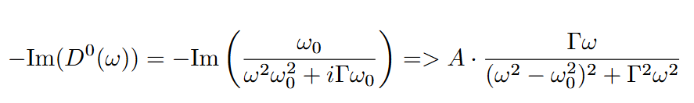
Si on TiO₂ - 08/09/2024
Room Temperature (0 mA)
Stokes
Anti-Stokes

Slide 2
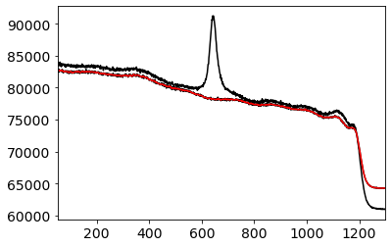
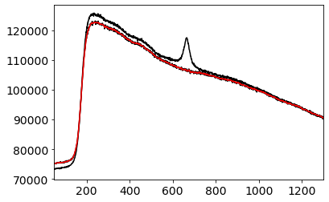
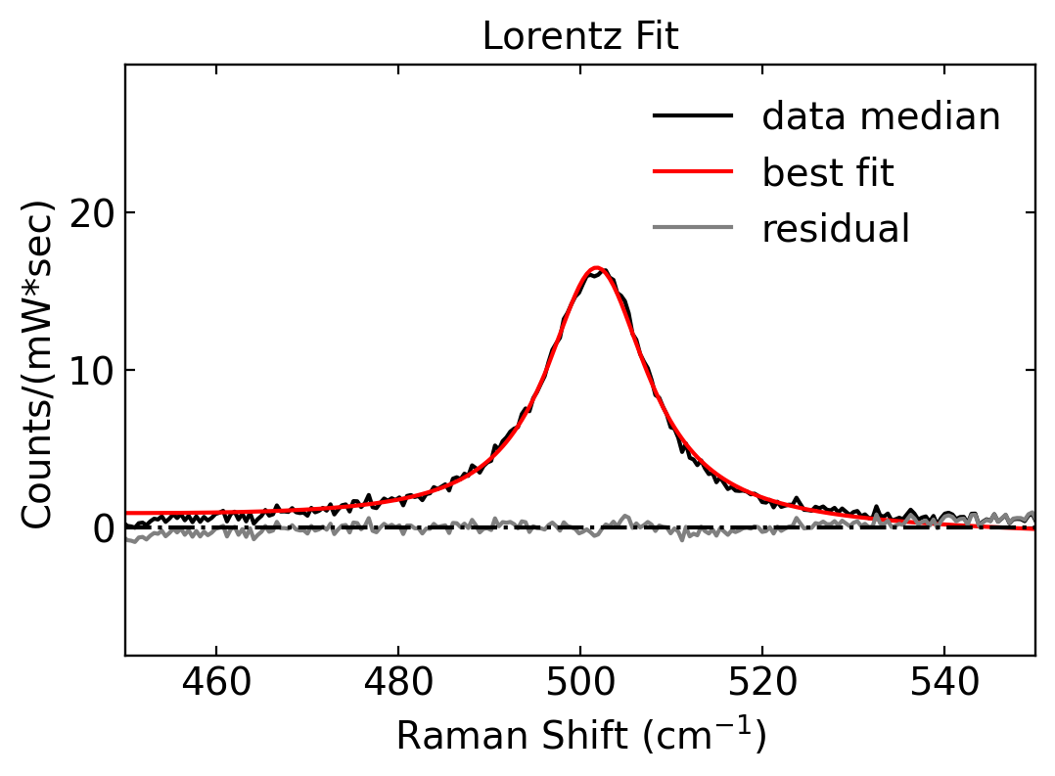
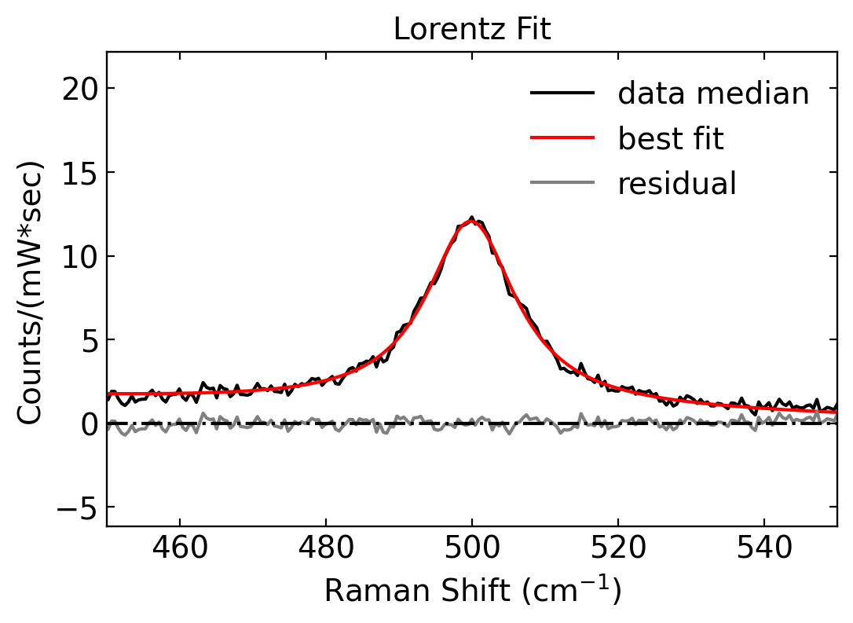
Si on TiO₂ - 08/09/2024
Stokes
Anti-Stokes
Strong backgrounds
Background subtraction results in reasonable fitting of the Si phonon

Slide 3
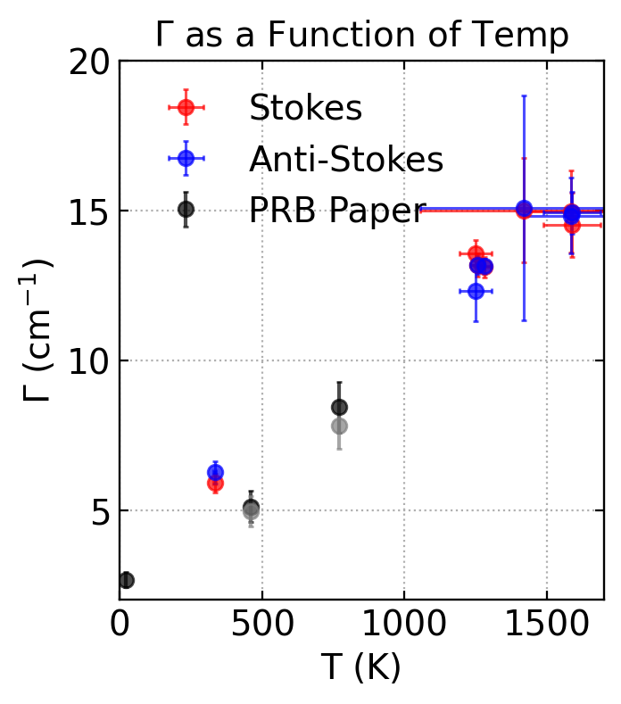
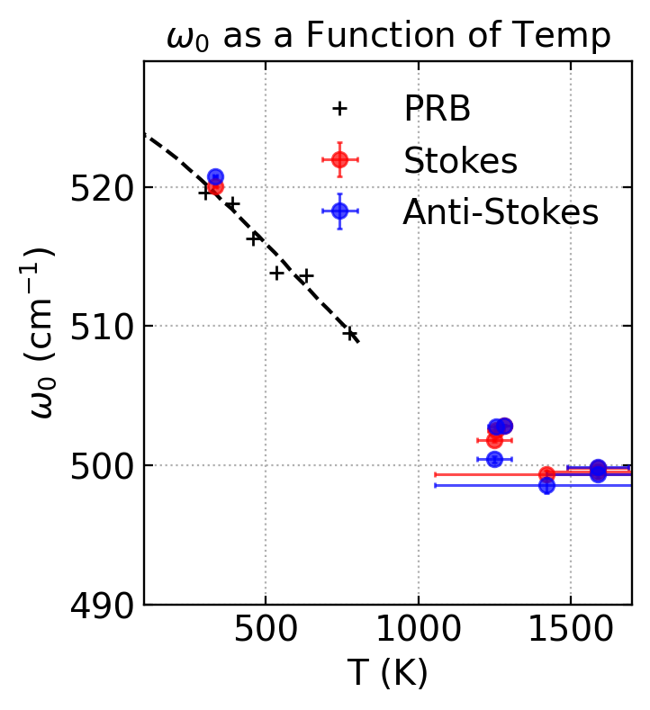
Si on TiO₂ - 08/09/2024
Data at 80 mA has large errors, due to large background. Maybe ist better to leave this data point out (next slide).

Slide 4
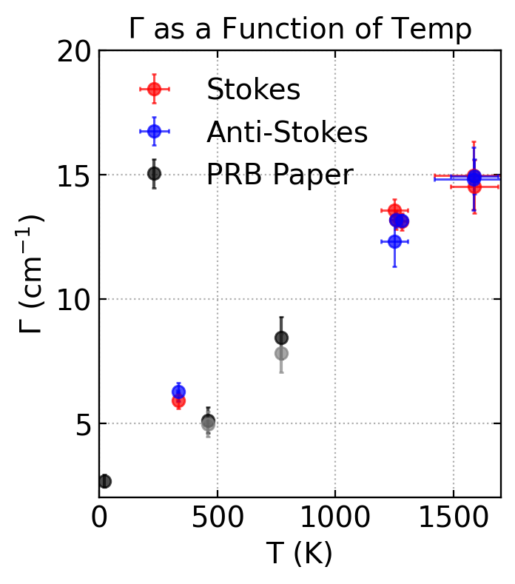
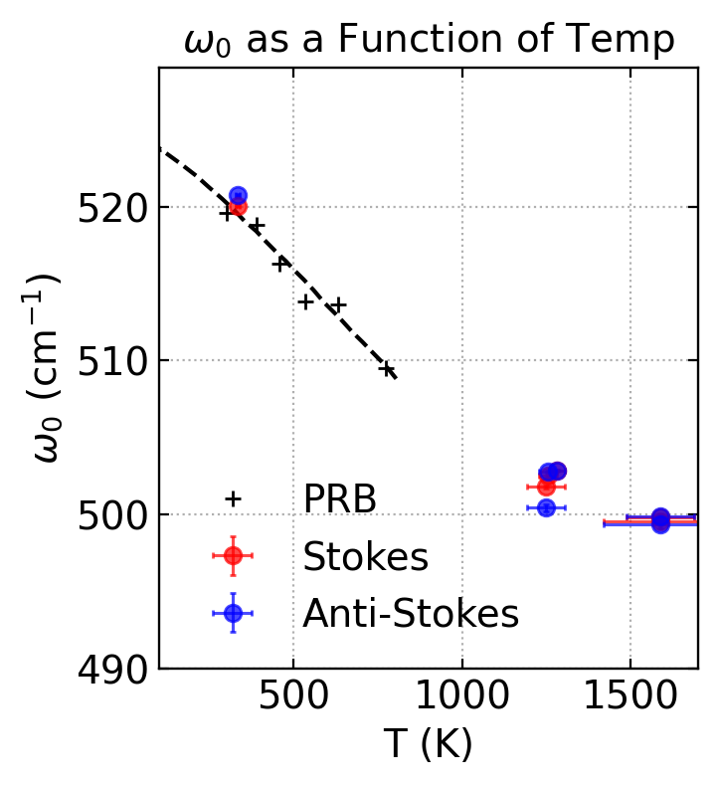
Si on TiO₂ - 08/09/2024

Slide 5
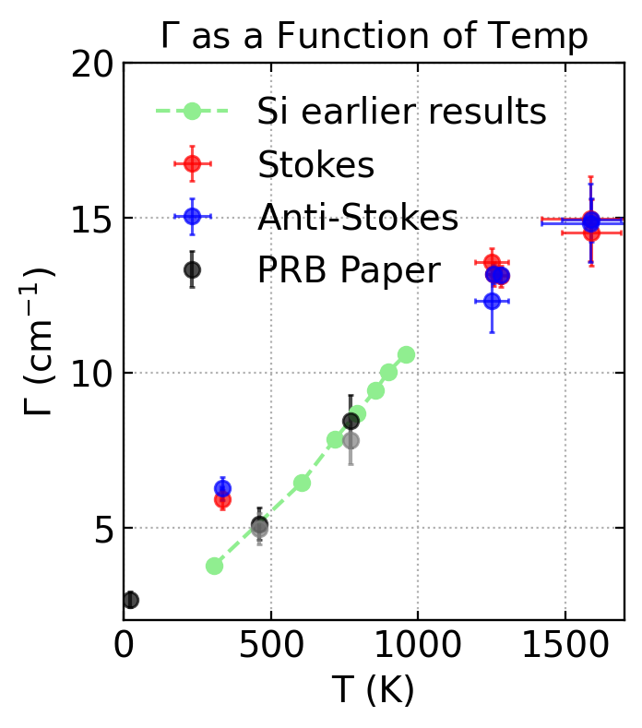
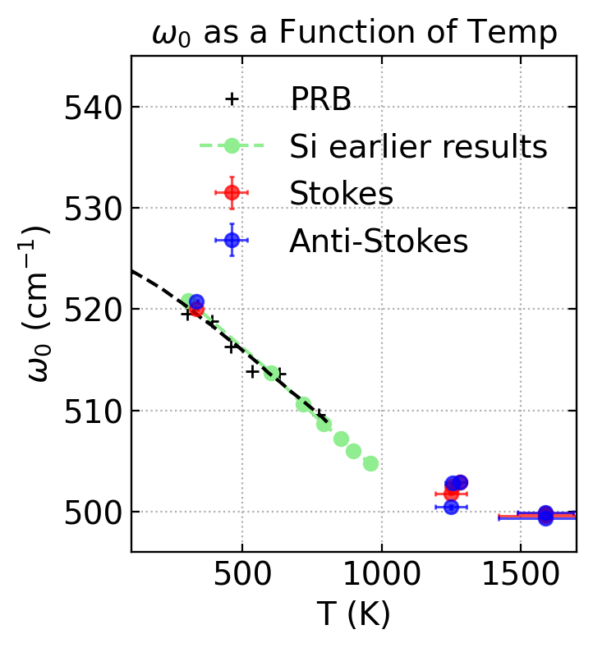
Si on TiO₂ - 08/09/2024

Slide 6
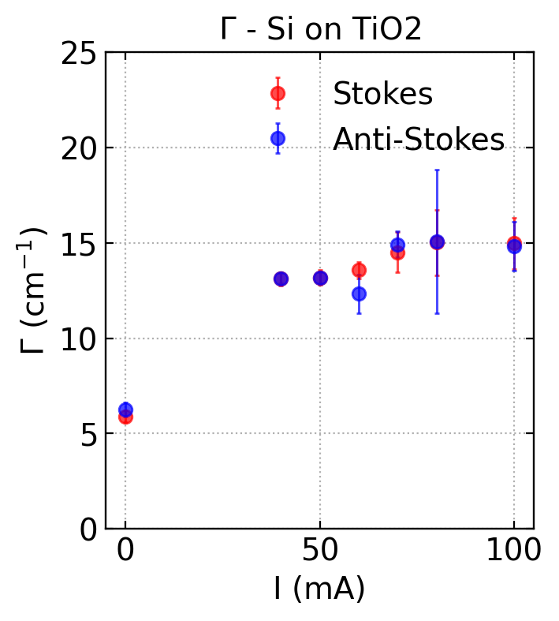
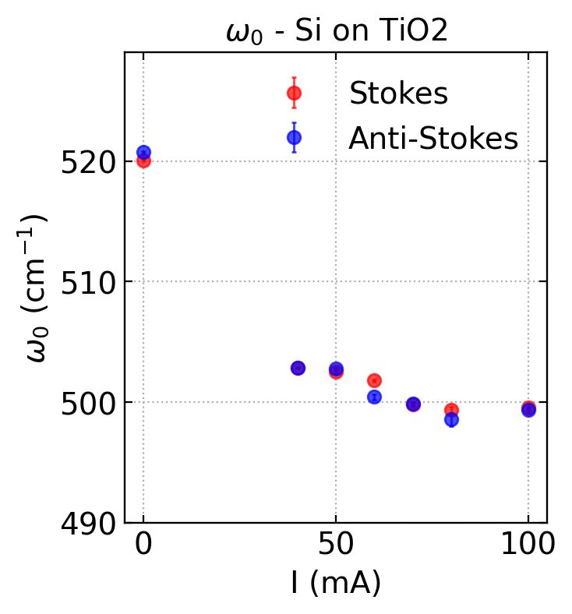
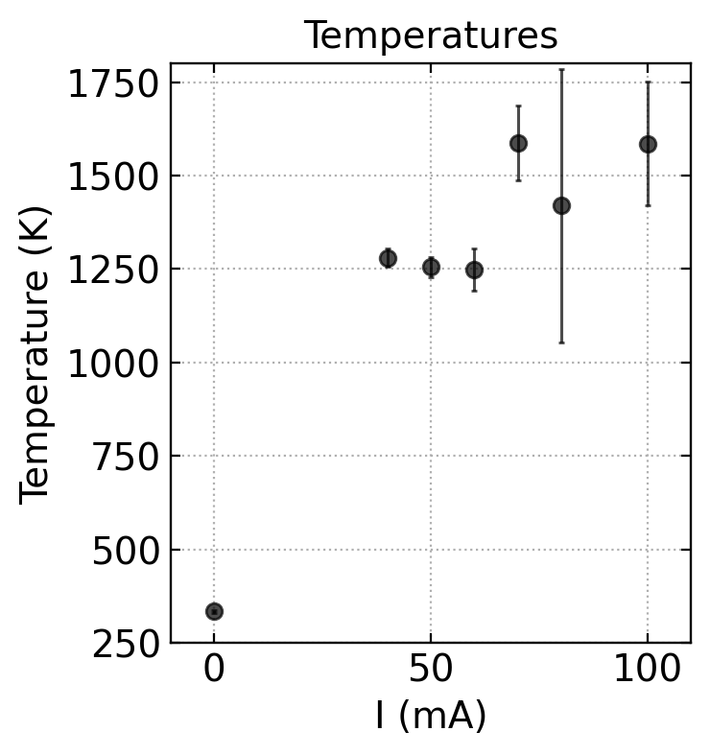
Si on TiO₂ - 08/09/2024

Slide 7
Si on TiO₂ - 08/09/2024
Temperature results:
0 mA 333.97 ± 1.49 K
40 mA 1280.37 ± 7.89 K
50 mA 1255.22 ± 8.76 K
60 mA 1248.58 ± 18.87 K
70 mA 1588.00 ± 33.24 K
80 mA 1419.47 ± 121.72 K
100 mA 1586.08 ± 55.47 K

