Slide 1
(a)
(b)
Controller
Obstacles
Active particle
Target
Reward
Observation
Action
Environment
Notes:
Conceptual illustration of active-particle steering. (a) A particle moves through a confined channel toward a target while avoiding fixed obstacles; the dashed path is an illustrative proposed route. (b) A controller sends an action to the environment and receives separate observation and reward signals. The network icon is symbolic and does not specify an implemented architecture. All geometry is schematic; no measured or simulated results are shown.
Image-guided native-object reconstruction.
{"source": "Built-in image generator, followed by visual semantic reconstruction", "synthetic": true, "retained_raster": [], "reconstruction_adjustments": ["Flat palette fills and actual Times New Roman text replace raster approximations.", "Path lowered-loop minimum is lifted slightly for particle/wall clearance.", "Short labels use fitted native text boxes and a right margin."]}

Slide 2
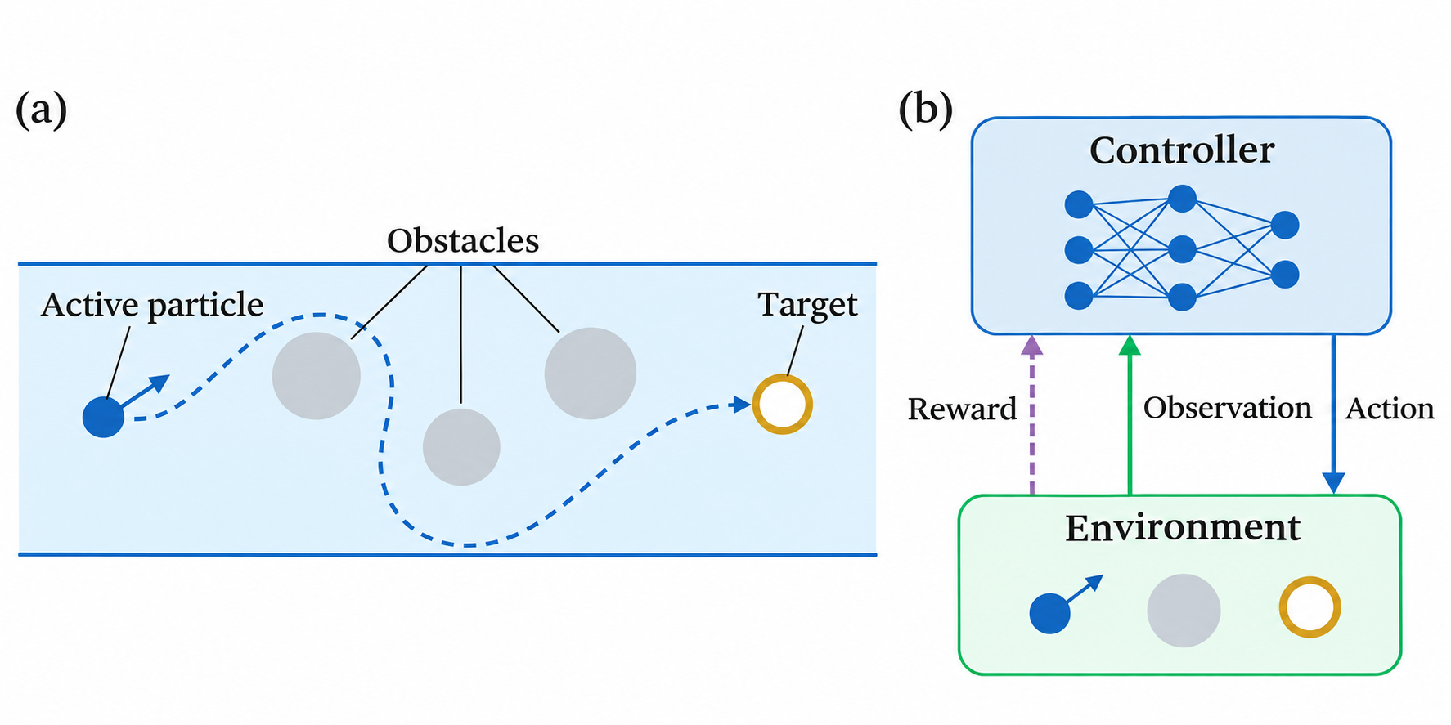
Notes:
Original model-generated visual reference. Edit native objects on slide 1. Source SHA256: 4a46d48d190e4cd8550b3f40c32b6c6b4591f4ae4a759658b5302192d8f3512c

