Slide 1
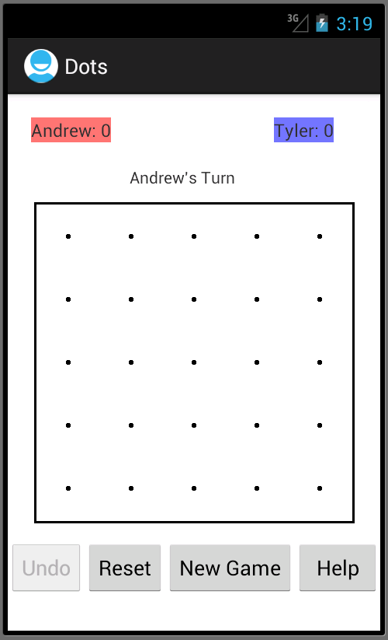
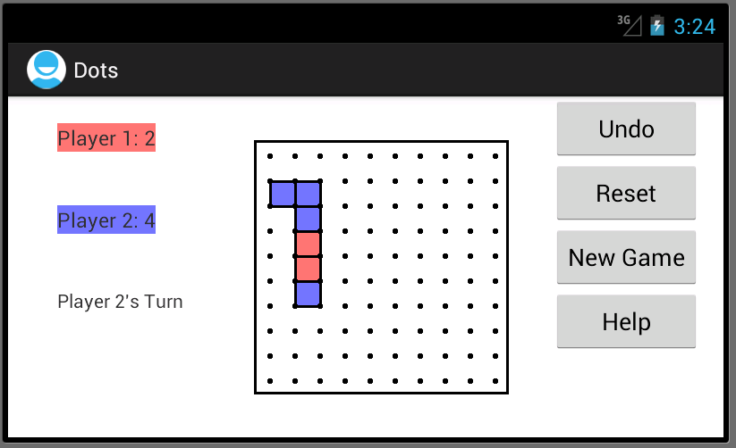
DOTS
Andrew Siegle and Tyler Hannan

Slide 2
FEATURES
ONE OR TWO PLAYER GAME
LANDSCAPE AND VERTICAL VIEWS
ADJUSTMENT FOR PHONE AND TABLET SCREEN SIZES
AI TO PLAY AGAINST
COLOR PREFERENCE
UNDO LAST MOVE
CHANGEABLE GRID SIZE
PERSONALIZED NAMES

Slide 3
WHAT IF
SQLLITE TO SAVE GAMES IN PROGRESS
MULTIPLE (MORE THAN 2) PLAYER SUPPORT
WIRELESS / MULTI-DEVICE GAMES
MORE PREFERENCES

Slide 4
DEMO

