Slide 1
Scalable GP with Additive Experts for Non-Gaussian UQ
Two-stage model for co-located multimodal regression
Scientific target: modes of p(y|x), not expert count
Advisor overview · equations = native PowerPoint Equation objects

Slide 2
Two-stage method at a glance
Stage 1
Exact GP midline
μ₀(x), σ₀(x)
→ freeze
Stage 2
Sparse residual mix
α, π, δ, γ
Adam on L
Data
{(xᵢ, yᵢ)}
i = 1…n
Predict p(y|x)
Report K_modes
vs K̂ / K_eff

Slide 3
Symbol glossary (1/2) — data & Stage 1
x, y — input and scalar response
n — number of training pairs
(xᵢ, yᵢ) — i-th training example
μ₀(x) — Stage-1 GP posterior mean; frozen in Stage 2
σ₀(x) — Stage-1 GP posterior std (noise/ceiling)
rᵢ = yᵢ − μ₀(xᵢ) — residual after Stage 1
ŝ — sample std of residuals {rᵢ}
c — cap multiplier for σ₀ (champion p12 uses c on residual scale)
σ₀^cap(x) — min(σ₀(x), max(c ŝ, 0.05)) — capped GP std
σ₀^mix(x) — GP std used in Stage 2: σ₀^cap (p12) or full σ₀ (legacy)
K_max — overcomplete expert budget (e.g. 6)
k = 1…K_max — expert index
ε — tiny floor for numerical stability / soft thresholds
T, t — total Adam steps and current step

Slide 4
Symbol glossary (2/2) — Stage 2 & reporting
α_k ∈ [0,1] — Hard-Concrete on/off switch for expert k
π_k (or π_k(x)) — mixture / gate weight; ConstantGate: independent of x
π̄_k — average gate mass = (1/n) Σᵢ π_k(xᵢ)
δ_k(x) — offset (constant or MLP); pinned to zero π·α-weighted center
γ_k ∈ (0,1) — variance carve-out fraction (sigmoid of raw_gamma)
μ_k(x) — expert mean = μ₀(x) + α_k δ_k(x)
Var_k(x) — expert variance = [σ₀^mix]² (1 − α_k γ_k) + ε
α̃_k — soft usage score from α_k and π̄_k (Option E)
τ — temperature for soft usage α̃_k
β_HC, γ_HC, ζ_HC — Hard-Concrete temperature & stretch (not expert variance)
λ_· — scalar weights on each regularizer (λ_k may anneal in t)
gap_ij — standardized mean gap |μ̄ᵢ−μ̄ⱼ| / (σ̄ᵢ+σ̄ⱼ)
K_modes — # local maxima of p(y|x) — scientific metric
K̂, K_eff — hard active count; usage×separation effective count (diagnostic)

Slide 5

Stage 1 — Exact GP midline
Fit one exact GPR on ALL training points → μ₀(x), σ₀(x)
$$σ_{0}^{cap}(x_{i})=min(σ_{0}(x_{i}),max(c\hat{s},0.05))$$
σ₀^cap — optional ceiling so Stage 2 does not ride a fat noise band (p12)
σ₀^mix — denotes whichever ceiling Stage 2 uses (cap or full)
• Full domain — no partitioning data by expert.
• After Stage 1 the GP is frozen; Stage 2 never updates it.
• Residual quantiles seed initial expert offsets δ_k.

Slide 6
Stage 2 — Mixture on the midline
$$μ_{k}(x)=μ_{0}(x)+α_{k}δ_{k}(x)$$
$${Var}_{k}(x)=[σ_{0}^{mix}(x)]^{2}(1−α_{k}γ_{k})+ε$$
$$p(y∣x)=\sum_{k=1}^{K_{max}}{π_{k}}𝒩(y;μ_{k}(x),{Var}_{k}(x))$$
α_k — Expert switch; overcomplete K_max, unused experts → 0
π_k — mixture weight (constant gate for co-located modes)
δ_k — residual offset; high α places expert off the midline
γ_k — carve-out: γ→1 sharpens active experts; γ→0 keeps fat blob
ε — tiny variance floor

Slide 7
How α_k becomes 0 or 1
$$γ_{HC}=−0.1,ζ_{HC}=1.1,β_{HC}=2/3$$
$$α_{k}={clip}_{\left[0 , 1\right]}(σ(logα_{k})(ζ_{HC}−γ_{HC})+γ_{HC})$$
$$α_{k}=0 if σ(logα_{k})≤\frac{0.1}{1.2}≈0.083$$
$$α_{k}=1 if σ(logα_{k})≥\frac{1.1}{1.2}≈0.917$$
$$t=−γ_{HC}/ζ_{HC}=0.1/1.1≈0.0909$$
• log α_k is free (Adam); α_k is not itself a free [0,1] parameter.
• Stretch into [γ_HC, ζ_HC]=[-0.1, 1.1], then clip_[0,1] → exact 0/1 in the tails.
• Training uses a stochastic Concrete sample; eval uses the deterministic formula.

Slide 8

Shared building block — soft usage α̃_k
$${\overset{\sim }{α}}_{k}=σ\left(\frac{α_{k}{\overline{π}}_{k}−ε}{τ}\right)$$
α̃_k ≈ 1 — expert is “on”: both α_k and π̄_k are above ε
α̃_k ≈ 0 — expert is unused for sparsity / separation / γ prior
Used in — L_usage, L_sep, L_alive, L_ov, L_γ, L_rec, and K_eff
• Makes every regularizer continuous and usage-aware.
• Avoids hard discrete on/off decisions inside the Adam loop.

Slide 9
Stage 2 loss — total objective
$$ℒ=NLL+λ_{k}(t)ℒ_{usage}+λ_{sep}ℒ_{sep}+λ_{α}ℒ_{HC}+λ_{orphan}ℒ_{orphan}$$
$$+0.5ℒ_{alive}+λ_{ov}ℒ_{ov}+λ_{δ}ℒ_{δ}+λ_{γ}ℒ_{γ}+λ_{rec}ℒ_{rec}$$
$$λ_{k}(t)=λ_{k}^{start}+\frac{t−1}{T−1}(λ_{k}−λ_{k}^{start})$$
NLL — mixture negative log-likelihood (only term that fits data)
λ_k(t) — annealed usage weight (P4: form modes before pruning)
λ_sep, λ_α, … — fixed weights on structural regularizers
• No mixture-mean MSE — would collapse co-located modes toward μ₀.
• Adam updates only Stage-2 parameters; Stage-1 GP stays frozen.

Slide 10

NLL — mixture negative log-likelihood
$$NLL=−\frac{1}{n}\sum_{i=1}^{n}{log}\sum_{k=1}^{K_{max}}{π_{k}}𝒩(y_{i};μ_{k}(x_{i}),{Var}_{k}(x_{i}))$$
Variables
n — training size
π_k — mixture weight for expert k
μ_k, Var_k — expert mean and variance at xᵢ
N(·) — Gaussian density
Why / justification
• Why: Directly trains the predictive density p(y|x).
• Justification: Correct likelihood for a Gaussian mixture (logsumexp).
• This is the only term that “wants” to explain the data.

Slide 11

L_usage — soft expert count (sparsity)
$${\overset{\sim }{α}}_{k}=σ\left(\frac{α_{k}{\overline{π}}_{k}−ε}{τ}\right),ℒ_{usage}=\sum_{k}{{\overset{\sim }{α}}_{k}}$$
Variables
α̃_k — soft usage of slot k
α_k, π̄_k — switch and average gate mass
ε, τ — threshold and temperature for the soft step
σ(·) — logistic sigmoid
Why / justification
• Why: Overcomplete K_max tends to keep unused experts alive.
• Justification: Continuous L0-style pressure on used slots.
• Annealed λ_k: form modes before pruning (P4).

Slide 12

L_sep — separate offset curves
$$ℒ_{sep}=\sum_{i<j}{{\overset{\sim }{α}}_{i}}{\overset{\sim }{α}}_{j}softplus\left(m_{sep}−\frac{1}{n}\sum_{ℓ}{|}δ_{ℓi}−δ_{ℓj}|\right)$$
Variables
δ_ℓi — pinned offset of expert i at training row ℓ
m_sep — target separation margin on mean |δᵢ−δⱼ|
α̃_i α̃_j — only push pairs that are both in use
softplus — smooth hinge: softplus(z)=log(1+e^z)
Why / justification
• Why: Two experts can copy the same residual curve.
• Justification: Usage-weighted push so distinct arms stay distinct.
• Feeds K_eff = Σ α̃_k s_k (duplicates get low separation score).

Slide 13
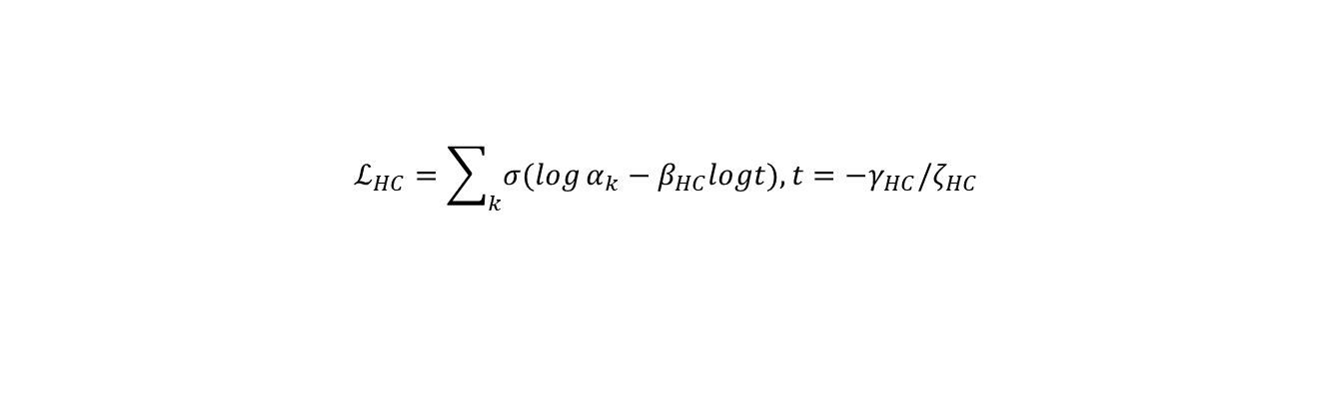
L_HC — Hard-Concrete complexity
$$ℒ_{HC}=\sum_{k}{σ(log}α_{k}−β_{HC}logt),t=−γ_{HC}/ζ_{HC}$$
Variables
log α_k — unconstrained Hard-Concrete location parameter
β_HC — Concrete temperature (code: beta on the gate)
γ_HC, ζ_HC — stretch constants (−0.1, 1.1)
t — threshold −γ_HC/ζ_HC for the L0 surrogate
Why / justification
• Why: Encourage α_k → 0 or 1, not half-on experts.
• Justification: Louizos et al. Concrete / Hard-Concrete L0 complexity.
• Stochastic α in training; deterministic α at eval.

Slide 14
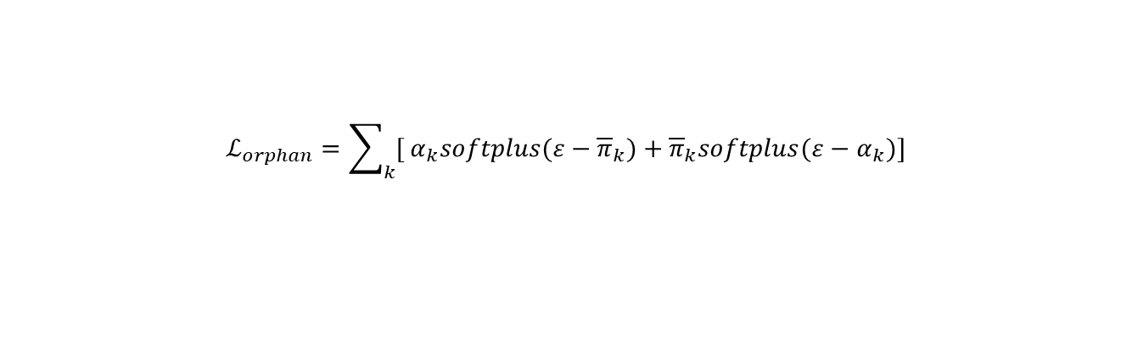
L_orphan — couple α and π
$$ℒ_{orphan}=\sum_{k}{[}α_{k}softplus(ε−{\overline{π}}_{k})+{\overline{π}}_{k}softplus(ε−α_{k})]$$
Variables
α_k — switch for expert k
π̄_k — average mixture weight
ε — dead-mass threshold
Why / justification
• Why: Block α-on/π≈0 (dead experts) and π-on/α≈0 (dead mass).
• Justification: Bidirectional π–α coupling stabilizes A04 fits.
• Stops runaway offsets and dead-π dominance.

Slide 15

L_alive — keep at least some mass
$$ℒ_{alive}=softplus(0.8−\sum_{k}{{\overset{\sim }{α}}_{k}})$$
Variables
Σ_k α̃_k — total soft usage
0.8 — soft floor on total usage
weight 0.5 — fixed coefficient in front of L_alive in code
Why / justification
• Why: Algorithm can kill all experts → parent GP only.
• Justification: Soft floor so multimodal data keeps ≥ ~1 used slot.
• Balances L_usage without a hard constraint.

Slide 16

L_ov — overlap / mean-gap
$${gap}_{ij}=\frac{abs({\overline{μ}}_{i}−{\overline{μ}}_{j})}{{\overline{σ}}_{i}+{\overline{σ}}_{j}},ℒ_{ov}=\sum_{i<j}{{\overset{\sim }{α}}_{i}}{\overset{\sim }{α}}_{j}softplus(m_{ov}−{gap}_{ij})$$
Variables
μ̄_k, σ̄_k — training-average expert mean and std
gap_ij — separation in units of combined widths
m_ov — soft target for the standardized gap
Why / justification
• Why: Means inside each other’s noise bands merge into one hump.
• Justification: Standardized separation discourages merged peaks.
• Does not prescribe a target K — only discourages overlap.

Slide 17

L_δ — offset L2
$$ℒ_{δ}=mean(δ^{2})$$
Variables
δ — all pinned offsets (over data / experts)
λ_δ — ridge weight (e.g. 0.02 in treated A04)
Why / justification
• Why: Offsets can explode (expert means diving far from data).
• Justification: Mild ridge keeps residual experts on midline scale.
• Paired with orphan coupling in A04 settings.

Slide 18

L_γ — carve-out prior (p12)
$$ℒ_{γ}=\sum_{k}{{\overset{\sim }{α}}_{k}}(1−γ_{k})^{2}$$
Variables
γ_k — carve-out fraction for expert k
α̃_k — soft usage — prior acts on active slots
(1−γ_k)² — penalty for not carving (staying as wide as σ₀)
Why / justification
• Why: Without pressure, γ→0 and experts stay as wide as σ₀ (fat blob).
• Justification: Active experts should sharpen modes below the GP ceiling.
• Part of champion p12 with capped σ₀; free β-scale was muted.

Slide 19
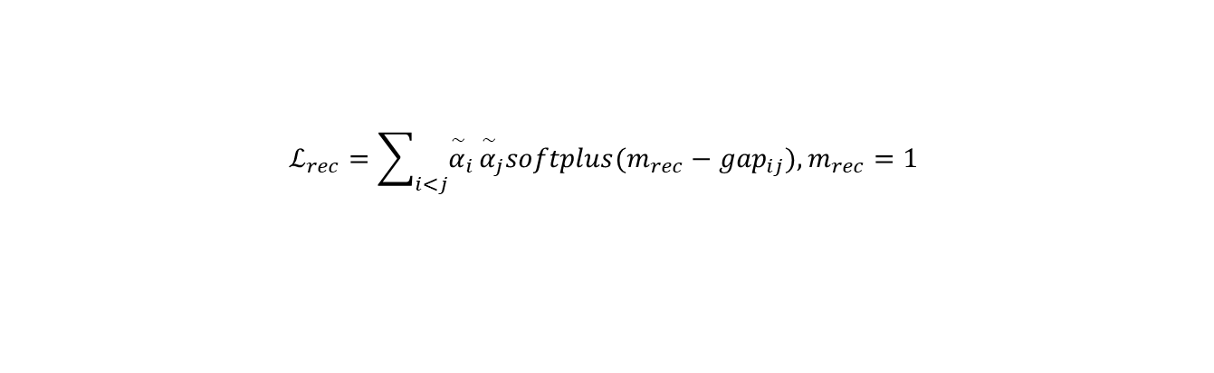
L_rec — recovery margin (+rec)
$$ℒ_{rec}=\sum_{i<j}{{\overset{\sim }{α}}_{i}}{\overset{\sim }{α}}_{j}softplus(m_{rec}−{gap}_{ij}),m_{rec}=1$$
Variables
gap_ij — same standardized gap as in L_ov
m_rec = 1 — Behboodian-scale margin (|Δμ| ≳ σᵢ+σⱼ)
λ_rec — weight (0 by default; 0.15 in recovery probes)
Why / justification
• Why: 1D GMM modes appear only if means separate vs σ.
• Justification: Enforce gap ≥ 1 so the fit stays multimodal-capable.
• Certificate checks this post-fit; does not prove match to truth.

Slide 20

What to remember
$$K_{modes}(x_{⋆})=\#\{local maxima of p(y∣x_{⋆})\}$$
• Stage 1: one GP on the full domain (then freeze).
• Stage 2: residual mixture — fit NLL + structure regularizers.
• Scientific metric: K_modes (peaks of p(y|x)), not K̂ experts.
• Champion path: cap σ₀ + γ prior (p12); optional +rec for mean–σ separation.
• Co-located multimodality is the design target; x-split tasks need different bias.

