Slide 1
True p(y|x) vs local data KDE
Why both appear on foundation / MidlineSparse marginal panels,
and how every formula is derived from the synthetic DGPs.
Source: plot_foundation_marginals.py · experiments_MOEGP

Slide 2
Purpose: two reference curves on each marginal panel
True p(y | x) (red)
Data KDE (local x) (gray dashed)
• Analytical density of the synthetic data-generating process (DGP).
• Gold standard for whether a model recovered multimodality / skew / heteroscedasticity.
• Does not depend on finite-sample noise or probe bandwidth.
• Answers: “What should p(y|x) look like in population?”
• Nonparametric estimate from train+test points near the probe x.
• Shows what the finite dataset actually supports at that x.
• Can disagree with truth when local n is small or modes are sparse.
• Answers: “What does this sample look like near x?”

Slide 3
Why keep both (not just one)?
• Scoring rules (CRPS, NLL) compare models to observed y; they do not visualize density shape.
• True p(y|x) diagnoses model misspecification of the DGP (e.g. unimodal GP on bimodal A01).
• Local KDE diagnoses whether the sample is informative at that probe (especially co-located modes).
• If model ≈ KDE but ≠ truth → under-sampling / hard local regime, not necessarily a bad model.
• If model ≈ truth but ≠ KDE → model may extrapolate the DGP better than the local histogram.
• If model ≠ both → clear failure of the predictive density at that x.

Slide 4

Setup: conditional density at a probe
All panels evaluate densities on a fine y-grid at a fixed probe x = x★.
$$p_{true}(y∣x^{⋆}),{\hat{p}}_{KDE}(y∣x^{⋆}),{\backslash qquadp}_{model}(y∣x^{⋆})$$
• True: closed form from the DGP used to generate the toy (A01–A05).
• KDE: Gaussian kernel density of y-values whose x lie near x★.
• Model: Gaussian mixture predictive from MidlineSparse / GP / TabPFN / TabFM / …
• Implemented in plot_foundation_marginals.TRUE_PDF and empirical_local_pdf.

Slide 5
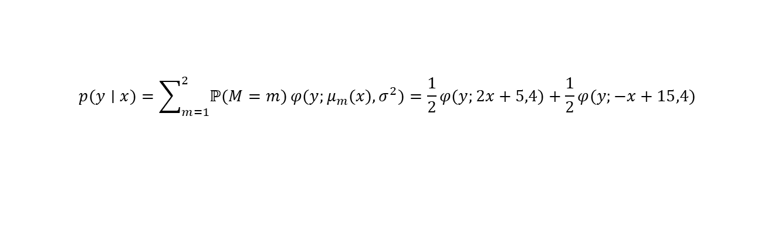
A01 bimodal — derivation of true p(y|x)
At each x, pick mode m∈{1,2} with equal probability, then add Gaussian noise.
$$μ_{1}(x)=2x+5,μ_{2}(x)=−x+15,σ=2$$
$$Y∣X=x,M=m\sim N(μ_{m}(x),σ^{2}),ℙ(M=1)=ℙ(M=2)=\frac{1}{2}$$
$$p(y∣x)=\sum_{m=1}^{2}{ℙ(M=m)}φ(y;μ_{m}(x),σ^{2})=\frac{1}{2}φ(y;2x+5,4)+\frac{1}{2}φ(y;−x+15,4)$$
Here φ(y; μ, σ²) is the N(μ,σ²) density. Modes are co-located in x (both active everywhere); separation grows with x, so panels near x≈8 show clear bimodality while x≈2 looks nearly unimodal.

Slide 6
Unimodal control & A02 step — true densities
Unimodal negative control
$$Y=0.5X+2+0.3ε,ε\sim N(0,1)⇒p(y∣x)=φ(y;0.5x+2,0.09)$$
A02 discontinuous step (separated regimes)
$$μ(x)=1\{x≥0.5\},\backslash qquadY=μ(X)+0.05ε,ε\sim N(0,1)$$
$$p(y∣x)=φ(y;1\{x≥0.5\},{0.05}^{2})$$
Unimodal: single Gaussian — models should not invent modes.
A02: mean jumps at 0.5; locally still unimodal, but hard for smooth GPs near the kink.

Slide 7
A04 trimodal — unequal widths
Three co-located Gaussian modes with distinct slopes and noise levels.
$$μ_{0}=2x+5,σ_{0}=0.8;μ_{1}=−0.5x+12,σ_{1}=2;μ_{2}=x−2,σ_{2}=4$$
$$ℙ(M=m)=\frac{1}{3},\backslash qquadY∣X=x,M=m\sim N(μ_{m}(x),σ_{m}^{2})$$
$$p(y∣x)=\sum_{m=0}^{2}{\frac{1}{3}}φ(y;μ_{m}(x),σ_{m}^{2})$$
• Wide component (σ=4) can mask narrow peaks in finite samples → KDE may look unimodal.
• True density still has up to three modes; MidlineSparse is scored on recovering them.

Slide 8
A05 heteroscedastic skew — generative story
$$Y=μ(X)+ε(X),μ(x)=0.5x+2$$
Noise ε(x) is a contaminated asymmetric Laplace (still unimodal at each x).
$$w=\frac{x−x_{lo}}{x_{hi}−x_{lo}}∈[0,1],{\backslash quadx}_{lo}=0,x_{hi}=10$$
$$σ(x)=σ_{min}+(σ_{max}−σ_{min})w^{1.5},σ_{min}=0.2,σ_{max}=2$$
$$τ(x)=τ_{min}+(τ_{max}−τ_{min})w,τ_{min}=0.35,τ_{max}=0.75$$
σ(x) grows nonlinearly (heteroscedasticity). τ(x) is the probability of the positive exponential side (skew). Contamination rate ε_c = 0.12, κ = 4.

Slide 9

A05 — asymmetric Laplace scales (Var ≈ σ²)
Two-sided exponential: P(+)=τ, scale b₊ on the positive side, b₋ on the negative.
$$b_{+}=\frac{σ}{\sqrt{2τ}},{\backslash qquadb}_{−}=\frac{σ}{\sqrt{2(1−τ)}}$$
$$Var(ε_{raw})=2(τb_{+}^{2}+(1−τ)b_{−}^{2})=σ^{2}$$
$$z≥0:f_{raw}(z)=τb_{+}^{−1}e^{−z/b_{+}}$$
$$z<0:f_{raw}(z)=(1−τ)b_{−}^{−1}e^{z/{b_{−}}}$$
When τ=1/2, b₊=b₋=σ/√2 and the law is symmetric Laplace with variance σ². Away from 1/2 the density is skewed while variance still tracks σ².

Slide 10
A05 — zero-mean centering and contamination mixture
$$E[ε_{raw}]=τb_{+}−(1−τ)b_{−}=Δ(x)$$
$$ε_{AL}=ε_{raw}−Δ(x)⇒E[ε_{AL}]=0$$
Change of variables for the density of AL noise (Jacobian = 1):
$$f_{AL}(e)=f_{raw}(e+Δ),\backslash qquade=y−μ(x)$$
$$p(y∣x)=(1−ε_{c})f_{AL}(y−μ(x))+ε_{c}φ(y;μ(x),(κσ(x))^{2})$$
With ε_c=0.12, κ=4: mostly skewed core, occasional wide Gaussian outliers. Target remains unimodal — MidlineSparse should not invent modes.

Slide 11

Local data KDE — mathematical definition
Pool train and test: {(x_i, y_i)}. Fix probe x★ and bandwidth h_x.
$$N(x^{⋆};h_{x})=\{i:|x_{i}−x^{⋆}|≤h_{x}\}$$
$${\hat{p}}_{KDE}(y∣x^{⋆})=\frac{1}{|N|h_{y}}\sum_{i∈N}{K}\left(\frac{y−y_{i}}{h_{y}}\right)$$
$$K(u)=\frac{1}{\sqrt{2π}}e^{−u^{2}/2}(Gaussian kernel; SciPy gaussian\backslash _kde)$$
SciPy’s gaussian_kde chooses the y-bandwidth h_y by Scott/Silverman rules from the local y-sample. We only control the x-neighborhood that defines N.

Slide 12
Local x-bandwidth schedule (implementation)
$$h_{x}^{\left(0\right)}=max(0.08(x_{max}−x_{min}),{10}^{−3})$$
• Collect N = {i : |x_i − x★| ≤ h_x}.
• If |N| < 12, set h_x ← 1.6 h_x and retry (up to 6 widenings).
• If still |N| < 5 after widening, omit the KDE curve (too few points).
• Otherwise fit gaussian_kde({y_i : i∈N}) and evaluate on the y-grid.
• Probes are interior linspace points (endpoints excluded) so neighborhoods are not half-empty.

Slide 13
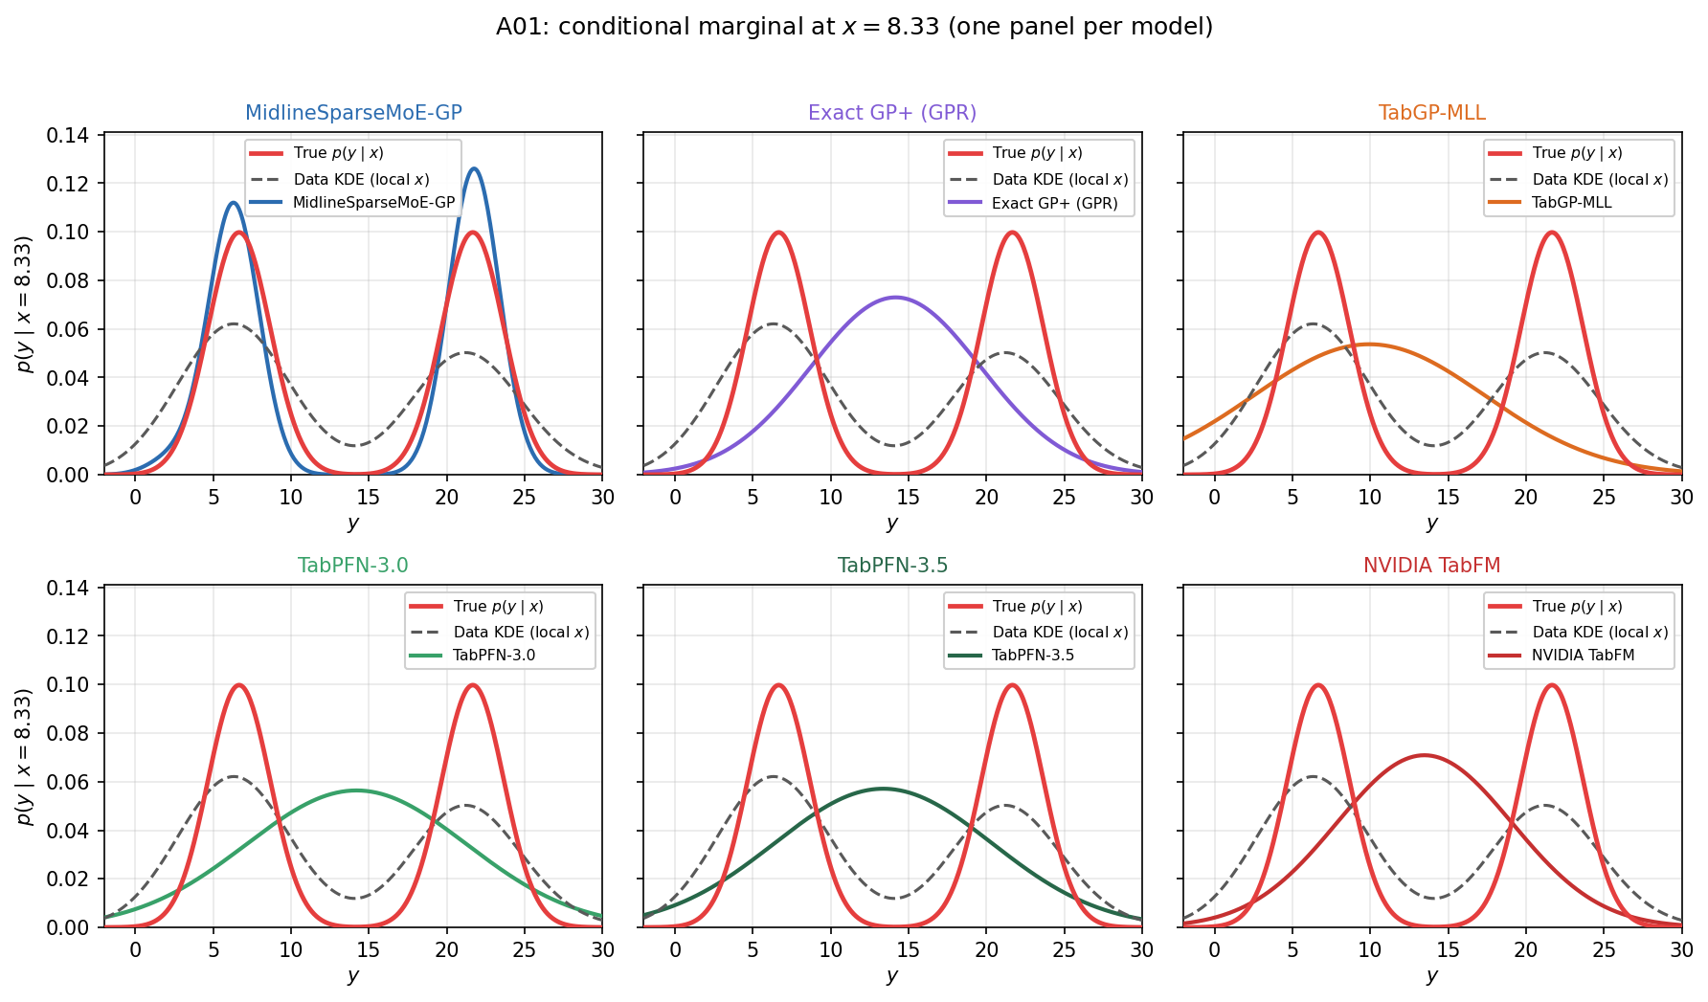
How to read a marginal panel
• Red = population truth.
• Gray dashed = finite-sample local shape.
• Colored = one model’s predictive density.
• A01 at large x: truth is bimodal; unimodal models fail the red curve.
• KDE may be flatter if few points fall in each mode locally.

Slide 14
Summary: what each curve answers
• True p(y|x) — no sample; uses DGP. Answers: population conditional law.
• Local KDE — uses data near x★; no DGP. Answers: what this sample supports locally.
• Model density — uses fit to data; not given the closed form. Answers: what the predictor believes.
• MidlineSparse / exact GP train on the same draws as the KDE, but never see the analytic density.
• Disagreement pattern: model≈KDE≠truth → sparse local sample; model≈truth≠KDE → model generalizes; model≠both → predictive failure.
Code: plot_foundation_marginals.TRUE_PDF and empirical_local_pdf

Slide 15
Takeaways
• True p(y|x) is the DGP’s closed-form conditional density — the scientific target.
• Local KDE is a bandwidthed empirical check that the sample carries that structure.
• A01/A04: mixture of Gaussians with known mode weights and σ.
• A05: derive AL scales for Var=σ², center to zero mean, then contaminate.
• KDE: Gaussian kernel on y-values with |x_i−x★|≤h_x, h_x grown until enough points.
• Use disagreements among (truth, KDE, model) to separate model error from data sparsity.

