Slide 1
Behavioral Risk Factor Surveillance System Dashboard
https://cwang-med-dashboard.netlify.app/
Charlie Wang

Slide 2
Content
Dashboard component
Data source: Behavioral Risk Factor Surveillance System
Back end:
Bigquery: for analytics, take 2 second. 2 queries.
Google cloud function: flask
Fix Cors
Front end:
React
Nivo line chart, bar chart, geo heatmap
Semantic UI

Slide 3
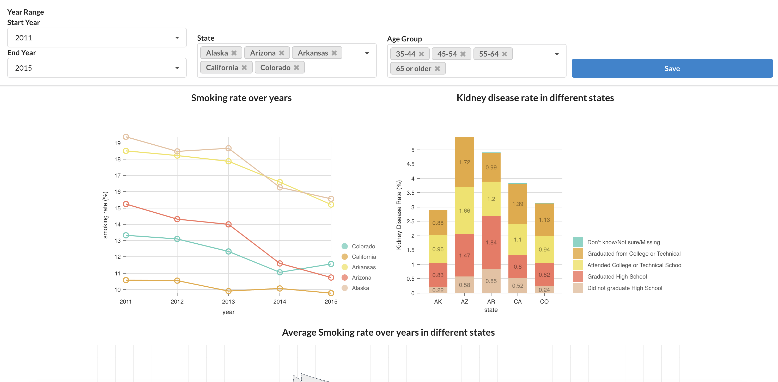
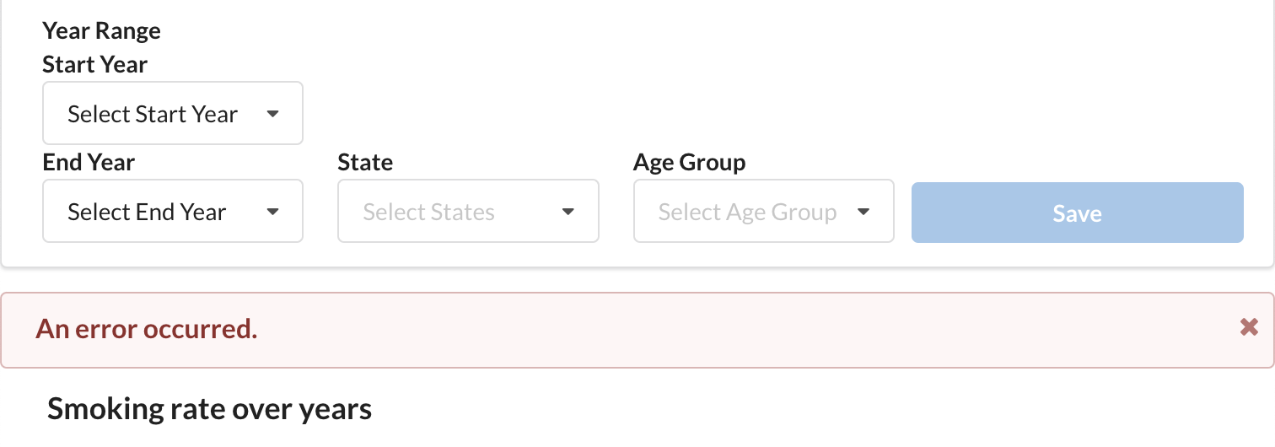
Dashboard component
Select year range, dynamic options
Apply filters button with
loading state that shows spinner
Multi selection dropdown
Dynamically showing error message
when catch the API call error

Slide 4
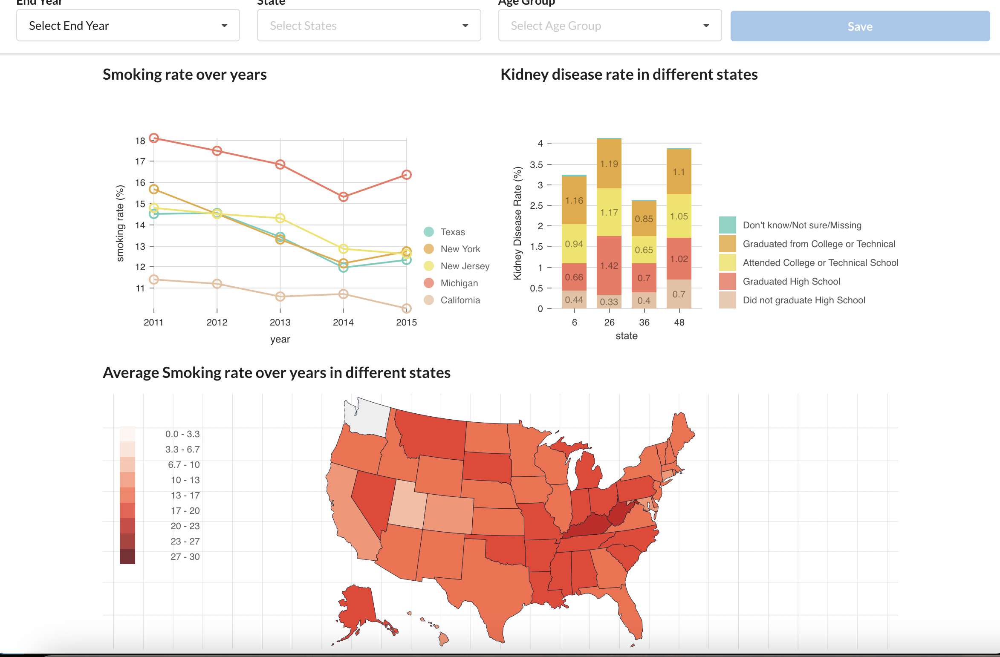
Dashboard component
Nivo Line Chart, Bar Chart,
Choropleth

Slide 5
Data source
Smoking Rate
_RFSMOK3: Adults who are current smokers
Simple definition: Yes or No or N/A
Should be defined by PM & Data team, but here we define it as:
Smoking Rate = _RFSMOK3==2 / all the options
Kidney Disease rate
CHCKIDNY: (Ever told) you have kidney disease?
Simple definition: Yes or No or N/A or Refused
here we define it as:
Smoking Rate = CHCKIDNY ==1 / all the options

Slide 6
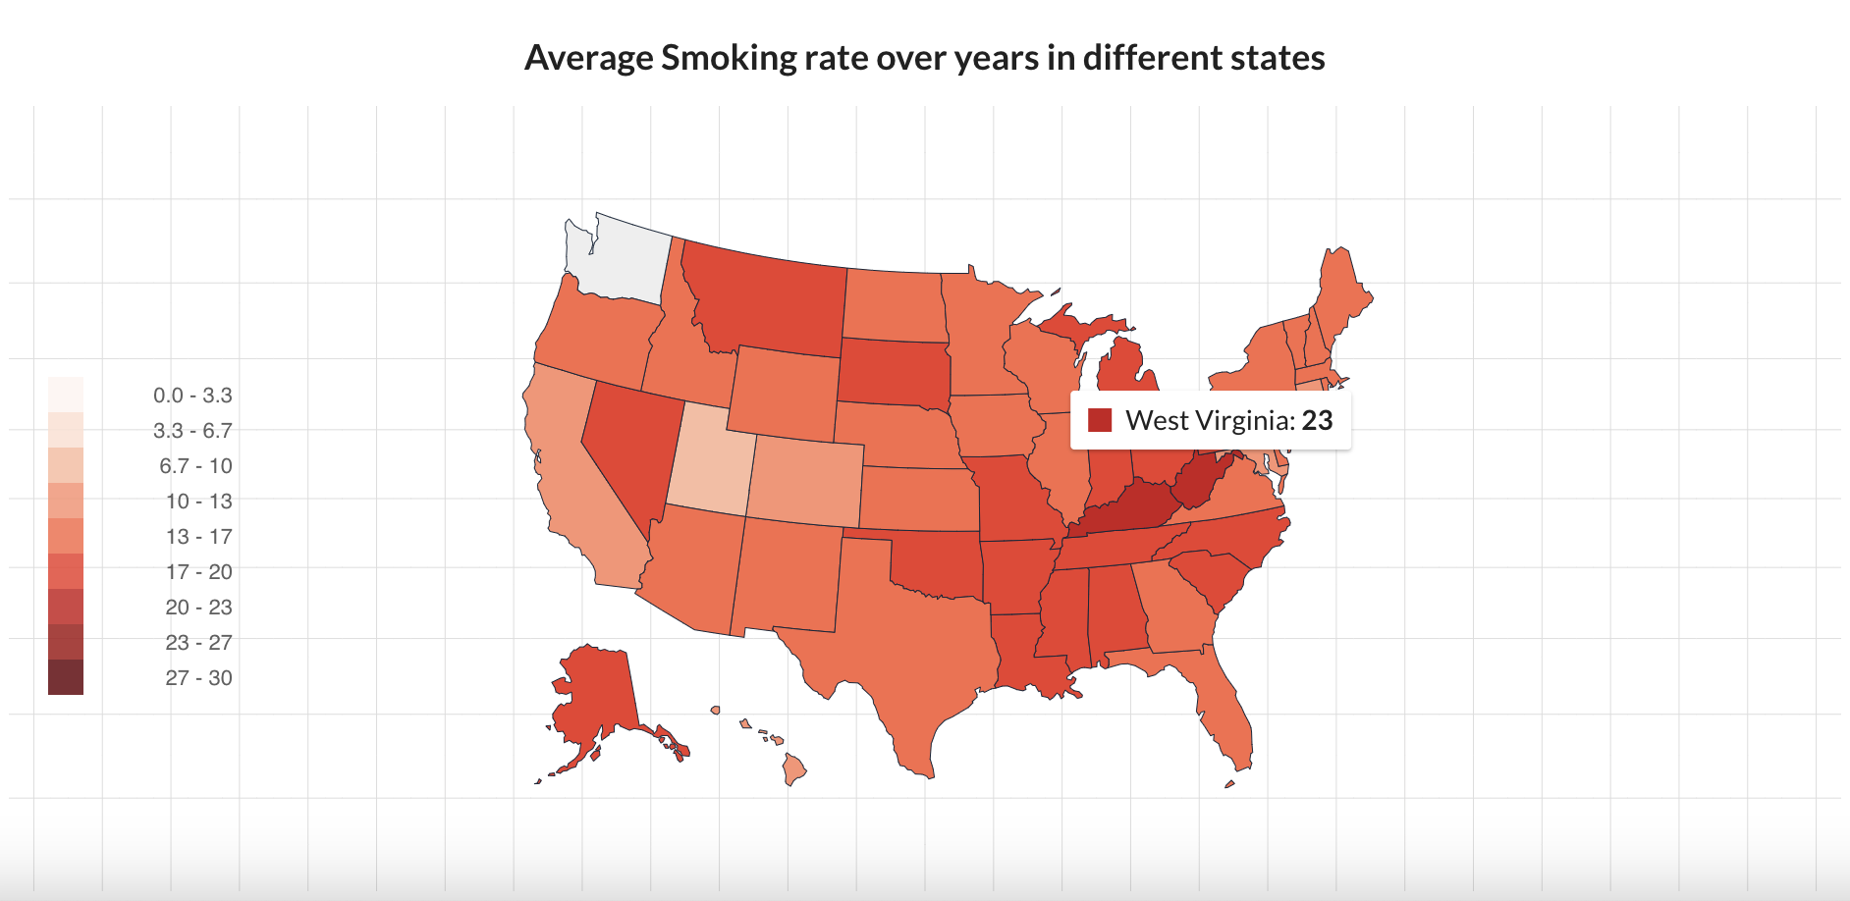
Example Analysis
WV has highest average smoking rate from 2011-2015,

Slide 7
Backend
Google cloud function + Bigquery:
Pros&Cons:
Easy to deploy
Easy to scale
For analytic purpose. We should use relational DB when we need it performant
Steps:
IAM management
Pour csv to BQ table in the console
Create function instance

Slide 8
Backend - Issues
Not performant?
Python cache -> no improvement
Create View/temp table -> minor improvement
Bottle neck: bigquery, need to use relational database
CORS
Add header

Slide 9
Frontend
Netlify
Deploy when new commit
React
Semantic UI
Easy to use, fast development
Nivo Chart
Looks cool!
Axios
POST with payload, set timeout
@Mixins
for responsiveness

Slide 10
Timeline
0.5 day for planning, explore the data handbook
1.5 day for building backend
Spend most of the time for getting payloads, build queries
1.5 day for building frontend
Spend most of the time transform data for charts

Slide 11
Reference
Data:
https://www.kaggle.com/datasets/cdc/behavioral-risk-factor-surveillance-system/data
https://www.cdc.gov/brfss/annual_data/2015/pdf/codebook15_llcp.pdf

