Slide 1
Sales KPI Dashboard
Correctness, pace to target, and recovery actions
Yi Wen

Slide 2
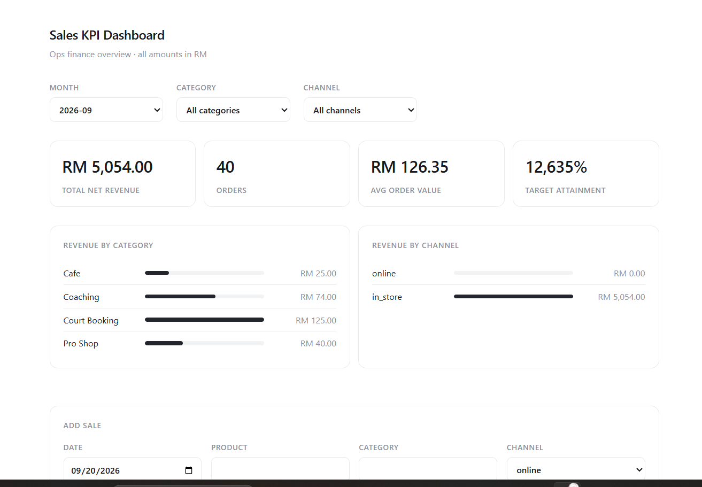
Five defects distorted the dashboard KPIs
The baseline mixed invalid transactions with incorrect aggregation logic
01
Refunded sales counted in revenue and orders
02
Discount percentage subtracted as a fixed RM amount
03
Category revenue overwritten instead of accumulated
04
Online sales classified as in-store sales
05
Attainment divided by order count instead of target
02

Slide 3
Corrected September KPIs reconcile
Revised results match a direct PostgreSQL validation query
Metric | Original | Corrected
Net revenue | RM 5,054.00 | RM 4,792.70
Orders | 40 | 37
Average order value | RM 126.35 | RM 129.53
Target attainment | 12,635% | 47.9%
37 completed orders
3 refunded records excluded
RM 10,000 monthly target
03

Slide 4
Calculation logic now matches the business definitions
NET REVENUE
Implementation choices
Quantity × unit price × (1 − discount ÷ 100)
One completed-sales collection feeds totals and breakdowns.
TARGET ATTAINMENT
Exact channel matching separates online and in-store revenue.
Completed-sales revenue ÷ monthly target
Missing or zero targets return N/A without invalid values.
The sales table retains refunded rows for operational visibility.
04

Slide 5
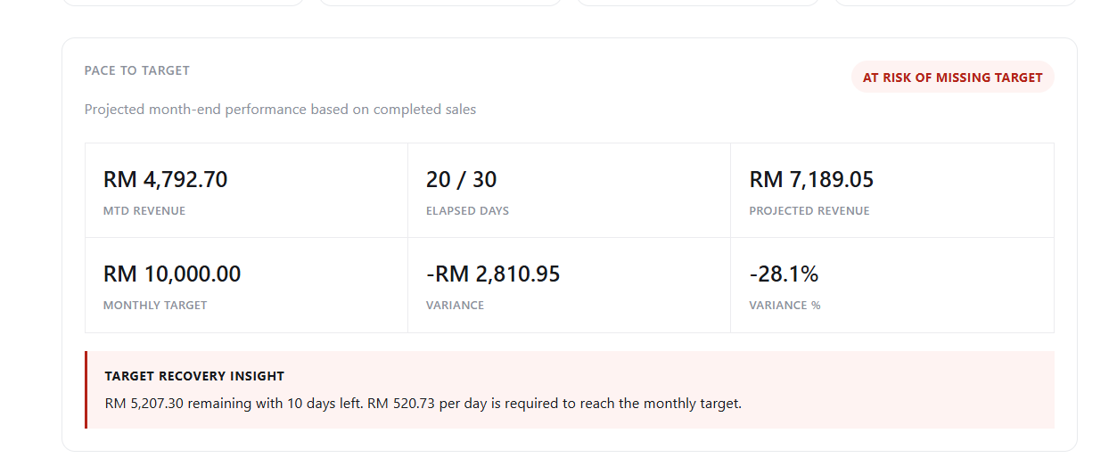
Pace to Target adds a forward-looking monthly view
Malaysia time determines elapsed days for the current month
CURRENT MONTH
MTD revenue ÷ elapsed days × days in month
Past month
Projection equals actual revenue
Future month
Zero elapsed days and an N/A projection
Edge cases
Leap years, missing targets, and divide-by-zero protection
05

Slide 6
Recovery insight defines the daily action
The panel explains what the operations team needs to recover before month end
RM 5,207.30
10
RM 520.73
REMAINING TO TARGET
DAYS REMAINING
REQUIRED PER DAY
Recovery calculation
max(target − MTD revenue, 0) ÷ remaining days
Safeguards
Reached target returns RM0 per day. Past months and missing targets return N/A. The final day never divides by zero.
Business value: the dashboard now explains the risk and the action required to close it.
06

Slide 7
Automated checks cover critical calculations
10
PASS
5
1
BACKEND TESTS
FRONTEND BUILD
CALCULATION DEFECTS FIXED
OPERATIONAL INNOVATION
Test area | Coverage
KPI correctness | Discounts, refunds, AOV, attainment, category and channel aggregation
Calendar logic | Past, current and future months, plus leap years
Safety | Missing targets, zero remaining days and N/A values
Delivery | Docker workflow, API endpoint, README and small Git commits
github.com/tywen-23/technical_test_ops_app
07

