Slide 1
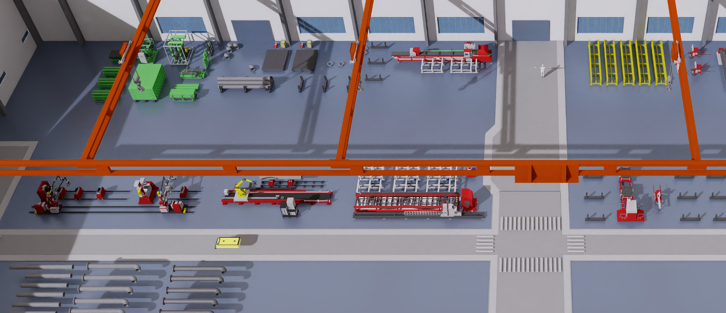
(a) Digital-twin production environment and entities
Human
Machine / workstation identifiers
M3/4
Buffer
M1 CNC pipe intersection cutting machine
M2 Large pipe roll-grooving machine
Gantry
M3 Workbench 0
M6/7
M5
M1
M2
M4 Workbench 1
M5 Robotic root-welding station
M6 Rotary surface-welding station 0
AGV
M7 Rotary surface-welding station 1
Material
M3 / M4 serve both spot welding and painting.
AGV: automated guided vehicle.
(b) Manufacturing and material handling
Manufacturing stages
1
Pipe cutting at M1
Deliver raw pipe to M1 → worker operates the cutting machine → cut pipe becomes available for transfer.
2
Roll grooving at M2
Transfer the cut pipe to the large roll-grooving machine → worker operates M2 → grooved pipe proceeds to assembly.
3
Assembly and spot welding at M3 / M4
Supply one pipe, one flange and one elbow → select a workbench → assemble and spot-weld → obtain a semi-finished pipe.
4
Argon-arc root welding at M5
Deliver the semi-finished pipe to the welding robot → worker operates the station → perform root welding.
5
MIG surface welding at M6 / M7
Transfer the root-welded pipe to a selected rotary welding station → perform surface welding → release it for painting.
6
Rust-proof painting at M3 / M4
Return the welded pipe to a workbench → apply rust-proof treatment → produce the finished water pipe.
Shared handling subtasks
7
Shared processing and outbound handling sequence
Worker approaches station → controls machine while it processes → waits for a free gantry → assists loading for outbound transfer.
8
Material transfer within one gantry zone
Worker and gantry approach material → load onto gantry → carry to the destination → place at the target station or storage area.
9
Material transfer across gantry zones
Source gantry loads an AGV → source gantry is released → AGV travels → a free destination gantry unloads and places the material.
(c) Multi-entity structural graph
Graph interpretation
G: gantry (4) H: human (5) R: AGV (4)
Blue: workstation backbone links.
G
H
R
Lavender: human / transport–station links.
Ochre: buffer–station affinities.
M1
M2
M3
M4
M5
M6
M7
M1–M7 match the workstation list in (a). G, H, R and B1–B3 each represent one node of their resource family.
Edges are undirected structural associations, not task precedence. Repeated nodes, self-loops and within-type transport links are omitted.
B1
B2
B3
Material is visible in the scene but is not a separate graph node. Its effects enter resource features, including supply, waiting and buffer occupancy.
B1: BlackStorage B2: GroundStorage B3: YellowStorage
38 nodes: 7 workstations + 4 gantries + 5 humans + 4 AGVs + 18 buffers.
Notes:
Revised from v4 per user instructions. Panel b now contains separately headed Manufacturing stages and Shared handling subtasks. Panel c depicts the directed six-stage product route, replacing the previous undirected model-adjacency illustration. Sources: env_asset_cfg/cfg_process_task_gallery.py and cfg_process_subtask_gallery.py. Workbench and rotary station pairs represent alternatives; P3/P6 reuse the workbench resource family. M labels identify resources, P labels identify manufacturing stages. Native editable shapes and connections preserved. Scene and other evidence are inherited from verified v4.

