Slide 1
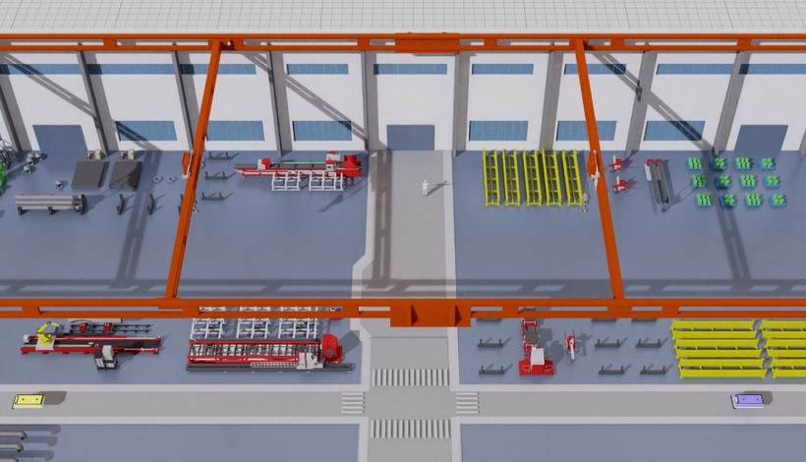






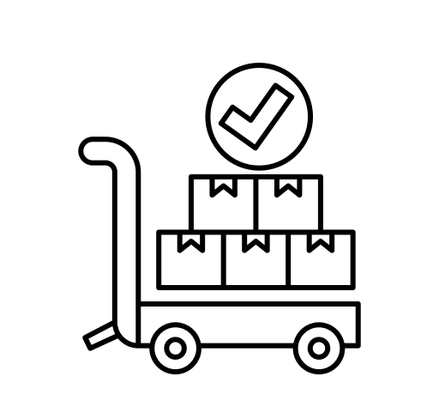
Digital twin & multi-entity data
Multi-entity heterogeneous graph
Process-informed event labels
✕ Prior work
✓ PHAST-DP
✕ Prior work
✓ PHAST-DP
×
×
×
machine-only nodes
5 entity types, typed edges
threshold spikes ≠ bottleneck
sustained events, 8-min rule
M^{G}: < 4-hop neighbours
Short-pattern
clustering
Type-specific rule b^{raw}
M^{S}: top-5 trajectory correlation
persistence
m = 8, g = 1
Isaac Sim line · single-axis disturbances
Event target (w, s, d)
M1
M2
M3
M4
M5
M6
M7
history
s
d
Human
Machine
16 pattern keys K^{P}
ongoing: hot at history end
regimes, not labels
upcoming: s > 0, d ≥ 8 min
machine
gantry
robot
human
buffer
+ cause: transport · shortage ·
starvation · queue buildup
Material
Logistics
X_{t} ∈ ℝ^{30×38×27}
process
handling
weak
buffer link
resources × minutes × features
pattern keys K^{P}
training targets
PHAST-DP
X_{t}
G, M^{G}, M^{S}
Bottleneck report
Grouped embedding
Encoder block × 5 (d = 80)
Multi-task heads
Weld-2
now
Delay-propagation module
Occurrence p^{cont} / p^{onset}
Gantry-1
Queue
4
✕ Prior work
✓ PHAST-DP
Pattern attention
station event
ŝ
d̂
Stall
6
queue patch P_{t,n}
Start π^{s} · duration d̂
AGV-3
t
i
j
t
t−τ
i
j
t
× 16 keys K^{P} → C^{P}
future minutes (cap 5/10/15)
Logistics
4
mean
same-time links
lagged precursors
C^{P} added to geo. keys
when and how long
Process cause ĉ
Shortage
1
Prefix p̂ · occupancy Ô
Transport
Geographic attn ×2 mask M^{G}, keys + C^{P}
Concat +
project
dense future grid
Shortage
Context
7
Starvation
Type
5
Temporal attn ×4 per resource, 30 windows
Cause ĉ · remaining ℓ̂
Queue
+ E_{time} + E_{lap} + E_{node}
Semantic attn ×2 mask M^{S}, similar resources
Add & Norm
+ FFN
graph-level pooling
validation-controlled decoding
Remaining order time ℓ̂
→ H⁽⁰⁾
12 min left

