Slide 1
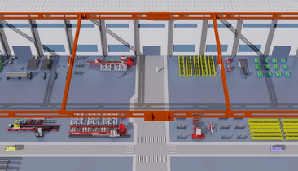
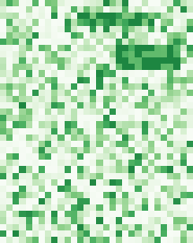






1
Digital-twin line
2
Multi-entity state
C1
3
Process labels + clustering
C2
4
Heterogeneous graph
C1
27 ch.
semantic top-5
type rule b^{raw}
short-pattern k-means
mach.
persistence
m=8, g=1
gantry
robot
M1
M2
M3
M4
M5
M6
M7
38 resources
human
event target (w,s,d)
Isaac Sim water-pipe line
buffer
history
s
d
ongoing: hot at history end
16 keys K^{P} (length-3)
process
buffer
handling
weak
Human
Machine
Material
Logistics
30 one-minute windows
upcoming: s > 0, d ≥ 8 min
regimes, not labels
one disturbance axis per episode
X_{t} ∈ ℝ^{30×38×27}
geographic mask M^{G}: < 4 hops
semantic mask M^{S}: top-5 trajectory corr.
training targets
K^{P}
X_{t}, G, M^{G}, M^{S}
6
Bottleneck report
5
PHAST-DP
process-informed heterogeneous-graph Transformer
now
C1
Multi-task heads
Encoder block × 5 (d = 80)
Grouped embedding
Weld-2
Pattern attention
C3
Gantry-1
occurrence p^{cont} / p^{onset}
queue patch P_{t,n} × activity keys K^{P} → C^{P}
Queue
4
station event
AGV-3
ŝ
d̂
Stall
6
start π^{s}, duration d̂
Geographic attention (2 heads)
Logistics
4
future minutes (onset cap 5/10/15)
when and how long
Concat + project
mask M^{G}; keys + C^{P} (delayed propagation)
mean
process cause ĉ
prefix p̂, occupancy Ô
[H_{T} ‖ H_{G} ‖ H_{S}]
Shortage
1
Transport
dense future grid
Temporal attention (4 heads)
Context
7
Shortage
cause ĉ, remain ℓ̂
each resource across 30 windows
Type
5
Starvation
graph-level pooling
Add & Norm
Queue
+ feed-forward
Semantic attention (2 heads)
+ E_{time} + E_{lap} + E_{node}
remaining order time ℓ̂
validation-controlled decoding
mask M^{S}; similar but non-adjacent resources
→ H⁽⁰⁾
12 min left

