Slide 1
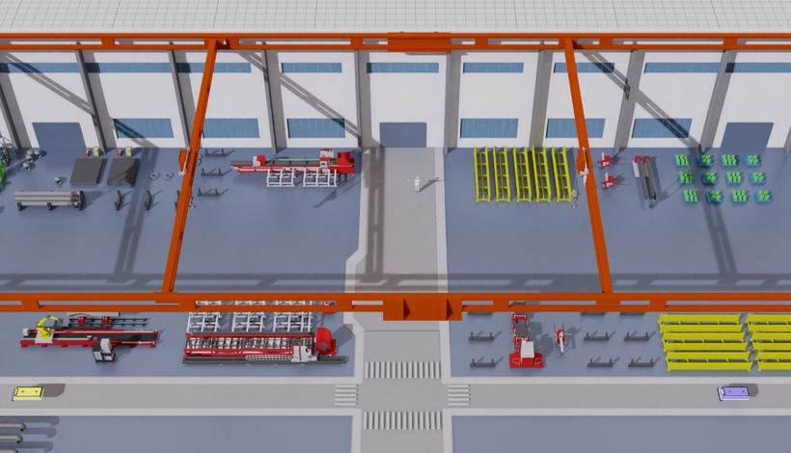
Digital manufacturing environment
Multi-entity heterogeneous graph
Process-informed rules
✕ Prior work
✓ PHGST-DP
✕ Prior work
✓ PHGST-DP
×
×
×
machine-only nodes
5 entity types, typed edges
threshold spikes ≠ bottleneck
sustained events, 8-min rule
Isaac Sim product line with single-axis disturbances
Clustered pattern
Type-specific rule b^{raw}
Input tensor (schematic)
persistence
m = 8, g = 1
27 features
Worker
Machine
M1
M2
M3
M4
M5
M6
M7
Event target (w, s, d)
38 resources
Gantry
Buffer
history
s
d
30 time windows
machine
gantry
robot
worker
buffer
Robot
Material
Xₜ: 30 × 38 × 27
process
handling
weak
buffer link
16 pattern keys K^{P}
PHGST-DP
X_{t}
G, M^{G}, M^{S}
pattern keys K^{P}
training targets
Bottleneck report
Encoder block × 5 (d = 80)
Weld-2
now
Prototype-conditioned delay-aware propagation module
Multi-task heads
Gantry-1
Grouped embedding
✕ Prior work
✓ PHGST-DP
ŝ
d̂
Pattern attention
Occurrence p^{cont} / p^{onset}
AGV-3
Queue
t
i
j
t
t−τ
i
j
t
C^{P} added to geo. keys
Stall
same-time links
lagged precursors
Start π^{s} · duration d̂
Process cause ĉ
Concat +
project
Prefix p̂ · occupancy Ô
Transport
Logistics
mean
Geographic attn ×2 mask M^{G}, keys + C^{P}
Shortage
Shortage
Temporal attn ×4 per resource, 30 windows
Cause ĉ · remaining ℓ̂
Starvation
Context
Add & Norm
+ FFN
Queue
Type
Semantic attn ×2 mask M^{S}, similar resources
validation-controlled decoding
Remaining order time ℓ̂
12 min left

