Slide 1
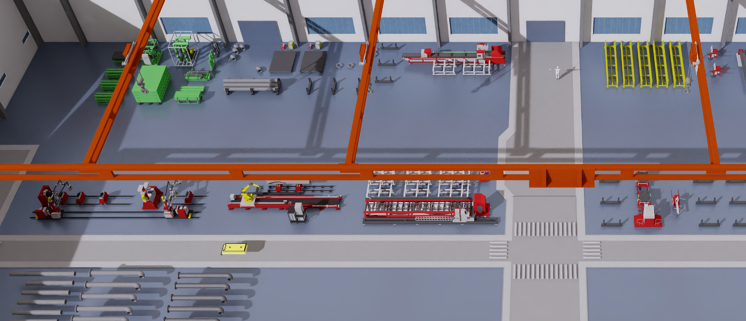
(a) Digital-twin production environment and resource entities
Machine / workstation identifiers
M3 / M4
Human
Buffer
M1
CNC pipe intersection
cutting machine
M2
Large pipe roll-grooving machine
Gantry
M3
Workbench 0
M6 / M7
M5
M1
M2
M4
Workbench 1
M5
Robotic root-welding station
M6
Rotary surface-welding station 0
AGV
M7
Rotary surface-welding station 1
Material
M3 / M4 support spot welding and painting.
AGV: automated guided vehicle.
(b) Manufacturing stages and shared material-handling subtasks
Manufacturing stages
Shared handling subtasks
1
Pipe cutting at M1
7
Processing and outbound handling
Raw pipe delivered; worker operates the cutting machine.
Cut pipe is released for transfer.
Worker approaches the station
2
Roll grooving at M2
→ Controls the machine during processing
Cut pipe transferred; worker operates the grooving machine.
Grooved pipe proceeds to assembly.
→ Waits for a free gantry
→ Assists loading for outbound transfer
3
Assembly and spot welding at M3 / M4
8
Transfer within one gantry zone
Pipe, flange and elbow supplied to a selected workbench.
Assembly and spot welding yield a semi-finished pipe.
Worker and gantry approach the material
4
Argon-arc root welding at M5
→ Load onto gantry and carry to destination
Semi-finished pipe delivered to the welding robot.
Worker operates the station for root welding.
→ Place at the station or storage area
5
MIG surface welding at M6 / M7
9
Transfer across gantry zones
Root-welded pipe transferred to a rotary welding station.
Surface welding prepares the pipe for painting.
Source gantry loads an AGV and is released
Rust-proof painting at M3 / M4
→ AGV travels to the destination
6
→ Free destination gantry unloads and places
Welded pipe returned to a workbench for rust-proof treatment.
The finished water pipe is ready.
(c) Multi-entity structural graph
G: gantries (4) H: workers (5) R: AGVs (4)
Structural relations
G
H
R
Workstation backbone
Human / transport–station links
Buffer–station affinities
M1
M2
M3
M4
M5
M6
M7
38 nodes: 7 workstations, 4 gantries,
5 workers, 4 AGVs and 18 buffers.
B1
B2
B3
Undirected associations, with representative
G / H / R and buffer nodes. Repeated nodes,
self-loops and within-type transport links
are omitted.
B1: BlackStorage B2: GroundStorage B3: YellowStorage
Material availability enters resource features through supply, waiting and buffer occupancy.
Notes:
Figure 3 redraw: the original a/b/c content is retained. Scene image is byte-for-byte extracted from figures/fig_experiment_final.pptx with the original crop.
Manufacturing stages 1–6 and handling subtasks 7–9 retain the original task semantics. The diagram is a representative undirected resource graph, not a task-precedence graph.
Graph edge data: source/isaaclab_tasks/isaaclab_tasks/direct/hc_factory/PDFormer/factory_bn/graph.py, PROCESS_CHAIN and BUFFER_MACHINE_AFFINITY. Agent nodes connect to all seven stations. B1 targets M1/M2; B2 targets M1/M2/M3; B3 targets M3–M7.
Layout reference: Safe reinforcement learning with online filtering for fatigue-predictive human-robot task planning and allocation in production, Figure 4. No artwork copied from the reference.

