Slide 1
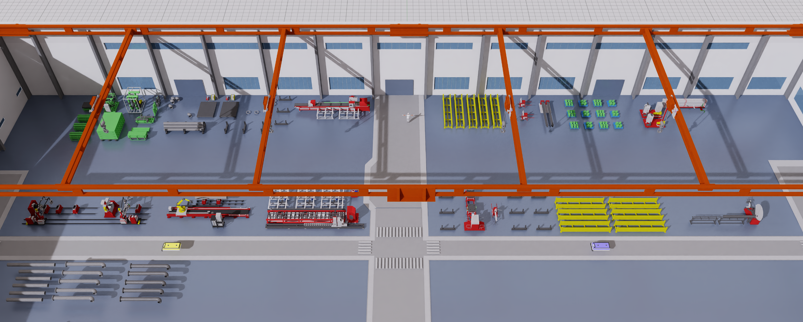
Overall methodology for dynamic bottleneck prediction
(a)
Factory observations
(b)
Resource representation
(c)
Prediction and reporting
Bottleneck report
windowing
PHAST-DP
Affected resource
spatiotemporal encoder
Onset and duration
Digital-twin production line
X: 30 × 38 × 27
Future bottleneck state
Resource states at 1-minute intervals
time × resources × features
Process-informed heads
Process cause
Topology + resource types
Remaining order time
Queue
G1
Stall
B1
B2
history regime + precursor cues
Logistics
M1
M2
M3
20-window forecast
t − 29
Observed history
t
H1
R1
Shared resource graph
Training supervision
Process-based event labels
Joint training objectives
prediction flow
Future operational states
training supervision
resource rules + persistence
events · states · time · cause
Notes:
图1：方法整体流程。左侧为项目真实 Isaac Sim 截图及历史窗口示意；中部为输入张量和共享资源图；右侧为 PHAST-DP 编码器、过程信息预测头和报告输出。底部虚线表示训练监督，未来状态只用于构造标签和损失。时间条的色块仅为窗口示意，不代表某次实验观测。监督目标包括事件、状态、时间与原因。
依据：论文 main.tex（dev_xwt，ffcfbb7）；实验代码 origin/dev_tyx（29655baee57b9095119589a211ae1e2113b84078）。代码路径 source/isaaclab_tasks/isaaclab_tasks/direct/hc_factory/PDFormer/factory_bn/。模型命名使用论文 PHAST-DP；代码类名仍为 BNPDFormer。Times New Roman 为用户指定。
图片：figures/camera_views/env_screen_shot.png。相关代码 dataset.py、graph.py、model.py、causes.py、train.py。

Slide 2
PHAST-DP model architecture
(a)
Input embedding
(b)
Spatiotemporal encoder
(c)
Prediction heads
Delay-pattern context
History regime + precursor cues
history query
Pattern matching
Station events
16 patterns
key context
continuation / onset · duration · prefix
30 × 38 × 27
Encoder block × 5
H(t)
Group-wise Linear + GELU
Temporal attention
4 heads
Future state + remaining time
queue · stall · logistics
LN
Geographic attention
2 heads
Layer skips + order progress
shortage · context · type
Mean of six groups
Semantic attention
2 heads
Process cause
Concat
Graph pooling + gated node evidence
+
d = 80
Time + Laplacian + node ID
+
LN + FFN
+
Project
Decoding and report
events · states · causes · remaining time
Notes:
图2：主模型结构。输入按六个特征组分别 Linear+GELU 后取均值，加入时间位置、Laplacian 与节点标识嵌入。五层编码器中每层并行时间4头、地理2头、语义2头，拼接投影和两次残差/FFN；虚线路径表示残差。延迟模式上下文只加到 geographic keys。事件头使用最后一步隐表示、历史regime和前兆特征；状态/订单剩余时间分支还使用跨层skip及订单进度；原因分支使用graph pooling和门控节点证据，不把订单进度画入原因头。绘图省略了各MLP内部层数。16个模式来自训练数据。
依据：论文 main.tex（dev_xwt，ffcfbb7）；实验代码 origin/dev_tyx（29655baee57b9095119589a211ae1e2113b84078）。代码路径 source/isaaclab_tasks/isaaclab_tasks/direct/hc_factory/PDFormer/factory_bn/。模型命名使用论文 PHAST-DP；代码类名仍为 BNPDFormer。Times New Roman 为用户指定。
代码：backbone.py, model.py, train.py, dataset.py, PDFormer.py。

Slide 3
Heterogeneous representation of factory resources
(a)
Resource types
(b)
Shared resource graph
(c)
Model inputs
H1
G1
Historical node features
M
Machines / workbenches
7 nodes
Buffer association
Q
S
L
A
C
T
G
Gantries
B1
B2
B3
B4
Queue · Stall · Logistics · Availability
4 nodes
Context · Resource type
R
Transport robots
M1
M2
M3
M4
4 nodes
Process chain
H
Workers
Resource–machine service
5 nodes
R1
R2
X: 30 × 38 × 27
B
Buffers
Geographic mask
18 nodes
Topology
Illustrative subgraph
hop distance < 4
15 prediction targets
Weighted, undirected connectivity
Training histories
Semantic mask
38 nodes with contextual resources
process / equipment relations
top-5 correlation neighbours
service / context relations
Material availability is a feature
Notes:
图3：突出多实体资源表示贡献。资源总数38：机器/工作台7、行车4、运输机器人4、工人5、缓冲区18；预测目标为机器、行车和机器人共15个，工人和缓冲区提供上下文。中部为示意子图，不是全部节点/全部边。graph.py 为加权无向图：工艺链1、同设备族0.8、缓冲区机器0.6、各服务agent（人/行车/机器人）至机器0.5、同类行车/机器人弱边0.3、自环1；图上省略权重/自环及部分边以便阅读。材料不是独立节点。特征组为Queue4、Stall6、Logistics4、Shortage1（图中A为availability/shortage）、Context7、Type5；色块和张量深浅是示意，不代表测量值。地理mask取hop<4，语义mask由训练轨迹相关性top5得到。
依据：论文 main.tex（dev_xwt，ffcfbb7）；实验代码 origin/dev_tyx（29655baee57b9095119589a211ae1e2113b84078）。代码路径 source/isaaclab_tasks/isaaclab_tasks/direct/hc_factory/PDFormer/factory_bn/。模型命名使用论文 PHAST-DP；代码类名仍为 BNPDFormer。Times New Roman 为用户指定。
代码：graph.py、dataset.py、backbone.py、FactoryBN_dense_bestmodel_start5.json。

