Slide 1
Introduction
Boston University CS 506 - Lance Galletti

Slide 2
Data Representation
How we represent data is linked to what information we are able to retrieve from it.

Slide 3
Data Representation - Records
m-dimensional points / vectors
Example: (name, age, balance) -> (“John”, 20, 100)

Slide 4
Data Representation - Records
m-dimensional points / vectors
Example: (name, age, balance) -> (“John”, 20, 100)
balance
Jane
John
age

Slide 5
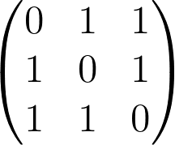
Data Representation - Graphs
Nodes connected by edges
Example:
Adjacency Matrix
Adjacency List
1 : {2, 3}
2 : {1, 3}
3 : {1, 2}

Slide 6
Data Representation - Images

Slide 7
Data Representation - Images

Slide 8
Data Representation - Images
Pixel

Slide 9
Data Representation - Text
---
---
------------------------------------------
----
List of words

Slide 10
Data Representation - Strings
DNA seq (A T G C C G T A …) -> list of characters

Slide 11
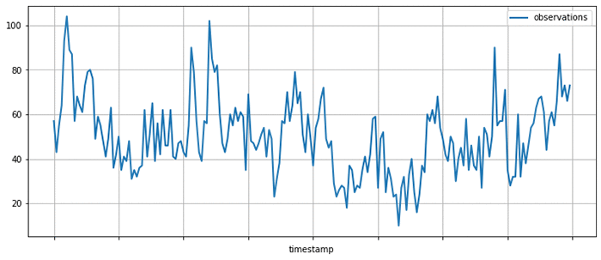
Data Representation - Time Series
List of data at specific intervals of time

Slide 12
Types of Learning
Supervised Learning
Unsupervised Learning

Slide 13
Supervised Learning
cricket chirps / min | temperature
10 | 40
5 | 37
17 | 53
55 | 103
40 | 78

Slide 14
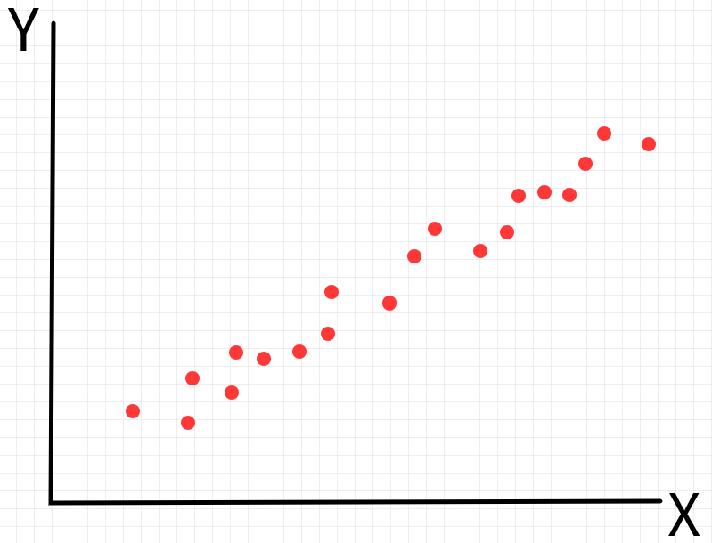
Supervised Learning
cricket chirps / min | temperature
10 | 40
5 | 37
17 | 53
55 | 103
40 | 78
cricket chirps / min
temperature

Slide 15
Supervised Learning
cricket chirps / min | temperature
10 | 40
5 | 37
17 | 53
55 | 103
40 | 78
cricket chirps / min
temperature

Slide 16
Supervised Learning
cricket chirps / min | temperature
10 | 40
5 | 37
17 | 53
55 | 103
40 | 78
cricket chirps / min
temperature

Slide 17
Supervised Learning
cricket chirps / min | temperature
10 | 40
5 | 37
17 | 53
55 | 103
40 | 78
cricket chirps / min
temperature

Slide 18
Supervised Learning
cricket chirps / min | temperature
10 | 40
5 | 37
17 | 53
55 | 103
40 | 78
cricket chirps / min
temperature

Slide 19
Supervised Learning
cricket chirps / min | temperature
10 | 40
5 | 37
17 | 53
55 | 103
40 | 78
cricket chirps / min
temperature
This type of supervised learning is referred to as regression

Slide 20
Supervised Learning
age | tumor size | malignant
20 | 12 | 0
22 | 15 | 1
47 | 20 | 1
59 | 2 | 1

Slide 21
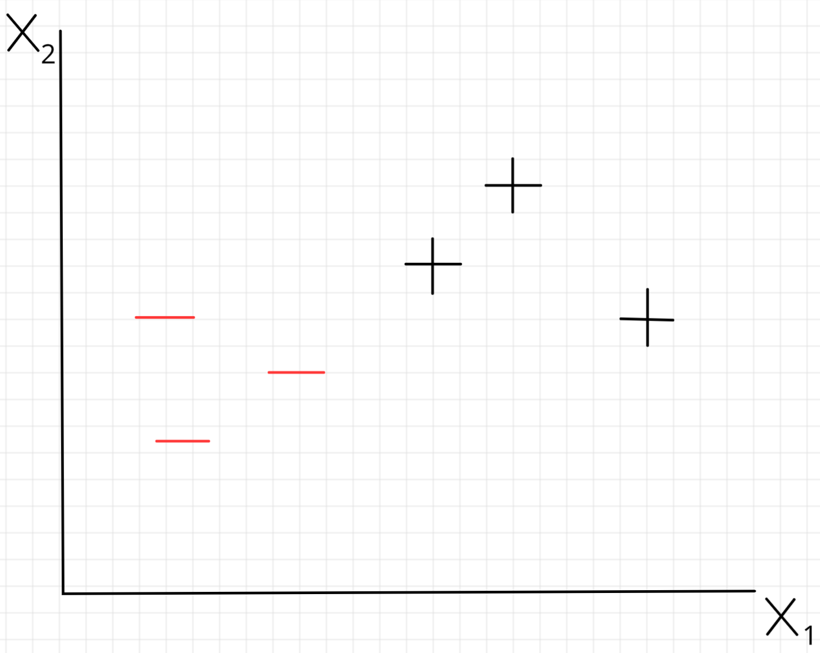
Supervised Learning
age
age | tumor size | malignant
20 | 12 | 0
22 | 15 | 1
47 | 20 | 1
59 | 2 | 1
Tumor size

Slide 22
Supervised Learning
age
age | tumor size | malignant
20 | 12 | 0
22 | 15 | 1
47 | 20 | 1
59 | 2 | 1
Tumor size

Slide 23
Supervised Learning
age
age | tumor size | malignant
20 | 12 | 0
22 | 15 | 1
47 | 20 | 1
59 | 2 | 1
Tumor size
This type of supervised learning is referred to as classification

Slide 24
Unsupervised Learning
Goal: Find interesting structure in the data

Slide 25
Unsupervised Learning
Goal: Find interesting structure in the data
This type of unsupervised learning is referred to as clustering

Slide 26
Unsupervised Learning
Dataset: Collection of Articles
Question: Are these articles covering the same topics?

