Slide 1

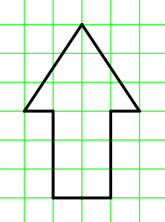
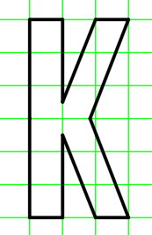
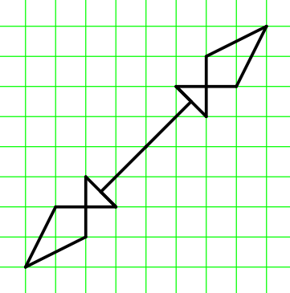
DEFINITIONS WINDOW
Modify the code (hint: go-to, mirror-x-on, mirror-y-on)
Exercise 1
Draw the following images using mirroring:
a) b) c)
Exercise 2
Design your own image using the mirroring function of Turtle. Draw your image first on a piece of grid paper.

Slide 2
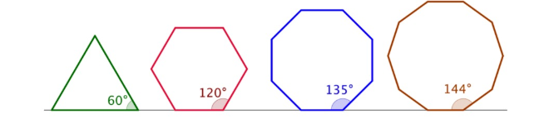
DEFINITIONS WINDOW
Exercise 3
Draw
a) Equilateral triagle
b) Regular hexagon
Draw
a) Regular octagon
b) Regular decagon
Exercise 4
Color of the line
change-color
Line width
change-pen-size

Slide 3
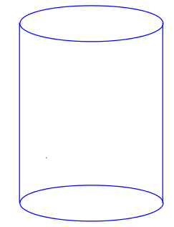
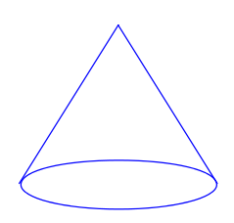
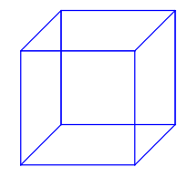
DEFINITIONS WINDOW
Exercise 5
Draw the following shapes using Racket turtle
a)
b)
c)
Hint 1: use stamper with ellipse shape
You can use either go-to or forward & turn-left commands
Hint 2: drawing cube in cavalier perspective: use ½ depth and 45º angle
Exercise 6
Program a function to draw cylinders (r, h), cones (r, h) or rectangular prisms (a, b, c).
Hint 3: Remember trigonometric functions, Pythagora’s theorem and reflecting in respect of an axis.

