Slide 1
Class Diagram & Design Patterns

Slide 2
Design Patterns
“Each pattern describes
a problem which occurs over and over again in our environment, and then describes the core of the solution to that problem, in such a way that you can use this solution a million times over, without ever doing it the same way twice”.
--- Christopher Alexander, 1977
This was in describing patterns in buildings and towns.
In SE, design patterns are in terms of objects and interfaces, not walls and doors.
The manner in which a collection of interacting objects collaborate to accomplish a specific task or provide some specific functionality.

Slide 3
Architecture vs. Design Patterns
Architecture
High-level framework for structuring an application
  “client-server based on remote procedure calls”
  “abstraction layering”
  “distributed object-oriented system based on CORBA”
Defines the system in terms of computational components & their interactions
Design Patterns
Lower level than architectures (Sometimes, called micro-architecture)
Reusable collaborations that solve subproblems within an application
  how can I decouple subsystem X from subsystem Y?
Why Design Patterns?
Design patterns support object-oriented reuse at a high level of abstraction
Design patterns provide a “framework” that guides and constrains object-oriented implementation

Slide 4
Organizing Design Patterns
By Purpose (reflects what a pattern does):
  Creational Patterns
  Structural Patterns
  Behavioral Patterns
By Scope: specifies whether the pattern applies primarily to
  classes or to
  objects.

Slide 5
Design Patterns Space
Purpose
Creational
Structural
Behavioral
Scope
Class
Factory Method
Adapter
Interpreter
Template
Object
Abstract Factory
Builder
Prototype
Singleton
Adapter
Bridge
Composite
Decorator
Façade
Flyweight
Proxy
Chain of
Responsibility
Command
Iterator
Mediator
Memento
Observer
State
Strategy
Visitor

Slide 6
Behavioral Patterns - Strategy Pattern
Intent: defines a family of algorithms, encapsulate each one, and make them interchangeable. Strategy lets the algorithm vary independently from clients that use it.
Motivation: when there are many algorithms for solving a problem, hard-wiring all algorithms in client’s code may have several problems:
  Clients get fat and harder to maintain
  Different algorithms may be appropriate at different time
  It is difficult to add new algorithms

Slide 7
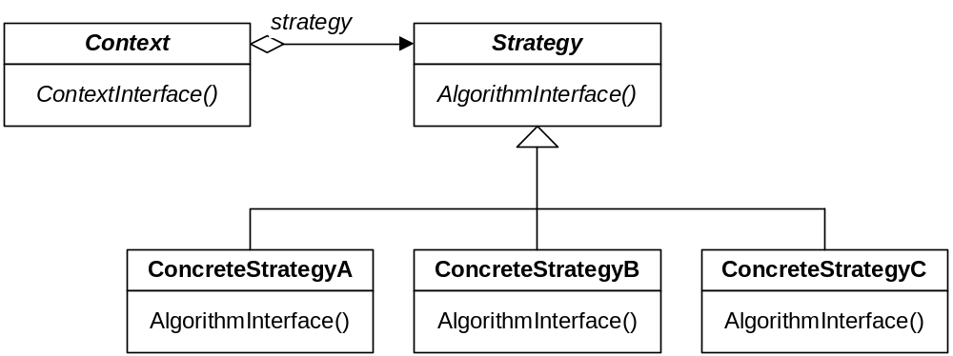
Behavioral Patterns - Strategy Pattern

Slide 8
Behavioral Patterns - Participants of Strategy
Strategy: declares an interface common to all supported algorithm. Context uses this interface to call the algorithm defined by a ConcreteStrategy.
ConcreteStrategy: implements the algorithm using the Strategy interface
Context: maintains a reference to a Strategy object and defines an interface that let Strategy access its data

Slide 9
Behavioral Patterns - Sorting Example
Requirement: we want to sort a list of integers using different sorting algorithms, e.g. quick sort, selection sort, insertion sort, etc.
E.g., {3, 5, 6, 2, 44, 67, 1, 344, ... }
{1, 2, 3, 5, 6, 44, 67, 344, ... }
One way to solve this problem is to write a function for each sorting algorithm, e.g.
  quicksort(int[] in, int[] res)
  insertionsort(int[] in, int[] res)
  mergesort(int[] in, int[] res)
A better way is to use the Strategy pattern

Slide 10
Behavioral Patterns - Strategy Pattern
Main
Main()
{…
stdRec.SetSortStr(sortStrInfo);
stdRec.Sort()}
How is stdRec implemented?
Main()
How is –sortStrategy implemented?
stdRec
-sortStrategy
SortStrategy
SortedList
-list: ArrayList
Sort(list:ArrayList)
SetSortStr(sortStr:SortStrategy)
Sort()
Sort()
{sortStrategy.Sort(list)}
QuickSort
InsertionSort
MergeSort
Sort(list:ArrayList)
Sort(list:ArrayList)
Sort(list:ArrayList)

Slide 11

Singleton pattern (creational)
Ensure that a class has only one instance and provide a global point of access to it
  Why not use a global variable?
class Singleton
{ public:
static Singleton* getInstance();
protected: //Why are the following protected?
Singleton();
Singleton(const Singleton&);
Singleton& operator= (const Singleton&);
private: static Singleton* instance;
};
Singleton *p2 = p1->getInstance();

