Slide 1
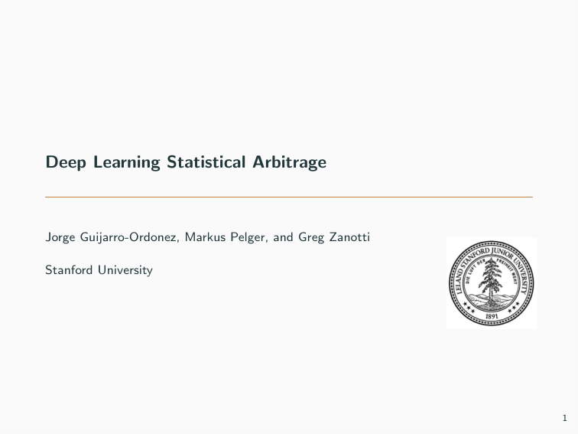
Motivation
Deep Learning Statistical Arbitrage Jorge Guijarro-Ordonez, Markus Pelger, and Greg Zanotti Stanford University 1

Slide 2
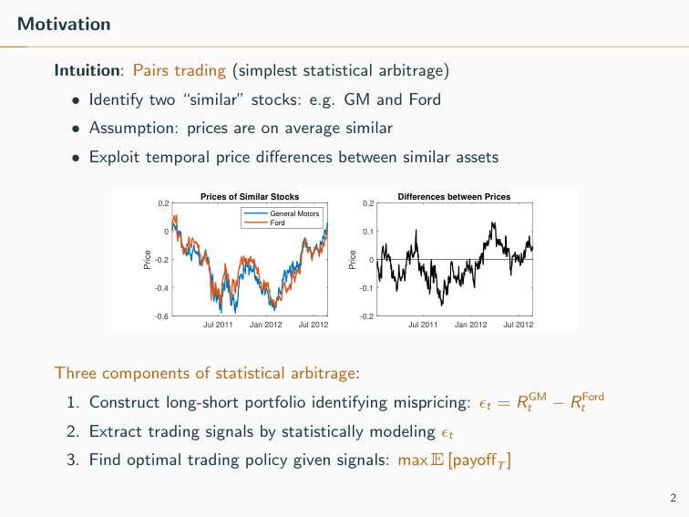
Fundamental Problem
Motivation Intuition: Pairs trading (simplest statistical arbitrage) • Identify two “similar” stocks: e.g. GM and Ford • Assumption: prices are on average similar • Exploit temporal price diﬀerences between similar assets Jul 2011 Jan 2012 Jul 2012 -0.6 -0.4 -0.2 0 0.2 Price Prices of Similar Stocks General Motors Ford Jul 2011 Jan 2012 Jul 2012 -0.2 -0.1 0 0.1 0.2 Price Differences between Prices Three components of statistical arbitrage: 1. Construct long-short portfolio identifying mispricing: ϵt = RGM t − RFord t 2. Extract trading signals by statistically modeling ϵt 3. Find optimal trading policy given signals: max E [payoﬀT] 2

Slide 3
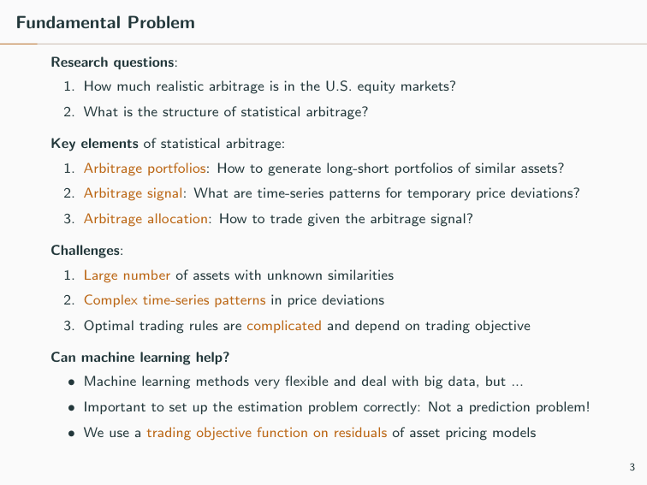
Contribution: Methodology
Fundamental Problem Research questions: 1. How much realistic arbitrage is in the U.S. equity markets? 2. What is the structure of statistical arbitrage? Key elements of statistical arbitrage: 1. Arbitrage portfolios: How to generate long-short portfolios of similar assets? 2. Arbitrage signal: What are time-series patterns for temporary price deviations? 3. Arbitrage allocation: How to trade given the arbitrage signal? Challenges: 1. Large number of assets with unknown similarities 2. Complex time-series patterns in price deviations 3. Optimal trading rules are complicated and depend on trading objective Can machine learning help? • Machine learning methods very ﬂexible and deal with big data, but ... • Important to set up the estimation problem correctly: Not a prediction problem! • We use a trading objective function on residuals of asset pricing models 3

Slide 4
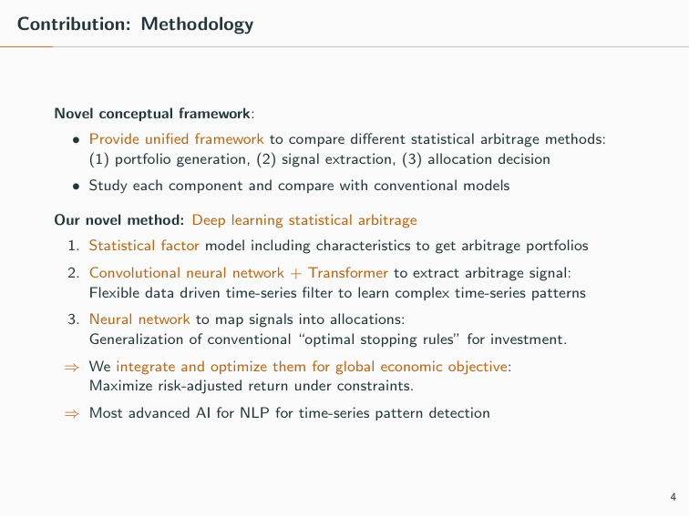
Contribution: Empirical
Contribution: Methodology Novel conceptual framework: • Provide uniﬁed framework to compare diﬀerent statistical arbitrage methods: (1) portfolio generation, (2) signal extraction, (3) allocation decision • Study each component and compare with conventional models Our novel method: Deep learning statistical arbitrage 1. Statistical factor model including characteristics to get arbitrage portfolios 2. Convolutional neural network + Transformer to extract arbitrage signal: Flexible data driven time-series ﬁlter to learn complex time-series patterns 3. Neural network to map signals into allocations: Generalization of conventional “optimal stopping rules” for investment. ⇒ We integrate and optimize them for global economic objective: Maximize risk-adjusted return under constraints. ⇒ Most advanced AI for NLP for time-series pattern detection 4

Slide 5
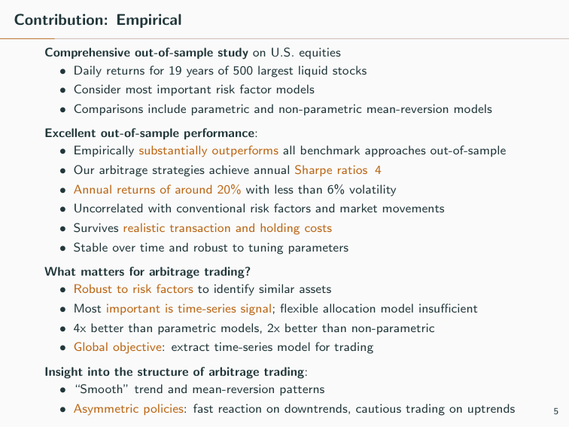
Literature (partial list)
Contribution: Empirical Comprehensive out-of-sample study on U.S. equities • Daily returns for 19 years of 500 largest liquid stocks • Consider most important risk factor models • Comparisons include parametric and non-parametric mean-reversion models Excellent out-of-sample performance: • Empirically substantially outperforms all benchmark approaches out-of-sample • Our arbitrage strategies achieve annual Sharpe ratios 4 • Annual returns of around 20% with less than 6% volatility • Uncorrelated with conventional risk factors and market movements • Survives realistic transaction and holding costs • Stable over time and robust to tuning parameters What matters for arbitrage trading? • Robust to risk factors to identify similar assets • Most important is time-series signal; ﬂexible allocation model insuﬃcient • 4x better than parametric models, 2x better than non-parametric • Global objective: extract time-series model for trading Insight into the structure of arbitrage trading: • “Smooth” trend and mean-reversion patterns • Asymmetric policies: fast reaction on downtrends, cautious trading on uptrends 5

Slide 6
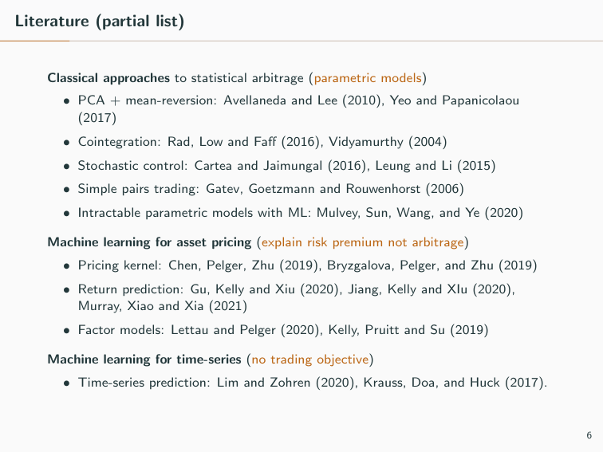
Model
Literature (partial list) Classical approaches to statistical arbitrage (parametric models) • PCA + mean-reversion: Avellaneda and Lee (2010), Yeo and Papanicolaou (2017) • Cointegration: Rad, Low and Faﬀ (2016), Vidyamurthy (2004) • Stochastic control: Cartea and Jaimungal (2016), Leung and Li (2015) • Simple pairs trading: Gatev, Goetzmann and Rouwenhorst (2006) • Intractable parametric models with ML: Mulvey, Sun, Wang, and Ye (2020) Machine learning for asset pricing (explain risk premium not arbitrage) • Pricing kernel: Chen, Pelger, Zhu (2019), Bryzgalova, Pelger, and Zhu (2019) • Return prediction: Gu, Kelly and Xiu (2020), Jiang, Kelly and XIu (2020), Murray, Xiao and Xia (2021) • Factor models: Lettau and Pelger (2020), Kelly, Pruitt and Su (2019) Machine learning for time-series (no trading objective) • Time-series prediction: Lim and Zohren (2020), Krauss, Doa, and Huck (2017). 6

Slide 7
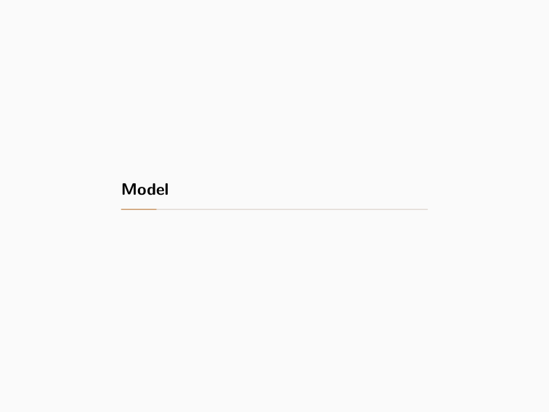
Arbitrage Portfolios
Model

Slide 8
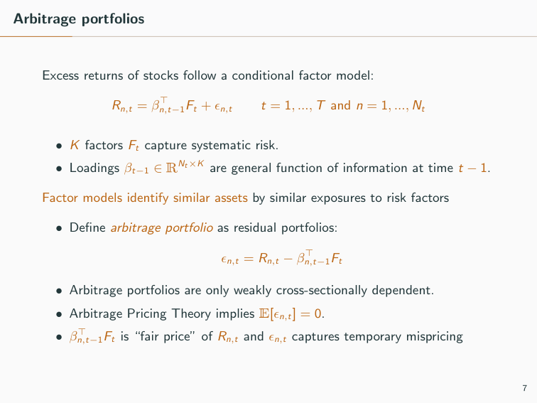
Arbitrage Signal and Allocation
Arbitrage portfolios Excess returns of stocks follow a conditional factor model: Rn,t = β⊤ n,t−1Ft + ϵn,t t = 1, ..., T and n = 1, ..., Nt • K factors Ft capture systematic risk. • Loadings βt−1 ∈ RNt×K are general function of information at time t − 1. Factor models identify similar assets by similar exposures to risk factors • Deﬁne arbitrage portfolio as residual portfolios: ϵn,t = Rn,t − β⊤ n,t−1Ft • Arbitrage portfolios are only weakly cross-sectionally dependent. • Arbitrage Pricing Theory implies E[ϵn,t] = 0. • β⊤ n,t−1Ft is “fair price” of Rn,t and ϵn,t captures temporary mispricing 7

Slide 9
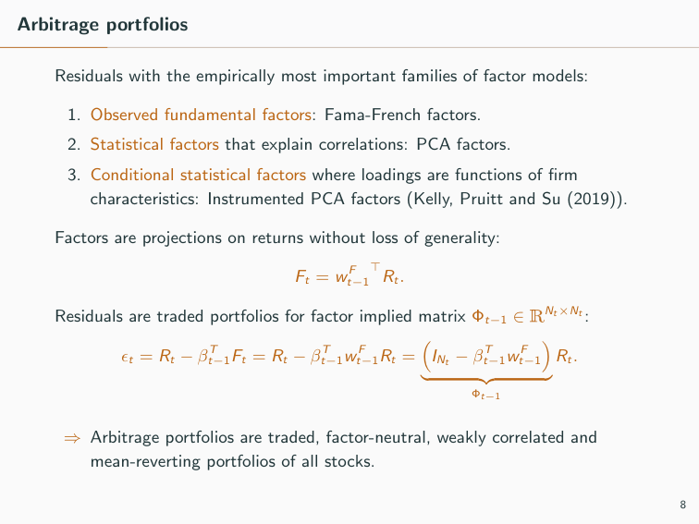
Estimation Problem
Arbitrage portfolios Residuals with the empirically most important families of factor models: 1. Observed fundamental factors: Fama-French factors. 2. Statistical factors that explain correlations: PCA factors. 3. Conditional statistical factors where loadings are functions of ﬁrm characteristics: Instrumented PCA factors (Kelly, Pruitt and Su (2019)). Factors are projections on returns without loss of generality: Ft = w F t−1 ⊤Rt. Residuals are traded portfolios for factor implied matrix Φt−1 ∈ RNt×Nt : ϵt = Rt − βT t−1Ft = Rt − βT t−1w F t−1Rt = � INt − βT t−1w F t−1 � � �� � Φt−1 Rt. ⇒ Arbitrage portfolios are traded, factor-neutral, weakly correlated and mean-reverting portfolios of all stocks. 8

Slide 10
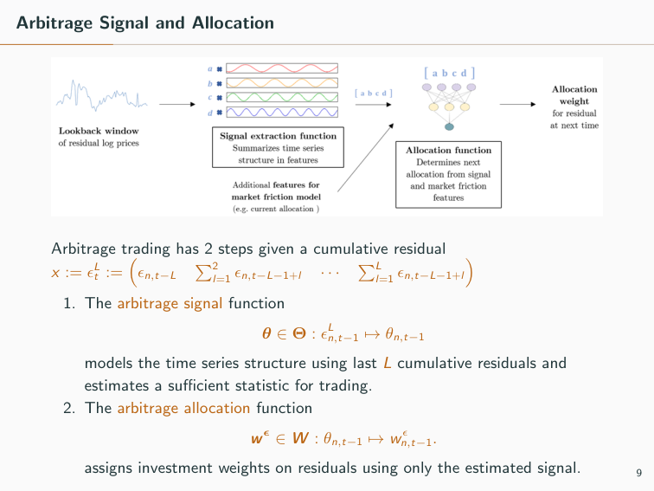
First Class: Parametric Models
Arbitrage Signal and Allocation Arbitrage trading has 2 steps given a cumulative residual x := ϵL t := � ϵn,t−L �2 l=1 ϵn,t−L−1+l · · · �L l=1 ϵn,t−L−1+l � 1. The arbitrage signal function θ ∈ Θ : ϵL n,t−1 �→ θn,t−1 models the time series structure using last L cumulative residuals and estimates a suﬃcient statistic for trading. 2. The arbitrage allocation function w ϵ ∈ W : θn,t−1 �→ w ϵ n,t−1. assigns investment weights on residuals using only the estimated signal. 9

Slide 11
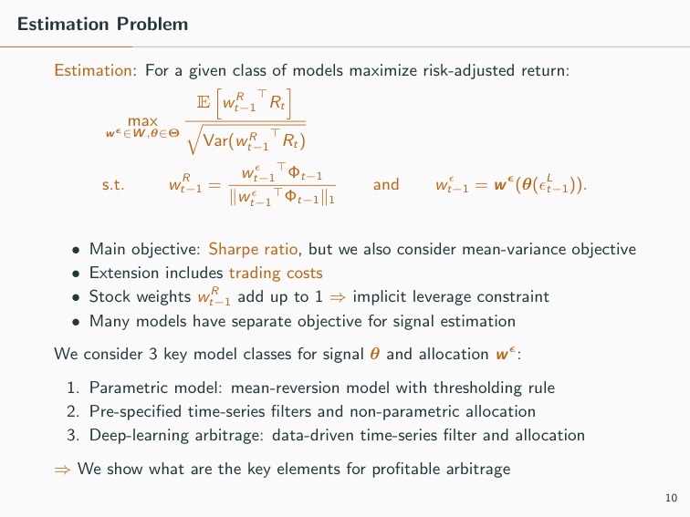
Second Class: Pre-specified filter with NN
Estimation Problem Estimation: For a given class of models maximize risk-adjusted return: max wϵ∈W ,θ∈Θ E � w R t−1 ⊤Rt � � Var(w R t−1 ⊤Rt) s.t. w R t−1 = w ϵ t−1 ⊤Φt−1 ∥w ϵ t−1 ⊤Φt−1∥1 and w ϵ t−1 = w ϵ(θ(ϵL t−1)). • Main objective: Sharpe ratio, but we also consider mean-variance objective • Extension includes trading costs • Stock weights w R t−1 add up to 1 ⇒ implicit leverage constraint • Many models have separate objective for signal estimation We consider 3 key model classes for signal θ and allocation w ϵ: 1. Parametric model: mean-reversion model with thresholding rule 2. Pre-speciﬁed time-series ﬁlters and non-parametric allocation 3. Deep-learning arbitrage: data-driven time-series ﬁlter and allocation ⇒ We show what are the key elements for proﬁtable arbitrage 10

Slide 12
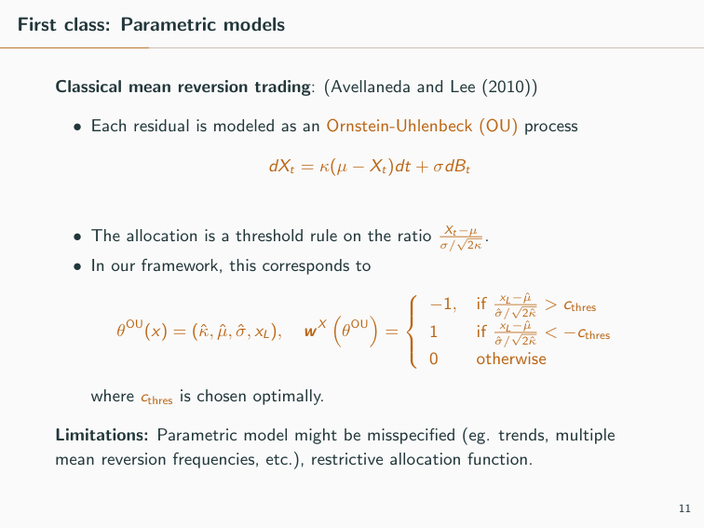
Third Class: CNN + Transformer
First class: Parametric models Classical mean reversion trading: (Avellaneda and Lee (2010)) • Each residual is modeled as an Ornstein-Uhlenbeck (OU) process dXt = κ(µ − Xt)dt + σdBt • The allocation is a threshold rule on the ratio Xt−µ σ/ √ 2κ. • In our framework, this corresponds to θOU(x) = (ˆκ, ˆµ, ˆσ, xL), w X � θOU� =      −1, if xL−ˆµ ˆσ/ √ 2ˆκ > cthres 1 if xL−ˆµ ˆσ/ √ 2ˆκ < −cthres 0 otherwise where cthres is chosen optimally. Limitations: Parametric model might be misspeciﬁed (eg. trends, multiple mean reversion frequencies, etc.), restrictive allocation function. 11

Slide 13
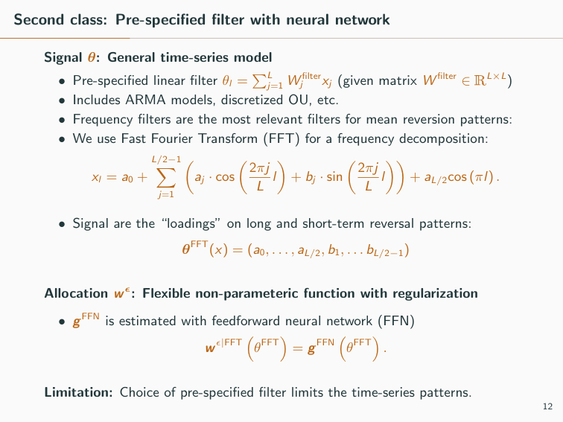
Convolutional Network Intuition
Second class: Pre-speciﬁed ﬁlter with neural network Signal θ: General time-series model • Pre-speciﬁed linear ﬁlter θl = �L j=1 W ﬁlter j xj (given matrix W ﬁlter ∈ RL×L) • Includes ARMA models, discretized OU, etc. • Frequency ﬁlters are the most relevant ﬁlters for mean reversion patterns: • We use Fast Fourier Transform (FFT) for a frequency decomposition: xl = a0 + L/2−1 � j=1 � aj · cos �2πj L l � + bj · sin �2πj L l �� + aL/2cos (πl) . • Signal are the “loadings” on long and short-term reversal patterns: θFFT(x) = (a0, . . . , aL/2, b1, . . . bL/2−1) Allocation w ϵ: Flexible non-parameteric function with regularization • g FFN is estimated with feedforward neural network (FFN) w ϵ|FFT � θFFT� = g FFN � θFFT� . Limitation: Choice of pre-speciﬁed ﬁlter limits the time-series patterns. 12

Slide 14
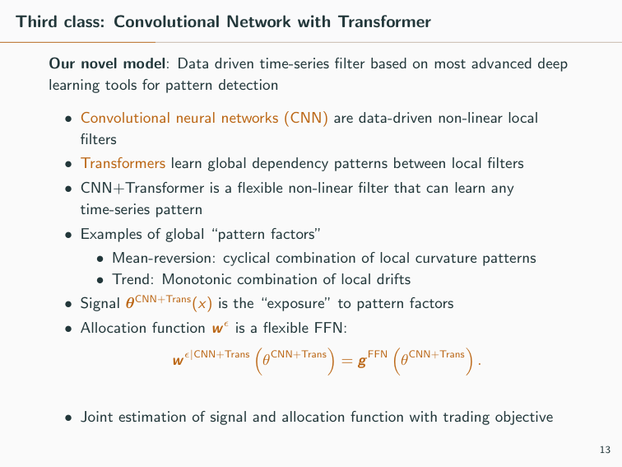
Transformer Network Intuition
Third class: Convolutional Network with Transformer Our novel model: Data driven time-series ﬁlter based on most advanced deep learning tools for pattern detection • Convolutional neural networks (CNN) are data-driven non-linear local ﬁlters • Transformers learn global dependency patterns between local ﬁlters • CNN+Transformer is a ﬂexible non-linear ﬁlter that can learn any time-series pattern • Examples of global “pattern factors” • Mean-reversion: cyclical combination of local curvature patterns • Trend: Monotonic combination of local drifts • Signal θCNN+Trans(x) is the “exposure” to pattern factors • Allocation function w ϵ is a ﬂexible FFN: w ϵ|CNN+Trans � θCNN+Trans� = g FFN � θCNN+Trans� . • Joint estimation of signal and allocation function with trading objective 13

Slide 15
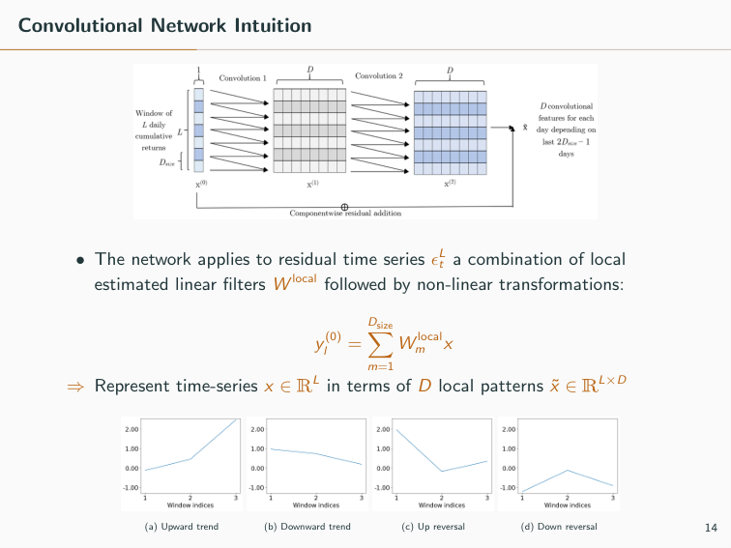
Convolutional Network Intuition • The network applies to residual time series ϵL t a combination of local estimated linear ﬁlters W local followed by non-linear transformations: y (0) l = Dsize � m=1 W local m x ⇒ Represent time-series x ∈ RL in terms of D local patterns ˜x ∈ RL×D (a) Upward trend (b) Downward trend (c) Up reversal (d) Down reversal 14

Slide 16
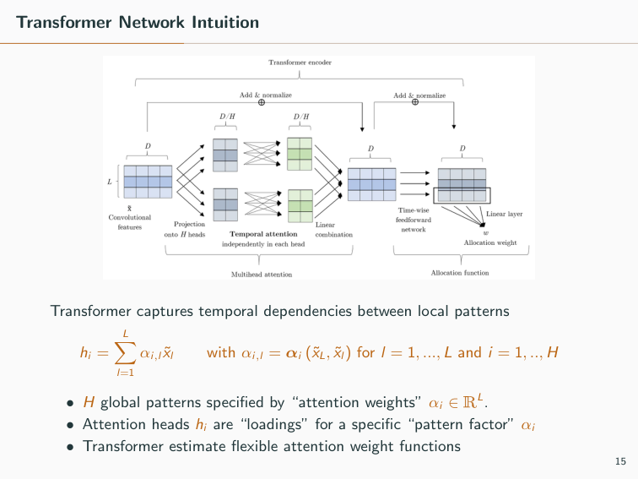
Transformer Network Intuition Transformer captures temporal dependencies between local patterns hi = L � l=1 αi,l ˜xl with αi,l = αi (˜xL, ˜xl) for l = 1, ..., L and i = 1, .., H • H global patterns speciﬁed by “attention weights” αi ∈ RL. • Attention heads hi are “loadings” for a speciﬁc “pattern factor” αi • Transformer estimate ﬂexible attention weight functions 15

Slide 17
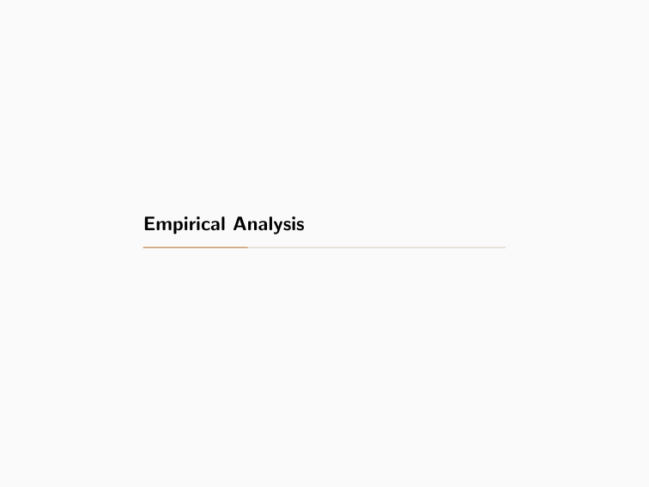
Empirical Analysis

Slide 18
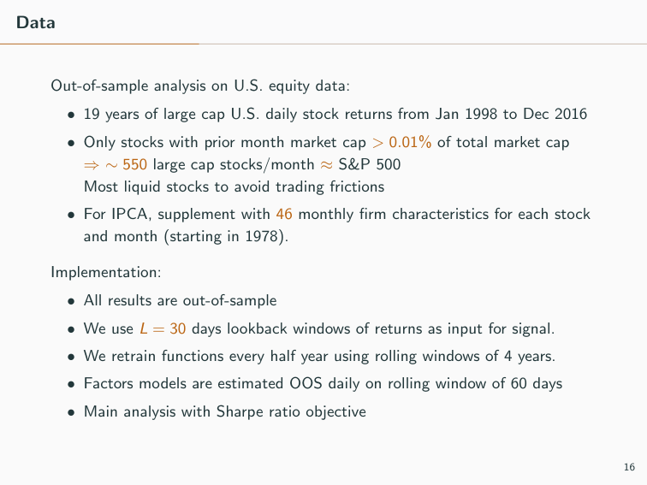
Data Out-of-sample analysis on U.S. equity data: • 19 years of large cap U.S. daily stock returns from Jan 1998 to Dec 2016 • Only stocks with prior month market cap > 0.01% of total market cap ⇒ ∼ 550 large cap stocks/month ≈ S&P 500 Most liquid stocks to avoid trading frictions • For IPCA, supplement with 46 monthly ﬁrm characteristics for each stock and month (starting in 1978). Implementation: • All results are out-of-sample • We use L = 30 days lookback windows of returns as input for signal. • We retrain functions every half year using rolling windows of 4 years. • Factors models are estimated OOS daily on rolling window of 60 days • Main analysis with Sharpe ratio objective 16

Slide 19
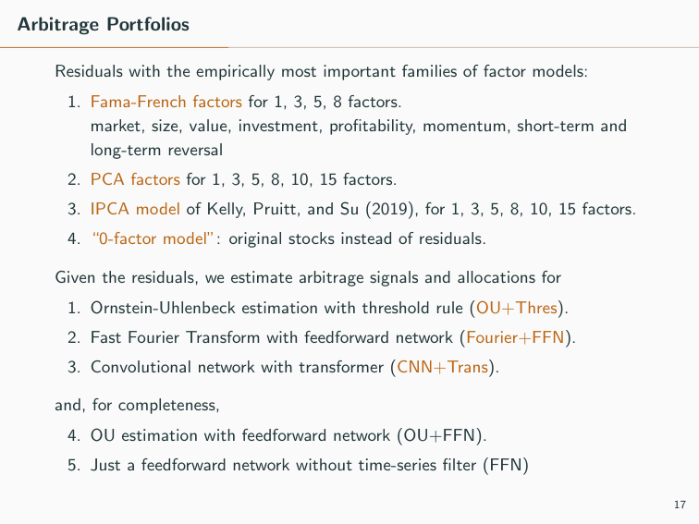
Arbitrage Portfolios Residuals with the empirically most important families of factor models: 1. Fama-French factors for 1, 3, 5, 8 factors. market, size, value, investment, proﬁtability, momentum, short-term and long-term reversal 2. PCA factors for 1, 3, 5, 8, 10, 15 factors. 3. IPCA model of Kelly, Pruitt, and Su (2019), for 1, 3, 5, 8, 10, 15 factors. 4. “0-factor model”: original stocks instead of residuals. Given the residuals, we estimate arbitrage signals and allocations for 1. Ornstein-Uhlenbeck estimation with threshold rule (OU+Thres). 2. Fast Fourier Transform with feedforward network (Fourier+FFN). 3. Convolutional network with transformer (CNN+Trans). and, for completeness, 4. OU estimation with feedforward network (OU+FFN). 5. Just a feedforward network without time-series ﬁlter (FFN) 17

Slide 20
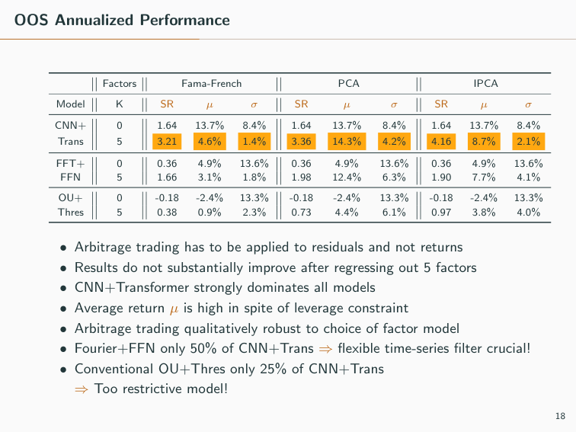
OOS Annualized Performance Factors Fama-French PCA IPCA Model K SR µ σ SR µ σ SR µ σ CNN+ 0 1.64 13.7% 8.4% 1.64 13.7% 8.4% 1.64 13.7% 8.4% Trans 5 3.21 4.6% 1.4% 3.36 14.3% 4.2% 4.16 8.7% 2.1% FFT+ 0 0.36 4.9% 13.6% 0.36 4.9% 13.6% 0.36 4.9% 13.6% FFN 5 1.66 3.1% 1.8% 1.98 12.4% 6.3% 1.90 7.7% 4.1% OU+ 0 -0.18 -2.4% 13.3% -0.18 -2.4% 13.3% -0.18 -2.4% 13.3% Thres 5 0.38 0.9% 2.3% 0.73 4.4% 6.1% 0.97 3.8% 4.0% • Arbitrage trading has to be applied to residuals and not returns • Results do not substantially improve after regressing out 5 factors • CNN+Transformer strongly dominates all models • Average return µ is high in spite of leverage constraint • Arbitrage trading qualitatively robust to choice of factor model • Fourier+FFN only 50% of CNN+Trans ⇒ ﬂexible time-series ﬁlter crucial! • Conventional OU+Thres only 25% of CNN+Trans ⇒ Too restrictive model! 18

Slide 21
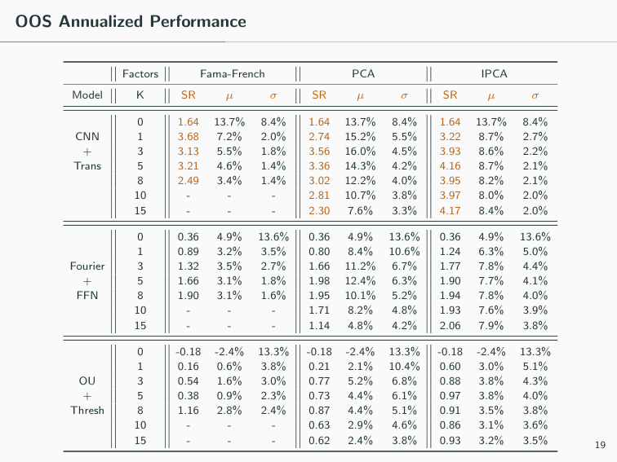
OOS Annualized Performance Factors Fama-French PCA IPCA Model K SR µ σ SR µ σ SR µ σ 0 1.64 13.7% 8.4% 1.64 13.7% 8.4% 1.64 13.7% 8.4% CNN 1 3.68 7.2% 2.0% 2.74 15.2% 5.5% 3.22 8.7% 2.7% + 3 3.13 5.5% 1.8% 3.56 16.0% 4.5% 3.93 8.6% 2.2% Trans 5 3.21 4.6% 1.4% 3.36 14.3% 4.2% 4.16 8.7% 2.1% 8 2.49 3.4% 1.4% 3.02 12.2% 4.0% 3.95 8.2% 2.1% 10 - - - 2.81 10.7% 3.8% 3.97 8.0% 2.0% 15 - - - 2.30 7.6% 3.3% 4.17 8.4% 2.0% 0 0.36 4.9% 13.6% 0.36 4.9% 13.6% 0.36 4.9% 13.6% 1 0.89 3.2% 3.5% 0.80 8.4% 10.6% 1.24 6.3% 5.0% Fourier 3 1.32 3.5% 2.7% 1.66 11.2% 6.7% 1.77 7.8% 4.4% + 5 1.66 3.1% 1.8% 1.98 12.4% 6.3% 1.90 7.7% 4.1% FFN 8 1.90 3.1% 1.6% 1.95 10.1% 5.2% 1.94 7.8% 4.0% 10 - - - 1.71 8.2% 4.8% 1.93 7.6% 3.9% 15 - - - 1.14 4.8% 4.2% 2.06 7.9% 3.8% 0 -0.18 -2.4% 13.3% -0.18 -2.4% 13.3% -0.18 -2.4% 13.3% 1 0.16 0.6% 3.8% 0.21 2.1% 10.4% 0.60 3.0% 5.1% OU 3 0.54 1.6% 3.0% 0.77 5.2% 6.8% 0.88 3.8% 4.3% + 5 0.38 0.9% 2.3% 0.73 4.4% 6.1% 0.97 3.8% 4.0% Thresh 8 1.16 2.8% 2.4% 0.87 4.4% 5.1% 0.91 3.5% 3.8% 10 - - - 0.63 2.9% 4.6% 0.86 3.1% 3.6% 15 - - - 0.62 2.4% 3.8% 0.93 3.2% 3.5% 19

Slide 22
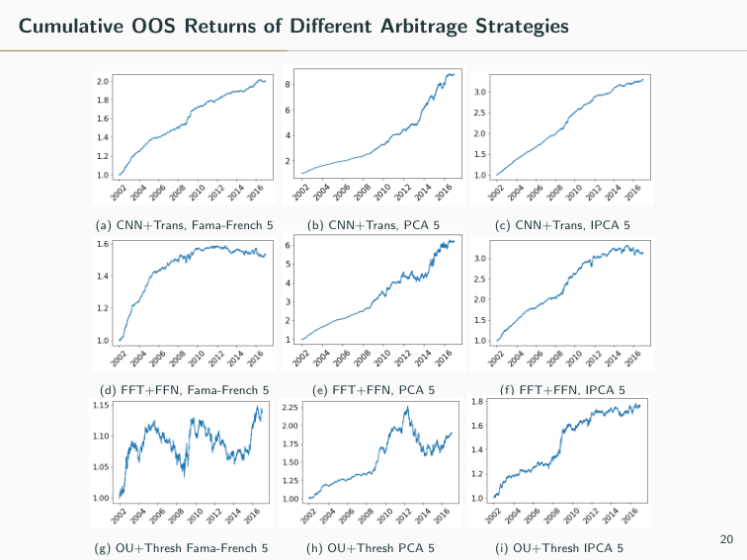
Cumulative OOS Returns of Diﬀerent Arbitrage Strategies (a) CNN+Trans, Fama-French 5 (b) CNN+Trans, PCA 5 (c) CNN+Trans, IPCA 5 (d) FFT+FFN, Fama-French 5 (e) FFT+FFN, PCA 5 (f) FFT+FFN, IPCA 5 (g) OU+Thresh Fama-French 5 (h) OU+Thresh PCA 5 (i) OU+Thresh IPCA 5 20

Slide 23
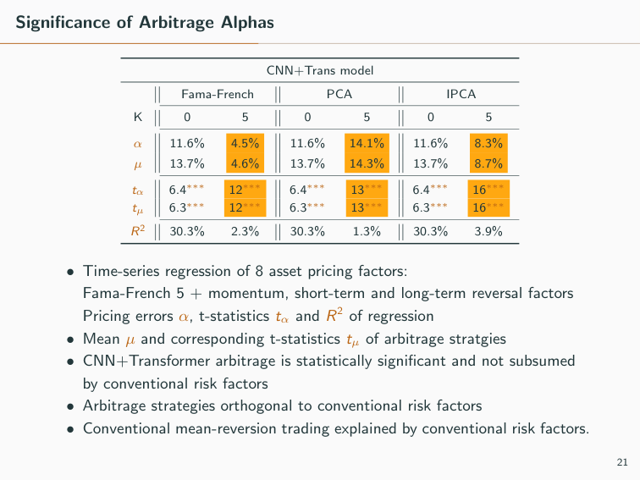
Signiﬁcance of Arbitrage Alphas CNN+Trans model Fama-French PCA IPCA K 0 5 0 5 0 5 α 11.6% 4.5% 11.6% 14.1% 11.6% 8.3% µ 13.7% 4.6% 13.7% 14.3% 13.7% 8.7% tα 6.4∗∗∗ 12∗∗∗ 6.4∗∗∗ 13∗∗∗ 6.4∗∗∗ 16∗∗∗ tµ 6.3∗∗∗ 12∗∗∗ 6.3∗∗∗ 13∗∗∗ 6.3∗∗∗ 16∗∗∗ R2 30.3% 2.3% 30.3% 1.3% 30.3% 3.9% • Time-series regression of 8 asset pricing factors: Fama-French 5 + momentum, short-term and long-term reversal factors Pricing errors α, t-statistics tα and R2 of regression • Mean µ and corresponding t-statistics tµ of arbitrage stratgies • CNN+Transformer arbitrage is statistically signiﬁcant and not subsumed by conventional risk factors • Arbitrage strategies orthogonal to conventional risk factors • Conventional mean-reversion trading explained by conventional risk factors. 21

Slide 24
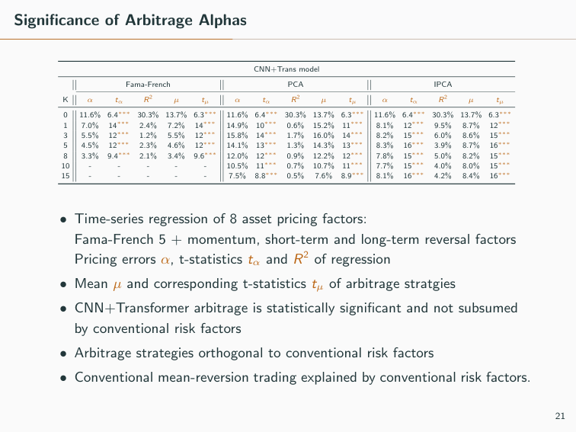
Signiﬁcance of Arbitrage Alphas CNN+Trans model Fama-French PCA IPCA K α tα R2 µ tµ α tα R2 µ tµ α tα R2 µ tµ 0 11.6% 6.4∗∗∗ 30.3% 13.7% 6.3∗∗∗ 11.6% 6.4∗∗∗ 30.3% 13.7% 6.3∗∗∗ 11.6% 6.4∗∗∗ 30.3% 13.7% 6.3∗∗∗ 1 7.0% 14∗∗∗ 2.4% 7.2% 14∗∗∗ 14.9% 10∗∗∗ 0.6% 15.2% 11∗∗∗ 8.1% 12∗∗∗ 9.5% 8.7% 12∗∗∗ 3 5.5% 12∗∗∗ 1.2% 5.5% 12∗∗∗ 15.8% 14∗∗∗ 1.7% 16.0% 14∗∗∗ 8.2% 15∗∗∗ 6.0% 8.6% 15∗∗∗ 5 4.5% 12∗∗∗ 2.3% 4.6% 12∗∗∗ 14.1% 13∗∗∗ 1.3% 14.3% 13∗∗∗ 8.3% 16∗∗∗ 3.9% 8.7% 16∗∗∗ 8 3.3% 9.4∗∗∗ 2.1% 3.4% 9.6∗∗∗ 12.0% 12∗∗∗ 0.9% 12.2% 12∗∗∗ 7.8% 15∗∗∗ 5.0% 8.2% 15∗∗∗ 10 - - - - - 10.5% 11∗∗∗ 0.7% 10.7% 11∗∗∗ 7.7% 15∗∗∗ 4.0% 8.0% 15∗∗∗ 15 - - - - - 7.5% 8.8∗∗∗ 0.5% 7.6% 8.9∗∗∗ 8.1% 16∗∗∗ 4.2% 8.4% 16∗∗∗ • Time-series regression of 8 asset pricing factors: Fama-French 5 + momentum, short-term and long-term reversal factors Pricing errors α, t-statistics tα and R2 of regression • Mean µ and corresponding t-statistics tµ of arbitrage stratgies • CNN+Transformer arbitrage is statistically signiﬁcant and not subsumed by conventional risk factors • Arbitrage strategies orthogonal to conventional risk factors • Conventional mean-reversion trading explained by conventional risk factors. 21

Slide 25
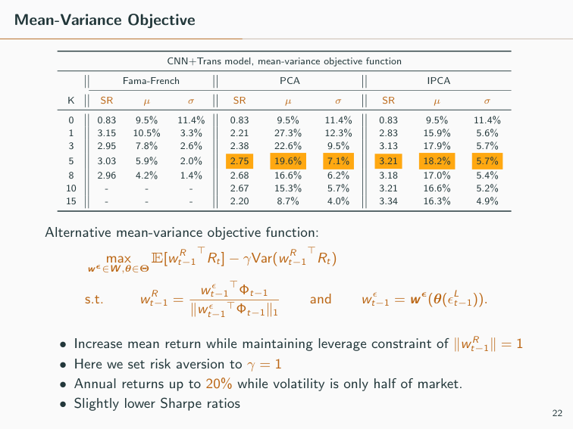
Mean-Variance Objective CNN+Trans model, mean-variance objective function Fama-French PCA IPCA K SR µ σ SR µ σ SR µ σ 0 0.83 9.5% 11.4% 0.83 9.5% 11.4% 0.83 9.5% 11.4% 1 3.15 10.5% 3.3% 2.21 27.3% 12.3% 2.83 15.9% 5.6% 3 2.95 7.8% 2.6% 2.38 22.6% 9.5% 3.13 17.9% 5.7% 5 3.03 5.9% 2.0% 2.75 19.6% 7.1% 3.21 18.2% 5.7% 8 2.96 4.2% 1.4% 2.68 16.6% 6.2% 3.18 17.0% 5.4% 10 - - - 2.67 15.3% 5.7% 3.21 16.6% 5.2% 15 - - - 2.20 8.7% 4.0% 3.34 16.3% 4.9% Alternative mean-variance objective function: max wϵ∈W ,θ∈Θ E[w R t−1 ⊤Rt] − γVar(w R t−1 ⊤Rt) s.t. w R t−1 = w ϵ t−1 ⊤Φt−1 ∥w ϵ t−1 ⊤Φt−1∥1 and w ϵ t−1 = w ϵ(θ(ϵL t−1)). • Increase mean return while maintaining leverage constraint of ∥w R t−1∥ = 1 • Here we set risk aversion to γ = 1 • Annual returns up to 20% while volatility is only half of market. • Slightly lower Sharpe ratios 22

Slide 26
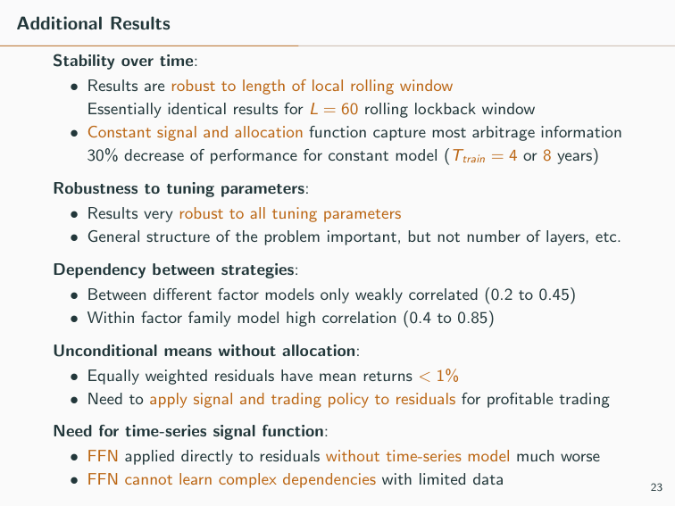
Additional Results Stability over time: • Results are robust to length of local rolling window Essentially identical results for L = 60 rolling lockback window • Constant signal and allocation function capture most arbitrage information 30% decrease of performance for constant model (Ttrain = 4 or 8 years) Robustness to tuning parameters: • Results very robust to all tuning parameters • General structure of the problem important, but not number of layers, etc. Dependency between strategies: • Between diﬀerent factor models only weakly correlated (0.2 to 0.45) • Within factor family model high correlation (0.4 to 0.85) Unconditional means without allocation: • Equally weighted residuals have mean returns < 1% • Need to apply signal and trading policy to residuals for proﬁtable trading Need for time-series signal function: • FFN applied directly to residuals without time-series model much worse • FFN cannot learn complex dependencies with limited data 23

Slide 27
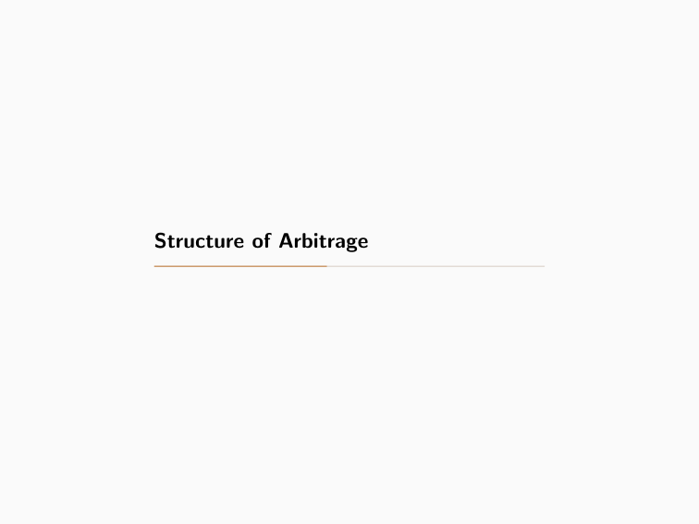
Structure of Arbitrage

Slide 28
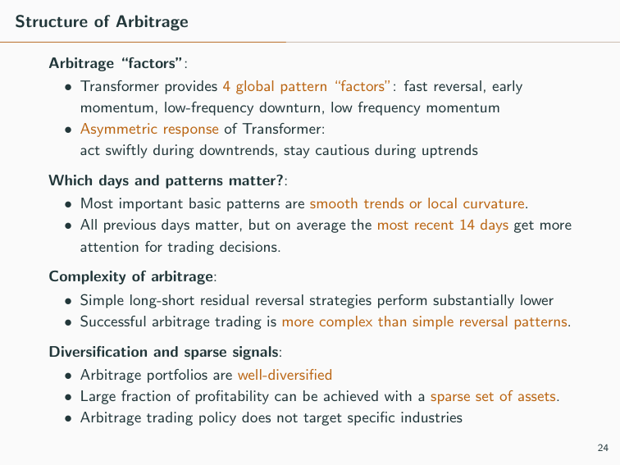
Structure of Arbitrage Arbitrage “factors”: • Transformer provides 4 global pattern “factors”: fast reversal, early momentum, low-frequency downturn, low frequency momentum • Asymmetric response of Transformer: act swiftly during downtrends, stay cautious during uptrends Which days and patterns matter?: • Most important basic patterns are smooth trends or local curvature. • All previous days matter, but on average the most recent 14 days get more attention for trading decisions. Complexity of arbitrage: • Simple long-short residual reversal strategies perform substantially lower • Successful arbitrage trading is more complex than simple reversal patterns. Diversiﬁcation and sparse signals: • Arbitrage portfolios are well-diversiﬁed • Large fraction of proﬁtability can be achieved with a sparse set of assets. • Arbitrage trading policy does not target speciﬁc industries 24

Slide 29
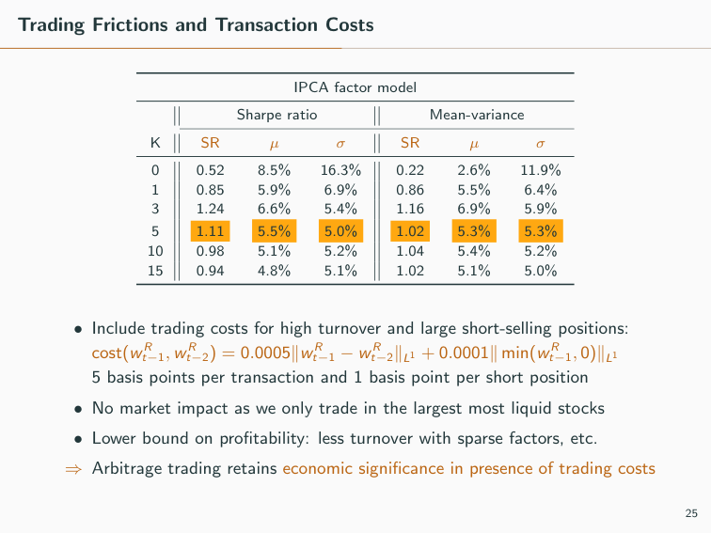
Trading Frictions and Transaction Costs IPCA factor model Sharpe ratio Mean-variance K SR µ σ SR µ σ 0 0.52 8.5% 16.3% 0.22 2.6% 11.9% 1 0.85 5.9% 6.9% 0.86 5.5% 6.4% 3 1.24 6.6% 5.4% 1.16 6.9% 5.9% 5 1.11 5.5% 5.0% 1.02 5.3% 5.3% 10 0.98 5.1% 5.2% 1.04 5.4% 5.2% 15 0.94 4.8% 5.1% 1.02 5.1% 5.0% • Include trading costs for high turnover and large short-selling positions: cost(w R t−1, w R t−2) = 0.0005∥w R t−1 − w R t−2∥L1 + 0.0001∥ min(w R t−1, 0)∥L1 5 basis points per transaction and 1 basis point per short position • No market impact as we only trade in the largest most liquid stocks • Lower bound on proﬁtability: less turnover with sparse factors, etc. ⇒ Arbitrage trading retains economic signiﬁcance in presence of trading costs 25

Slide 30
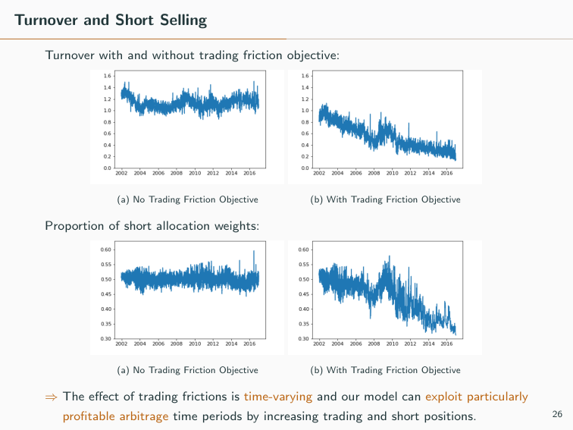
Turnover and Short Selling Turnover with and without trading friction objective: (a) No Trading Friction Objective (b) With Trading Friction Objective Proportion of short allocation weights: (a) No Trading Friction Objective (b) With Trading Friction Objective ⇒ The eﬀect of trading frictions is time-varying and our model can exploit particularly proﬁtable arbitrage time periods by increasing trading and short positions. 26

Slide 31
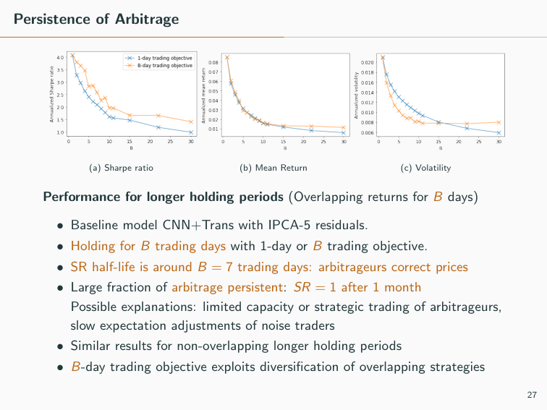
Persistence of Arbitrage (a) Sharpe ratio (b) Mean Return (c) Volatility Performance for longer holding periods (Overlapping returns for B days) • Baseline model CNN+Trans with IPCA-5 residuals. • Holding for B trading days with 1-day or B trading objective. • SR half-life is around B = 7 trading days: arbitrageurs correct prices • Large fraction of arbitrage persistent: SR = 1 after 1 month Possible explanations: limited capacity or strategic trading of arbitrageurs, slow expectation adjustments of noise traders • Similar results for non-overlapping longer holding periods • B-day trading objective exploits diversiﬁcation of overlapping strategies 27

Slide 32
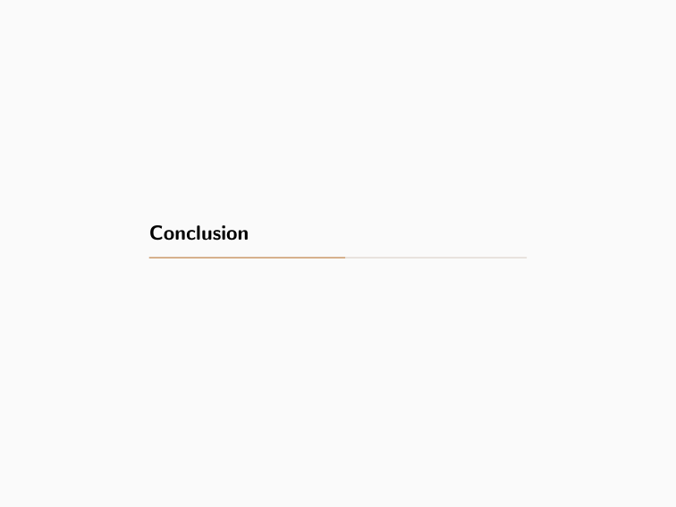
Conclusion

Slide 33
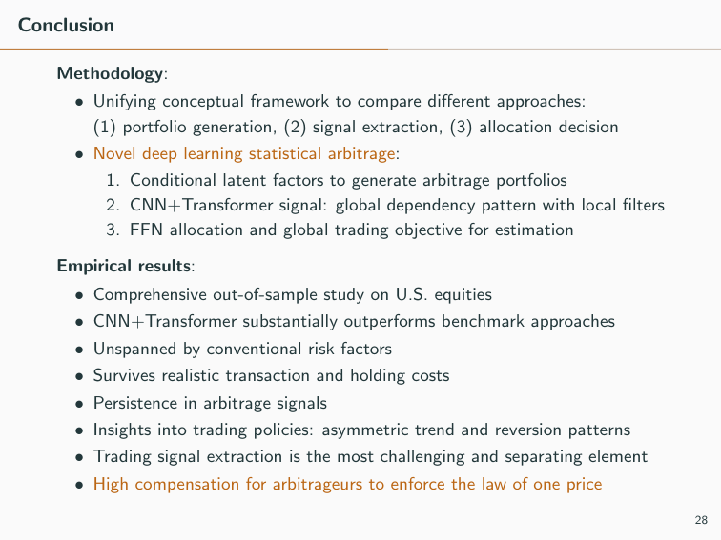
Conclusion Methodology: • Unifying conceptual framework to compare diﬀerent approaches: (1) portfolio generation, (2) signal extraction, (3) allocation decision • Novel deep learning statistical arbitrage: 1. Conditional latent factors to generate arbitrage portfolios 2. CNN+Transformer signal: global dependency pattern with local ﬁlters 3. FFN allocation and global trading objective for estimation Empirical results: • Comprehensive out-of-sample study on U.S. equities • CNN+Transformer substantially outperforms benchmark approaches • Unspanned by conventional risk factors • Survives realistic transaction and holding costs • Persistence in arbitrage signals • Insights into trading policies: asymmetric trend and reversion patterns • Trading signal extraction is the most challenging and separating element • High compensation for arbitrageurs to enforce the law of one price 28

Slide 34
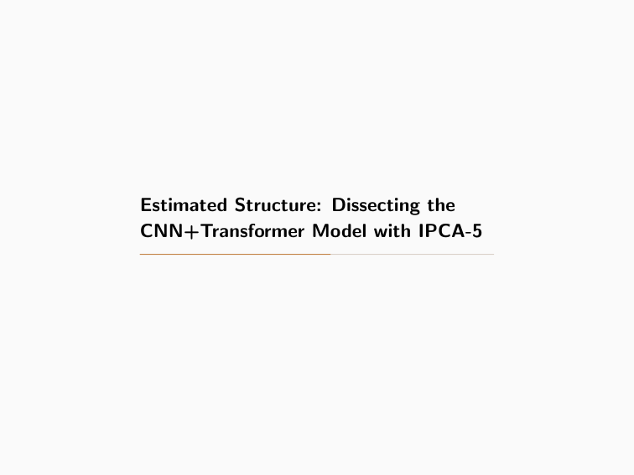
Estimated Structure: Dissecting the CNN+Transformer Model with IPCA-5

Slide 35
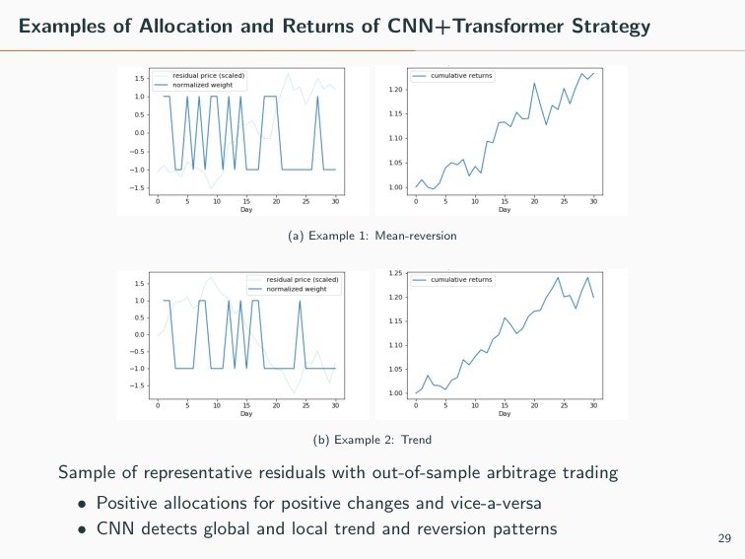
Examples of Allocation and Returns of CNN+Transformer Strategy (a) Example 1: Mean-reversion (b) Example 2: Trend Sample of representative residuals with out-of-sample arbitrage trading • Positive allocations for positive changes and vice-a-versa • CNN detects global and local trend and reversion patterns 29

Slide 36
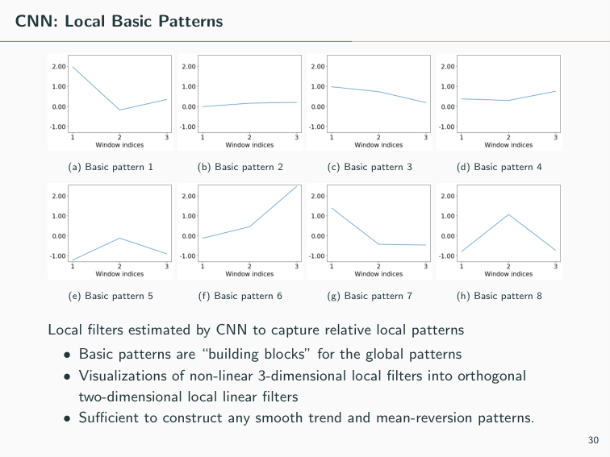
CNN: Local Basic Patterns (a) Basic pattern 1 (b) Basic pattern 2 (c) Basic pattern 3 (d) Basic pattern 4 (e) Basic pattern 5 (f) Basic pattern 6 (g) Basic pattern 7 (h) Basic pattern 8 Local ﬁlters estimated by CNN to capture relative local patterns • Basic patterns are “building blocks” for the global patterns • Visualizations of non-linear 3-dimensional local ﬁlters into orthogonal two-dimensional local linear ﬁlters • Suﬃcient to construct any smooth trend and mean-reversion patterns. 30

Slide 37
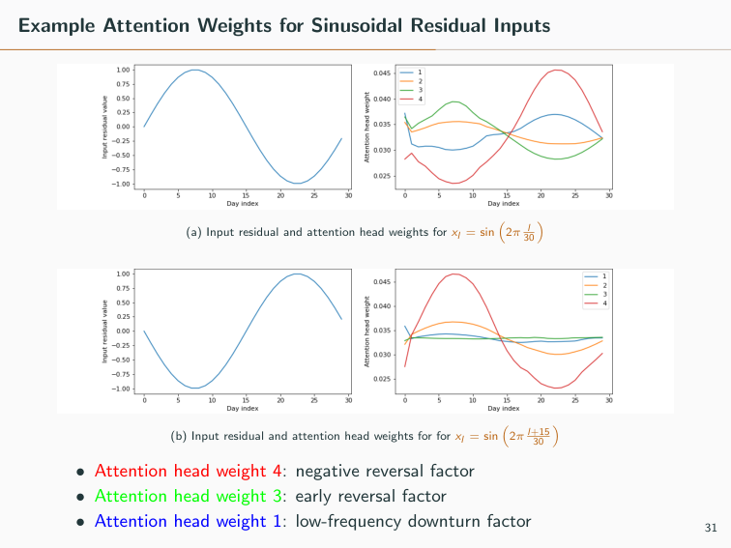
Example Attention Weights for Sinusoidal Residual Inputs (a) Input residual and attention head weights for xl = sin � 2π l 30 � (b) Input residual and attention head weights for for xl = sin � 2π l+15 30 � • Attention head weight 4: negative reversal factor • Attention head weight 3: early reversal factor • Attention head weight 1: low-frequency downturn factor 31

Slide 38
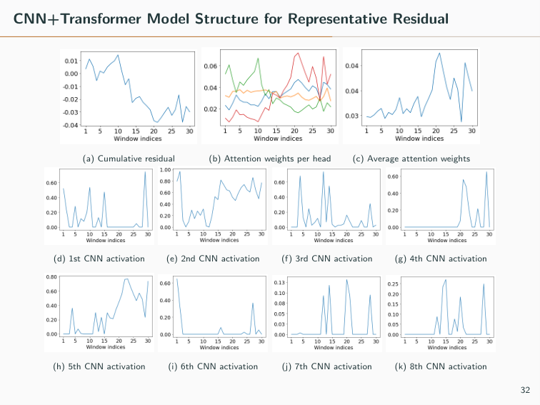
CNN+Transformer Model Structure for Representative Residual (a) Cumulative residual (b) Attention weights per head (c) Average attention weights (d) 1st CNN activation (e) 2nd CNN activation (f) 3rd CNN activation (g) 4th CNN activation (h) 5th CNN activation (i) 6th CNN activation (j) 7th CNN activation (k) 8th CNN activation 32

Slide 39
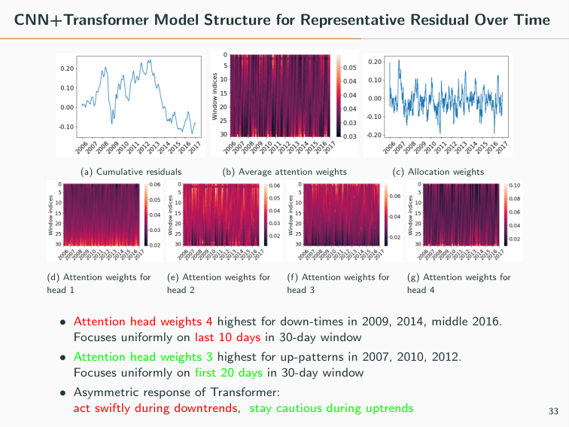
CNN+Transformer Model Structure for Representative Residual Over Time (a) Cumulative residuals (b) Average attention weights (c) Allocation weights (d) Attention weights for head 1 (e) Attention weights for head 2 (f) Attention weights for head 3 (g) Attention weights for head 4 • Attention head weights 4 highest for down-times in 2009, 2014, middle 2016. Focuses uniformly on last 10 days in 30-day window • Attention head weights 3 highest for up-patterns in 2007, 2010, 2012. Focuses uniformly on ﬁrst 20 days in 30-day window • Asymmetric response of Transformer: act swiftly during downtrends, stay cautious during uptrends 33

Slide 40
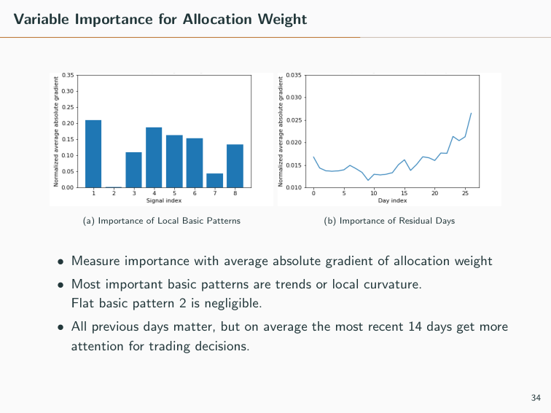
Variable Importance for Allocation Weight (a) Importance of Local Basic Patterns (b) Importance of Residual Days • Measure importance with average absolute gradient of allocation weight • Most important basic patterns are trends or local curvature. Flat basic pattern 2 is negligible. • All previous days matter, but on average the most recent 14 days get more attention for trading decisions. 34

Slide 41
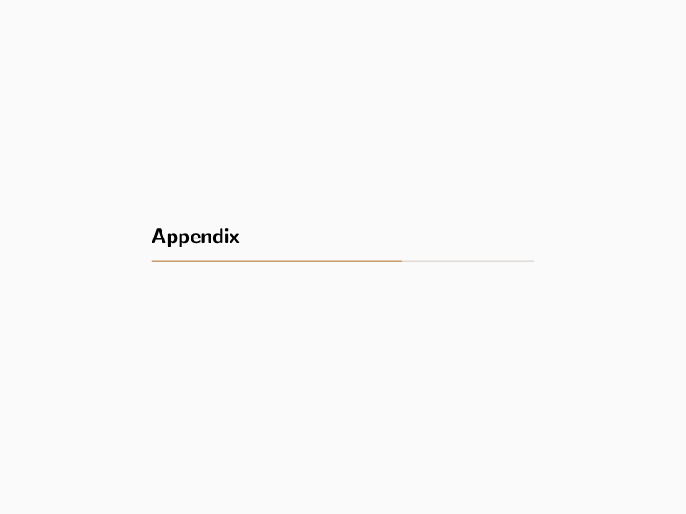
Appendix

Slide 42
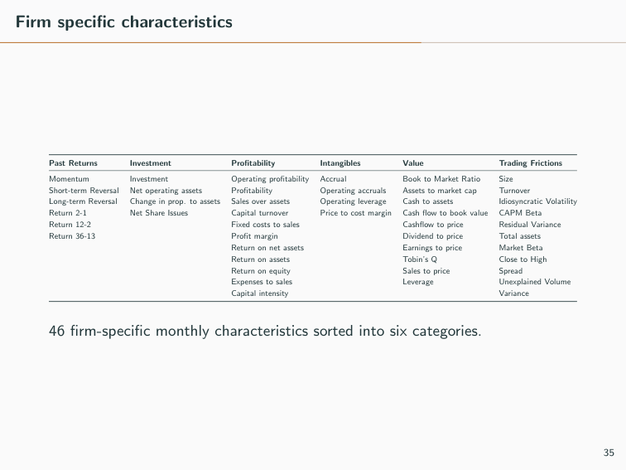
Firm speciﬁc characteristics Past Returns Investment Proﬁtability Intangibles Value Trading Frictions Momentum Investment Operating proﬁtability Accrual Book to Market Ratio Size Short-term Reversal Net operating assets Proﬁtability Operating accruals Assets to market cap Turnover Long-term Reversal Change in prop. to assets Sales over assets Operating leverage Cash to assets Idiosyncratic Volatility Return 2-1 Net Share Issues Capital turnover Price to cost margin Cash ﬂow to book value CAPM Beta Return 12-2 Fixed costs to sales Cashﬂow to price Residual Variance Return 36-13 Proﬁt margin Dividend to price Total assets Return on net assets Earnings to price Market Beta Return on assets Tobin’s Q Close to High Return on equity Sales to price Spread Expenses to sales Leverage Unexplained Volume Capital intensity Variance 46 ﬁrm-speciﬁc monthly characteristics sorted into six categories. 35

Slide 43
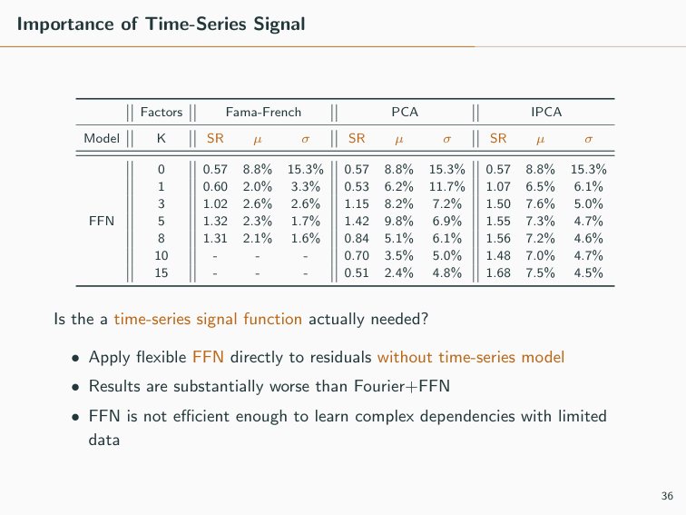
Importance of Time-Series Signal Factors Fama-French PCA IPCA Model K SR µ σ SR µ σ SR µ σ 0 0.57 8.8% 15.3% 0.57 8.8% 15.3% 0.57 8.8% 15.3% 1 0.60 2.0% 3.3% 0.53 6.2% 11.7% 1.07 6.5% 6.1% 3 1.02 2.6% 2.6% 1.15 8.2% 7.2% 1.50 7.6% 5.0% FFN 5 1.32 2.3% 1.7% 1.42 9.8% 6.9% 1.55 7.3% 4.7% 8 1.31 2.1% 1.6% 0.84 5.1% 6.1% 1.56 7.2% 4.6% 10 - - - 0.70 3.5% 5.0% 1.48 7.0% 4.7% 15 - - - 0.51 2.4% 4.8% 1.68 7.5% 4.5% Is the a time-series signal function actually needed? • Apply ﬂexible FFN directly to residuals without time-series model • Results are substantially worse than Fourier+FFN • FFN is not eﬃcient enough to learn complex dependencies with limited data 36

Slide 44
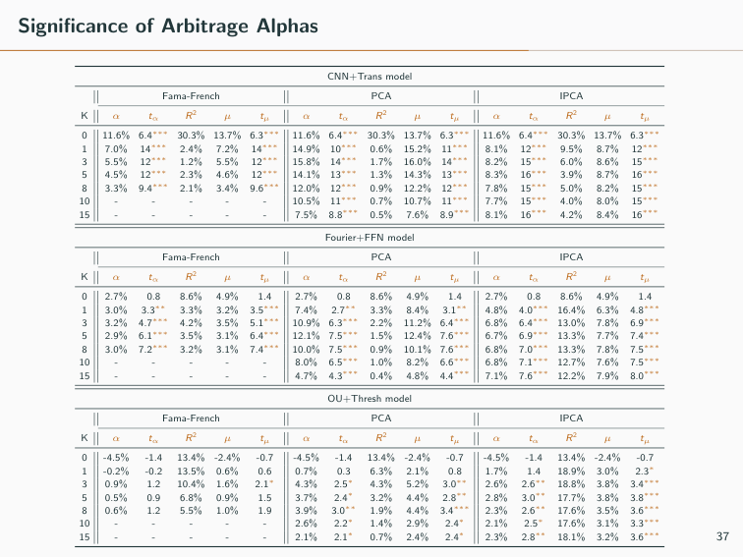
Signiﬁcance of Arbitrage Alphas CNN+Trans model Fama-French PCA IPCA K α tα R2 µ tµ α tα R2 µ tµ α tα R2 µ tµ 0 11.6% 6.4∗∗∗ 30.3% 13.7% 6.3∗∗∗ 11.6% 6.4∗∗∗ 30.3% 13.7% 6.3∗∗∗ 11.6% 6.4∗∗∗ 30.3% 13.7% 6.3∗∗∗ 1 7.0% 14∗∗∗ 2.4% 7.2% 14∗∗∗ 14.9% 10∗∗∗ 0.6% 15.2% 11∗∗∗ 8.1% 12∗∗∗ 9.5% 8.7% 12∗∗∗ 3 5.5% 12∗∗∗ 1.2% 5.5% 12∗∗∗ 15.8% 14∗∗∗ 1.7% 16.0% 14∗∗∗ 8.2% 15∗∗∗ 6.0% 8.6% 15∗∗∗ 5 4.5% 12∗∗∗ 2.3% 4.6% 12∗∗∗ 14.1% 13∗∗∗ 1.3% 14.3% 13∗∗∗ 8.3% 16∗∗∗ 3.9% 8.7% 16∗∗∗ 8 3.3% 9.4∗∗∗ 2.1% 3.4% 9.6∗∗∗ 12.0% 12∗∗∗ 0.9% 12.2% 12∗∗∗ 7.8% 15∗∗∗ 5.0% 8.2% 15∗∗∗ 10 - - - - - 10.5% 11∗∗∗ 0.7% 10.7% 11∗∗∗ 7.7% 15∗∗∗ 4.0% 8.0% 15∗∗∗ 15 - - - - - 7.5% 8.8∗∗∗ 0.5% 7.6% 8.9∗∗∗ 8.1% 16∗∗∗ 4.2% 8.4% 16∗∗∗ Fourier+FFN model Fama-French PCA IPCA K α tα R2 µ tµ α tα R2 µ tµ α tα R2 µ tµ 0 2.7% 0.8 8.6% 4.9% 1.4 2.7% 0.8 8.6% 4.9% 1.4 2.7% 0.8 8.6% 4.9% 1.4 1 3.0% 3.3∗∗ 3.3% 3.2% 3.5∗∗∗ 7.4% 2.7∗∗ 3.3% 8.4% 3.1∗∗ 4.8% 4.0∗∗∗ 16.4% 6.3% 4.8∗∗∗ 3 3.2% 4.7∗∗∗ 4.2% 3.5% 5.1∗∗∗ 10.9% 6.3∗∗∗ 2.2% 11.2% 6.4∗∗∗ 6.8% 6.4∗∗∗ 13.0% 7.8% 6.9∗∗∗ 5 2.9% 6.1∗∗∗ 3.5% 3.1% 6.4∗∗∗ 12.1% 7.5∗∗∗ 1.5% 12.4% 7.6∗∗∗ 6.7% 6.9∗∗∗ 13.3% 7.7% 7.4∗∗∗ 8 3.0% 7.2∗∗∗ 3.2% 3.1% 7.4∗∗∗ 10.0% 7.5∗∗∗ 0.9% 10.1% 7.6∗∗∗ 6.8% 7.0∗∗∗ 13.3% 7.8% 7.5∗∗∗ 10 - - - - - 8.0% 6.5∗∗∗ 1.0% 8.2% 6.6∗∗∗ 6.8% 7.1∗∗∗ 12.7% 7.6% 7.5∗∗∗ 15 - - - - - 4.7% 4.3∗∗∗ 0.4% 4.8% 4.4∗∗∗ 7.1% 7.6∗∗∗ 12.2% 7.9% 8.0∗∗∗ OU+Thresh model Fama-French PCA IPCA K α tα R2 µ tµ α tα R2 µ tµ α tα R2 µ tµ 0 -4.5% -1.4 13.4% -2.4% -0.7 -4.5% -1.4 13.4% -2.4% -0.7 -4.5% -1.4 13.4% -2.4% -0.7 1 -0.2% -0.2 13.5% 0.6% 0.6 0.7% 0.3 6.3% 2.1% 0.8 1.7% 1.4 18.9% 3.0% 2.3∗ 3 0.9% 1.2 10.4% 1.6% 2.1∗ 4.3% 2.5∗ 4.3% 5.2% 3.0∗∗ 2.6% 2.6∗∗ 18.8% 3.8% 3.4∗∗∗ 5 0.5% 0.9 6.8% 0.9% 1.5 3.7% 2.4∗ 3.2% 4.4% 2.8∗∗ 2.8% 3.0∗∗ 17.7% 3.8% 3.8∗∗∗ 8 0.6% 1.2 5.5% 1.0% 1.9 3.9% 3.0∗∗ 1.9% 4.4% 3.4∗∗∗ 2.3% 2.6∗∗ 17.6% 3.5% 3.6∗∗∗ 10 - - - - - 2.6% 2.2∗ 1.4% 2.9% 2.4∗ 2.1% 2.5∗ 17.6% 3.1% 3.3∗∗∗ 15 - - - - - 2.1% 2.1∗ 0.7% 2.4% 2.4∗ 2.3% 2.8∗∗ 18.1% 3.2% 3.6∗∗∗ 37

Slide 45
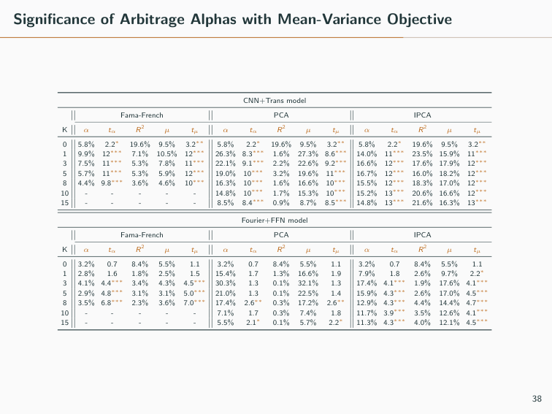
Signiﬁcance of Arbitrage Alphas with Mean-Variance Objective CNN+Trans model Fama-French PCA IPCA K α tα R2 µ tµ α tα R2 µ tµ α tα R2 µ tµ 0 5.8% 2.2∗ 19.6% 9.5% 3.2∗∗ 5.8% 2.2∗ 19.6% 9.5% 3.2∗∗ 5.8% 2.2∗ 19.6% 9.5% 3.2∗∗ 1 9.9% 12∗∗∗ 7.1% 10.5% 12∗∗∗ 26.3% 8.3∗∗∗ 1.6% 27.3% 8.6∗∗∗ 14.0% 11∗∗∗ 23.5% 15.9% 11∗∗∗ 3 7.5% 11∗∗∗ 5.3% 7.8% 11∗∗∗ 22.1% 9.1∗∗∗ 2.2% 22.6% 9.2∗∗∗ 16.6% 12∗∗∗ 17.6% 17.9% 12∗∗∗ 5 5.7% 11∗∗∗ 5.3% 5.9% 12∗∗∗ 19.0% 10∗∗∗ 3.2% 19.6% 11∗∗∗ 16.7% 12∗∗∗ 16.0% 18.2% 12∗∗∗ 8 4.4% 9.8∗∗∗ 3.6% 4.6% 10∗∗∗ 16.3% 10∗∗∗ 1.6% 16.6% 10∗∗∗ 15.5% 12∗∗∗ 18.3% 17.0% 12∗∗∗ 10 - - - - - 14.8% 10∗∗∗ 1.7% 15.3% 10∗∗∗ 15.2% 13∗∗∗ 20.6% 16.6% 12∗∗∗ 15 - - - - - 8.5% 8.4∗∗∗ 0.9% 8.7% 8.5∗∗∗ 14.8% 13∗∗∗ 21.6% 16.3% 13∗∗∗ Fourier+FFN model Fama-French PCA IPCA K α tα R2 µ tµ α tα R2 µ tµ α tα R2 µ tµ 0 3.2% 0.7 8.4% 5.5% 1.1 3.2% 0.7 8.4% 5.5% 1.1 3.2% 0.7 8.4% 5.5% 1.1 1 2.8% 1.6 1.8% 2.5% 1.5 15.4% 1.7 1.3% 16.6% 1.9 7.9% 1.8 2.6% 9.7% 2.2∗ 3 4.1% 4.4∗∗∗ 3.4% 4.3% 4.5∗∗∗ 30.3% 1.3 0.1% 32.1% 1.3 17.4% 4.1∗∗∗ 1.9% 17.6% 4.1∗∗∗ 5 2.9% 4.8∗∗∗ 3.1% 3.1% 5.0∗∗∗ 21.0% 1.3 0.1% 22.5% 1.4 15.9% 4.3∗∗∗ 2.6% 17.0% 4.5∗∗∗ 8 3.5% 6.8∗∗∗ 2.3% 3.6% 7.0∗∗∗ 17.4% 2.6∗∗ 0.3% 17.2% 2.6∗∗ 12.9% 4.3∗∗∗ 4.4% 14.4% 4.7∗∗∗ 10 - - - - - 7.1% 1.7 0.3% 7.4% 1.8 11.7% 3.9∗∗∗ 3.5% 12.6% 4.1∗∗∗ 15 - - - - - 5.5% 2.1∗ 0.1% 5.7% 2.2∗ 11.3% 4.3∗∗∗ 4.0% 12.1% 4.5∗∗∗ 38

Slide 46
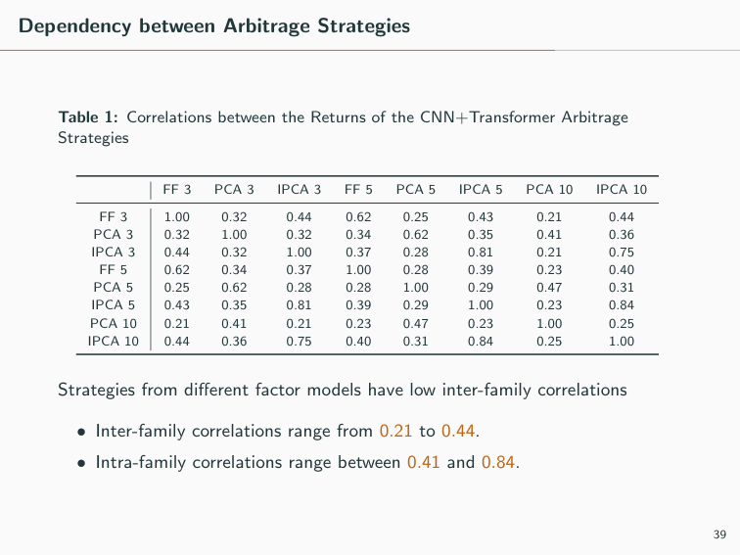
Dependency between Arbitrage Strategies Table 1: Correlations between the Returns of the CNN+Transformer Arbitrage Strategies FF 3 PCA 3 IPCA 3 FF 5 PCA 5 IPCA 5 PCA 10 IPCA 10 FF 3 1.00 0.32 0.44 0.62 0.25 0.43 0.21 0.44 PCA 3 0.32 1.00 0.32 0.34 0.62 0.35 0.41 0.36 IPCA 3 0.44 0.32 1.00 0.37 0.28 0.81 0.21 0.75 FF 5 0.62 0.34 0.37 1.00 0.28 0.39 0.23 0.40 PCA 5 0.25 0.62 0.28 0.28 1.00 0.29 0.47 0.31 IPCA 5 0.43 0.35 0.81 0.39 0.29 1.00 0.23 0.84 PCA 10 0.21 0.41 0.21 0.23 0.47 0.23 1.00 0.25 IPCA 10 0.44 0.36 0.75 0.40 0.31 0.84 0.25 1.00 Strategies from diﬀerent factor models have low inter-family correlations • Inter-family correlations range from 0.21 to 0.44. • Intra-family correlations range between 0.41 and 0.84. 39

Slide 47
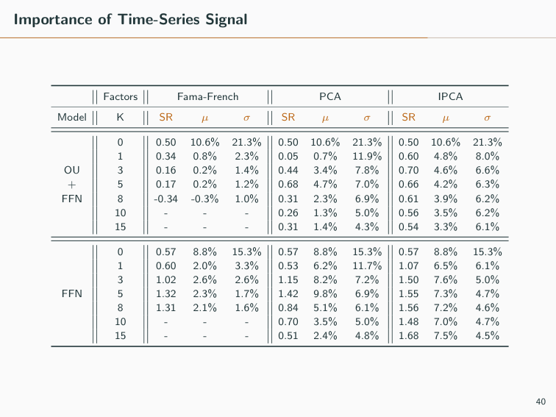
Importance of Time-Series Signal Factors Fama-French PCA IPCA Model K SR µ σ SR µ σ SR µ σ 0 0.50 10.6% 21.3% 0.50 10.6% 21.3% 0.50 10.6% 21.3% 1 0.34 0.8% 2.3% 0.05 0.7% 11.9% 0.60 4.8% 8.0% OU 3 0.16 0.2% 1.4% 0.44 3.4% 7.8% 0.70 4.6% 6.6% + 5 0.17 0.2% 1.2% 0.68 4.7% 7.0% 0.66 4.2% 6.3% FFN 8 -0.34 -0.3% 1.0% 0.31 2.3% 6.9% 0.61 3.9% 6.2% 10 - - - 0.26 1.3% 5.0% 0.56 3.5% 6.2% 15 - - - 0.31 1.4% 4.3% 0.54 3.3% 6.1% 0 0.57 8.8% 15.3% 0.57 8.8% 15.3% 0.57 8.8% 15.3% 1 0.60 2.0% 3.3% 0.53 6.2% 11.7% 1.07 6.5% 6.1% 3 1.02 2.6% 2.6% 1.15 8.2% 7.2% 1.50 7.6% 5.0% FFN 5 1.32 2.3% 1.7% 1.42 9.8% 6.9% 1.55 7.3% 4.7% 8 1.31 2.1% 1.6% 0.84 5.1% 6.1% 1.56 7.2% 4.6% 10 - - - 0.70 3.5% 5.0% 1.48 7.0% 4.7% 15 - - - 0.51 2.4% 4.8% 1.68 7.5% 4.5% 40

Slide 48
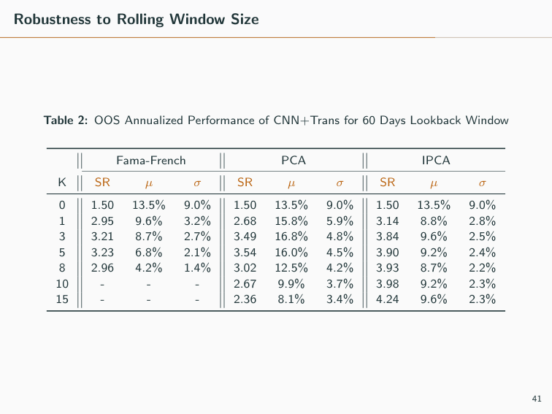
Robustness to Rolling Window Size Table 2: OOS Annualized Performance of CNN+Trans for 60 Days Lookback Window Fama-French PCA IPCA K SR µ σ SR µ σ SR µ σ 0 1.50 13.5% 9.0% 1.50 13.5% 9.0% 1.50 13.5% 9.0% 1 2.95 9.6% 3.2% 2.68 15.8% 5.9% 3.14 8.8% 2.8% 3 3.21 8.7% 2.7% 3.49 16.8% 4.8% 3.84 9.6% 2.5% 5 3.23 6.8% 2.1% 3.54 16.0% 4.5% 3.90 9.2% 2.4% 8 2.96 4.2% 1.4% 3.02 12.5% 4.2% 3.93 8.7% 2.2% 10 - - - 2.67 9.9% 3.7% 3.98 9.2% 2.3% 15 - - - 2.36 8.1% 3.4% 4.24 9.6% 2.3% 41

Slide 49
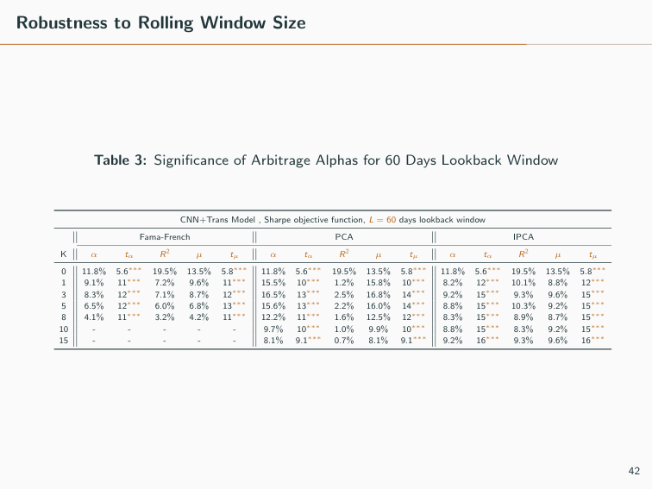
Robustness to Rolling Window Size Table 3: Signiﬁcance of Arbitrage Alphas for 60 Days Lookback Window CNN+Trans Model , Sharpe objective function, L = 60 days lookback window Fama-French PCA IPCA K α tα R2 µ tµ α tα R2 µ tµ α tα R2 µ tµ 0 11.8% 5.6∗∗∗ 19.5% 13.5% 5.8∗∗∗ 11.8% 5.6∗∗∗ 19.5% 13.5% 5.8∗∗∗ 11.8% 5.6∗∗∗ 19.5% 13.5% 5.8∗∗∗ 1 9.1% 11∗∗∗ 7.2% 9.6% 11∗∗∗ 15.5% 10∗∗∗ 1.2% 15.8% 10∗∗∗ 8.2% 12∗∗∗ 10.1% 8.8% 12∗∗∗ 3 8.3% 12∗∗∗ 7.1% 8.7% 12∗∗∗ 16.5% 13∗∗∗ 2.5% 16.8% 14∗∗∗ 9.2% 15∗∗∗ 9.3% 9.6% 15∗∗∗ 5 6.5% 12∗∗∗ 6.0% 6.8% 13∗∗∗ 15.6% 13∗∗∗ 2.2% 16.0% 14∗∗∗ 8.8% 15∗∗∗ 10.3% 9.2% 15∗∗∗ 8 4.1% 11∗∗∗ 3.2% 4.2% 11∗∗∗ 12.2% 11∗∗∗ 1.6% 12.5% 12∗∗∗ 8.3% 15∗∗∗ 8.9% 8.7% 15∗∗∗ 10 - - - - - 9.7% 10∗∗∗ 1.0% 9.9% 10∗∗∗ 8.8% 15∗∗∗ 8.3% 9.2% 15∗∗∗ 15 - - - - - 8.1% 9.1∗∗∗ 0.7% 8.1% 9.1∗∗∗ 9.2% 16∗∗∗ 9.3% 9.6% 16∗∗∗ 42

Slide 50
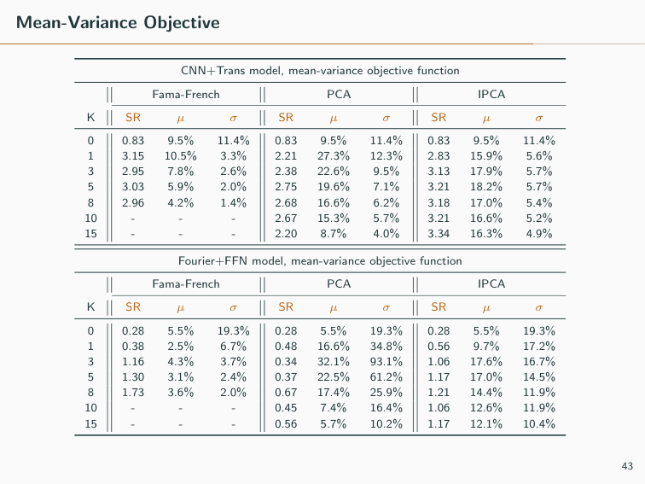
Mean-Variance Objective CNN+Trans model, mean-variance objective function Fama-French PCA IPCA K SR µ σ SR µ σ SR µ σ 0 0.83 9.5% 11.4% 0.83 9.5% 11.4% 0.83 9.5% 11.4% 1 3.15 10.5% 3.3% 2.21 27.3% 12.3% 2.83 15.9% 5.6% 3 2.95 7.8% 2.6% 2.38 22.6% 9.5% 3.13 17.9% 5.7% 5 3.03 5.9% 2.0% 2.75 19.6% 7.1% 3.21 18.2% 5.7% 8 2.96 4.2% 1.4% 2.68 16.6% 6.2% 3.18 17.0% 5.4% 10 - - - 2.67 15.3% 5.7% 3.21 16.6% 5.2% 15 - - - 2.20 8.7% 4.0% 3.34 16.3% 4.9% Fourier+FFN model, mean-variance objective function Fama-French PCA IPCA K SR µ σ SR µ σ SR µ σ 0 0.28 5.5% 19.3% 0.28 5.5% 19.3% 0.28 5.5% 19.3% 1 0.38 2.5% 6.7% 0.48 16.6% 34.8% 0.56 9.7% 17.2% 3 1.16 4.3% 3.7% 0.34 32.1% 93.1% 1.06 17.6% 16.7% 5 1.30 3.1% 2.4% 0.37 22.5% 61.2% 1.17 17.0% 14.5% 8 1.73 3.6% 2.0% 0.67 17.4% 25.9% 1.21 14.4% 11.9% 10 - - - 0.45 7.4% 16.4% 1.06 12.6% 11.9% 15 - - - 0.56 5.7% 10.2% 1.17 12.1% 10.4% 43

Slide 51

Constant Model without Re-estimation Table 4: OOS Annualized Performance of CNN+Trans for Constant Model Ttrain = 4 years Fama-French PCA IPCA K SR µ σ SR µ σ SR µ σ 0 1.10 8.5% 7.8% 1.10 8.5% 7.8% 1.10 8.5% 7.8% 1 1.90 4.5% 2.3% 0.44 3.0% 6.9% 0.94 3.1% 3.3% 3 1.60 3.6% 2.2% 1.65 8.7% 5.3% 1.82 5.3% 2.9% 5 1.81 3.0% 1.7% 1.93 9.8% 5.1% 2.09 5.4% 2.6% 8 1.70 2.5% 1.5% 2.04 9.6% 4.7% 1.89 5.0% 2.6% 10 - - - 2.06 9.1% 4.4% 1.77 4.7% 2.7% 15 - - - 1.82 7.0% 3.9% 2.09 5.5% 2.7% Ttrain = 8 years Fama-French PCA IPCA K SR µ σ SR µ σ SR µ σ 0 1.33 12.0% 9.0% 1.33 12.0% 9.0% 1.33 12.0% 9.0% 1 2.06 5.0% 2.4% 1.81 15.2% 8.4% 2.02 8.5% 4.2% 3 2.46 5.3% 2.2% 2.04 13.1% 6.4% 2.47 7.5% 3.0% 5 1.82 3.2% 1.8% 1.91 11.9% 6.2% 2.64 7.6% 2.9% 8 1.48 2.5% 1.7% 1.89 10.8% 5.7% 2.71 8.3% 3.1% 10 - - - 1.82 10.0% 5.5% 2.68 8.2% 3.1% 15 - - - 1.38 6.2% 4.5% 2.70 7.8% 2.9% 44

Slide 52

Constant Model without Re-estimation Table 5: Signiﬁcance of Arbitrage Alphas for Constant Model CNN+Trans model, Sharpe objective function, Ttrain = 4 years Fama-French PCA IPCA K α tα R2 µ tµ α tα R2 µ tµ α tα R2 µ tµ 0 8.4% 4.2∗∗∗ 3.0% 8.5% 4.3∗∗∗ 8.4% 4.2∗∗∗ 3.0% 8.5% 4.3∗∗∗ 8.4% 4.2∗∗∗ 3.0% 8.5% 4.3∗∗∗ 1 4.0% 6.8∗∗∗ 5.9% 4.5% 7.3∗∗∗ 4.1% 2.0∗ 4.5% 5.2% 2.5∗ 3.1% 3.7∗∗∗ 1.6% 3.1% 3.6∗∗∗ 3 3.2% 5.7∗∗∗ 4.9% 3.6% 6.2∗∗∗ 8.2% 6.1∗∗∗ 2.7% 8.7% 6.4∗∗∗ 5.3% 7.4∗∗∗ 11.7% 5.3% 7.0∗∗∗ 5 2.8% 6.6∗∗∗ 4.3% 3.0% 7.0∗∗∗ 9.3% 7.1∗∗∗ 1.8% 9.8% 7.5∗∗∗ 5.5% 8.6∗∗∗ 8.3% 5.4% 8.1∗∗∗ 8 2.3% 6.1∗∗∗ 5.1% 2.5% 6.6∗∗∗ 9.0% 7.5∗∗∗ 2.2% 9.6% 7.9∗∗∗ 5.0% 7.7∗∗∗ 8.2% 5.0% 7.3∗∗∗ 10 - - - - - 8.6% 7.5∗∗∗ 1.9% 9.1% 8.0∗∗∗ 5.1% 8.0∗∗∗ 16.6% 4.7% 6.9∗∗∗ 15 - - - - - 6.8% 6.8∗∗∗ 1.0% 7.0% 7.1∗∗∗ 5.8% 9.3∗∗∗ 17.6% 5.5% 8.1∗∗∗ CNN+Trans model, Sharpe objective function, Ttrain = 8 years Fama-French PCA IPCA K α tα R2 µ tµ α tα R2 µ tµ α tα R2 µ tµ 0 10.1% 4.1∗∗∗ 18.1% 12.0% 4.4∗∗∗ 10.1% 4.1∗∗∗ 18.1% 12.0% 4.4∗∗∗ 10.1% 4.1∗∗∗ 18.1% 12.0% 4.4∗∗∗ 1 4.4% 6.5∗∗∗ 14.3% 5.0% 6.8∗∗∗ 14.5% 5.8∗∗∗ 2.5% 15.2% 6.0∗∗∗ 7.0% 6.6∗∗∗ 30.6% 8.5% 6.7∗∗∗ 3 4.9% 7.9∗∗∗ 11.6% 5.3% 8.2∗∗∗ 12.8% 6.7∗∗∗ 2.7% 13.1% 6.8∗∗∗ 7.0% 7.9∗∗∗ 8.2% 7.5% 8.2∗∗∗ 5 2.9% 5.8∗∗∗ 12.3% 3.2% 6.0∗∗∗ 11.6% 6.2∗∗∗ 1.6% 11.9% 6.3∗∗∗ 7.1% 8.7∗∗∗ 12.1% 7.6% 8.7∗∗∗ 8 2.3% 4.7∗∗∗ 5.4% 2.5% 4.9∗∗∗ 10.2% 6.0∗∗∗ 3.1% 10.8% 6.3∗∗∗ 7.7% 9.0∗∗∗ 14.6% 8.3% 9.0∗∗∗ 10 - - - - - 9.4% 5.7∗∗∗ 2.6% 10.0% 6.0∗∗∗ 7.7% 8.9∗∗∗ 11.3% 8.2% 8.9∗∗∗ 15 - - - - - 6.0% 4.4∗∗∗ 0.9% 6.2% 4.6∗∗∗ 7.4% 8.9∗∗∗ 11.2% 7.8% 8.9∗∗∗ 45

Slide 53

Empirical example: (1) OU+Threshold signals & allocation weights 46

Slide 54

Empirical example: (2) Fourier+FFN signals & allocation weights 47

Slide 55

Simulation example: (3) CNN+Transformer signals & allocation weights 48

Slide 56

Fourier+FFN architecture FFN equations: x(l) =ReLU(W (l−1)x(l−1) + b(l−1)) w =W (L)x(L) + b(L) 49

Slide 57

Convolutional network equations Given µ(i) k = 1 L L � l=1 y (i) l,k, σ(i) k = � � � � 1 L L � l=1 � y (i) l,k − µ(i) k �2 . Input time series x(0) ∈ RL are passed through k = 1, . . . , F convolutional ﬁlters of size fsize, normalization, and ReLU: y (0) l,k = b(1) k + fsize � m=1 W (1) k,mx(0) l−m+1, x(1) l,k = ReLU � y (0) 1,k − µ(0) k σ(0) k � . Output x(1) 1 ∈ RL×F passes through k = 1, . . . , F convolutional ﬁlters of size fsize × F, normalization, and ReLU: y (1) l,k = b(2) k + fsize � m=1 F � k=1 W (2) k,mx(1) l−m+1,k, x(2) l,k = ReLU � y (1) l,k − µ(1) k σ(1) k � , Finally, residuals are added back to output x(2) ∈ RL×F via residual connection, to compute features ˜x ∈ RL×F: ˜xl,k = x(2) l,k + x(0) l . ⇒ All b(i) and W (i) are parameters; all convolutions are left-padded with 0. 50

Slide 58

Transformer equations • Features ˜x ∈ RL×F are projected onto i = 1, . . . , h F/h-dimensional subspaces (“heads”): Vi = ˜xW V i + bV i , Ki = ˜xW K i + bK i , Qi = ˜xW Q i + bQ i ∈ RL×F/h. • Projections Vi are aggregated temporally obtaining hidden states yi ∈ RL×F/h, for yi,l = L � j=1 w (i) l,j Vi,j ∈ RF/h, w (i) l,j = exp(Ki,l · Qi,j) �L m=1 exp(Ki,l · Qi,m) ∈ [0, 1]. • Final output is Concat(y1, ..., yh)W O + bO ∈ RL×F. • This is passed through time-wise feedforward networks. • W V i , W K i , W Q i ∈ RF×F/h, bV i , bK i , bQ i ∈ RF/h, W O ∈ RF×F, bO ∈ RF ⇒ parameters to estimate. 51

Slide 59

Hyperparameter information Notation Model Hyperparameters Initial Candidates Chosen OU+Thres R2T R2 ﬁlter threshold 0.5 0.25, 0.5, 0.75 0.25 ST Signal threshold to long/short 1.25 1, 1.25, 1.5 1.25 LKB Number of days in residual lookback window 30 30 30 DFT+FFN HLC Hidden layer conﬁguration [16,8,4] [16,8,4] [16,8,4] DRPH Dropout rate (% removed) in hidden layers 0.25 0.25 0.25 LKB Number of days in residual lookback window 30 30 30 WDW Number of days in rolling training window 1000 1000 1000 RTFQ Number of days of retraining frequency 125 125 125 CNN+Trans D Number of ﬁlter channels in CNN 4 4, 8 8 ATT Number of attention heads 4 2, 4 4 HDN Number of hidden units in transformer’s linear layer 2F 2F, 3F 2F DRPA Dropout rate (% removed) in the transformer 0.25 0.5, 0.25 0.25 Dsize Filter size in CNN 2 2 2 LKB Number of days in residual lookback window 30 30 30 WDW Number of days in rolling training window 1000 1000 1000 RTFQ Number of days of retraining frequency 125 125 125 52

