Slide 1

Predictive Analytics in Finance: A Deep Dive into Tesla's Stock
Team Members:
Kevin Liang
Tianhao Zhang
Jacky Chen

Slide 2
Project Overview
Model Objects:
The primary aim is to develop a machine-learning model capable of performing strategical investment decision and predicting Tesla's stock price movement.
Analysis of Complex Relationships:
By analyzing these variables, the model intends to unravel the intricate relationships between market sentiment, broader economic indicators, and Tesla's stock behavior.
Anticipated Insights:
We expect that this model will provide valuable insights into how sentiment analysis, when combined with traditional financial indicators, can enhance our understanding and prediction of stock market behaviors.

Slide 3
Dataset Definition
Data Sources:
Kaggle (https://www.kaggle.com/)
YahooFinance (https://finance.yahoo.com/)
Independent Variables:
Historical data of Tesla
Sentiment from Twitter (X)
Technical indicators
Macroeconomic indicators
Dependent Variables
Tesla's daily stock movement & Strategical investment decision

Slide 4
Exploratory Data Analysis (EDA)
Challenges:
Multiple Stocks in Tweet Database
Discrepancy in Data Timings
Classification on Tweets to Numerical Scores
Limited Historical Data for Tesla
Resolution:
Implemented filtering techniques to isolate Tesla-related tweets.
Changed the tweet date to the next trading day for tweet dates that are not trading days.
Classified the sentiment of the tweets (‘Positive’ → 1, ‘Negative’ → -1, ‘Neutral’ → 0).

Slide 5
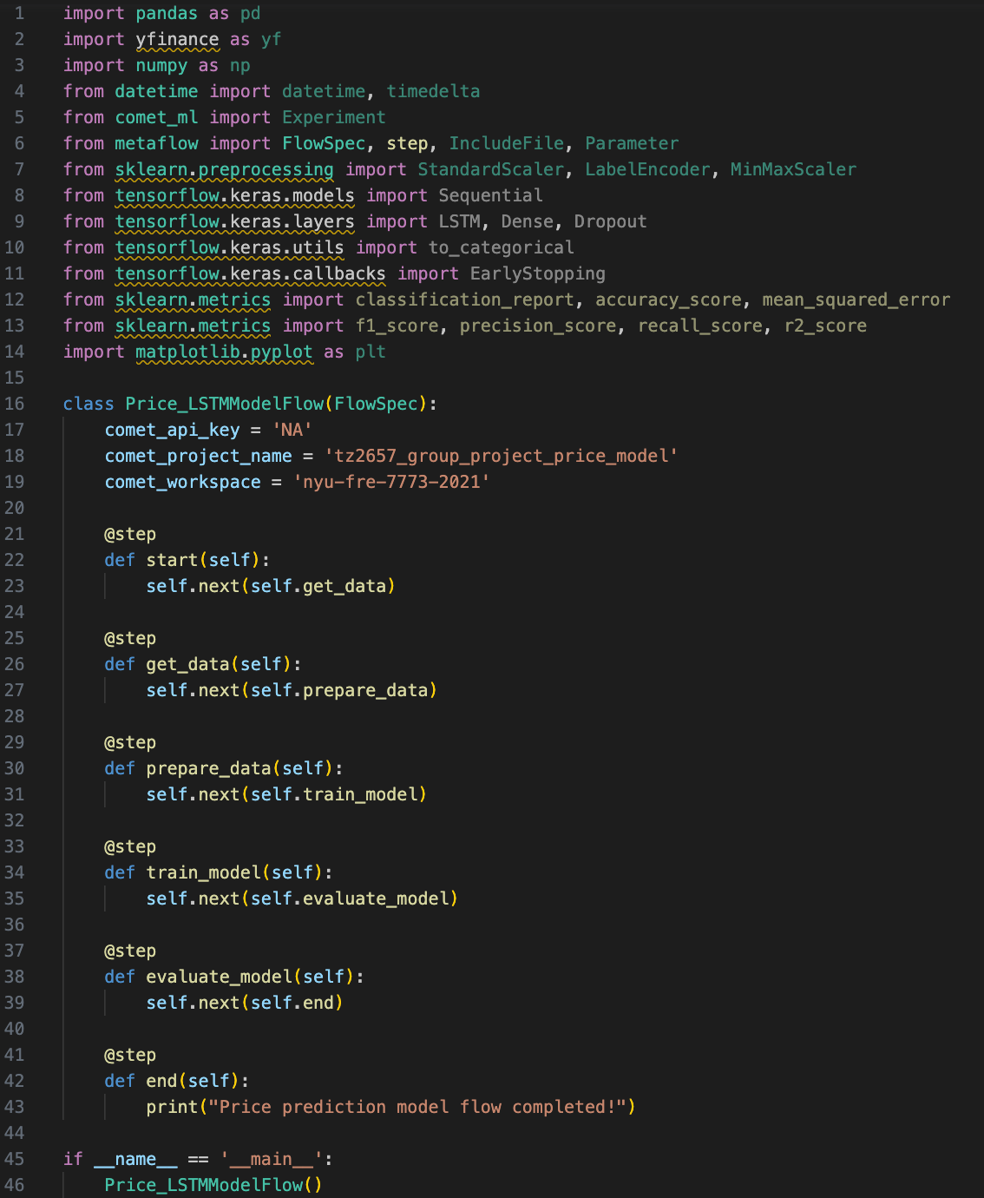
Code Structure and Dependencies
Main Dependencies:
pandas
numpy
yfinance
sklearn
tensorflow
metaflow
transformers
matplotlib

Slide 6
Data Preparation Part 1
Set index of the data as date time.
Use Transformer package to classify all the tweets, it will provide three results: Negative, Neutral, Positive.
Represented as -1, 0, 1 using dictionary mappings.
Set the start and end date, merge financial metrics
Daily return, volatility, MA20, VIX, S&P500, US30, etc.

Slide 7
Data Preparation Part 2:
Data Shifting Logic:
Shift all date backward by 1 trading day (Prevent future leakage).
Tweets, not in trading days, were automatically shifted to the next available trading day.
Training Test-Split Methods:
60% training, 30% testing, 20 days in between (Prevent future leakage).

Slide 8
Strategical Investment Decision Model
Random Forest vs. LSTM
Input: Datasets.
Output: Return short, long, or wait.
Strategies:
Developed a very simple strategy that if the value of price change is greater than 0.5%, we either short/long the stock, and otherwise wait.
Important Hyperparameter:
EarlyStopping (Epoch) – It is a stop in the train process when the result is no longer improving.
Used Back Testing to compare the profits that were predicted by LSTM model and inactive trading (Benchmark).

Slide 9
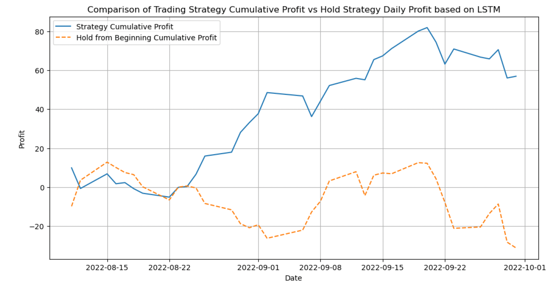
Strategical Investment Decision Model Result
Random Forest:
LSTM:

Slide 10
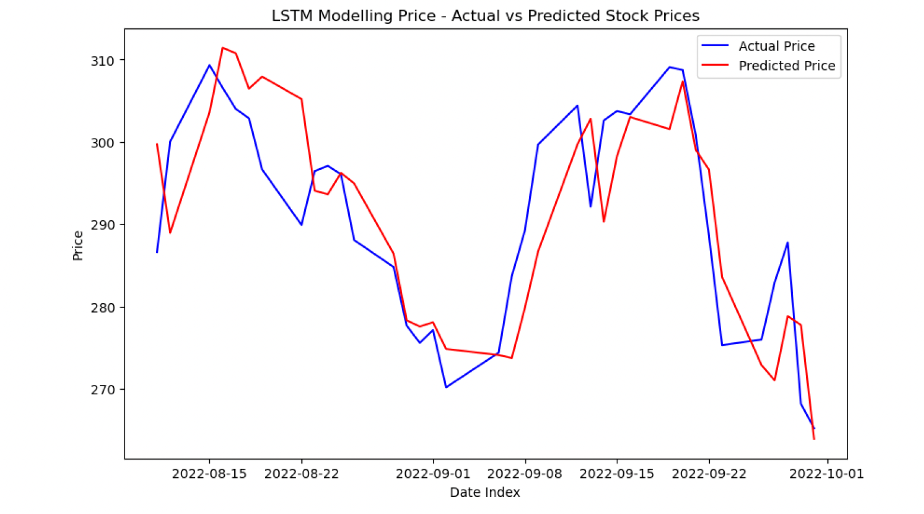
Pricing Model
Random Forest vs. LSTM Model.
R^2 and Mean Squared Error
Plot Actual vs. Predicted Stock Price
Connected results to Comet
Random Forest :
LSTM:

Slide 11
Conclusion
Summary of Project Achievements:
Achieved significant milestones by using LSTM model.
Highlight the transformative power of machine learning in developing the approach to time-series analysis within financial analytics and decision-making.
Future Implications:
Successfully predicting Tesla's stock price movement can inform strategies in other high-growth, high-variability sectors.
This model could become a steppingstone towards more sophisticated financial tools that can handle the uncertainty and rapid changes characteristic of today's economy.

Slide 12
Q & A

