Slide 1

The PH-Tree
A Multi-Dimensional Index
Tilmann Zäschke
PH-tree presentation 2022 © 2022 by Tilmann Zäschke is licensed under CC BY 4.0. To view a copy of this license, visit http://creativecommons.org/licenses/by/4.0/
Notes:
Multi-dim index: relational database table, index not one column but a combination of multiple columns

Slide 2
PH-tree vs Quadtree
The PH-tree is similar to a quadtree in the sense that:
It uses a hierarchy of nodes to organize data
Each node is a square and has four quadrants (eight in 3D, in general 2^{dim} quadrants), i.e. each node splits space in all dimensions.
Nodes are split into sub-nodes when they contain too many points.
However, the PH-tree does various things differently in order to
improve scalability with higher dimensions than 2D or 3D,
avoid “deep” trees when storing strongly clustered data,
avoid nodes with < 2 entries (except the root node), and
reduce reshuffling of data when nodes are split/merged.

Slide 3
PH-tree vs Quadtree
Differences in appearance to quadtrees
The PH-tree works with integers (it works fine with floating point numbers as well, as we discuss later)
The PH-tree’s “highest”possible node always has (0,0) as center and an endge length lmax = 2³² (for 32 bit coordinates).
This node may not exist in most trees, but all nodes are aligned as if it existed, e.g. no other node overlaps with (0,0).
In a PH-tree, child nodes always have an edge length
lchild = lparent / 2^{y}, with y being a positive integer such that lchild is always an integer >= 1, in fact lchild is always a power of 2.
This limits the depth of a PH-tree to 32.
Quadrant capacity = 1.

Slide 4

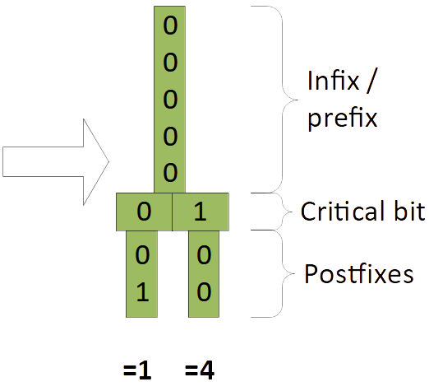
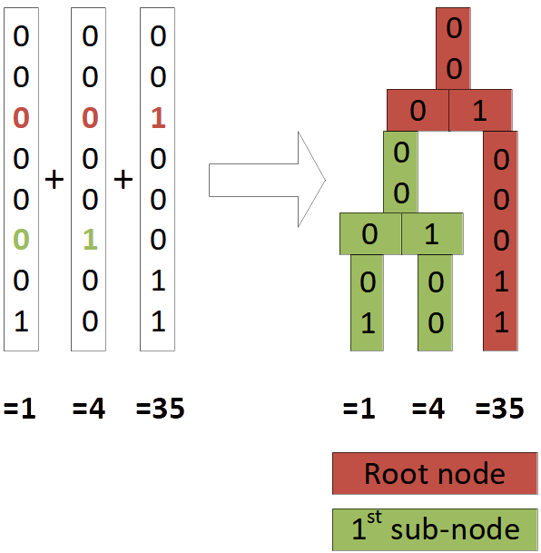
1D PH-Tree
Example of a 1-dimensional PH-tree with 8-bit coordinates
(we use bit representation (= base 2) for most examples):
First we add (1) and (4) to the tree, then we add (35).
→ The 1D PH-Tree is equivalent to a
CritBit tree or digital PATRICIA trie
→ Limited depth & imbalance
→ No rebalancing

Slide 5
Some terminology
From the viewpoint of a node, every point (=key) is divided into the following sections:
Infix: all bits above the current node
Prefix: all bits between the current node and it’s parent.
Critical bit(s): the bit(s) that represent the HC address of the point/key.
Postfix: all bits below the current node (usually only if there is no child node, otherwise called “infix of child”).
A a stored point is also called
key or coordinate.
d is the number of dimensions of.
w is the number of bits,
e.g. 32 or 64.
Child node
Root node
Prefix
0
0
Infix = prefix
0
1
Critical bit
Infix
0
0
0
0
0
1
1
Postfix
Postfix
Critical bit
0
1
Postfixes
0
1
0
0

Slide 6
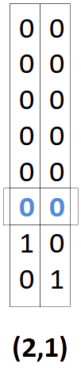
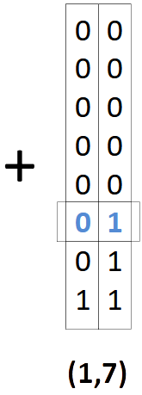
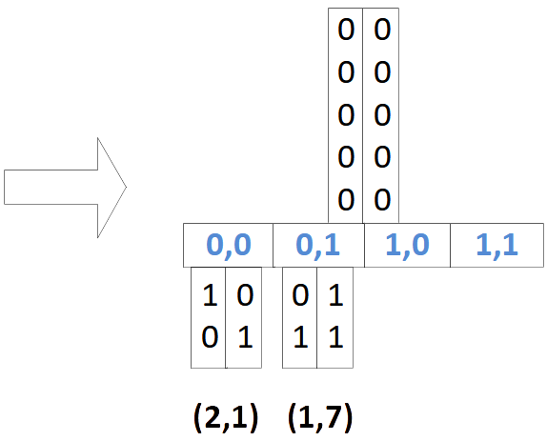
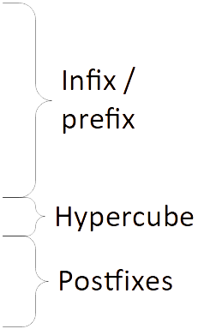
2D PH-Tree Insertion
(01) = position in linear array
The extracted bits (01) at the depth of the node give us directly the index in the array of quadrants!
Complexity: Calculate index: O(d) (d = number of dimensions)
Find child: O(1)

Slide 7
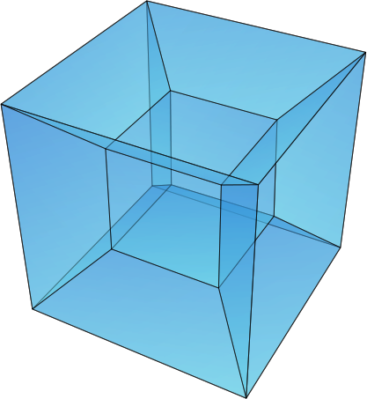
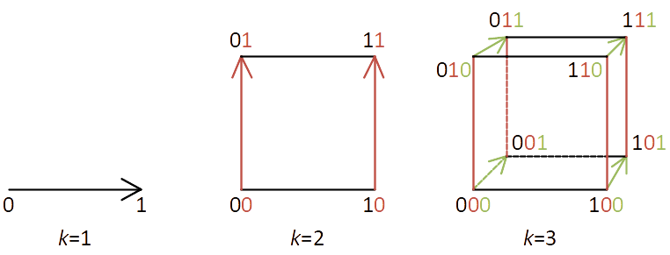
Excursion: Hypercube
d-dimensional binary cube (binary Hamming Space)
One bit for every dimension.
Hypercube (HC) address: e.g. 011…
Idea: quadrants in a node can be numbered
and accessed with their HC address.
This allows processing up to
64 dimensions in a 64 bit
CPU register in O(1)!
(Wikipedia, Goffrie, CC BY-SA 3.0)
d=1
d=2
d=3

Slide 8
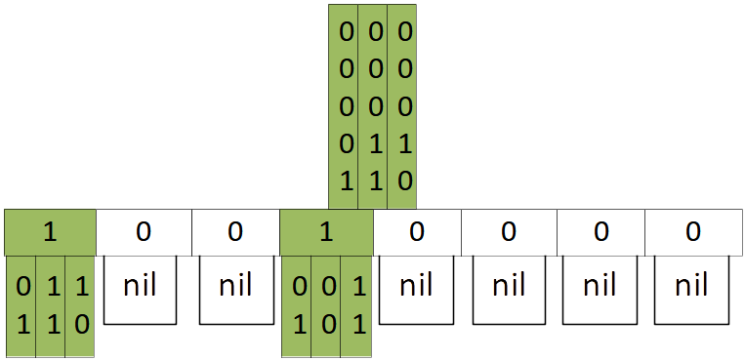
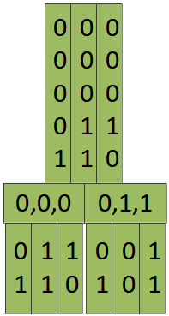
List HC & B+tree HC
Arrays with 2^{d} quadrants don’t scale well with dimensionality. For higher dimensions the nodes store quadrants in a sorted list or B+tree. The three storage modes are called AHC (array), LHC (linear list) and BHC (B+tree).
array
Space: O(w*d*2^{d})
Search: O(1)
sorted list
O(w*d*n)
O(log n)

Slide 9

Insertion Example #2
Insertions (and deletions) can navigate the tree quickly by extracting the array position from the key.
d
0
0
0
0
0
0
w
0,0
0,0
0,0
1,1
0
0
001
0
000
1
0,0
0,1
1,0
1,1
1
0
0
1
0
1
1
1
1
0
0
1
(2,1)
(1,7)
(6,5)
(18,17)

Slide 10
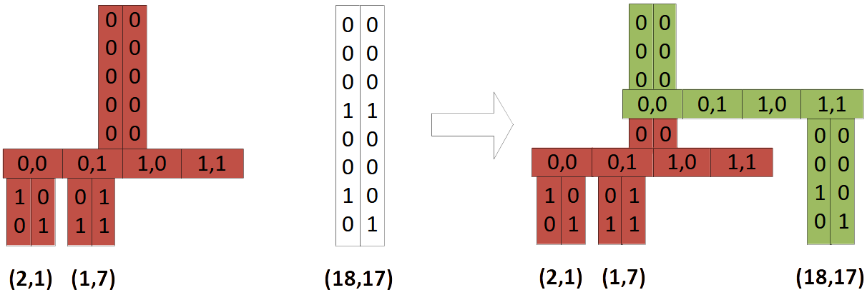
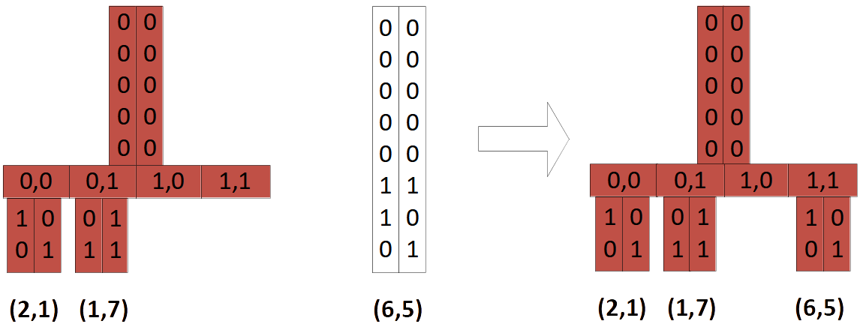
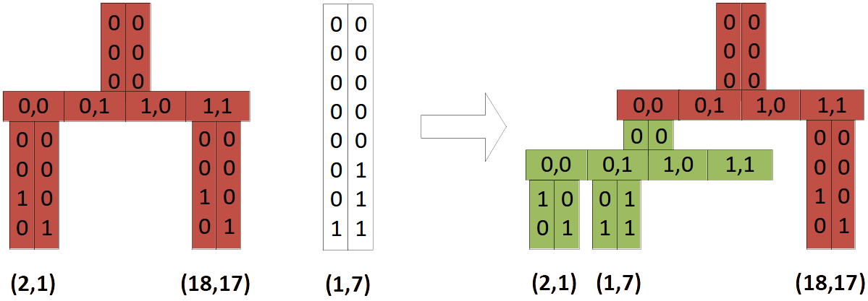
Insertion
a)
3 cases for insert:
a) prefix collision
b) free postfix slot
c) postfix collision
b)
c)

Slide 11
Hypercube navigation – point access
Point query
How do we find a key
(=does a given key exist)?
For each node:
compare infix/prefix
extract HC-address from current key
if entry at HC-address exists:
access subnode or key/postfix

Slide 12
Hypercube navigation – window queries (WQ)
Window queries (WQ):
Find all points that lie inside
a rectangular query window
defined by qMin and qMax.
Example:
qMin = (-1,6);
qMax = (9,6);
query(qMin, qMax);
For each node, naïve approach:
Iterate through all quadrants, compare each quadrants prefix with qMin/qMax.
There are 2^{d} quadrants.
Can we do better?
(qMax)
(qMin)

Slide 13
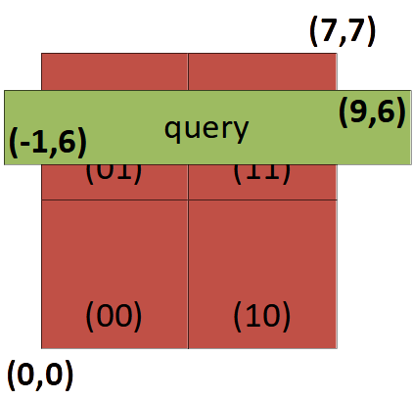
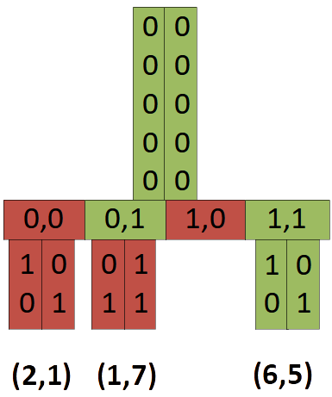
Window queries – navigation in nodes
Example: qMin/qMax = (-1,6) / (9,6)
Example query execution on one node:
(0,0) = (2,1) → mismatch
(0,1) = (1,7) → postfix mismatch
(1,0) = (1xx,0xx) → mismatch
(1,1) = (6,5) → match!
Naïve approach
For each node, iterate through all quadrants:
calculate each quadrants corners
compare each corners with qMin/qMax.
→ O(d * 2^{d}) per node
Can we do better?
Note: the ideas discussed on the following pages are partially quite complex. For a full discussion and proof please refer to [2].

Slide 14
Window Queries – minPos & maxPos
For each node we calculate two values
minPos and maxPos as follows:
query: qMin(-1,6) / qMax (9,6)
center: (00000100,00000100)2 = (4,4)10
minPos[0] = (-1 ≥ 4) = 0
minPos[1] = (6 ≥ 4) = 1
maxPos[0] = (9 ≥ 4) = 1
maxPos[1] = (6 ≥ 4) = 1
→ minPos / maxPos: (0,1)/(1,1)
for (d = 0; d <= dimensions; d++) {
center = calcCenterOfNodeFromPrefix()
minPos[d] = qMin[d] >= center ? 1 : 0;
maxPos[d] = qMax[d] >= center ? 1 : 0;
}
Note: minPos[d]/maxPos[d] refer to their d’s bit.

Slide 15
Window queries – navigation in nodes
How can we use minPos/maxPos?
→ minPos / maxPos: (0,1)/(1,1)
Idea #1
minPos and maxPos are the
lowest and highest overlapping quadrant!
In our example this removes only the first quadrant from iteration, but it may remove more.
Also, it is cheap, calculated in O(d) per node!
However, we still have O(d + d * 2^{d}) per node
Can we do better?

Slide 16
Window queries – Check quadrant
Idea #2
A fast way to check if a quadrant at pos is applicable:
minPos/maxPos = (01)/(11)
pos (0,1): (01 | 01) & 11 = 01 ü
pos (1,0): (10 | 01) & 11 = 11 != 10 ✗
pos (1,1): (11 | 01) & 11 = 11 ü
minPos has 1 if positions with ‘0’ should be skipped
maxPos has 0 if positions with ‘1’ should be skipped
This reduces complexity from O(d + d*2^{d}) to O(d + 2^{d})
Can we do better?
isValid = ((pos | minPos) & maxPos) == pos);

Slide 17
Window queries – Find next quadrant
Idea #3
Find a function
pos_next = inc(pos, minPos, maxPos)
that returns the next matching quadrant.
If inc() executes in O(1), then complexity is still
O(d + 2^{d}), however it is also optimal in the sense that the complexity is at the same time:
O(d + number_of_matching_entries).
This is better than quadtrees, octrees or R-Trees which all have
O(d * number_of_ALL_entries) per node.
The next slide gives an overview over how inc() works. A full explanation and proof is available in [2].

Slide 18
Window queries – find next quadrant
Example: inc(01) => (11)
Use a trick:
→ in pos, set all bits to ‘1’ where only
one value is allowed (constrained bits).
→ now, if we add ‘1’ for increment, any change to a constrained
bit will cause an overflow and update the next higher bit.
→ then we set all the constrained bits back to their previous value.
→ inc() finds next slot in O(1) for d < 64
pos = pos | minPos | (~maxPos) = 01 | 01 | 00 = 01;
pos++ => 01 + 1 = 10;
pos = (pos & maxPos) | minPos = (10 & 11) | 01 = 11;

Slide 19
Window queries – the power of minPos / maxPos
For each node calculate minPos/maxPos: O(d)
Use these values:
as start/end point for iteration
check whether any quadrant matches: O(1)
get next valid quadrant: O(1)
isValid = ((pos | minPos) & maxPos) == pos);
long r = v | (~maxPos);
return ((++r) & maxPos) | minPos;
Note: in practice, inc() is rarely useful because check() is so cheap and the limiting factor is getting the node from RAM into the CPU.
This explanation is obviously very superficial. For details please refer to the original papers [1], [2], and see http://phtree.org

Slide 20
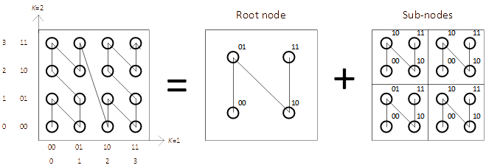
Window query – result ordering
When traversing the tree as described above (depth-first & traverse nodes in order of their HC-address) the result follows a Z-oder curve (also called Morton order):

Slide 21
Floating point keys – IEEE conversion
The PH-tree can natively only store integer keys. The following conversion allows fast and lossless conversion from floating-point to integer and back.
Java:
C++:
Essentially, this takes the bit-representation of a floarting point value and treats it as integer (after some conversion for negative numbers). This preserves the total ordering of values which is all that is required for insert(), remove(), point_query() and window_query().
Other operations, such as nearest_neighbor_query(), need to convert coordinates back to floating point data.
long encode(double value) {
long r = Double.doubleToRawLongBits(value);
return (r >= 0) ? r : r ^ 0x7FFFFFFFFFFFFFFFL;
}
std::int64_t encode(double value) {
std::int64_t r;
memcpy(&r, &value, sizeof(r));
return r >= 0 ? r : r ^ 0x7FFFFFFFFFFFFFFFL;
}

Slide 22
Floating point keys – multiply conversion
Another common conversion is strategy is to multiply the floating point value with a constant and casting it to an integer:
This is also fast an preserves a certain amount of precision.
The main advantage resulting index tends to be faster. This effect hasn’t been fully investigated, but there are two effects:
The tree is more “dense”, i.e. the length of the infix is more often zero. That allows skipping comparison of infixes when navigating the tree
If the implementation supports prefix-sharing (bit-streaming): Normal integer values tend to have longer common prefixes, allowing for more prefix sharing, resulting in lower memory usage and better cache usage.
One (slight?) problem is that the rounding affects the precision of all operations: insert(), remove(), point_query(), window_query(), nearest_neighbor_query(), … .
long encode(double value) {
return (long) value * 100;
}

Slide 23
Prefix sharing (bit-streaming)
All entries in a node share a common prefix.
E.g. on the example on the right, all entries
in the red node share a common
prefix (00000,00000)2.
To save memory, we can store the
prefix (actually infix) only once per node.
Using the example on the right:
normal storage: 2 keys * 2 dimensions * 8 bit = 32 bit.
prefix sharing:
(1 prefix * 2 dim * 1 bit) + (2 keys * 2 dim * 2 bit) = 2 + 8 bit = 10 bit
The bits above the infix can be taken from the parent node. The bits above the postfix are equal to the array position.
This approach can safe a lot of memory, especially when used with multiply-conversion. With the Java implementation we saw performance improvemenmts of 20%-30% for all operations.

Slide 24
Rectangles & boxes as key
The plain PH-tree can only store points (vectors) as keys. However, storing axis-aligned boxes as keys can efficiently be done by putting the two defining corners (minima and maxima) of a box into a single 2*d key, for example by concatenating them:
k = { min0, min1, …, mind−1, max0, max1, …, maxd−1}
Example: a 2D box is stored in a 4D point: (2,3)/(4,5) → (2,3,4,5).
This works trivially for lookup, insert and remove operations. Window queries need to be converted from d d-dimensional vectors to (2∗d)-dimensional vectors. For a window query that matches all boxes that are completely inside the query box, the query keys are:
kmin = { min0, min1, …, mind-1, min0, min1, …, mind−1 }
kmax = { max0, max1, …, maxd-1, max0, max1, …, maxd−1 }
Or, for a window query that matches all boxes that intersect with a query box:
kmin = { −∞, −∞, ..., −∞, min0, min1, …, mind−1 }
kmax = { max0, max1, ..., maxd−1, +∞, +∞, …, +∞ }
Example: qMin/qMax = (3,4)/(4,5) → (−∞, −∞, 3, 4)/(4, 5, +∞, +∞)
This is usually managed internally by the implementation. For more details please see [3].

Slide 25
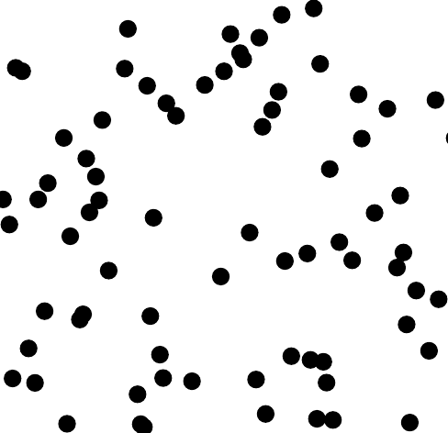
Experimental evaluation (Java only)
The following slides show experiments with strongly clustered dataset.
Each blob consists of 100s or 1000s of points (floating point coordinates).
We compare multiple indexes: a kd-tree (KD), a quadtree (QT0Z), a R*tree (R*Tree), and two PH-trees, one with default conversion (PH2) and one with Integer-Multiply conversion (PH2-IPP). All are written in Java and available from:
https://github.com/tzaeschke/tinspin-indexes
Details and more experiments are available at: https://github.com/tzaeschke/TinSpin/blob/master/doc/benchmark-2017-01/Diagrams.pdf

Slide 26
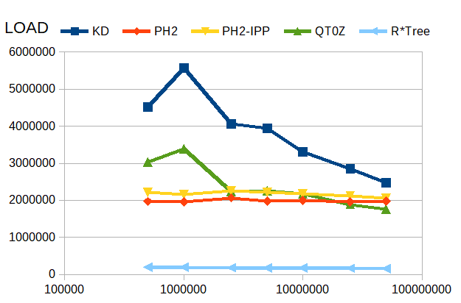
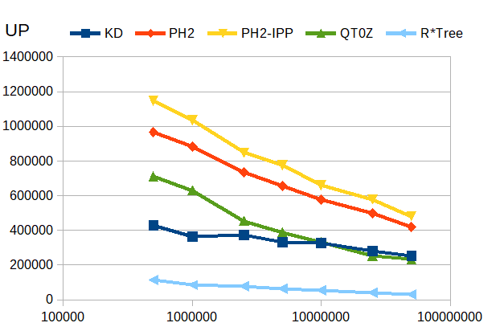
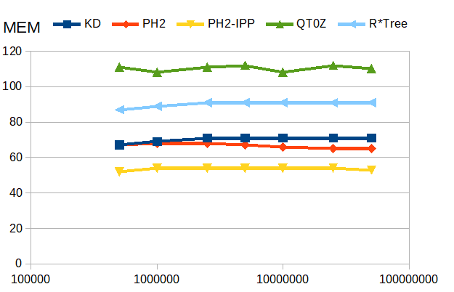
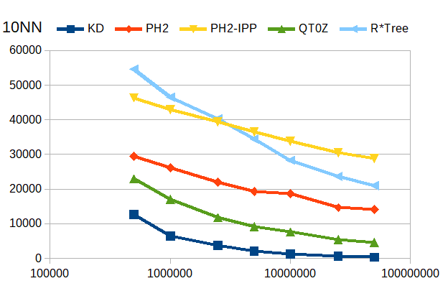
3D, varying size: 500’000 – 50’000’000
x-axis: # of points in index; y-axis: operations per second (for ‘memory’: bytes per entry)
insert
update
memory
10-NN
Notes:
May get faster with more data!

Slide 27
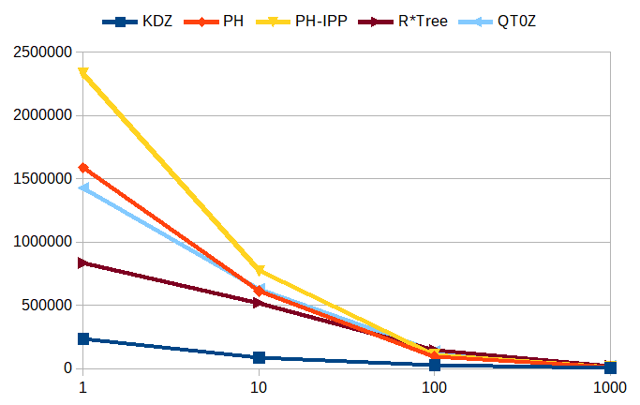
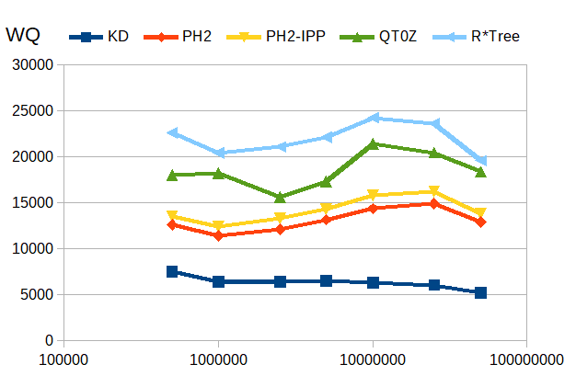
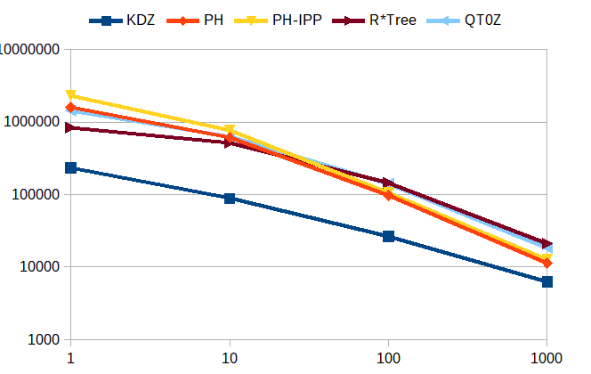
Window Queries – 3D
The number of points in a query result have a strong effect on query performance.
On the bottom we vary the index size.
On the right we vary the query window size on a dataset with 1M points, top uses logarithmic scale and bottom linear scale.
x: # of points in index; y: queries/sec;
constant: 1000 results per query
x: # of points in query result; y: queries/sec; constant: 10⁶ points in index
Notes:
May get faster with more data!

Slide 28
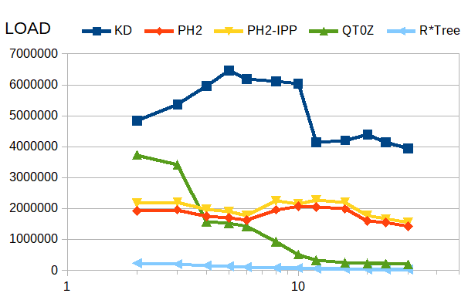
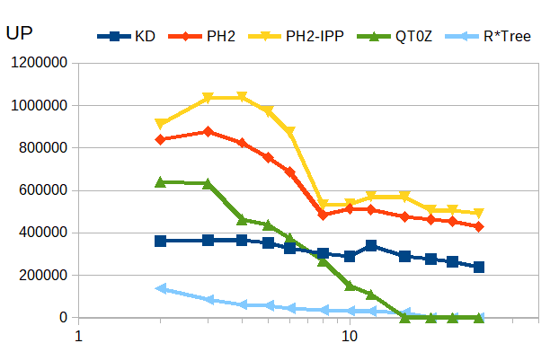
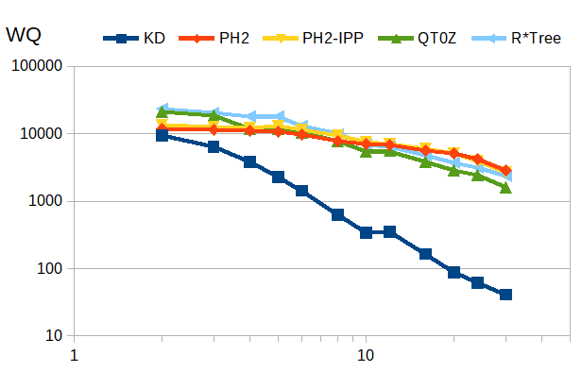
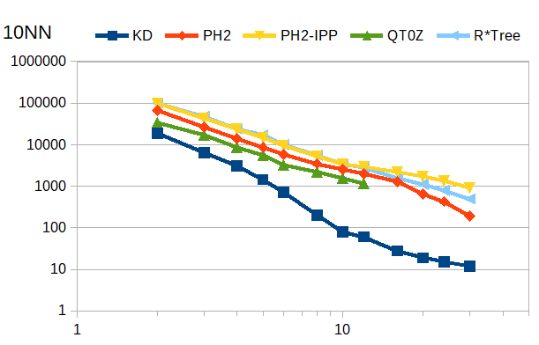
1M entries, varying d: 2 – 30
x-axis: # of dimensions; y-axis: operations per second
insert
update
window
10-NN
Notes:
May get faster with more data!

Slide 29
PH-Tree – Summary
General features
→ points or rectangle data
→ integer and floating point data
→ insert/move/remove, point query, window query, kNN search
→ Z-ordered
Static
→ no rebalancing: may benefit concurrency or persistence
Hypercube
→ exploits 64 bit constant time operations
Good with large and clustered datasets
Complex to implement
Source code: http://www.phtree.org
Test framework: http://www.tinspin.org
Notes:
Exploitation of 32/64 bit registers occurs quite often during the presentation → emphasize!
Large datasets: better prefix sharing + more HCs
Static: good for storage (few pages rewritten)

Slide 30
PH-tree
http://www.phtree.org
Test framework with other indexes
(kD-tree, quadtree, R*tree, STR-tree, cover-tree, ball-tree, …)
http://www.tinspin.org
PH-tree presentation 2022 © 2022 by Tilmann Zäschke is licensed under CC BY 4.0. To view a copy of this license, visit http://creativecommons.org/licenses/by/4.0/

Slide 31
References – PH-tree
[1] The PH-Tree: A Space-Efficient Storage Structure and Multi-Dimensional Index; Tilmann Zäschke, Christoph Zimmerli and Moira C. Norrie, Proc. of Intl. Conf. on Management of Data (SIGMOD), 2014
[2] Efficient z-ordered traversal of hypercube indexes; PH-Tree: Tilmann Zäschke and Moira C. Norrie, Proc. of 17th BTW 2017, Stuttgart, Germany, 2017
[3] The PH-Tree Revisited; T. Zäschke (2015).
[4] Cluster-Computing and Parallelization for the Multi-Dimensional PH-Index; Bogdan Vancea (2015).

Slide 32
References – Other
Quadtree:
[5] Quad Trees A Data Structure for Retrieval on Composite Keys; R. Finkel and J. Bentley; Acta Informatica, 4:1-9, 1974.
PATRICIA-Trie:
[6] PATRICIA - Practical Algorithm To Retrieve Information Coded in Alphanumeric; D. R. Morrison; Journal of the ACM, 15(4):514-534, October 1968.
Crit-Bit Tree:
[7] D.J. Bernstein, http://cr.yp.to/critbit.html

Slide 33
Various Slides

Slide 34
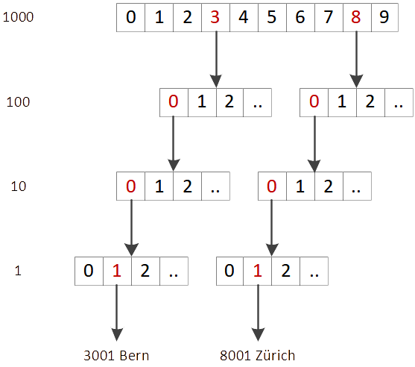
P: PATRICIA Trie
static tree
concatenate key while
walking down the tree
height max = size of key
no rebalancing
prefix sharing
storage shared
with other keys
array of sub-nodes allows fast access

Slide 35
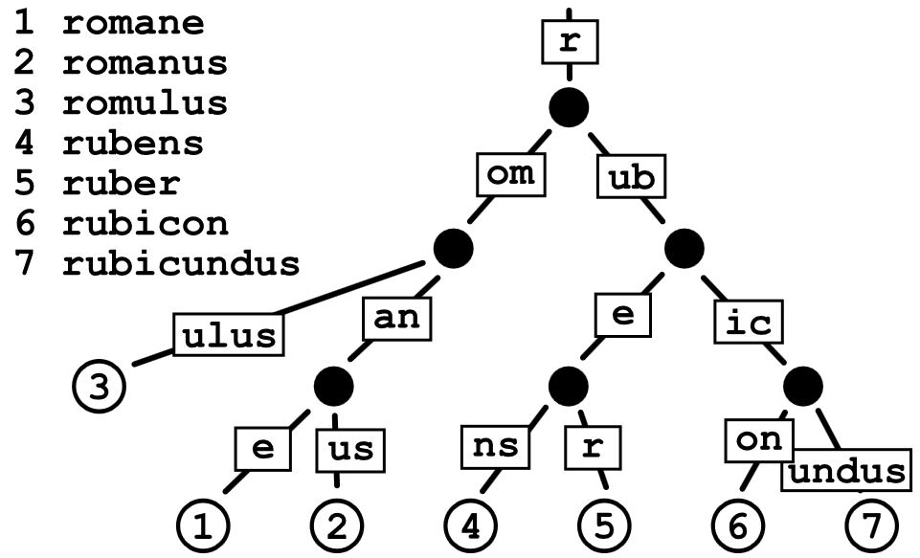
P: PATRICIA-Trie
Practical Algorithm To Retrieve Information Coded In Alphanumeric
→ List of sub-nodes i.o. array
By Claudio Rocchini, CC-BY 2.5

