Slide 1
Taming Reentrancy with Auditable Language Design
Master Thesis
Tynan Richards
March 30, 2026

Slide 2
Introduction
Decentralized Finance:
Basically: Financial Markets on the blockchain
Multi-billion-dollar industry
Virtually unregulated
Programmatic “Smart Contracts”
Bugs / Vulnerabilities:
Hundreds of millions of dollars lost every year
Blockchain → no way to reclaim funds
Security Guarantees:
Open-source code
Third-party audits
Bug bounties
This is my background!

Slide 3
Smart Contract
A “program” that is executed by the Ethereum Virtual Machine
Immutable, cannot be “fixed in prod”
Execution:
EVM is single-threaded
External Call: One contract may call into another
Storage: per-contract, persistent
Memory: Transient, not shared between calls
Reentrancy:
Call-back into executing contract
Concurrency bugs

Slide 4
Reentrancy
Contract A
Contract B
Malicious
Storage | 3
Storage | 4
R-W conflict example
Conflict!
Write
Read
Call
A
External Call
B
External Call
A
Memory | 3
Memory | 3
Memory | 0
Memory | 4
Memory | 0

Slide 5
Reentrancy
First occurrence: June 17, 2016
Infamous ETH DAO hack
Only retroactive hard-fork in Ethereum history
Well-known vulnerability class
Easily classifiable / detectable
Most contracts do not need it
Still represents >10% of exploits since 2020
→ Why is this still an issue today?

Slide 6
Smart Contract Vulnerabilities
What other vulnerabilities exist?
Dataset: 549 exploits, 2021 – 2024
Total funds lost: $1.671 billion
$284M
$422M
$524M
Notes:
549 recent exploits in 2020-2024, totalling $1.671 billion. excluding some huge outliers (e.g. bridge exploits)

Slide 7
Smart Contract Development
Two widely-used compilers:
Solidity OOP, ~87% market share
Vyper Pythonic, ~8% market share
Majority of development time is spent on front-end apps!
Only ~10% is spent on coding smart contracts
Security “guaranteed” by code audits
Code readability is important!
Notes:
market share is really % of TVL

Slide 8
Auditability: Side Effects
Blockchain state is the only thing that persists
execution only serves to determine state changes
Solidity and Vyper have ambiguous execution order
e.g. f() + g() → order is undefined!
No warnings, easy to miss
Unexpected interactions
External calls may lead to reentrancies
Use of stale values
Aliasing / address collision
Notes:
Not common knowledge
Maybe mention that there are actual cases where order is not left to right

Slide 9
Problem Statement
Main Goals:
Prevent reentrancy vulnerabilities
Improve code auditability
Language Design:
Offload responsibility to the compiler
Model reentrancy natively
Explicitly track side effects
Type-safe state machines via ADTs
Notes:
~6-7mins

Slide 10
Goal 1: Reentrancy Protection
Setup:
3 entry points
3 call sites
One desired reentrant call
Protection must use runtime check!
Contract

Slide 11
Entry-Point Annotation
“State of the Art”
Potential vulnerabilities!
@nonReentrant
Contract
Entered | 1
@nonReentrant
Entered | 0
Notes:
actually, it’s even worse – the reentrancies are only guarded against if we entered the contract through one of the @nonReentrant entrypoints. but I’m not sure how to concisely explain that...

Slide 12
Entry-Point Annotation
“State of the Art”
All entry-points open!
@nonReentrant
Contract
@nonReentrant
Entered | 0
Notes:
actually, it’s even worse – the reentrancies are only guarded against if we entered the contract through one of the @nonReentrant entrypoints. but I’m not sure how to concisely explain that...

Slide 13
Solution: Call Path Specification
Safety by default
Call site annotation specifying the entry point!
“Unlock” entry point at runtime
Only the desired call path is possible!
A
B
C
Lock | 001
Lock | 000
Lock | 111
@reenter(C)

Slide 14
Goal 2: Side Effects
How do developers ensure correctness of side effects?
Minimize number
Encapsulate
Documentation / Comments
What about auditors?
“Summarize” every entry-point / function:
Inputs / outputs
State mutations
External calls
Let’s look at real-world examples

Slide 15
AAVE Lending Pool
1
2
3
4
5
6
7
8
9
10
11
12
13
14
function updateStateOnLiquidation(…) external {
updateA(…);
updateB(…);
updateC(…);
updateD(…);
if (…) {
updateE(…);
}
}
function updateStateOnLiquidation(…) external {
updatePrincipalReserveStateOnLiquidationInternal(…);
updateCollateralReserveStateOnLiquidationInternal(…);
updateUserStateOnLiquidationInternal(…);
updateReserveInterestRatesAndTimestampInternal(…);
if (!_liquidatorReceivesAToken) {
updateReserveInterestRatesAndTimestampInternal(…);
}
}
Each update(…) modifies exactly one state variable!

Slide 16
Curve Tricrypto
1
2
3
4
5
6
7
8
9
# _transfer_in updates self.balances here:
dx_received: uint256 = self._transfer_in(i, dx, msg.sender, False)
# No ERC20 token transfers occur here:
out: uint256[3] = self._exchange(i, j, dx_received, min_dy)
# _transfer_out updates self.balances here.
# Update to state occurs before external calls:
self._transfer_out(j, out[0], receiver)
Developers are “manually” tracking side effects
Comments can be wrong or misleading
Why not let the compiler enforce this?

Slide 17
Let’s pretend we’re auditing this code
→ What are all the side effects?
1
2
3
4
5
6
7
8
9
10
11
12
13
14
def exchange(i: uint256, j: uint256, dx: uint256, min_dy: uint256) -> uint256:
# _transfer_in updates self.balances here:
dx_received: uint256 = self._transfer_in(i, dx, msg.sender, False)
# No ERC20 token transfers occur here:
out: uint256[3] = self._exchange(i, j, dx_received, min_dy)
# _transfer_out updates self.balances here.
# Update to state occurs before external calls:
self._transfer_out(j, out[0], msg.sender)
log TokenExchange(msg.sender, i, dx_received, j, out[0], out[1], out[2])
return out[0]
Extra external call here!
Let’s trust the developer!

Slide 18
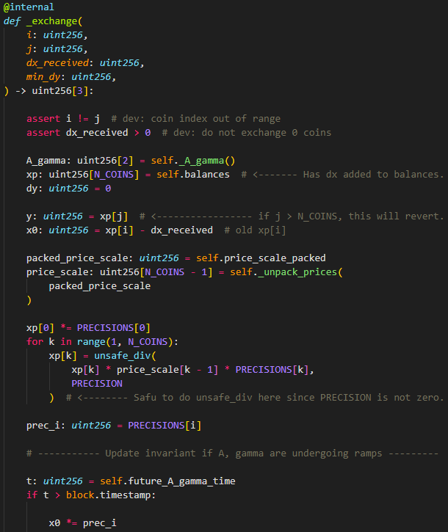
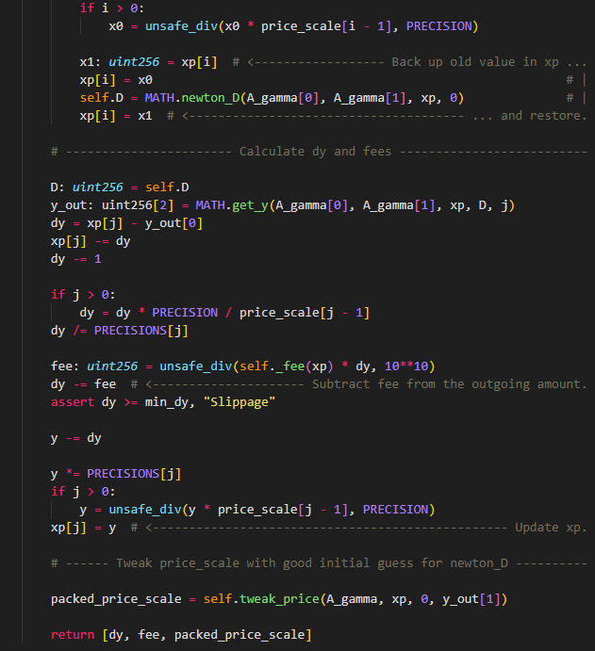
Another 200 LoC!

Slide 19
Let’s pretend we’re auditing this code
→ What are all the side effects?
→ How do they interact with the external calls?
1
2
3
4
5
6
7
8
9
10
11
12
13
14
def exchange(i: uint256, j: uint256, dx: uint256, min_dy: uint256) -> uint256:
# _transfer_in updates self.balances here:
dx_received: uint256 = self._transfer_in(i, dx, msg.sender, False)
# No ERC20 token transfers occur here:
out: uint256[3] = self._exchange(i, j, dx_received, min_dy)
# _transfer_out updates self.balances here.
# Update to state occurs before external calls:
self._transfer_out(j, out[0], msg.sender)
log TokenExchange(msg.sender, i, dx_received, j, out[0], out[1], out[2])
return out[0]

Slide 20
Effects in Calls
Issue:
Unknown side effects in external call
Internal state may change due to reentrant calls
→ We can leverage our reentrancy protection!

Slide 21
Effects in Calls
1
2
3
4
5
6
7
8
9
10
11
12
13
14
15
16
17
18
19
20
21
22
23
24
contract FlashLoan {
debt: HashMap<Address, u256>;
pub fn repay(self)
modifies(self.debt[…])
{…}
pub fn flashLoan(self, amount: u256)
reenters(Self::repay)
modifies(self.debt[…])
{
let caller = EVM::caller();
self.debt[caller] = amount;
EVM::transfer(caller, amount);
modify(self.debt[caller]) {
// Reentrant call into untrusted code
EVM::reentrant_call(…, Self::repay);
}
assert(self.debt[caller] == 0);
}
}
First annotate the fn effects
Machine-checked
Inline effects:
Only annotate if hidden
e.g. function call
Reentrant call:
Can only reenter Self::repay
Treat like a regular function call!

Slide 22
Goal 3: Algebraic Data Types (ADTs)
Contracts often model state machines
Perfect application for ADTs
Model failure with Result types
Solidity and Vyper do not support ADTs

Slide 23
Implementation
Initial goal: Functional language
Not widely used, difficult to learn
Language syntax closely based on Rust
Popular → Easier to adopt
Safety by default
ADTs, pattern matching
“Low-level” control
Notes:
~20mins

Slide 24
Feature Set
User-defined types as in Rust (struct, trait, etc.)
Rust “enum” is actually ADT
Generics and trait bounds
mostly intended for Result types
Type inference (Hindley-Milner)
Side effect checks:
Default: Function signatures only
--strict: Inline effect annotations

Slide 25
Compiler
Written in Rust, ~30k LoC + 10k LoC for tests
Pipeline:
Source
File
Lexer
Parser
Desugaring
Linker
Type Inference
Solidity
Contract
Code Generation
Monomorphization
Effect Checks

Slide 26
Why Solidity?
Low-level control over memory
“Inline assembly” for specific optimizations
Produces optimized bytecode
Guaranteed compatibility with existing contracts
Leverage existing tools (testing / deployment)

Slide 27
Evaluation
ADTs:
Faithfully model state machines
Machine-checked exhaustiveness of pattern matching
Reentrancy:
Safety by default prevents most bugs
When does it not suffice?
Mandated callbacks in token standards
Cross-contract reentrancies
Specific use cases (e.g. flash loans)
Effects:
Primary goal: enhance auditability
Flags unexpected / missing side effects
Propagated across reentrant calls
Notes:
~24mins
ADTs also enhance auditability

Slide 28
Evaluation: Reentrancy
Can we prevent real-world reentrancies?
Do we need call path specification? or is ‘safety by default’ enough?
Same dataset as earlier
54 reentrancy bugs
37 could have rejected all reentrant calls
Category | Count | Funds Lost | Safety by Default | Path-Specific
Missing Guard | 37 | $141 million | Yes
Cross-Protocol | 6 | $9.6 million | If upstream protocol uses this compiler
Callback Token | 6 | $57.6 million | Yes (incompatible with the token standard) | Yes
Cross-Function | 2 | $27.7 million | No | Yes
Flash Loan | 2 | $5.7 million | No | Yes
Compiler Bug | 1 | $41 million | Unclear
Total | 54 | $187 million | 49/54 | 53/54

Slide 29
Evaluation: Performance
Performance:
Main difference: Reentrancy guards
Metrics:
Instructions consume ‘gas’
Storage slots are cached
Only first access is expensive
Base transaction cost: 21k gas ~ $0.01
Setup:
Simplest real-world contract: ERC20 Token
Measure gas costs of external functions
Compare existing reentrancy guards to ours

Slide 30
Reentrancy Guards
Standard Practice:
ReentrancyGuard library contract
Make state-mutating functions @nonReentrant
Guard itself modifies state → cannot be used on read-only functions
→ 6 cross-protocol vulnerabilities
But:
Functions that make no external calls do not need to modify guard
We can choose best approach at compile-time
Notes:
~27mins

Slide 31
Cost of Reentrancy Guards
ERC20 Token Transfer: (no external calls, warm)
Unguarded: 10’621 gas
Standard guard: 10’977 gas
Ours: 10’843 gas -134
ERC20 Total Supply: (read-only, cold)
Unguarded: 2248 gas
Ours: 4489 gas +2241
Cache | Scenario | Standard | Ours | Delta
Warm Slot | Default | 300 | 300 | 0
 | No external calls | 300 | 100 | -200
 | Read-only function | 0 | 100 | 100
Cold Slot | Default | 2300 | 2300 | 0
 | No external calls | 2300 | 2100 | -200
 | Read-only function | 0 | 2100 | 2100
Worst-case scenario: 10% extra gas
Notes:
Extra performance hit is from bit-field check Because of 21k base transaction cost, “only” 10%
Repeated accesses would be cheaper since slot warm

Slide 32
Evaluation: Overhead of Effect Annotations
Developers:
How many additional LoC?
Auditors:
How much effort is saved?
Can more bugs be found?
Setup:
ERC20 Token ~50 LoC
Token Exchange ~300 LoC
AAVE Lending Pool ~1100 LoC
Curve Tricrypto ~1500 LoC
Notes:
28-29mins

Slide 33
Evaluation: Overhead
Developers:
How many additional LoC?
Overhead shrinks as contract size increases!
Contract | State vars | LoC | Effectful Functions | Indirect Effects | Additional LoC %
ERC20 | 3 | ~50 | 6 / 9 | 2 | 16.67%
Token Exchange | 8 | ~100 | 7 / 16 | 2 | 9%
AAVE Lending Pool | 5 | ~1100 | 42 / 88 | 32 | 6.73%
Curve Tricrypto | 24 | ~1500 | 33 / 90 | 24 | 3.8%

Slide 34
Curve Tricrypto
1
2
3
4
5
6
7
8
9
# _transfer_in updates self.balances here:
dx_received: uint256 = self._transfer_in(i, dx, msg.sender, False)
# No ERC20 token transfers occur here:
out: uint256[3] = self._exchange(i, j, dx_received, min_dy)
# _transfer_out updates self.balances here.
# Update to state occurs before external calls:
self._transfer_out(j, out[0], receiver)
Many developers already annotate effects!
Little additional overhead
‘Enforce’ good practices
Improve auditability

Slide 35
Conclusion
Language design effectively prevents reentrancy bugs
Facilitates (static) analysis across reentrant call paths
Effect annotations result in reasonable coding overhead
Improve auditability
Flag unexpected or missing side effects
Many projects already follow similar patterns
ADTs enable type-safe state machines, result types
Notes:
Mention the ~10% smart contract coding time as well

Slide 36
Future Work
EVM Safety:
Multi-contract systems
Access Control primitives
Recent trend: Exploits taking advantage of precision loss
Even in audited projects
Codegen:
Optimize memory allocations
Rely less on Solidity
Generate Yul IR directly
User Studies
Especially for effect syntax

Slide 37
Taming Reentrancy with Auditable Language Design
Key features:
Path-Specific Reentrancy Protection
Effect Tracking System
Algebraic Data Types
Thanks for your attention!
Notes:
why not modify existing? backwards compatibility, solidity type system / inheritance, vyper restrictive memory and memcpy, vyper no burden on developer side effect prevent vuln? two example slides, but hard to quantify
ADTs prevent vuln? not really, but reduce “space of possibilities”

Slide 38
Popsicle Finance 2021-08, $20 million
Issue: transferring funds did not transfer reward debt
Calculating earned rewards gave too large value
1
2
3
4
5
6
7
8
9
10
11
12
fn transfer(to, amount)
modifies(self.balances)
{ … }
// but NOT modifies(self.fee_growth)
// → red flag for developer / auditor
fn transfer(to, amount)
modifies(self.balances)
modifies(self.fee_growth)
{ … }
// ^^^ does not actually modify fee_growth
// → compiler should emit warning

Slide 39
Super Sushi Samurai 2024-03, $4.8 million
1
2
3
4
5
6
7
8
9
function _transfer(address from, address to, uint256 amount) {
uint256 fromBalance = _balances[from];
uint256 toBalance = _balances[to] + amount;
/* Some safety checks */
_balances[from] = fromBalance - amount;
_balances[to] = toBalance;
}
Incorrect state update when from == to
1
2
3
4
5
6
7
8
9
10
fn transfer(self, from: Address, to: Address, amount: u256)
modifies(self.balances[from])
modifies(self.balances[to])
{
let from_balance = self.balances[from];
let to_balance = self.balances[to];
self.balances[from] = from_balance - amount;
self.balances[to] = to_balance + amount;
}
Value overwritten when from == to

Slide 40
Future Work: Language
Adoption Road-Blocks:
EVM features:
events
special call types
programmatic contract creation
Improve effect syntax
rigorous handling of variable mutability
Auto-generate effect annotations
to reduce overhead
Memory-efficient ADTs
Modularity (libraries, contract composition)
Documentation
Tooling
Interpreter:
Testing tools deploy mock blockchain, simulate full VM execution
huge overhead, bad performance
debugging tools are not great
Performance greatly impacts fuzz testing
Unit tests, step-by-step debugging for internal functions

Slide 41
Common Vulnerabilities (Count)
Vulnerability | 2021 | 2022 | 2023 | 2024 | Total | %
Business Logic | 7 | 21 | 65 | 58 | 151 | 27.5%
Price Manipulation | 10 | 35 | 42 | 21 | 108 | 19.7%
Access Control | 3 | 16 | 22 | 35 | 76 | 13.8%
Reentrancy | 9 | 13 | 17 | 15 | 54 | 9.84%
Input Validation | 2 | 10 | 8 | 18 | 38 | 6.92%
Precision | 5 | 5 | 18 | 12 | 40 | 7.29%
Arbitrary Call | 0 | 8 | 9 | 9 | 26 | 4.74%
Token Design | 3 | 4 | 18 | 3 | 28 | 5.1%
Slippage | 2 | 0 | 9 | 2 | 13 | 2.37%
Other | 0 | 5 | 5 | 5 | 15 | 2.73%

Slide 42
Common Vulnerabilities (Funds Lost, in $M)
Vulnerability | 2021 | 2022 | 2023 | 2024 | Total | %
Business Logic | 62 | 178 | 223 | 61 | 524 | 31.355
Price Manipulation | 215 | 48 | 115 | 44 | 422 | 25.25154
Access Control | 4 | 26 | 15.5 | 15 | 60.5 | 3.620186
Reentrancy | 87 | 103 | 63 | 31 | 284 | 16.99393
Input Validation | 20 | 1.9 | 10.6 | 109 | 141.5 | 8.467046
Precision | 51 | 3.7 | 65 | 32 | 151.7 | 9.077391
Arbitrary Call | 0 | 4.3 | 2.4 | 9 | 15.7 | 0.939453
Token Design | 0.2 | 0.076 | 0.355 | 5 | 5.631 | 0.336947
Slippage | 11 | 0 | 0.663 | 0.091 | 11.754 | 0.703333
Other | 0 | 34 | 18 | 2.4 | 54.4 | 3.255175

Slide 43
Solidity
1
2
3
4
5
6
7
8
9
10
11
12
13
14
15
16
17
18
19
pragma solidity ^0.8.31;
contract Counter {
uint256 private value;
constructor(uint256 x) {
value = x;
}
function get()
returns (uint256)
{
return value;
}
function increment() {
value += 1;
}
}
Inspired by OOP
Contracts ↔ Objects
Complex type system
Inheritance
Function Pointers
Storage Pointers
Few protection mechanisms
Large library of contracts

Slide 44
Vyper
1
2
3
4
5
6
7
8
9
10
11
12
13
14
15
16
17
18
19
value: uint256
@public
def __init__(x: uint256):
self.value = x
@public
@constant
def get() -> uint256:
return self.value
@public
def increment() -> bool:
self.value += 1
Closely based on Python
Strives to be simple
No low-level control
e.g. of memory allocations
large memory footprint
Some opt-in protection mechanisms

Slide 45
1
2
3
4
5
6
7
8
9
10
11
12
13
14
color0
color1
color2
color3
color4
color5
color6

Slide 46
1
2
3
4
5
6
7
8
9
10
11
12
13
14
15
16
17
18
19
color0
color1
color2
color3
color4
color5
color6

Slide 47
1
2
3
4
5
6
7
8
9
10
11
12
13
14
color0
color1
color2
color3
color4
color5
color6
1
2
3
4
5
6
7
8
9
10
11
12
13
14
color0
color1
color2
color3
color4
color5
color6

Slide 48
1
2
3
4
5
6
7
8
9
10
11
12
13
14
color0
color1
color2
color3
color4
color5
color6
color0
color1
color2
color3
color4
color5
color6

