Slide 1
gClass Builders

Slide 2

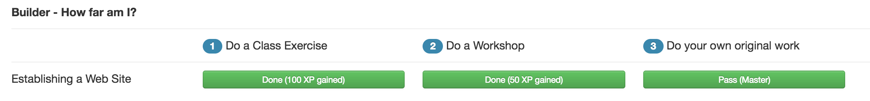
The Builder Process
Establishing your website
Embedding media
Showing your embedding stuff
Get a good taste of HTML and of a site design process!

Slide 3
Original Work
Levels
Newbie (40 xp)
Apprentice (80 xp)
Master (120 xp)
For maximum quality, aim for MASTER
For each level, you must do the previous work as well (ex. You must also do the NEWBIE and APPRENTICE work in order to get MASTER)

Slide 4
HTML
Put web pages on a web server
Do basic page design with HTML
Spice the design up with CSS

Slide 5
Site Design Process
Design the user experience (UX)
Test the UX
Design the main info type
Site sketches
Usability test
Event info
Info into the databases
Info out of the databases
Info on the page
Event tables
Event queries
Event pages

