Slide 1
Experiment instruction
On each trial, a cross sign will appear at the center of the screen to tell you that a new trial will start. Then a dot appears, which indicates the tones will be played soon.
On each trial, you will hear two pairs of tones with a delay between the pairs. After listening to the second pair of tones, please respond whether the duration of the second pair is shorter or longer than the duration of the first pair. Please press F key on the keyboard by your left index finger if the second one is shorter than the first one. Please press J key by your right index finger if the second one is longer.
Sometimes, there are extra tones before the first pair of tones. After the delay duration, you will hear the second pair of tones. You will make the same type of response as before.

Slide 2
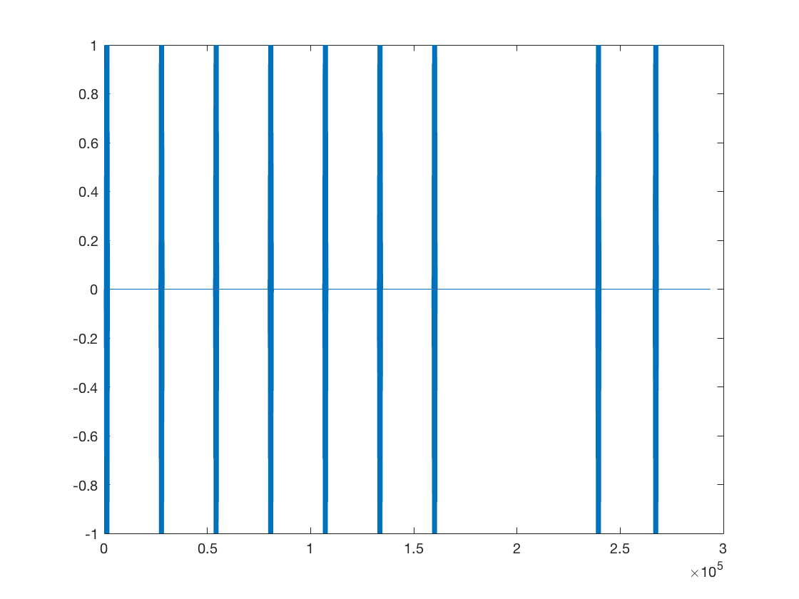
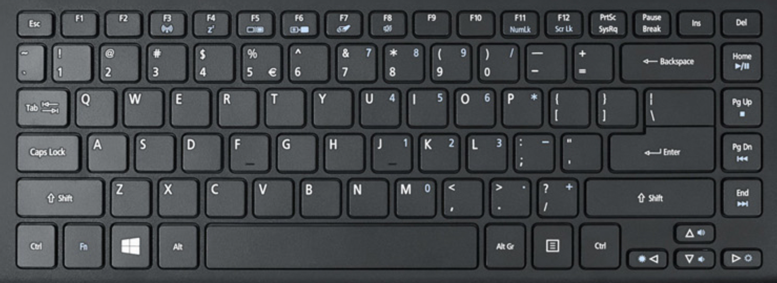
First pair
Second pair
Delay

Slide 3
First pair
Second pair
Delay

Slide 4
First pair
Second pair
Delay

Slide 5
First pair
Second pair
Delay

Slide 6
First pair
Second pair
Delay

Slide 7
First pair
Second pair
Delay

Slide 8
Experiment instruction
You will have a chance to take a break in each 54 trials. It’s up to you to take a break or keep doing the experiment. It’s also up to you for how long you want to rest. If you want to continue without taking a rest, just press space key on the keyboard to go on. The whole experiment duration may depend on how long are your breaks.

