Slide 1
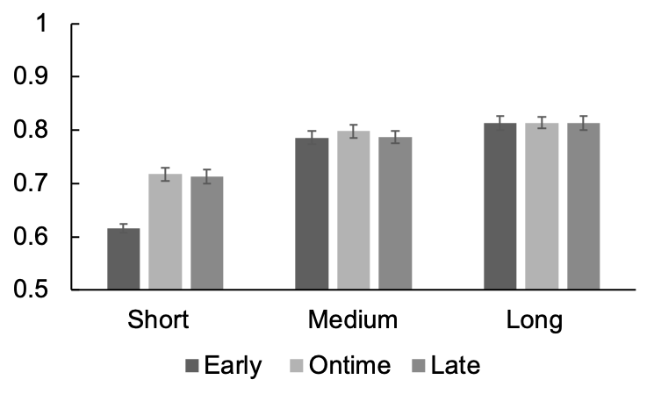
The results out of 78 subjects
***
***
Accuracy

Slide 2
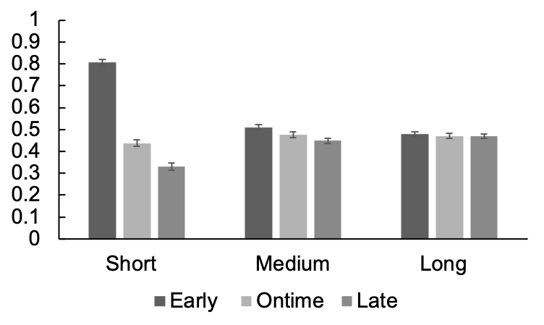
The results out of 78 subjects
***
***
***
***
*
Proportion of
responding short
*

Slide 3
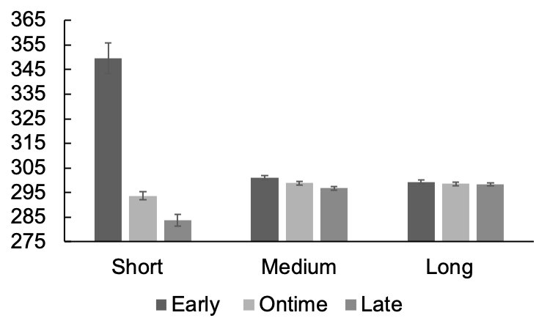
The results out of 78 subjects
***
***
***
Points of subjective
equality (ms)
***
*
*

Slide 4
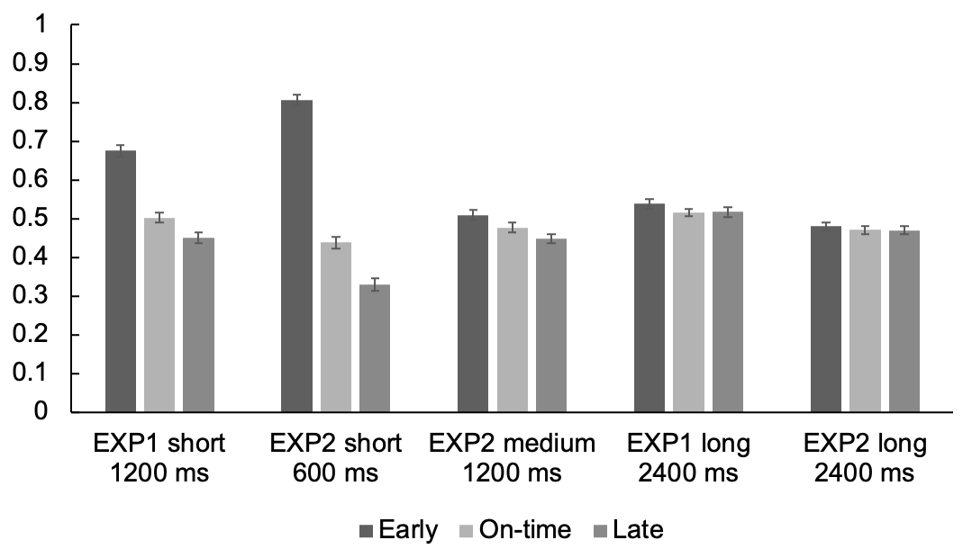
The results out of 78 subjects
Proportion of
responding short

Slide 5
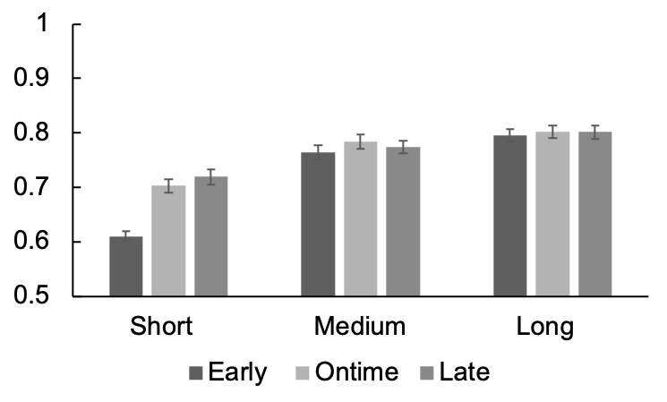
***
***
Accuracy

Slide 6
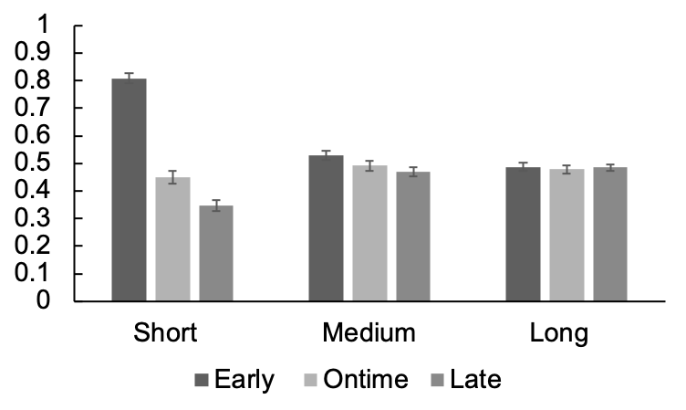
***
***
***
***
*
Proportion of
responding short

Slide 7
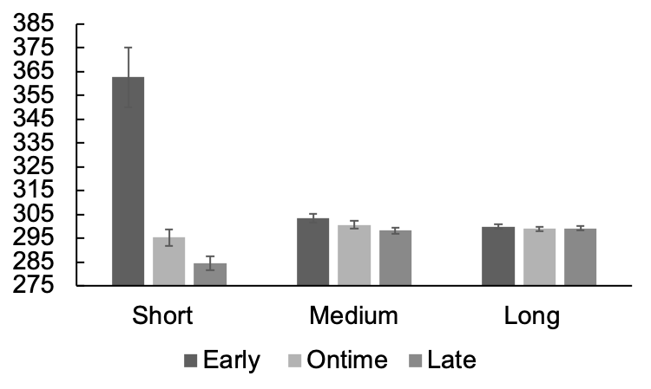
***
***
*
Points of subjective
equality (ms)
**

Slide 8
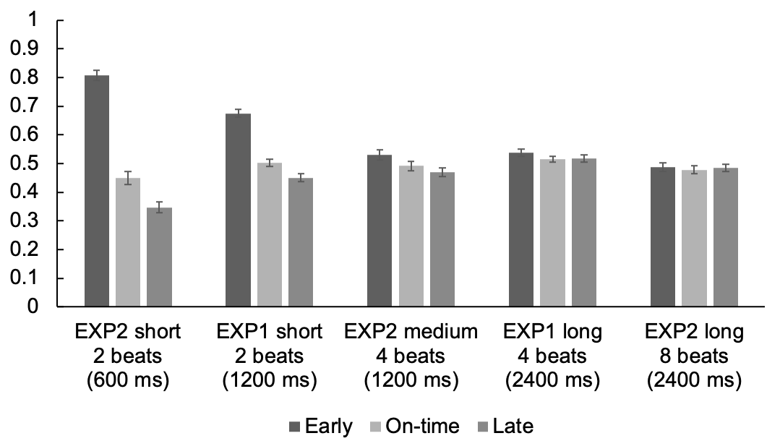
Proportion of
responding short

Slide 9
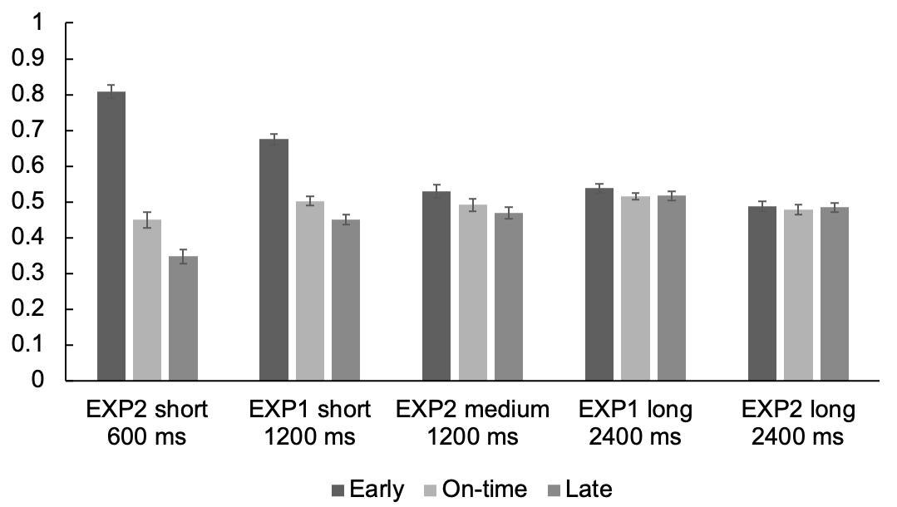
Proportion of
responding short

Slide 10

Proportion of
responding short

Slide 11
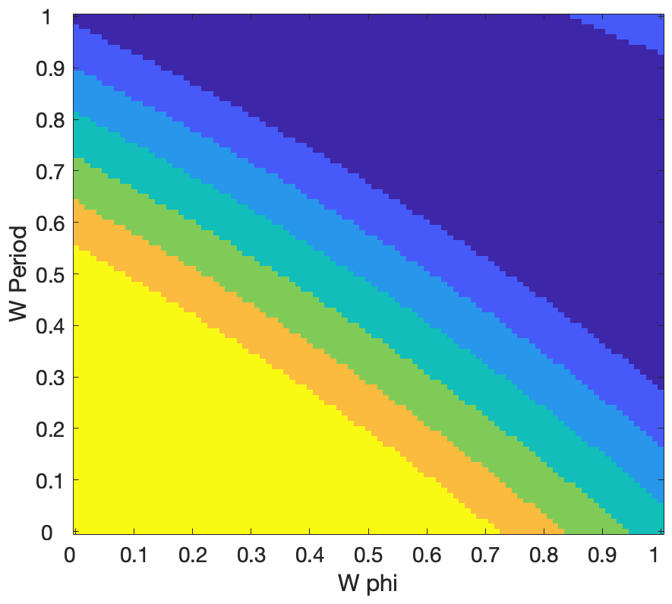
Early
1
0.83
0.67
0.50
0.33
0.17
0

Slide 12
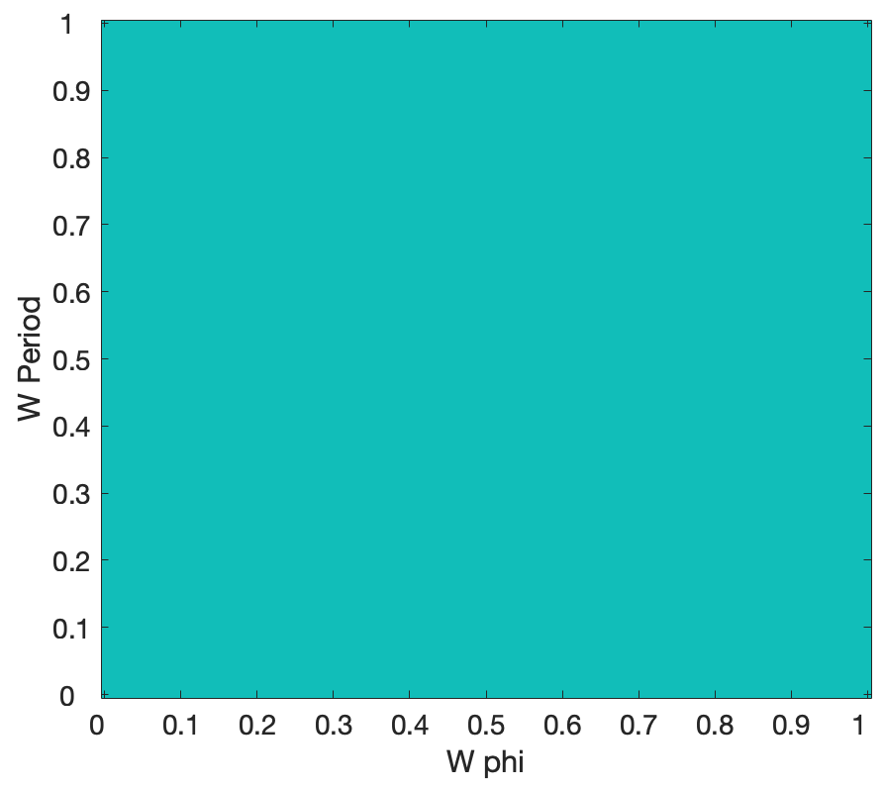
Ontime
1
0.83
0.67
0.50
0.33
0.17
0

Slide 13
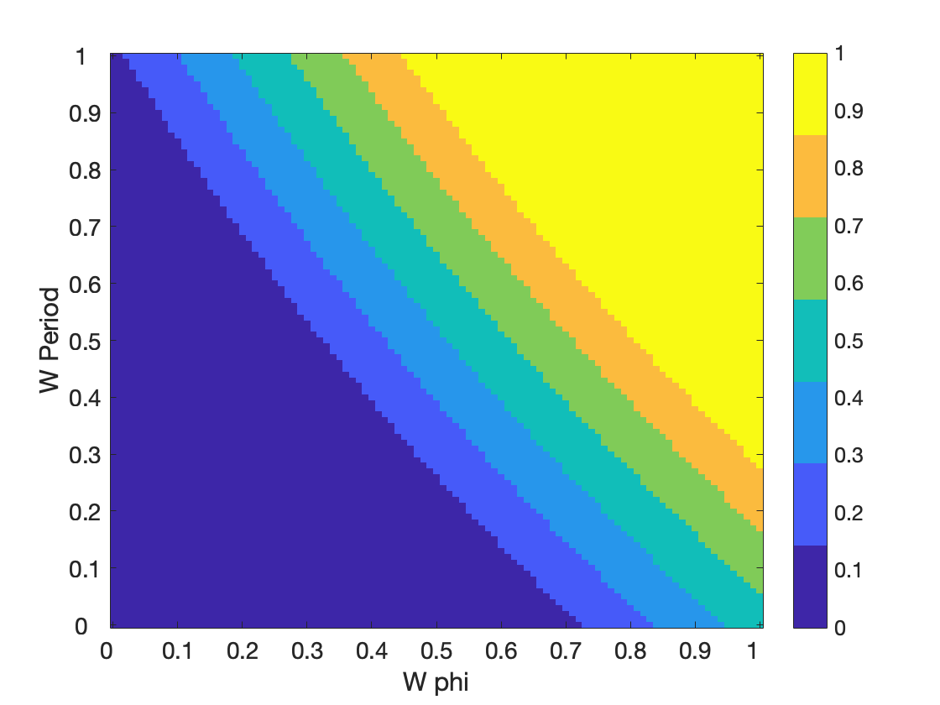
Late
1
0.83
0.67
0.50
0.33
0.17
0

Slide 14
1
0.83
0.67
0.50
0.33
0.17
0

Slide 15













EXP1
0.67, 0.50, 0.45
M & J EXP4

Slide 16
EXP1
0.67, 0.50, 0.45

Slide 17
EXP2
0.81, 0.45, 0.35

Slide 18
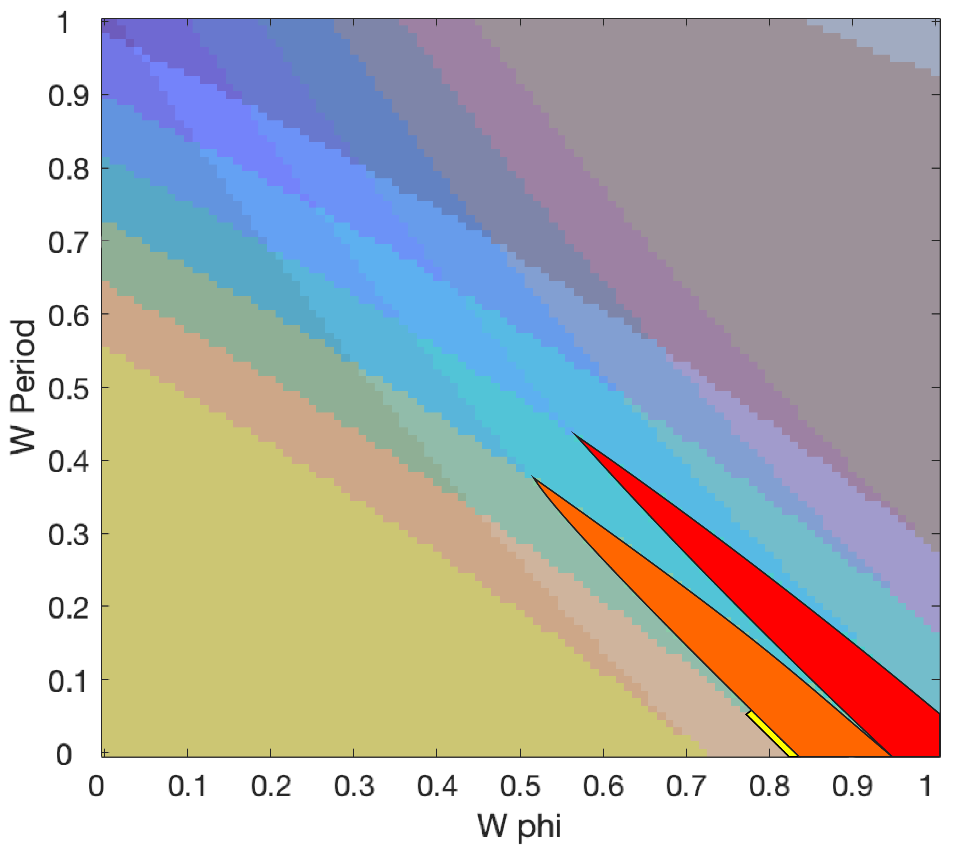
EXP1 short
Long delays
M&J EXP4
EXP2 short

Slide 19
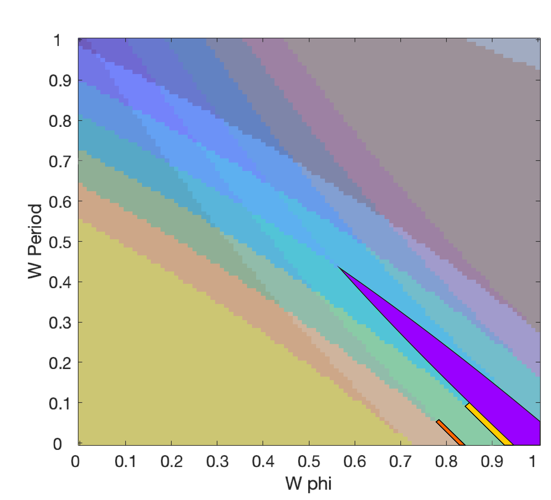
Long delays
EXP1 short
M&J EXP4
EXP2 short

